Slide 1
Debug with node-inspector
Install Node Inspector:
$ npm install -g node-inspector
Run your code with debug support:
$ node --debug yourApp.js
You may run and pause on the first line:
$ node --debug-brk yourApp.js
Run Inspector:
$ node-inspector &
Open Browser:
http://127.0.0.1:8080/debug?port=5858
ALSO - node-debug youtApp.js

Slide 2
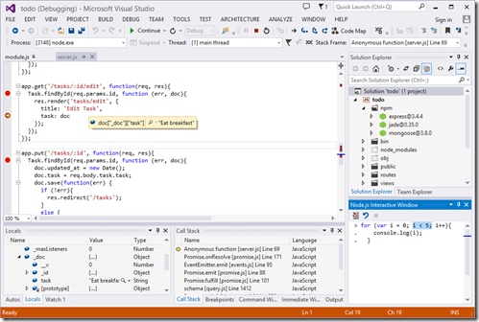
Develop with Visual Studio
Download NTVS - http://nodejstools.codeplex.com/
Still buggy….
Supports Intellisense
Supports Debugging
Profiler
NPM
Azure Deployment

