Slide 1

MS Dynamics 365 Sales
goldenpath-software

Slide 2
Agenda
Growth strategy
Market analysis
Financial overview
Innovative solutions
Future initiatives

Slide 3
Introduction to Dynamics 365 Sales
Navigating the future

Slide 4
Dynamics 365 Sales
Dynamics 365 Sales for your customer engagement, such as processing orders, managing inventory, and doing your finances.

Slide 5
Dynamics 365 Sales integration with Business Central
For example, a salesperson in Dynamics 365 Sales can use the price lists from Business Central when they create a sales order. When they add the item to the sales order line in Dynamics 365 Sales, they can see the inventory level (availability) of the item from Business Central.
5

Slide 6
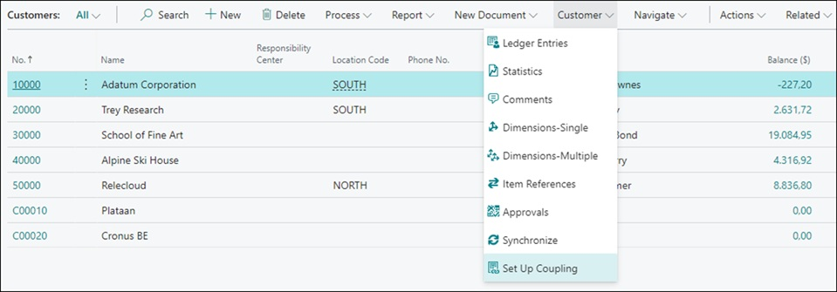
Coupling data in Business Central
To synchronize data between Business Central and Dynamics 365 Sales, you must first couple records.
For example, a salesperson in Dynamics 365 Sales can use the price lists from Business Central when they create a sales order. When they add the item to the sales order line in Dynamics 365 Sales, they can see the inventory level (availability) of the item from Business Central.

Slide 7
With the synchronization between Business Central and Dynamics 365 Sales you can
Handle sales order data
Handle sales quote data
Handle posted sales invoices, customer payments, and statistics
Handle sales prices

Slide 8
Thank you
Oleksandr Fishchuk
ofishchuk@goldenpath-software.pl
www.goldenpath-software.pl

