Slide 1

MS Dynamics365 Supply chain management
goldenpath-software

Slide 2
Agenda
Growth strategy
Market analysis
Financial overview
Innovative solutions
Future initiatives

Slide 3
Introduction to Dynamics365 Supply chain management
Navigating the future

Slide 4
Dynamics365 Supply chain management
With Business Central, you can streamline your supply chain
sales/purchase orders
blanket sales/purchase orders
invoice without an order process

Slide 5

Documents
Unlocking new horizons

Slide 6

Sales orders
use sales orders if your sales process requires that you ship parts of an order quantity, for example, because the full quantity isn't available at once
6

Slide 7
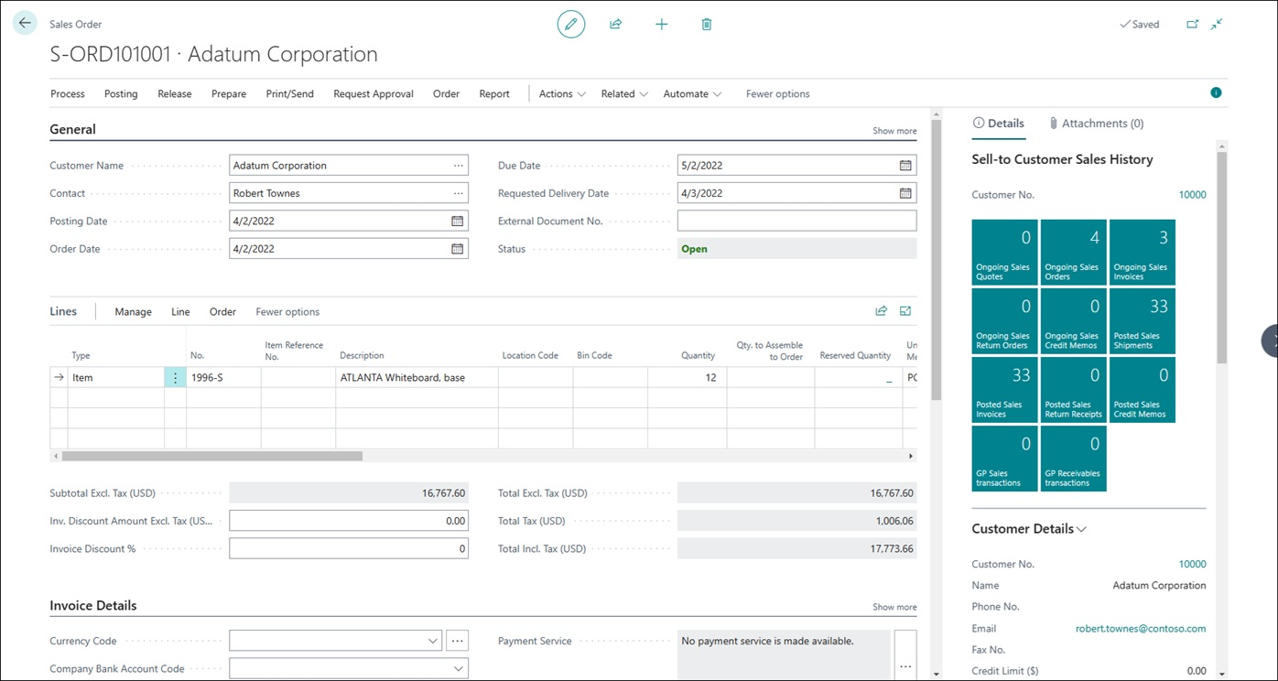
Sales order

Slide 8
Purchase orders
use purchase orders if your purchasing process requires that you record partial receipts of an order quantity, for example, because the full quantity was not available at the vendor
8

Slide 9
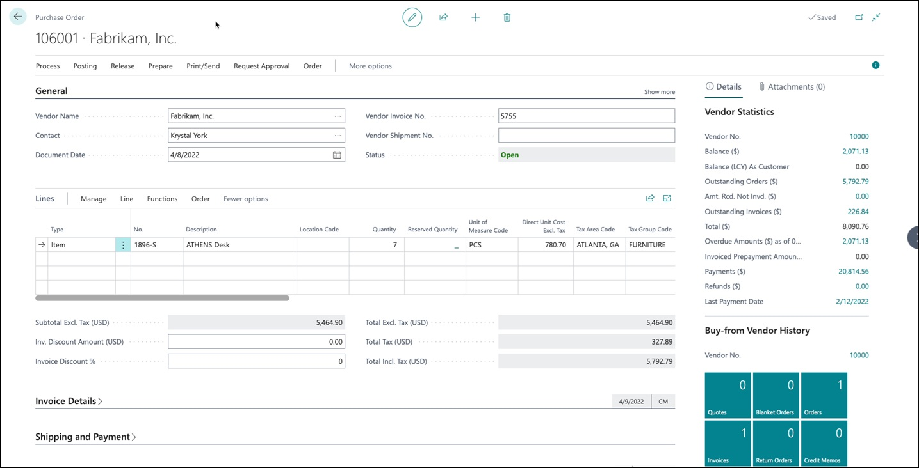
Purchase order

Slide 10
Inventory, non-inventory, and services
Inventory items are physical inventory units, whereas
non-inventory items are physical units that aren't tracked in inventory.
Items that are of the services type are used as labor time units
10

Slide 11
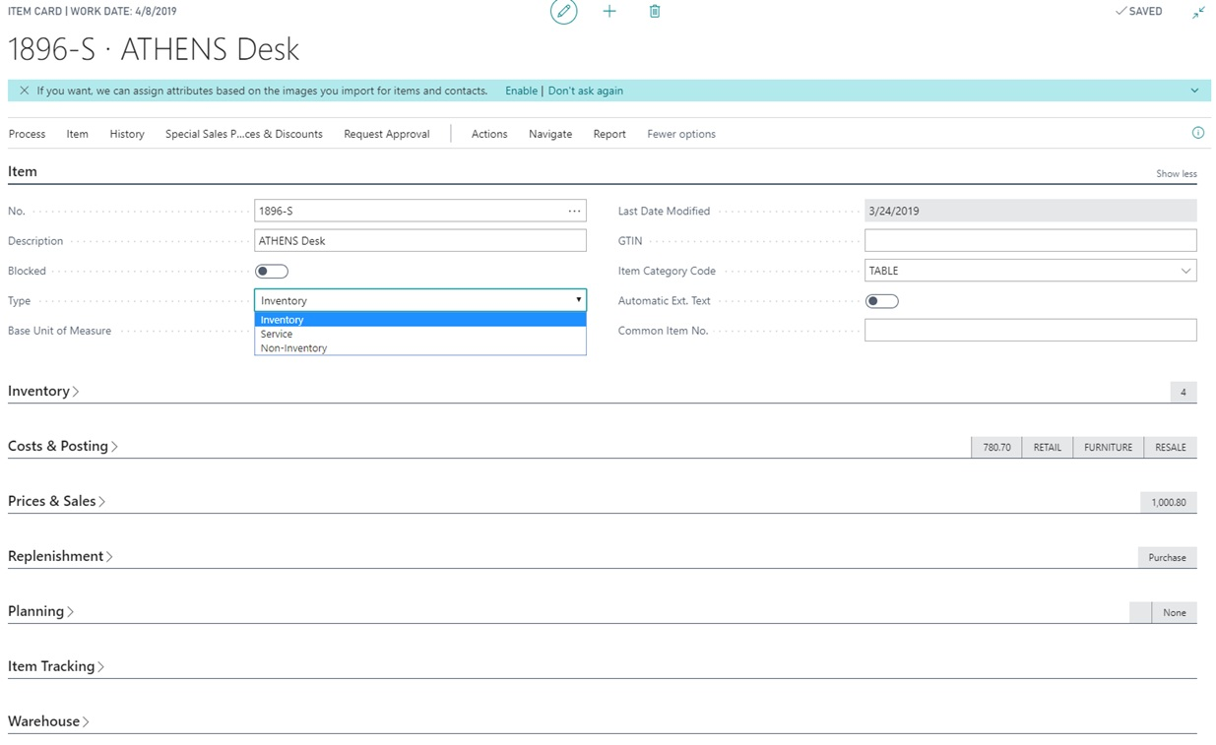
Inventory or non-inventory or services

Slide 12
Categories and attributes
To increase your overview of items and to help you find them, you can categorize items and give them attributes to search and sort by.
12

Slide 13
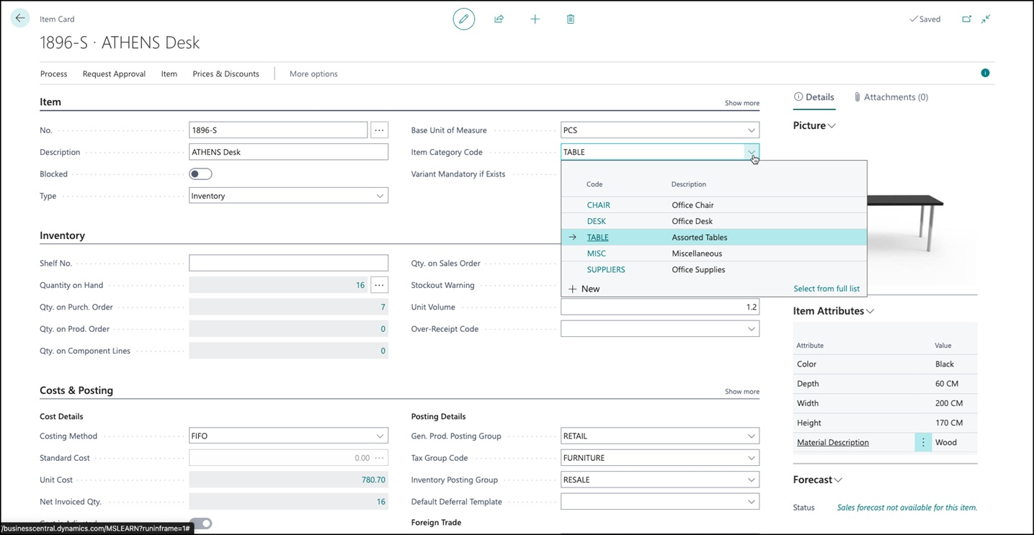
Categories and attributes

Slide 14
Actions
Unlocking new horizons

Slide 15
Special prices and discounts
You can market to your customers and customer groups with special prices and discounts. Special prices and line discounts can depend on conditions, such as the minimum order quantity and the order date. The program automatically applies the best price
15

Slide 16
Item availability
Inventory increases and decreases are recorded when you post purchase and sales documents, respectively. You can also increase or decrease the quantity of an item in inventory by posting directly to the item ledger entries, for example, after a physical count or if you don't record purchases
16

Slide 17
Catalog items
You can set up and use items that you don't maintain in inventory to your customers. You can register these items that you don't want to manage in your system until you start selling them as catalog item
17

Slide 18
Item substitutions
Business Central allows you to offer substitute items when requested items are unavailable. By setting up item substitutions, you can link similar items. When the program notifies you that an item that a customer has requested is out of stock, you can view the substitute items and select one that you have in stock
18

Slide 19
Locations
You can manage inventory in multiple locations that might represent a production plant, distribution center, warehouse, showroom, retail outlet, or service car.
19

Slide 20
Item transfers
With transfer orders, you can transfer items from one location to another. When transfers take more than one day, you can use in-transit locations that hold items in transfer. With direct transfers, you can transfer items without using in-transit locations. This is useful when transfer shipments and transfer receipts are processed at the same day
20

Slide 21
Sales and inventory forecasting
The sales and inventory forecast produces, with machine learning technology, a predictive analysis of future sales and inventory levels. By setting period type and origin, you can specify the historical data that the program uses
21

Slide 22
Thank you
Oleksandr Fishchuk
ofishchuk@goldenpath-software.pl
www.goldenpath-software.pl

