Slide 1

MS Dynamics365 Business central human resources
goldenpath-software.pl

Slide 2
Agenda
Growth strategy
Market analysis
Financial overview
Innovative solutions
Future initiatives

Slide 3
MS Dynamics365 Business Central human resources
Navigating the future

Slide 4
Human resources
You can register and maintain employee information, such as employment contracts, confidential information, qualifications, and employee contacts. You can also register employee absences, which allows you to analyze registered absences, as necessary.

Slide 5

Register employees
Unlocking new horizons

Slide 6

Employee card
On the employee card, you can set up information, such as union membership, relatives, and contracts for the employee. You can use alternate addresses to keep track of your employees’ location.
You can reimburse employees for their expenses during business activities. For this purpose, you must fill in the fields on the Payments FastTab on the Employee Card page.
6

Slide 7
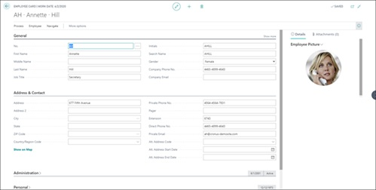
Employee card
You must first register each employee by creating a card with all the core and related information.
7

Slide 8
Manage employee absence
On the employee card, you can set up information, such as union membership, relatives, and contracts for the employee. You can use alternate addresses to keep track of your employees’ location.
You can reimburse employees for their expenses during business activities. For this purpose, you must fill in the fields on the Payments FastTab on the Employee Card page.
8

Slide 9
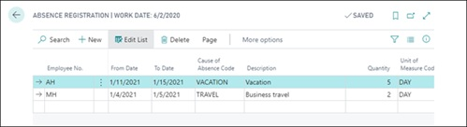
Employee card
You must record the absence on the Absence Registration page. It can then be viewed in different ways for analysis and reporting needs
9

Slide 10
Thank you
Oleksandr Fishchuk
ofishchuk@goldenpath-software.pl
www.goldenpath-software.pl

