Slide 1

MS Dynamics365 Business central manufacturing management
goldenpath-software.pl

Slide 2
Agenda
Growth strategy
Market analysis
Financial overview
Innovative solutions
Future initiatives

Slide 3
MS Dynamics365 Business Central manufacturing management
Navigating the future

Slide 4
Manufacturing capabilities
Set up various parameters such as work centers, routings, and production BOMs

Slide 5

Production orders
Unlocking new horizons

Slide 6

Production orders are central component
Production orders are used to manage the conversion of purchased materials into manufactured items.
Production orders route work through various work or machine centers on the shop floor.
6

Slide 7
Production orders consists of:
Products that are planned for manufacturing
Materials that are required for the planned production orders
Products that have just been manufactured
Materials that have already been selected
Products that have been manufactured in the past
Materials that were used in previous manufacturing operations
7

Slide 8
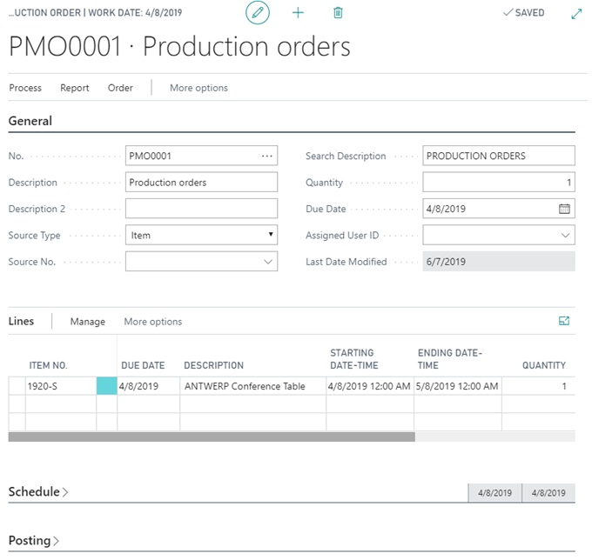
Production orders
8

Slide 9
Manufacturing capabilities
Version management
Version management allows you to create and manage different versions of the manufacturing bill of materials and routings
Basic supply planning
Basic supply planning allows you to plan for material requirements based on demand with support for master production scheduling and materials requirements planning.
Demand forecasting
With demand forecasting, you can plan and create production and purchase orders, taking into consideration the demand forecast together with the level of available inventory and parameters of requirement planning.
9

Slide 10
Thank you
Oleksandr Fishchuk
ofishchuk@goldenpath-software.pl
www.goldenpath-software.pl

