Slide 1

MS Dynamics 365 Project management
goldenpath-software

Slide 2
Agenda
Growth strategy
Market analysis
Financial overview
Innovative solutions
Future initiatives

Slide 3
MS Dynamics365 Project management
Navigating the future

Slide 4
Project management
The Projects functionality helps you keep track of usage on projects and provides data for invoicing the customer.
You can manage both fixed-price projects and time-and-materials projects

Slide 5

Projects functionality
Unlocking new horizons

Slide 6

Projects
With the Projects functionality, you can manage long-term projects that involve the use of employee labor hours, machine hours, inventory items, and other types of usage that you want to keep track of. Using the Projects functionality provides a good overview of not only individual projects, but also the allocation
6

Slide 7
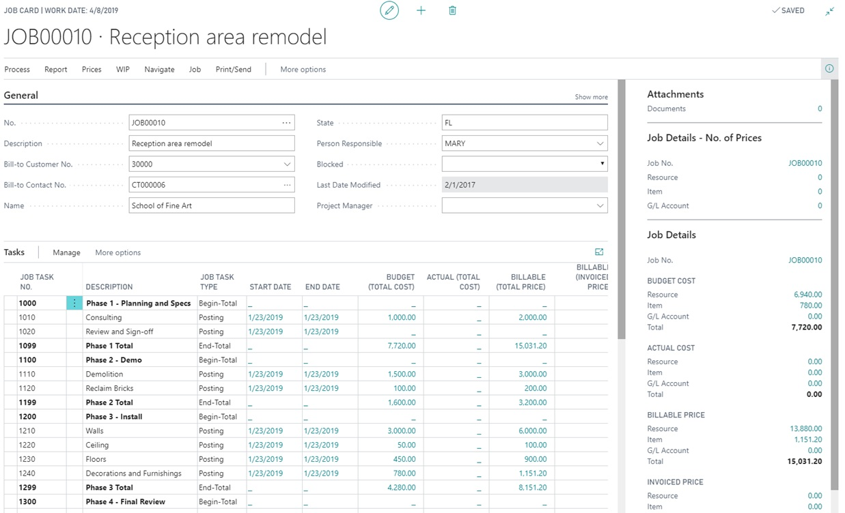
Project functionality
On the project card, you can enter all the data that you need to manage the project from an administrative and financial point of view
By entering tasks for your project, you can specify everything that must be done to complete the job. For each task, you can plan capacity and sales for resources and items.
7

Slide 8
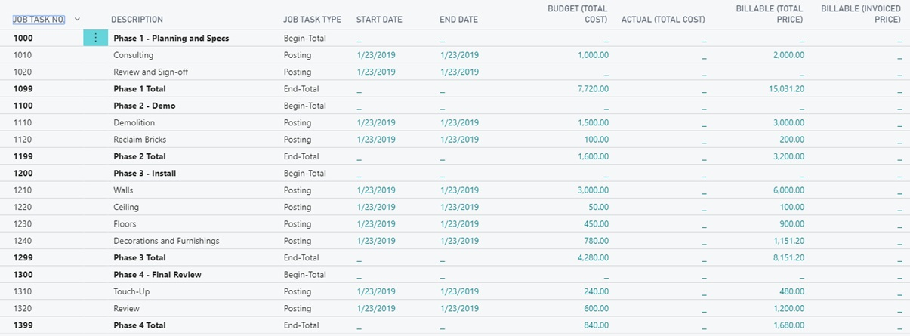
Project functionality
By entering tasks for your project, you can specify everything that must be done to complete the job. For each task, you can plan capacity and sales for resources and items.
8

Slide 9
Resource functionality
Unlocking new horizons

Slide 10
Resources
A resource can be defined as a person's effort or that of a machine. With the Resources functionality, you can register and sell resources, combine related resources into one resource group, or track individual resources.
10

Slide 11
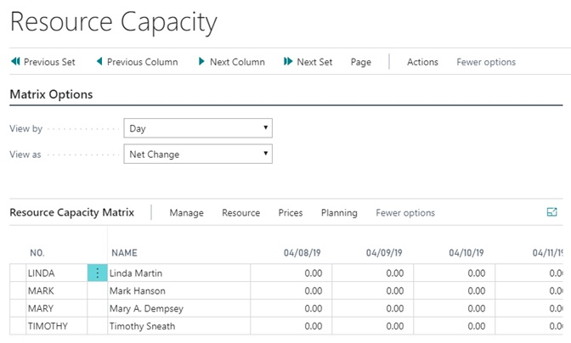
Resource Capacity and Availability
You can set capacity for each resource and monitor the usage for resources, which allows you to obtain a complete overview of the capacity and availability of your resources.
11

Slide 12
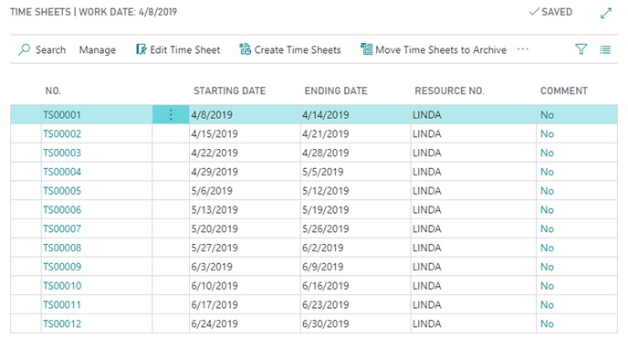
Timesheet
Time sheets are a simple and flexible solution for time registration with manager approval, and they integrate with the Service, Projects, and Basic Resources functionalities.
With timesheets, resources can enter hours that are spent on projects. After configuring which resources should enter timesheets, the timesheet administrator can prepare timesheets by week based on project planning line
12

Slide 13
Thank you
Mirjam Nilsson
mirjam@contoso.com
www.contoso.com

