Slide 1

MS Dynamics 365 service management
goldenpath-software

Slide 2
Agenda
Growth strategy
Market analysis
Financial overview
Innovative solutions
Future initiatives

Slide 3
MS Dynamics 365 service management
Navigating the future

Slide 4
Service management
Used in business scenarios such as complex customer service distribution systems, industrial service environments with bills of materials, and high-volume dispatching of service technicians with requirements for spare parts managemen

Slide 5

Service management functionalities
Respond to service requests
Plan and schedule repair assignments
Follow up on the status of repair assignments
Track and invoice repair costs
Handle warranties
Set and use service contracts
Optimize inventory levels for spare parts
Improve spare parts for costing
5

Slide 6
Service management components
Component 1
Service management
Component 2
Service contract management
Component 3
Service price management
6

Slide 7

Service management
Unlocking new horizons

Slide 8
Service management
WARRANTY
You can manage warranty details on the service items and spare parts and record details on service levels, response times, and discount levels.
ITEMS
Service items are the equipment or the item that needs to be serviced or repaired
SERVICE ORDERS
are assignments to service the equipment
8

Slide 9
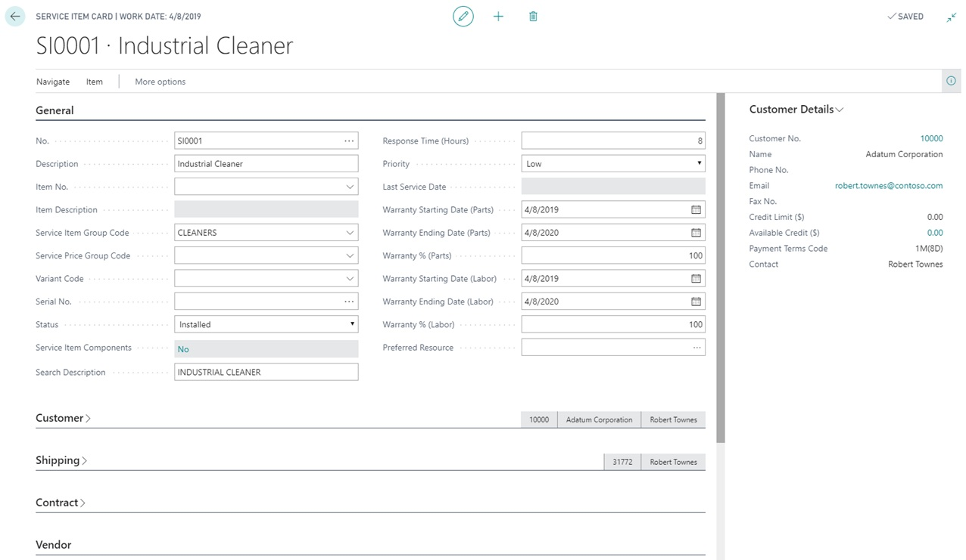
Service management: Items
9

Slide 10
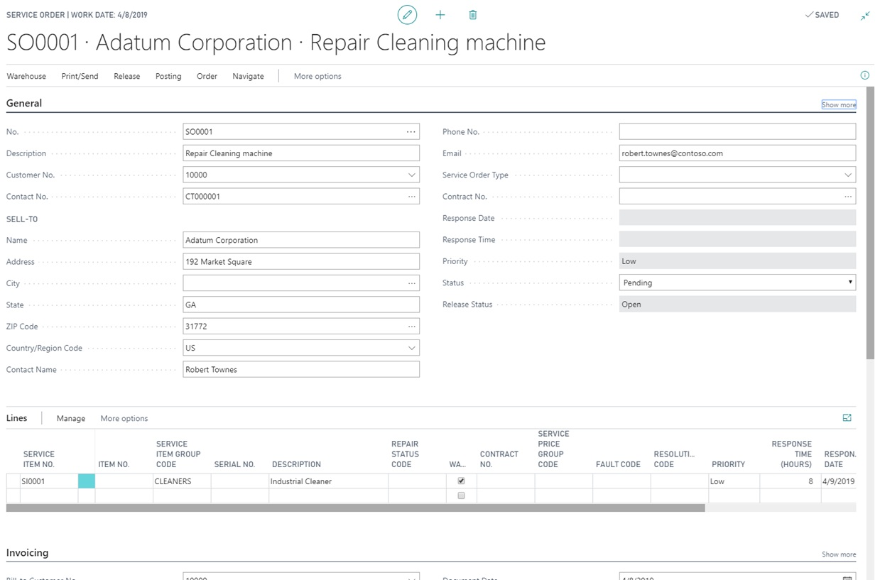
Service management: service orders
10

Slide 11
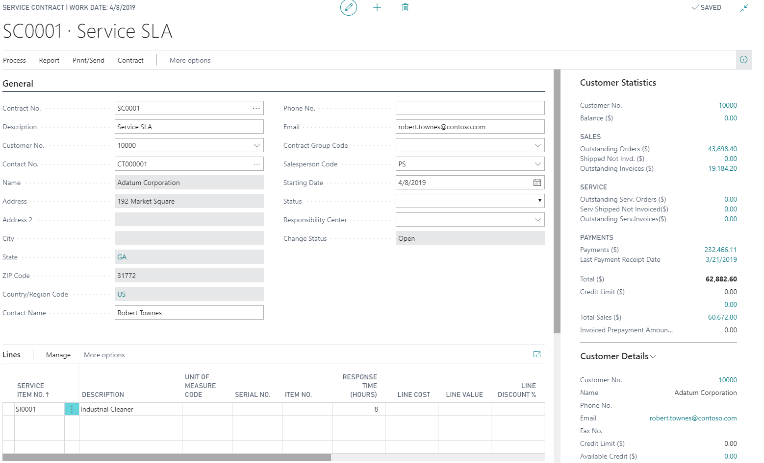
Service contract management
You can set up an agreement with the customer that addresses the service level to be delivered, and maintain information on contract history, contract renewal, and contract templates. You can also generate contract quotes.
11

Slide 12
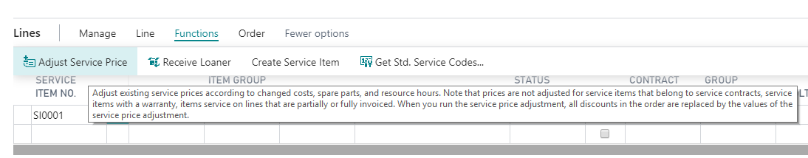
Service price management
With service price management, you can set up, maintain, and monitor service prices. You can also define price calculation structures that include all parameters that are involved in providing service
12

Slide 13
Thank you
Mirjam Nilsson
mirjam@contoso.com
www.contoso.com

