Slide 1

Manage environments
Goldenpath-software

Slide 2
Agenda
Growth strategy
Market analysis
Financial overview
Innovative solutions
Future initiatives

Slide 3
Manage sandbox and production environments
Navigating the future

Slide 4
How to create
The Business Central administration center provides a simple method for creating the production environments for a tenant. For each tenant, administrators can create multiple production environments, including the option for environments to be on different country-specific or region-specific versions of Business Central.
You can use one production environment and three sandbox environments

Slide 5
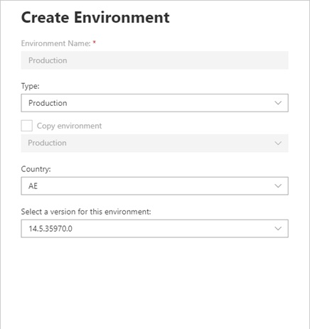
Create environment
Unlocking new horizons

Slide 6
Applied actions
Option 1
Based on production env
Option 2
Copy environment
Option 3
Delete/restoring the sandbox
Option 4
Transfer envs between tenants
6

Slide 7
Create a sandbox based on a production environment
If a sandbox is created with a copy of a production environment, several precautions are taken for that sandbox:
The job queue is automatically stopped.
Any base application integration settings are cleared.
Outbound HTTP calls from extensions are blocked by default and must be approved for each extension.
Any General Data Protection Regulation (GDPR) action must be handled separately and repeated for the sandbox. No synchronization occurs with the production environment after the sandbox has been created.
7

Slide 8
Copy environments
You can create an environment that is a copy of an existing environment, such as a sandbox that is based on production for troubleshooting, or a production environment that is based on a sandbox, for example
8

Slide 9

The following setups are set to a status of disabled:
Doc. Exch. Service Setup
Curr. Exch. Rate Update Setup
VAT Reg. No. Srv Config
Graph Mail Setup
CRM Connection Setup
CDS Connection Setup
All records in the Service Connection table
All records in the Exchange Sync table
9

Slide 10
The following data is cleared:
Password in the OCR Service Setup table
SMTP Server in SMTP Mail Setup
Exchange Service URL in the Marketing Setup table
10

Slide 11
The following changes are made for first-party extensions:
AMC Banking 365 Fundamentals - The Service URL in AMC Banking Setup is reset to default for Sandbox environments.
Email - Outlook REST API - All email accounts of types Microsoft 365 and Current User are deleted.
Email - SMTP Connector - SMTP Server details are deleted.
11

Slide 12
Delete a sandbox
Business Central comes with the promise of keeping your data safe and available to you. We give environments a state of soft-deleted for seven days after you delete them. The same terms apply when the environment is scheduled for deletion after a trial has expired.
12

Slide 13
Restoring an environment
As an administrator, you can restore an existing environment from a time in the past, within the 30-day retention period. An environment can only be restored within the same Business Central version (minor and major).
Permission to restore environments is limited to specific types of users: internal and delegated administrators.
13

Slide 14
Transfer environments between Microsoft Entra tenants
In some cases, administrators might want to transfer their Dynamics 365 Business Central environment to another Microsoft Entra tenant (formerly Azure Active Directory tenant)
The process for transferring a Business Central environment to a different Microsoft Entra tenant is a self-service scenario. Internal administrators can request an environment transfer from the source tenant, and then accept the transfer from the target tenant
14

Slide 15
Manage access using Microsoft Entra ID groups
To manage access at the environment level, you can assign an Azure Active Directory (Microsoft Entra ID) group to the environment. By assigning a Microsoft Entra ID group to an environment, only direct and indirect members of the group are granted access to the environment.
15

Slide 16
Thank you
Mirjam Nilsson
mirjam@contoso.com
www.contoso.com

