Slide 1
MSc Research Project Presentation
Seán Ó Fithcheallaigh
May 24, 2023

Slide 2
Agenda
Research background and Related Work
Aims and Objectives
Project work
Data collection
Machine Learning Analysis
Deep Learning Analysis
Deployment to Edge device
Conclusions and Future Work
Questions?
2/13

Slide 3
Project Background and Related Work
Edge Based Obstacle Detection [Za’aba et. al., 2019]
This work uses mobile devices such as smartphones and tablets
Uses the device’s camera to collect images, and runs an edge detection algorithm to detect an object
Also uses the device’s proximity sensors, accelerometer and gyroscope to adapt itself to the environment
Automatic Train Pairing [Sattiraju et. al., 2017]
Authors use machine learning techniques to carry out real-time ranging and localisation
The work presents information on a number of data labelling techniques, including a grid system and discusses the performance of a number of classification models to perform automatic train pairing
LineChaser [Kuribayashi et. al., 2021]
The proposed system presented uses a smartphone’s camera in this work to guide the user to the end of a line, and an infrared sensor to continuously report the distance and direction of the last person in the line, allowing the user to follow them
The proposed system requires the user to operate and hold a smartphone throughout
Smart Blind Stick [Elsonbat, 2021]
This work modified a traditional stick used by a blind person and modified it with ultrasonic sensors to detect distance and water sensors to detect rainfall and a water level
The stick is connected to an application which runs on a smartphone
The application will receive information to assist their journey
As we live longer, more and more people are expected to develop visual impairments. Experts predict by 2050 the number of people suffering from sight loss will double to over 4 million [L. Pezzullo, 2018]
Having a visual impairment can have a serious impact on a person’s physical and mental health
Development and use of an Edge device for obstacle detection and navigation would allow the user to live a more full, independent life
L. Pezzullo, J. Streatfeild, P. Simkiss and D. Shickle, ”The economic impact of sight loss and blindness in the UK adult population,” BMC Health Services Research, vol. 18, 2018.
K. A. B. Za’aba and L. B. Theng, ”Edge Based Obstacle Detection Model Focused on Indoor Floor-Based Obstacles,” 2019 IEEE 9th Symposium on Computer Applications & Industrial Electronics (ISCAIE), Malaysia, 2019, pp. 202-207, doi: 10.1109/ISCAIE.2019.8743866.
R. Sattiraju, J. Kochems and H. D. Schotten, ”Machine learning based obstacle detection for Automatic Train Pairing,” 2017 IEEE 13th International Workshop on Factory Communication Systems (WFCS), Trondheim, Norway, 2017, pp. 1-4, doi: 10.1109/WFCS.2017.7991962
Masaki Kuribayashi, Seita Kayukawa, Hironobu Takagi, Chieko Asakawa, and Shigeo Morishima. 2021. LineChaser: M. Kuribayashi,K. Seita, T. Hironobu, A. Chieko and M. Shigeo, ”LineChaser: A Smartphone-Based Navigation System for Blind People to Stand in Lines,” Proceedings of the 2021 CHI Conference on Human Factors in Computing Systems, p. 13, 2021.
Amira. A. Elsonbat, “Smart Blind Stick Design and Implementation”, International Journal of Engineering and Advanced Technology (IJEAT), 2021, 10(5), 17–20. 10.35940/ijeat.D2535.0610521
3/13

Slide 4
Aims and Objectives
Develop an Edge device for obstacle detection and localisation in an indoor setting to, allow navigation of an unfamiliar environment by people with visual impairments
Development of a data collection system, and subsequent data collection
Investigate the performance of various machine learning techniques on the collected dataset
Deploy the model to an Edge device and evaluate the performance
4/13

Slide 5
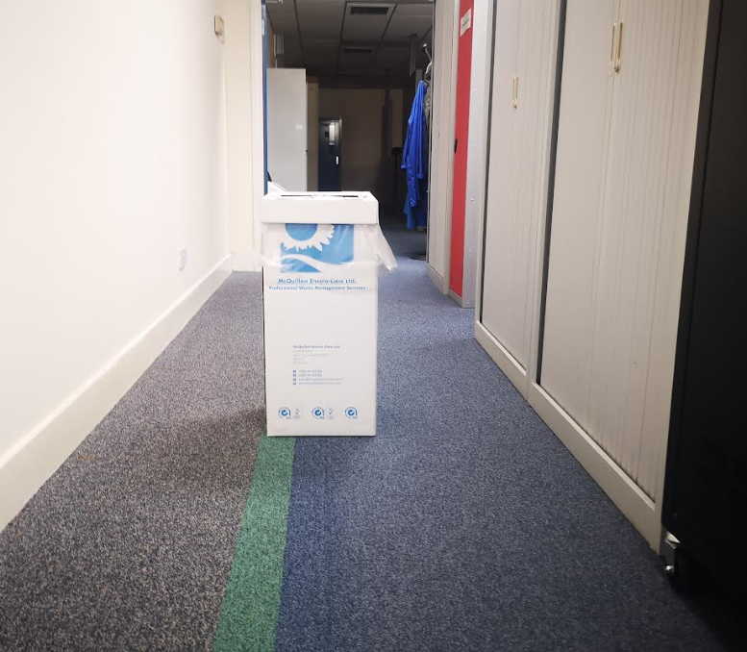
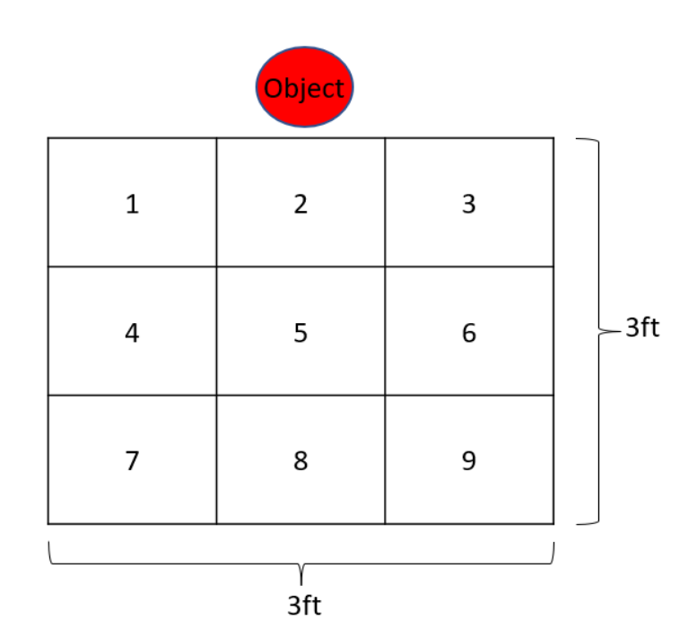
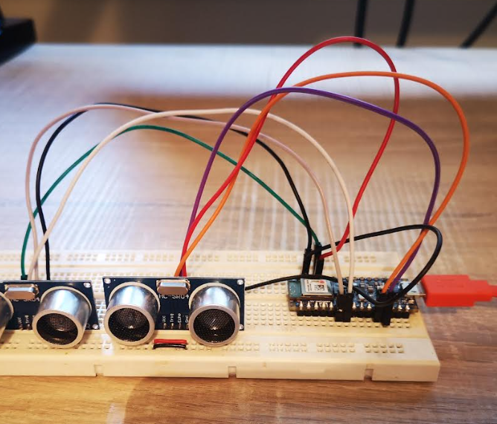
Project Work: Data Collection
Data was collected using an Arduino Development Kit using 2 ultrasonic sensors, coded using the Arduino IDE
Objects were placed in the centre of a hallway
Data was collected from each grid location of a 3 by 3 grid
5/13

Slide 6
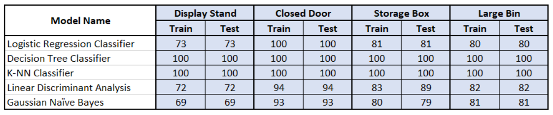
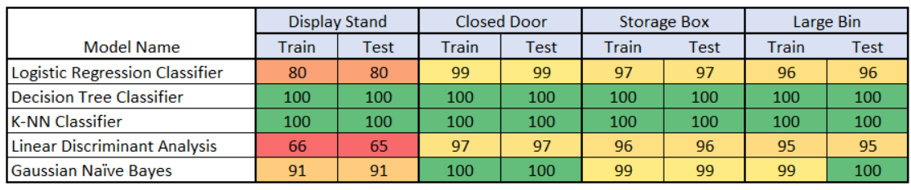
Analysis: Machine Learning
This analysis aims to answer the question: Can we use machine learning techniques to classify the data?
Data processed through a number of classification algorithms for a “binary search”, and a “grid search”
Binary Search
Results
Grid Search
Results
6/13

Slide 7
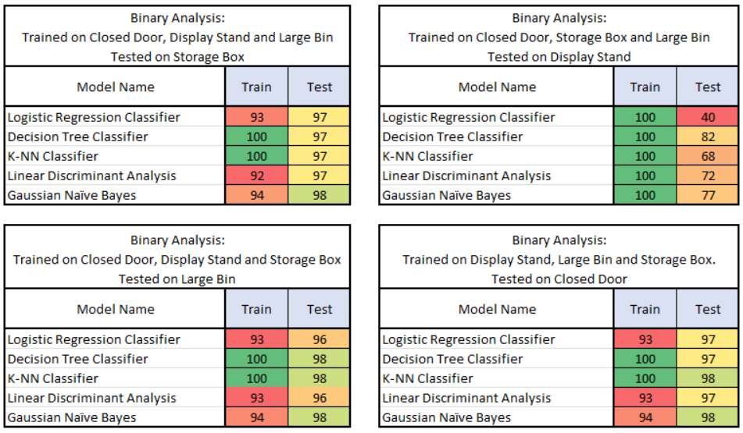
Analysis: Machine Learning
With the Decision Tree and K-Nearest Neighbour showing 100% accuracy, I wanted to dig deeper into these results
7/13

Slide 8
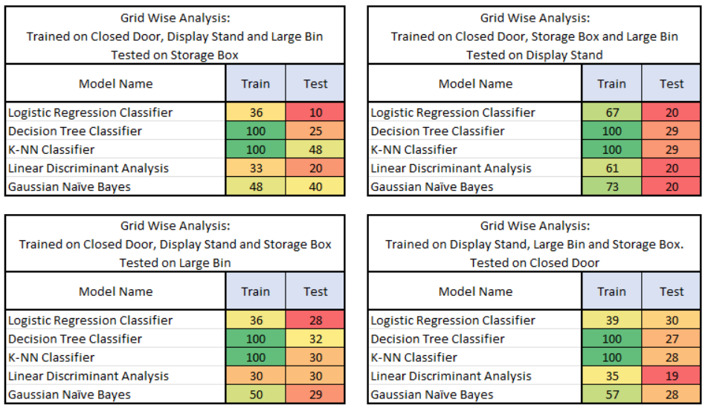
Analysis: Machine Learning
With the Decision Tree and K-Nearest Neighbour showing 100% accuracy, I wanted to dig deeper into these results
8/13

Slide 9
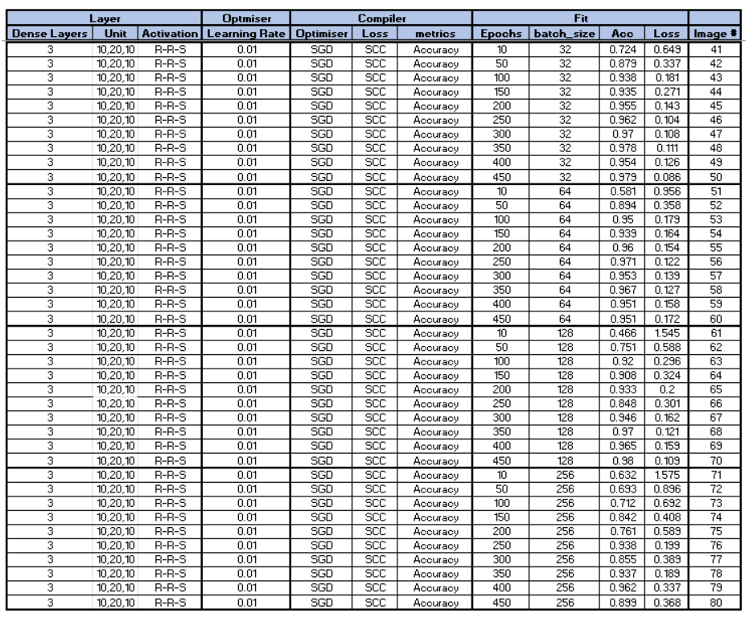
Analysis: Neural Networks
Neural networks built using the Keras framework from TensorFlow
Hyperparameters of a Dense network were tuned for the best Accuracy and Loss results
Number of layers and neurons
Learning rate
Batch size
Epochs
Optimisers
9/13

Slide 10
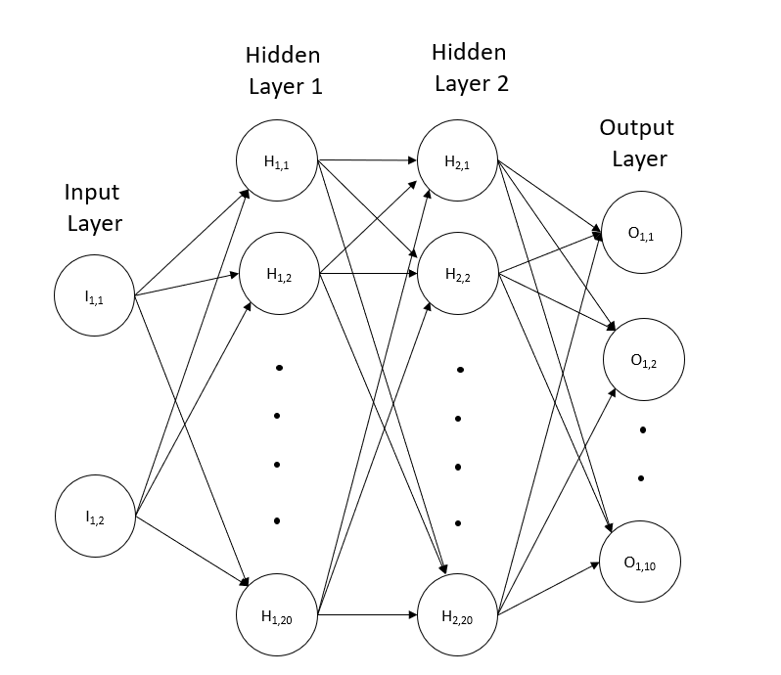

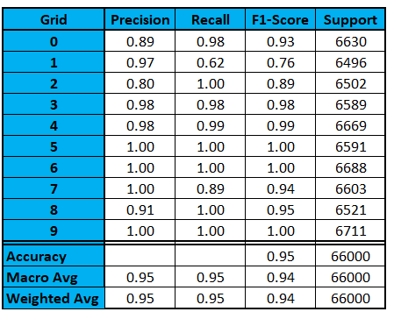
Analysis: Neural Networks
10/13

Slide 11
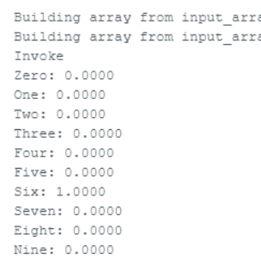
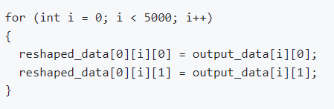
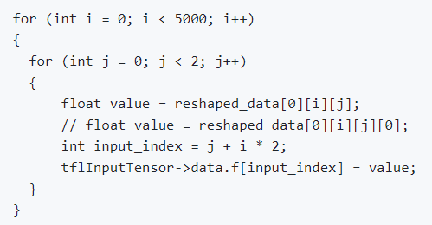
Deployment onto Constrained Device
Neural network was converted to a header file using TensorFlow
This header file can be imported into the microcontroller to be used with TensorFlow Lite
Initial tests did not produce an output from the inference
Investigations pointed towards the shape of the data being given to the input tensor was wrong
Modifications were made to both the sensor shape and the data being fed into the tensor
The system started to produce results, but it was always the same few grids no matter the data fed into the system
11/13

Slide 12
Conclusions and Future Work
A large dataset was created, using a number of obstacles
Initial analysis indicated that detecting obstacles is possible, but standard machine-learning techniques alone were not sufficient
Development of neural network proved promising with good accuracy scores
Deploying the model onto the constrained device generated a number of challenges, which have not been fully overcome
If these challenges could be overcome, this work has shown the potential to develop a system which could be used by people with visual impairments to navigate an unfamiliar indoor environment
12/13

Slide 13
Questions?
13/13

Slide 14
Backup

Slide 15
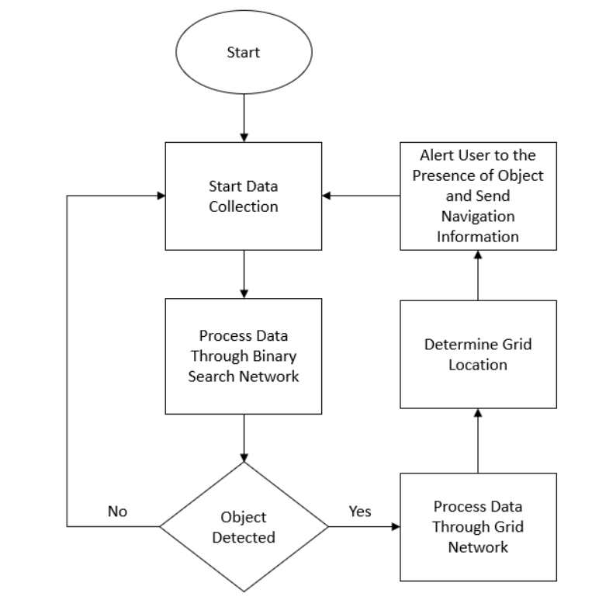
Proposed System Algorithm

