Slide 1
MSc Research Project Presentation
Seán Ó Fithcheallaigh
May 24, 2023

Slide 2
Agenda
Project Background and Related Work
Aims and Objectives
Project Activities
Data collection
Machine Learning Analysis
Deep Learning Analysis
Deployment onto a Constrained Device
Conclusions and Future Work
Questions?
2/13

Slide 3
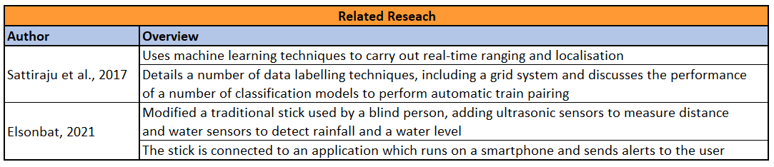
Project Background and Related Work
As we live longer, more and more people are expected to develop visual impairments. Experts predict by 2050 the number of people suffering from sight loss will double to over 4 million [L. Pezzullo, 2018]
Having a visual impairment can have a serious impact on a person’s physical and mental health
Development and use of an Edge device for obstacle detection and navigation would allow the user to live a more full, independent life
L. Pezzullo, J. Streatfeild, P. Simkiss and D. Shickle, ”The economic impact of sight loss and blindness in the UK adult population,” BMC Health Services Research, vol. 18, 2018.
R. Sattiraju, J. Kochems and H. D. Schotten, ”Machine learning based obstacle detection for Automatic Train Pairing,” 2017 IEEE 13th International Workshop on Factory Communication Systems (WFCS), Trondheim, Norway, 2017, pp. 1-4, doi: 10.1109/WFCS.2017.7991962
A. Elsonbat, “Smart Blind Stick Design and Implementation”, International Journal of Engineering and Advanced Technology (IJEAT), 2021, 10(5), 17–20. 10.35940/ijeat.D2535.0610521
3/13

Slide 4
Aims and Objectives
Using machine learning methods within a constrained device, develop a system for obstacle detection and localisation in an indoor setting, to allow navigation of an unfamiliar environment by people with visual impairments
Development of a data collection system, and subsequent data collection
Investigate the performance of various machine learning techniques on the collected dataset
Deploy the model to an Edge, or constrained device and evaluate the performance
4/13

Slide 5
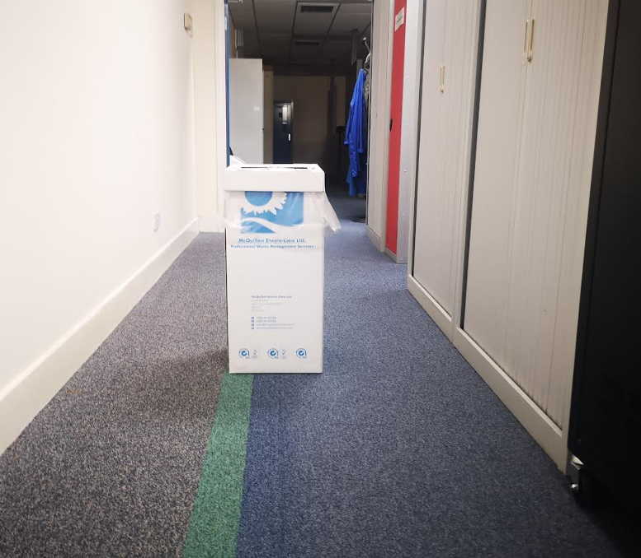
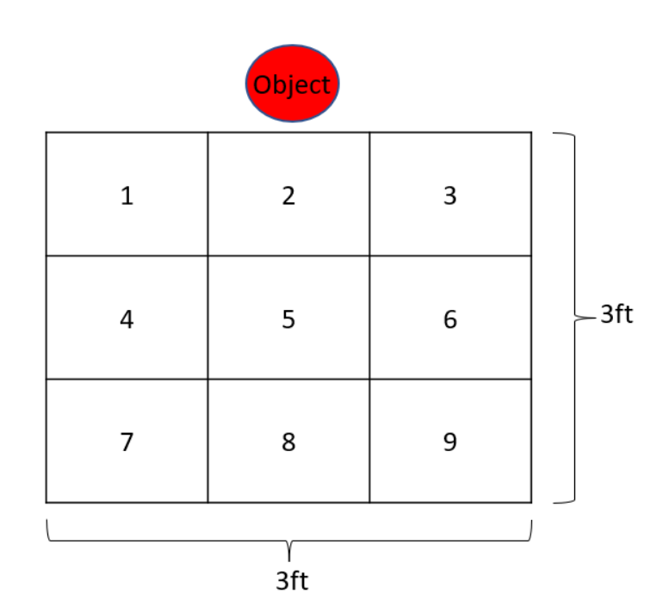
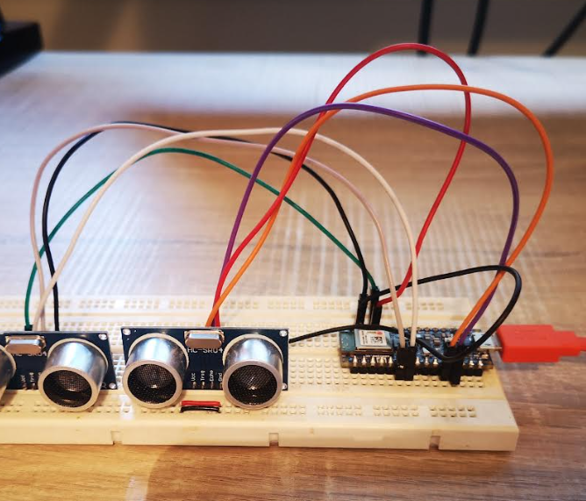
Data Collection
Data was collected using an Arduino Development Kit and two ultrasonic sensors,
Code development for data collection was carried out using the Arduino IDE
Objects were placed in the centre of a hallway
Data was collected from each grid location of a 3-by-3 grid
5/13

Slide 6
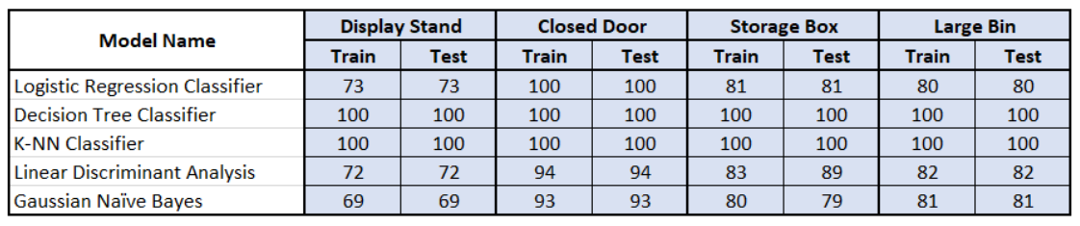
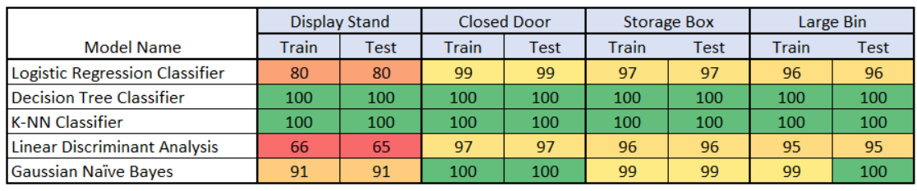
Machine Learning Analysis
This analysis aims to answer the question: Can we use machine learning techniques to classify the data?
Data processed through a number of classification algorithms for a “binary search”, and a “grid search”
Binary Search
Results
Grid Search
Results
6/13

Slide 7
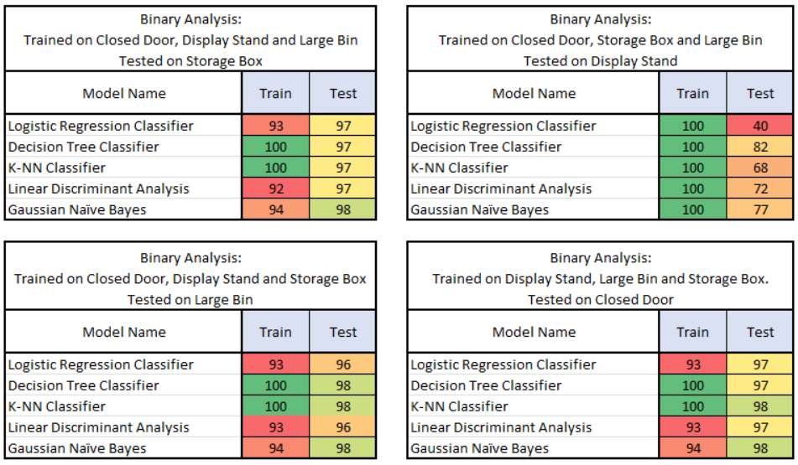
Machine Learning Analysis
With the Decision Tree and K-Nearest Neighbour showing 100% accuracy, further investigation of these results was carried out
7/13

Slide 8
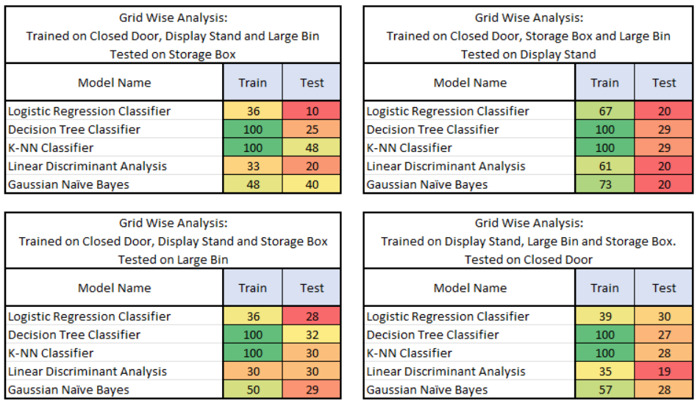
Machine Learning Analysis
Passing unseen data to the algorithms for the test phase produced lower accuracy scores
8/13

Slide 9
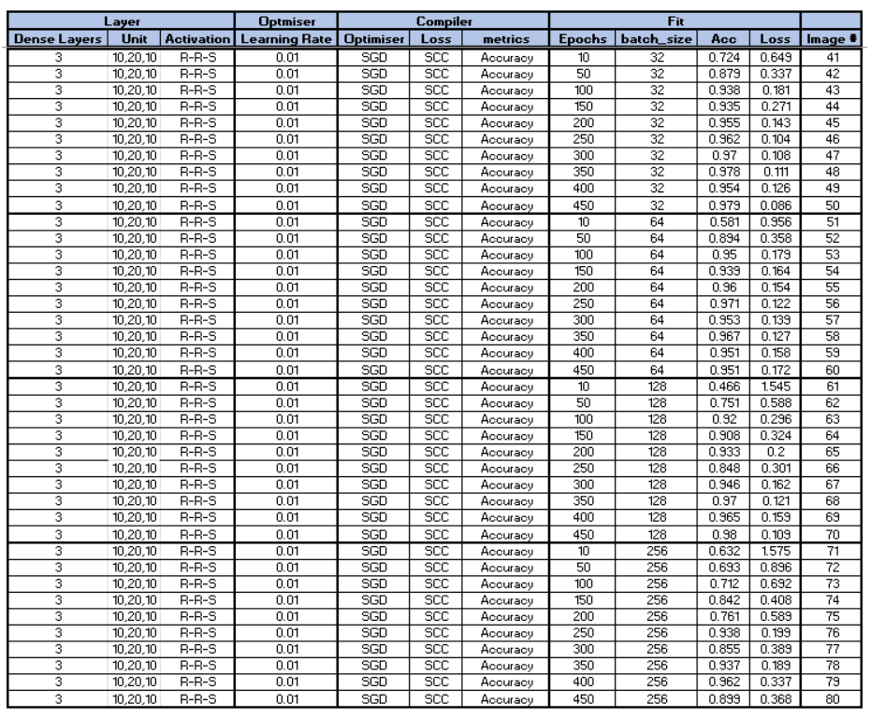
Neural Networks Analysis
Neural networks built using the Keras framework from TensorFlow
Hyperparameters of a Dense network were tuned for the best Accuracy and Loss results
Number of layers and neurons
Learning rate
Batch size
Epochs
Optimisers
9/13

Slide 10
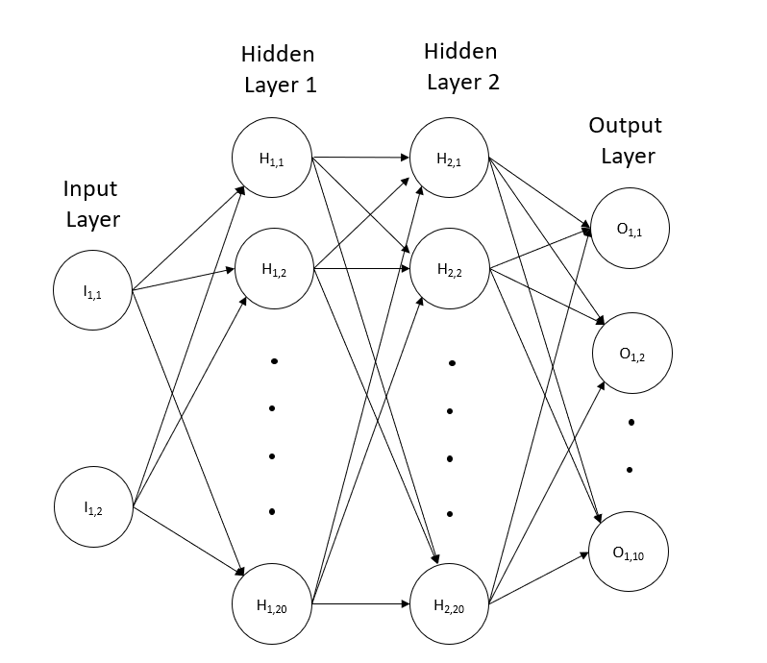

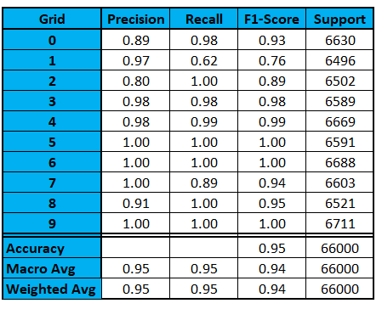
Neural Networks Analysis
10/13

Slide 11
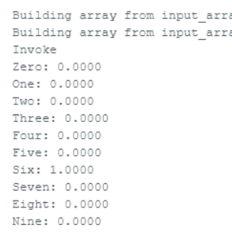
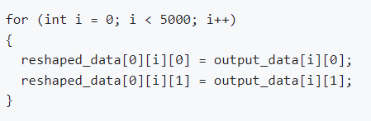
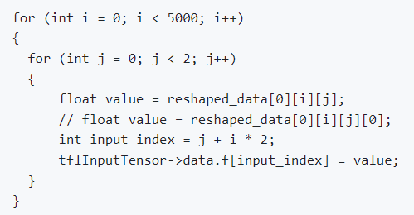
Deployment onto a Constrained Device
Neural network model was converted to a header file using TensorFlow
This header file can be imported into the microcontroller to be used with TensorFlow Lite
Initial tests did not produce an output from the inference
Investigations pointed towards the shape of the data being given to the input tensor was wrong
Code was modified to change the shape of the data being fed into the input tensor
The system started to produce results, but it was always for the same grid number no matter the data passed into the system
11/13

Slide 12
Conclusions and Future Work
A large dataset was created by gathering ultrasonic distance data from a number of obstacles using a grid system
Initial analysis indicated that detecting obstacles was possible, but standard machine learning techniques alone were not sufficient
Initial development of neural network proved promising with good accuracy scores
Deploying the model onto the constrained device generated several challenges, which have not been fully overcome
If these challenges could be overcome, this work has shown the potential to develop a system which could be used by people with visual impairments to navigate an unfamiliar indoor environment
To confirm this, further development of the neural network would need to be carried out by repeating the processing of passing unseen data to the network to fully understand the performance
12/13

Slide 13
Questions?
13/13

Slide 14
Backup

Slide 15
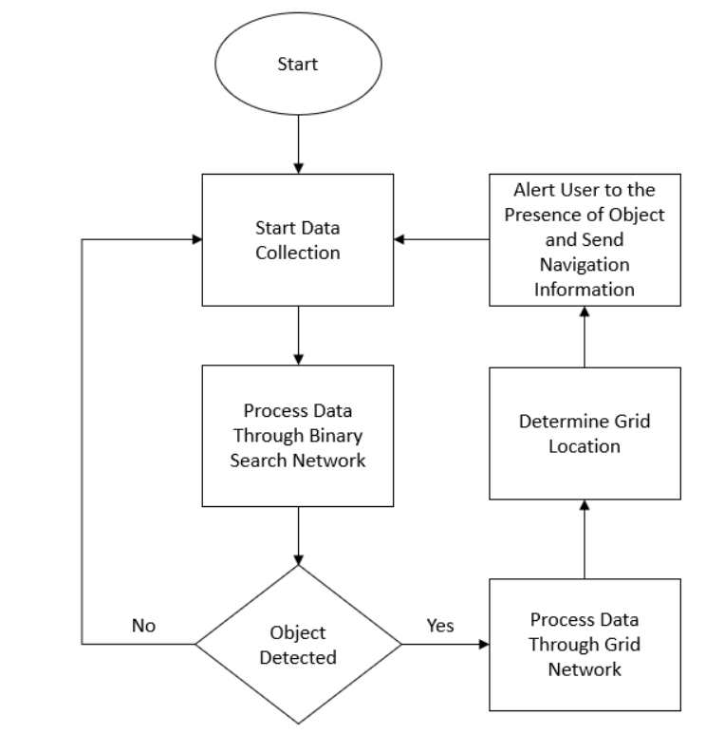
Proposed System Algorithm

