Slide 1
MSc Research Project Presentation
Seán Ó Fithcheallaigh
May 24, 2023
Notes:
Hello, my name is Seán Ó Fithcheallaigh and I am a part-time student on the MSc in Artificial Intelligence
I’d like to thank everyone for coming along to listen to my presentation for my research project which was based on the development of a constrained device, for people with visual impairments
But more on that in a bit.

Slide 2
Agenda
Project Background and Related Work
Aims and Objectives
Project Activities
Data collection
Machine Learning Analysis
Deep Learning Analysis
Deployment onto a Constrained Device
Conclusions and Future Work
Questions?
2/13
Notes:
So just quickly to cover the agenda.
We’ll start off with a quick discussion on the background of my project and talk about some of the related work
I will discuss the aims and objectives
Then we will get into the work done during the research, so we will look at the data collection element, then look at the main elements of analysis that I did, and then we will talk about deploying onto the constrained device.
From there I will move onto the conclusions and talk about some future work before taking some questions

Slide 3
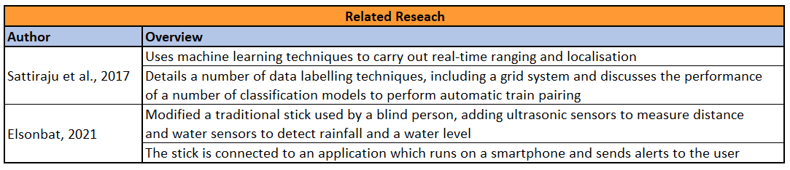
Project Background and Related Work
As we live longer, more and more people are expected to develop visual impairments. Experts predict by 2050 the number of people suffering from sight loss will double to over 4 million [L. Pezzullo, 2018]
Having a visual impairment can have a serious impact on a person’s physical and mental health
Development and use of an Edge device for obstacle detection and navigation would allow the user to live a more full, independent life
L. Pezzullo, J. Streatfeild, P. Simkiss and D. Shickle, ”The economic impact of sight loss and blindness in the UK adult population,” BMC Health Services Research, vol. 18, 2018.
R. Sattiraju, J. Kochems and H. D. Schotten, ”Machine learning based obstacle detection for Automatic Train Pairing,” 2017 IEEE 13th International Workshop on Factory Communication Systems (WFCS), Trondheim, Norway, 2017, pp. 1-4, doi: 10.1109/WFCS.2017.7991962
A. Elsonbat, “Smart Blind Stick Design and Implementation”, International Journal of Engineering and Advanced Technology (IJEAT), 2021, 10(5), 17–20. 10.35940/ijeat.D2535.0610521
3/13
Notes:
Okay, so, as a society we have people who are living longer lives. And naturally, as we get older, we are more susceptible to developing medical issues. One of these could be sight loss.
It is expected that by 2050 the number of people who suffer from sight loss will double to over 4 million people.
As you can imagine, losing your sight can have a serious impact on a person’s mental and physical well-being – things that a person might have done without thinking, such as walking to the local shop, now become a bigger task.
The development and use of an edge device, or constrained device, for obstacle detection and navigation, would allow a person to live a more full, independent life.
So work has been done in this area already, For example, the paper listed here from 2017 looked at using machine learning to carry out real-time ranging and localisation of objects. The work discussed a number od labelling options, including the use of a gris system, and looked at how well classification algorithms performed for automatic train pairing
The work carried out in 2021 looks at the development of a “smart blind stick”, which had ultrasonic sensors added to measure distance, as well as a water sensor to detect rainfall and water level. This system would connect to an app on the users phone and send them alerts
There are of course other research, but I highlight these as they come at the problem of object detection from a few different angels.

Slide 4
Aims and Objectives
Using machine learning methods within a constrained device, develop a system for obstacle detection and localisation in an indoor setting, to allow navigation of an unfamiliar environment by people with visual impairments
Development of a data collection system, and subsequent data collection
Investigate the performance of various machine learning techniques on the collected dataset
Deploy the model to an Edge, or constrained device and evaluate the performance
4/13
Notes:
So that brings me to the aims an objectives of my research.
The aim is to use machine learning methods within a constrained device and develop a system for obstacle detection and localisation in an indoor setting, to allow navigation of an unfamiliar environment by people with visual impairments.
To meet this aim, there will be several milestones to meet.
Development of a data collection system, and subsequent data collection
Investigate the performance of various machine learning techniques on the collected dataset
Deploy the model to an Edge, or constrained device and evaluate the performance
So, let’s move onto to discuss the data collection phase

Slide 5
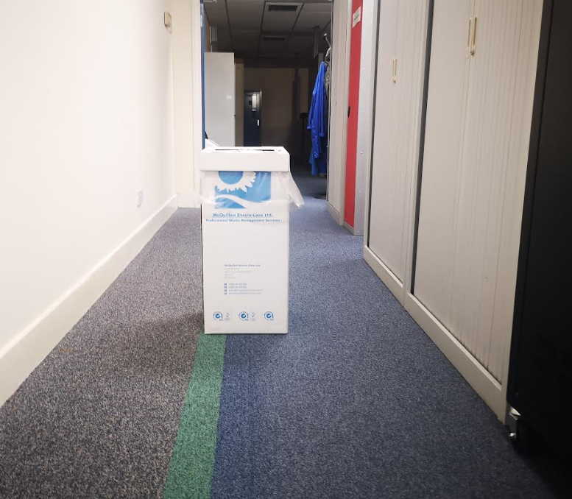
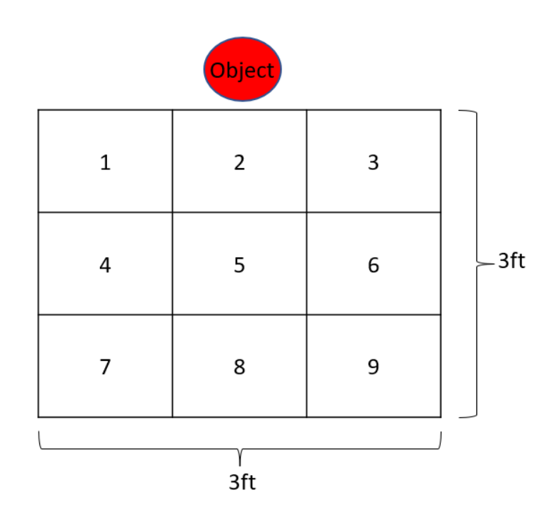
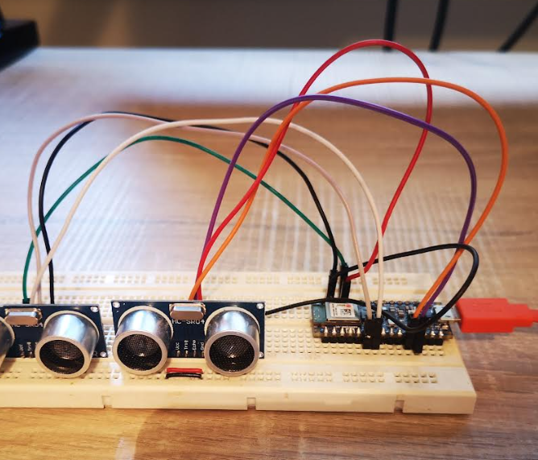
Data Collection
Data was collected using an Arduino Development Kit and two ultrasonic sensors,
Code development for data collection was carried out using the Arduino IDE
Objects were placed in the centre of a hallway
Data was collected from each grid location of a 3-by-3 grid
5/13
Notes:
Data was collected using an Arduino dev kit, and two ultrasonic sensors.
I looked at several potential sensors, including sensors such as LiDAR, but given the parameters, I was working with, the ultrasonic sensors were the ideal option.
The code used in the Arduino was developed within the Arduino IDE. The Arduino language is a variant of C++, with some functions, methods and libraries that can be used and imported
Several large object were selected for the data collection, specifically a large bin, a storage box, a display stand and a closed door – obstacles that you might find in a hallway in an office say.
Data was collected from a 3 by 3 grid for the purposes of localisation. The object was placed in the centre, seen here in the red, and the data collection system was moved from grid to grid, with data called from two ultrasonic sensors, or two channels

Slide 6
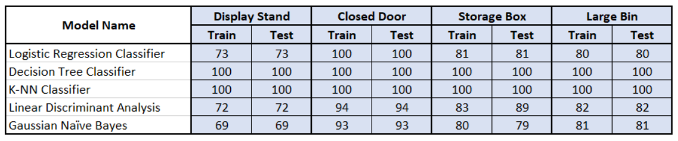
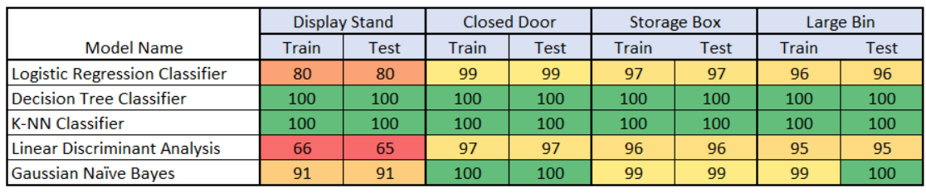
Machine Learning Analysis
This analysis aims to answer the question: Can we use machine learning techniques to classify the data?
Data processed through a number of classification algorithms for a “binary search”, and a “grid search”
Binary Search
Results
Grid Search
Results
6/13
Notes:
Once I had my dataset, the next phase was the analysis.
The question I wanted to answer was can standard machine learning techniques be used to classify the data.
I started off by investigating if machine learning could be used to detect an object at all. This is the “Binary Search”
The results here are the percentage accuracy values, and we can see that generally the accuracy is quite good. In particular he DT and KNN accuracy results are very good, at 100%
After that, I wanted to understand the accuracy of classifying the data for each grid. This is shown in the grid search results, and again we can see that the DT and KNN were showing accuracy of 100%

Slide 7
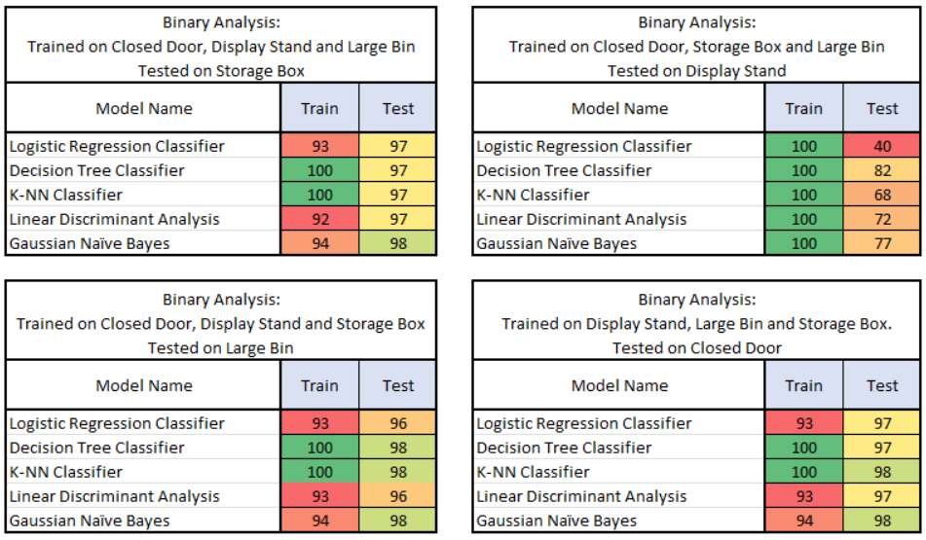
Machine Learning Analysis
With the Decision Tree and K-Nearest Neighbour showing 100% accuracy, further investigation of these results was carried out
7/13
Notes:
I am always a bit weary when things are too good. So, I wanted to investigate the 100 % accuracy score a bit further
To do this I trained the algorithms in three of the data sets, leaving 1 dataset out. This 1 dataset would then be used to test the model. This meant that models would never have “seen” this data.
This dataset left out was rotated, so one dataset was left out once.
As before, I ran the data to see if an object could be detected at all, that’s the binary search, and we can see that the accuracy results during training are 100% for the DT and KNN algorithms.
During the test phase, we can see that there is generally, a slight reduction in the accuracy scores.

Slide 8
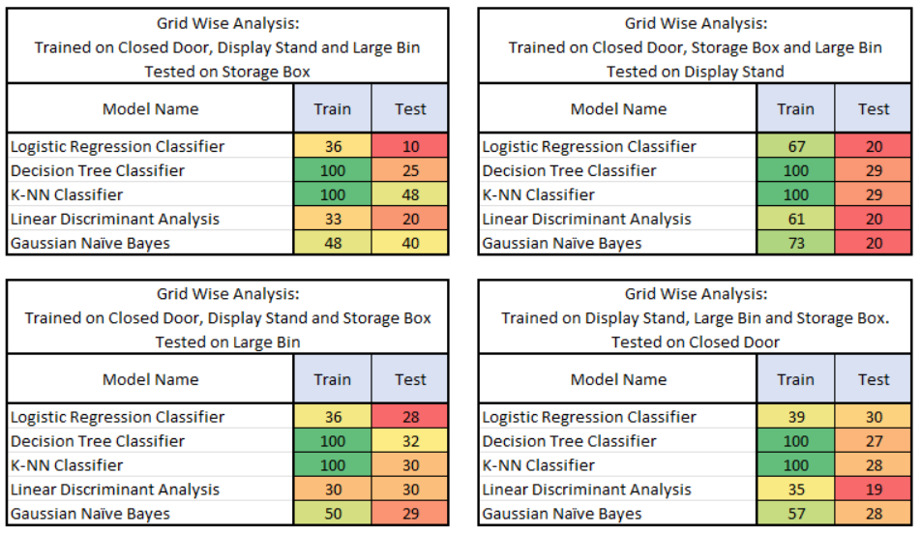
Machine Learning Analysis
Passing unseen data to the algorithms for the test phase produced lower accuracy scores
8/13
Notes:
The same was done for the grid analysis, and we can see an even bigger reduction in the accuracy scores during the testing phase.
So, this analysis shows that what you might call standard classification algorithms have good accuracy scores when trying to determine if there is an object present or not, but they struggle when trying to detect an object from the grid data
So, a new approach, neural networks were investigated

Slide 9
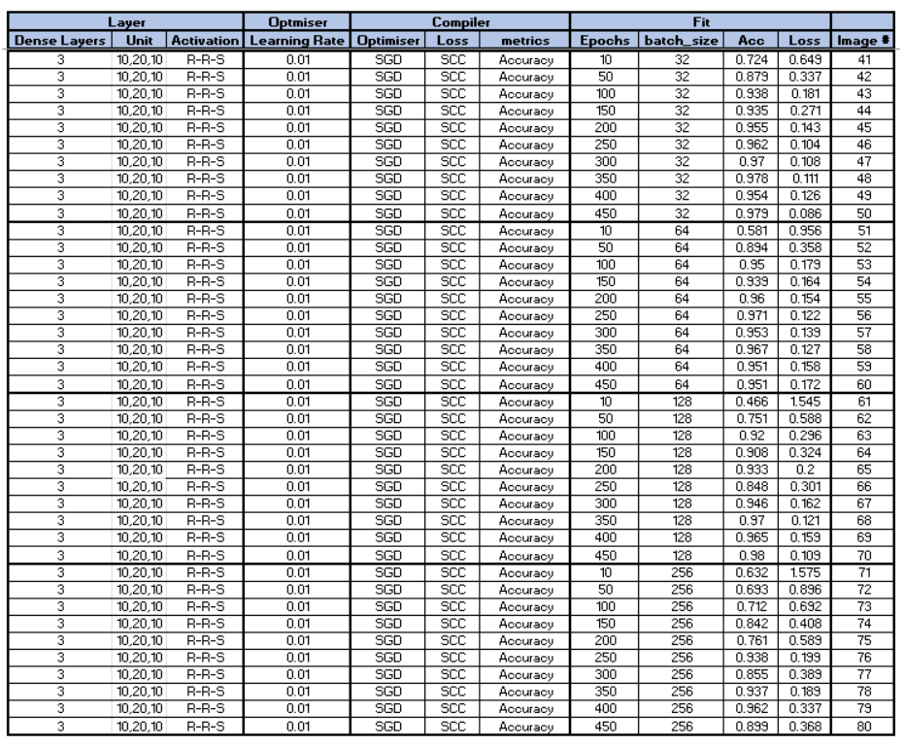
Neural Networks Analysis
Neural networks built using the Keras framework from TensorFlow
Hyperparameters of a Dense network were tuned for the best Accuracy and Loss results
Number of layers and neurons
Learning rate
Batch size
Epochs
Optimisers
9/13
Notes:
I used the Keras framework from TensorFlow to build a dense neural network.
I varied the hyperparameters of the network to try and find the best accuracy and loss scores, and the image on the left here is just to give an idea of that process.
The parameters I varied were the number of layers and the number of neurons, the learning late, the batch size, epochs and the optimisers
A series of experiments were done, and all the results were logged in tables like this

Slide 10
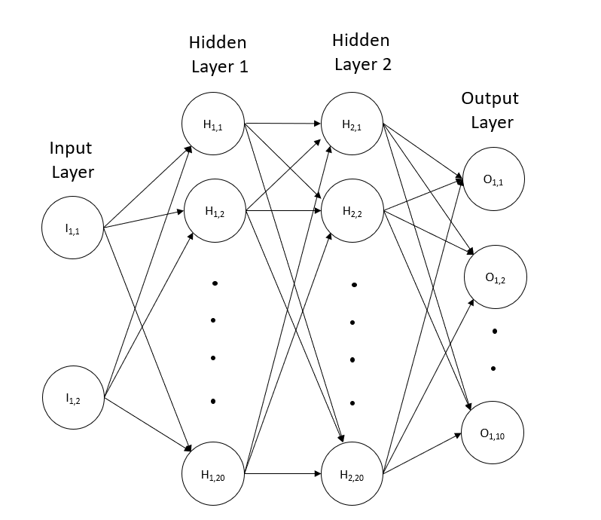

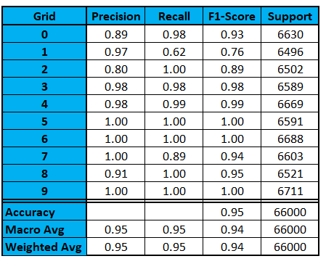
Neural Networks Analysis
10/13
Notes:
After these experiments I found that a dense network consisting of 4 layers, with 2 neurons on the input layer to represent the two channels of data, 20 neurons each on the hidden layers and 10 neurons on the output layer, to replresent the 10 potential outcomes – the 9 grid positions plus no obstacles
We can see from the scores here, particularly the f1 score, that the model preforms very well with an accuracy of 95%

Slide 11
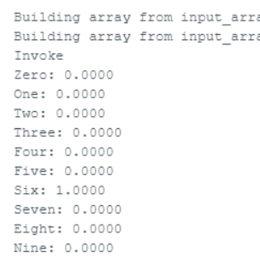
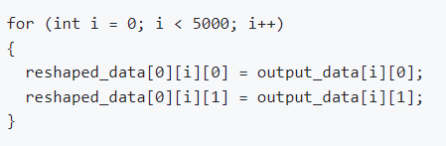
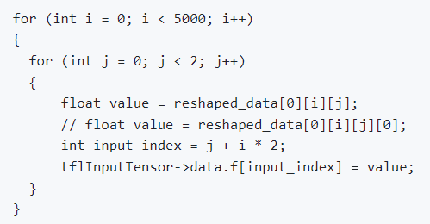
Deployment onto a Constrained Device
Neural network model was converted to a header file using TensorFlow
This header file can be imported into the microcontroller to be used with TensorFlow Lite
Initial tests did not produce an output from the inference
Investigations pointed towards the shape of the data being given to the input tensor was wrong
Code was modified to change the shape of the data being fed into the input tensor
The system started to produce results, but it was always for the same grid number no matter the data passed into the system
11/13
Notes:
So now we move into the final phase – deploying the model onto a constrained device
The first step to deploying the model was to convert it to a header file, or a .h file which can be done within TensorFlow
Next, the header file can be imported into the microcontroller to be used with TensorFlow Lite.
With this all completed, I carried out some tests, going back to the same objects and grid system, but I didn’t get any output from the inference.
Investigations and research pointed towards the possibility that the shape of the data being passed for inference was wrong.
This was investigated further to understand what the shape should be, and the code was modified to take this shape into account.
I also modified the code to strip it back to as simple a system as possible, so I put data used for training the models into two separate header files which could be imported and passed into the input tensor for inference
The system started to produce results, but it also retuned the same grid number, or series of grid numbers no matter what data was passed to it.

Slide 12
Conclusions and Future Work
A large dataset was created by gathering ultrasonic distance data from a number of obstacles using a grid system
Initial analysis indicated that detecting obstacles was possible, but standard machine learning techniques alone were not sufficient
Initial development of neural network proved promising with good accuracy scores
Deploying the model onto the constrained device generated several challenges, which have not been fully overcome
If these challenges could be overcome, this work has shown the potential to develop a system which could be used by people with visual impairments to navigate an unfamiliar indoor environment
To confirm this, further development of the neural network would need to be carried out by repeating the processing of passing unseen data to the network to fully understand the performance
12/13
Notes:
So, to review:
A large dataset was created by gathering ultrasonic distance data from a number of obstacles using a grid system
Initial analysis indicated that detecting obstacles was possible, but standard machine learning techniques alone were not sufficient
Initial development of neural network proved promising with good accuracy scores
Deploying the model onto the constrained device generated several challenges, which have not been fully overcome
If these challenges could be overcome, this work has shown the potential to develop a system which could be used by people with visual impairments to navigate an unfamiliar indoor environment
To confirm this, further development of the neural network would need to be carried out by repeating the processing of passing unseen or hold out data to the network to fully understand the performance

Slide 13
Questions?
13/13

Slide 14
Backup

Slide 15
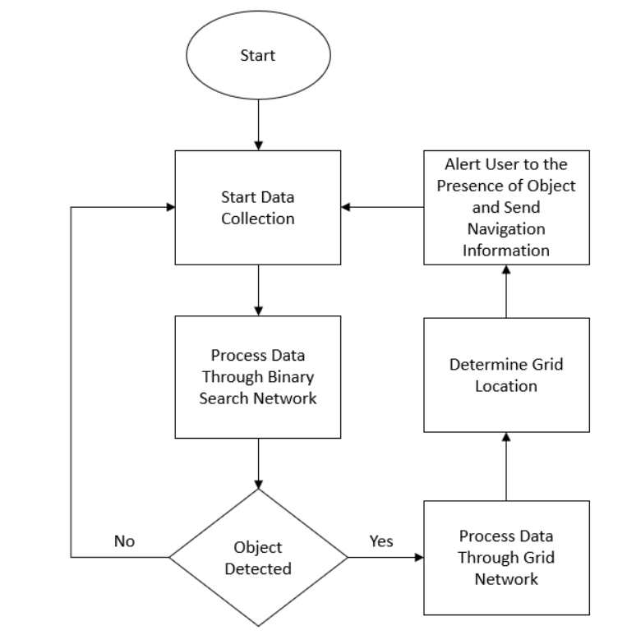
Proposed System Algorithm

