Slide 1





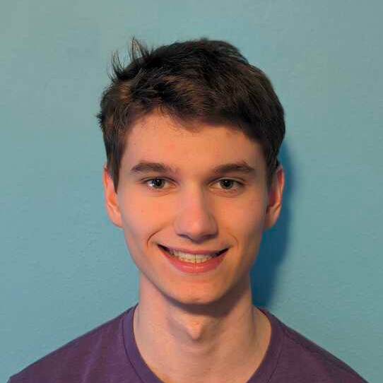






Efficient Extraction from Effectful E-Graphs
Oliver Flatt, Anjali Pal, Yihong Zhang, Ryan Tjoa, Kirsten Graham, Alex Fischman,
Chandrakana Nandi, Eli Rosenthal, Zachary Tatlock, Haobin Ni

Slide 2
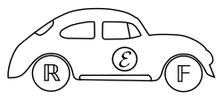



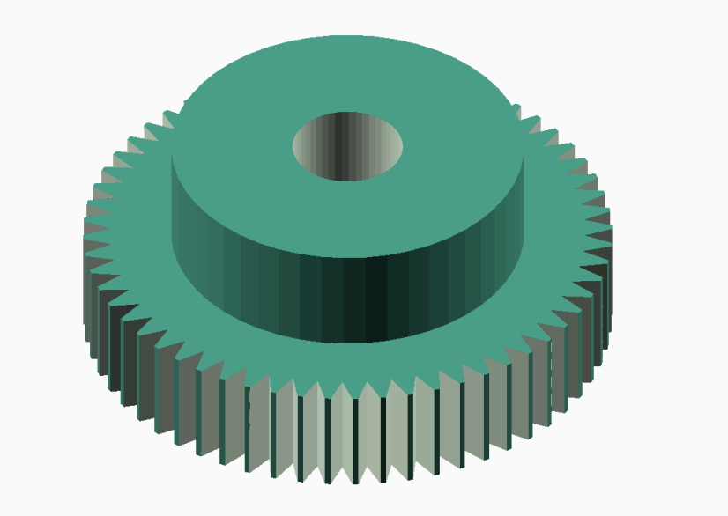


E-Graphs are Super Useful!
Floating point
Python Simulations
ML Kernels
RTL Optimization
(Herbie)
(Luminal)
SQL
CAD
WASM
…and more!
(Szalinski)
(Cranelift)

Slide 3
Equivalence Graph (E-Graph)
Input term: (a + 1) - 1

Slide 4
Equivalence Graph (E-Graph)
Input term: (a + 1) - 1
−
+
a
1

Slide 5
Equivalence Graph (E-Graph)
Input term: (a + 1) - 1
−
(α + β) − γ ⇝ α + (β − γ)
+
a
1

Slide 6
Equivalence Graph (E-Graph)
Input term: (a + 1) - 1
−
+
(α + β) − γ ⇝ α + (β − γ)
+
−
a
1

Slide 7
Equivalence Graph (E-Graph)
Input term: (a + 1) - 1
−
+
(α + β) − γ ⇝ α + (β − γ)
+
−
0
α − α ⇝ 0
a
1

Slide 8
Equivalence Graph (E-Graph)
Input term: (a + 1) - 1
−
+
(α + β) − γ ⇝ α + (β − γ)
+
−
0
α − α ⇝ 0
α + 0 ⇝ α
a
1

Slide 9
Equivalence Graph (E-Graph)
Input term: (a + 1) - 1
−
+
+
−
0
a
1

Slide 10
Equivalence Graph (E-Graph)
Input term: (a + 1) - 1
Output term: a
−
+
+
−
0
a
1

Slide 11
Equivalence Graph (E-Graph)
Extraction Problem
Input term: (a + 1) - 1
Output term: a
−
+
+
−
0
a
1

Slide 12
E-Graphs are Super Useful!
Floating point
Python Simulations
ML Kernels
RTL Optimization
None handle side-effects!
(Herbie)
(Luminal)
SQL
CAD
WASM
…and more!
(Szalinski)
(Cranelift)

Slide 13
Effect-safe Extraction
Input program: v1 = load a
print (v1 + 10)

Slide 14
Effect-safe Extraction
Input program: v1 = load a
print (v1 + 10)
print
+
σ1
v1
10
load
σ
a

Slide 15
Effect-safe Extraction
Input program: v1 = load a
print (v1 + 10)
print
+
v2
σ1
v1
10
load
σ
a

Slide 16
Effect-safe Extraction
Input program: v1 = load a
print (v1 + 10)
print
+
v2
σ1
v1
10
load
σ
a
Surprisingly, Effect-safe Extraction is NP-Hard!!

Slide 17
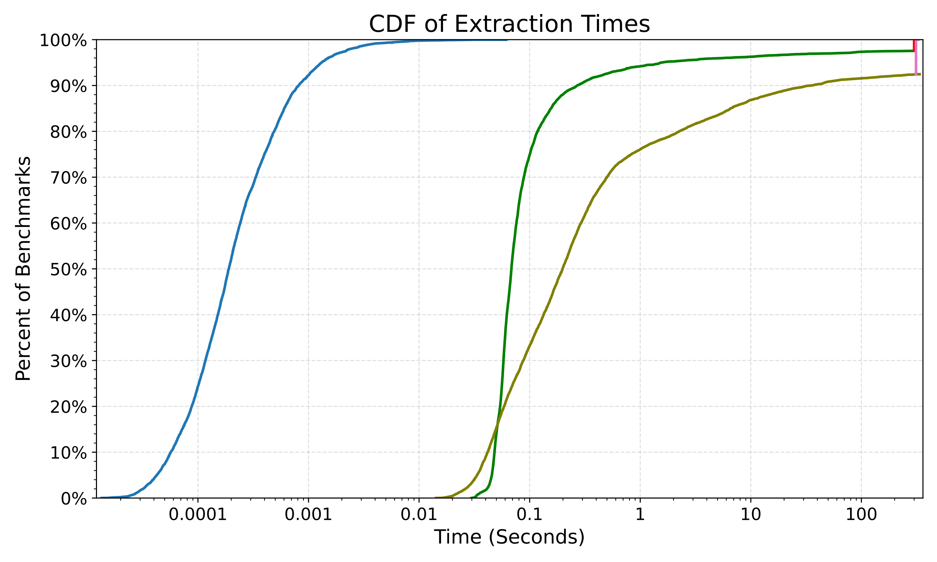
Fast Effect-safe Extraction in Practice
Solver Timeouts
Solver-Based Techniques
Extraction is fast
Our Approach
Log scale

Slide 18
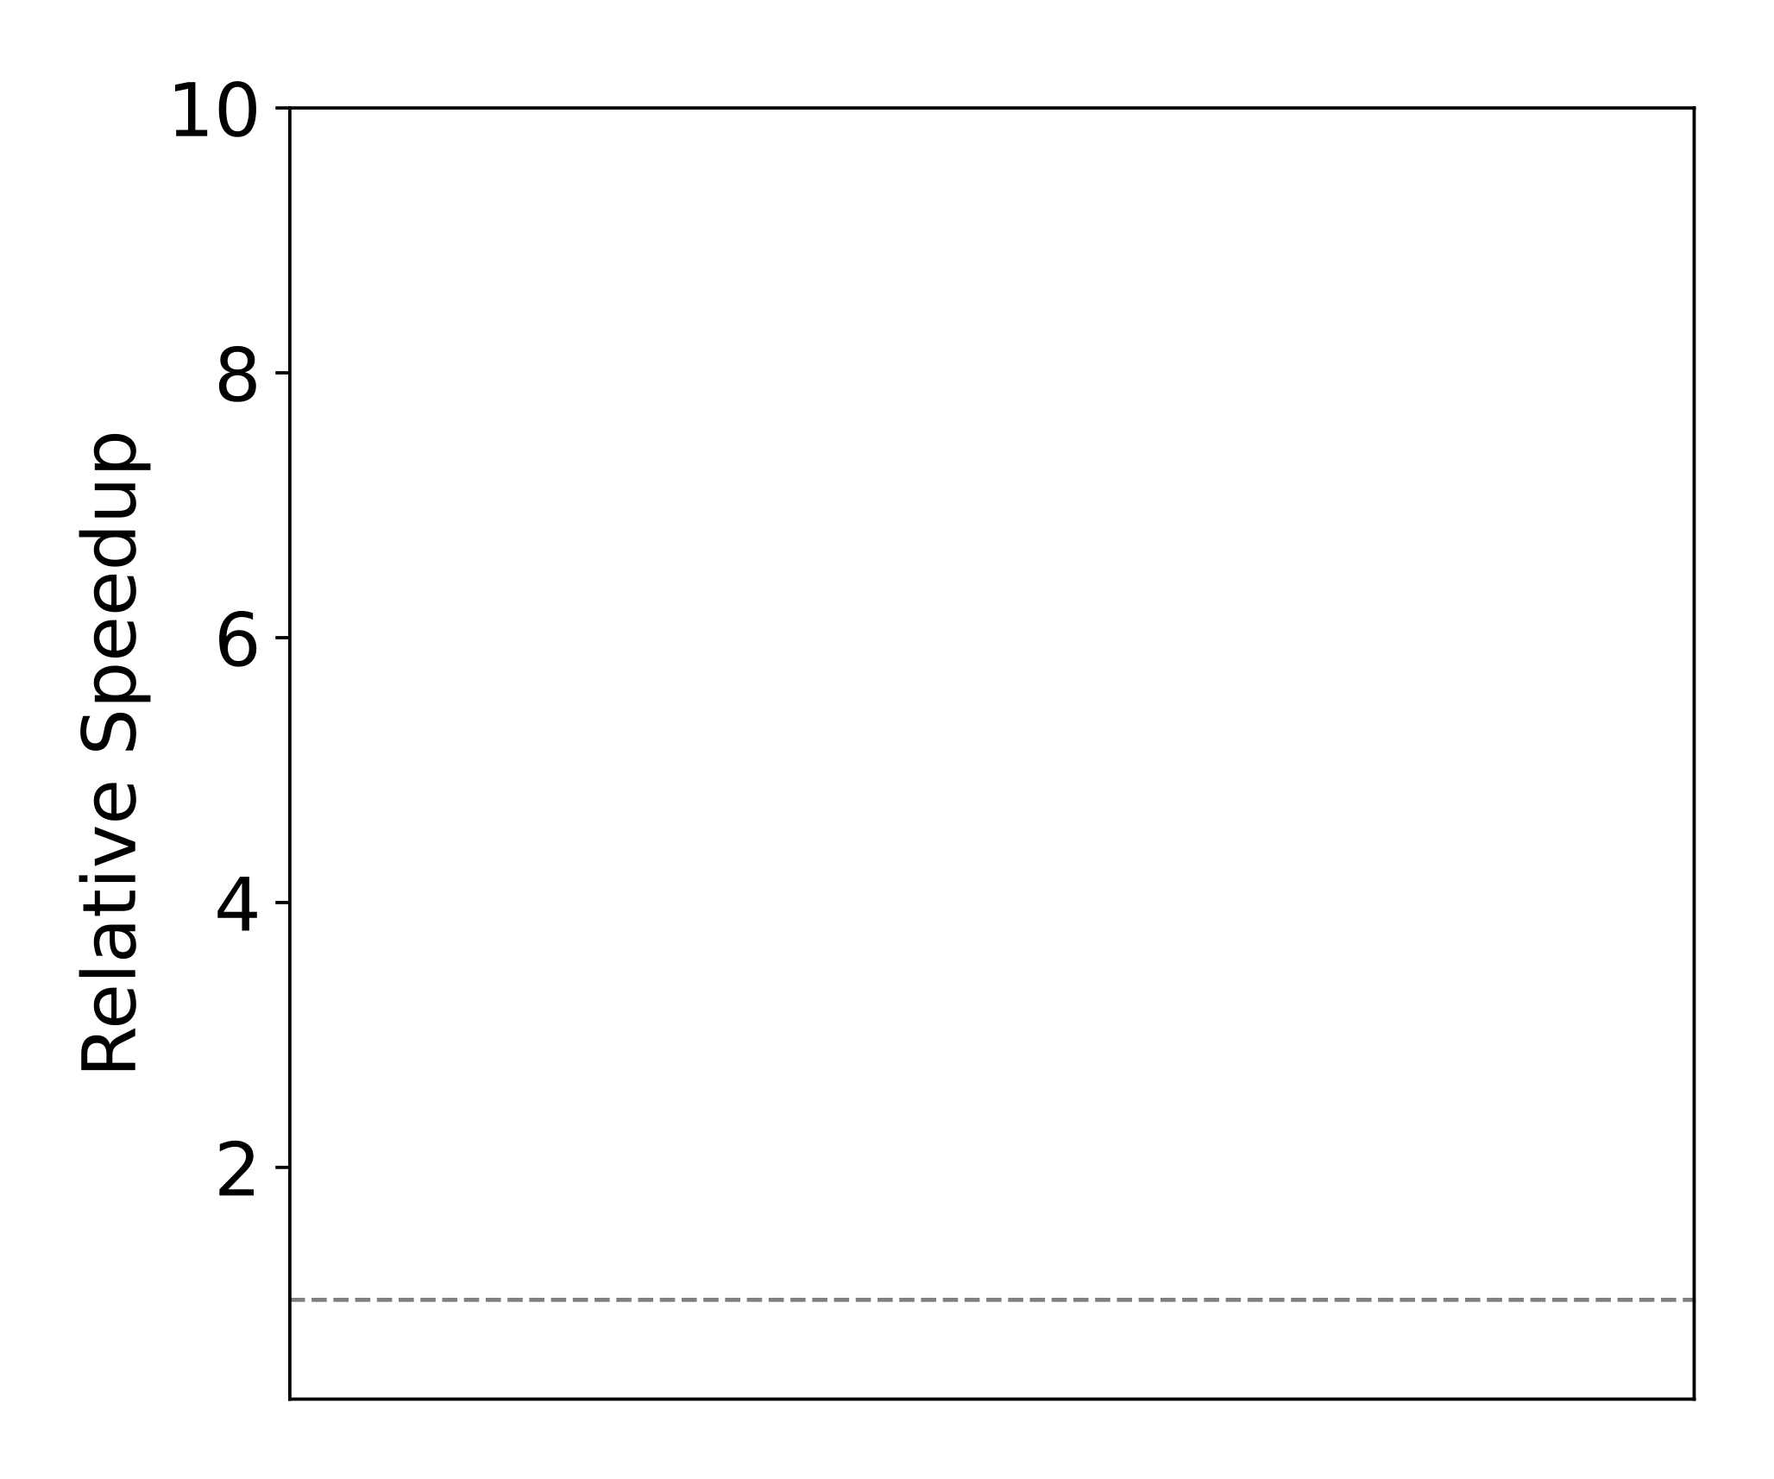
Fast Effect-safe Extraction in Practice
LLVM-O0-O0
Polybench Benchmark Suite

Slide 19
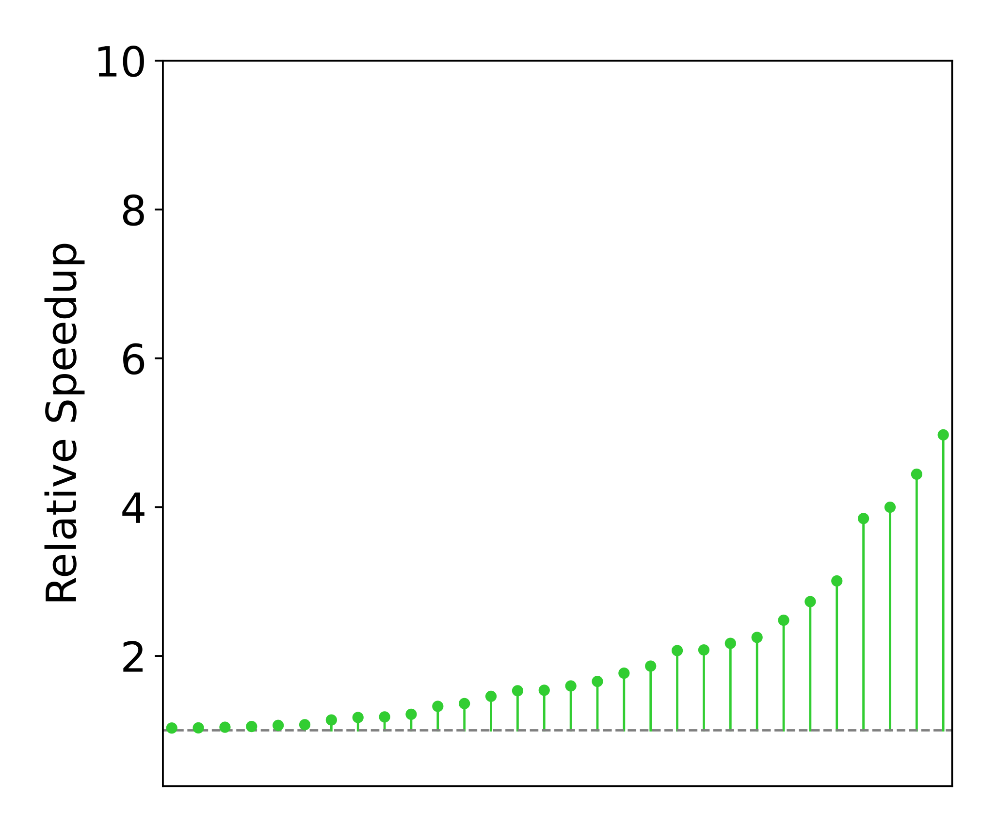
Fast Effect-safe Extraction in Practice
eggcc
LLVM-O0-O0
Polybench Benchmark Suite

Slide 20
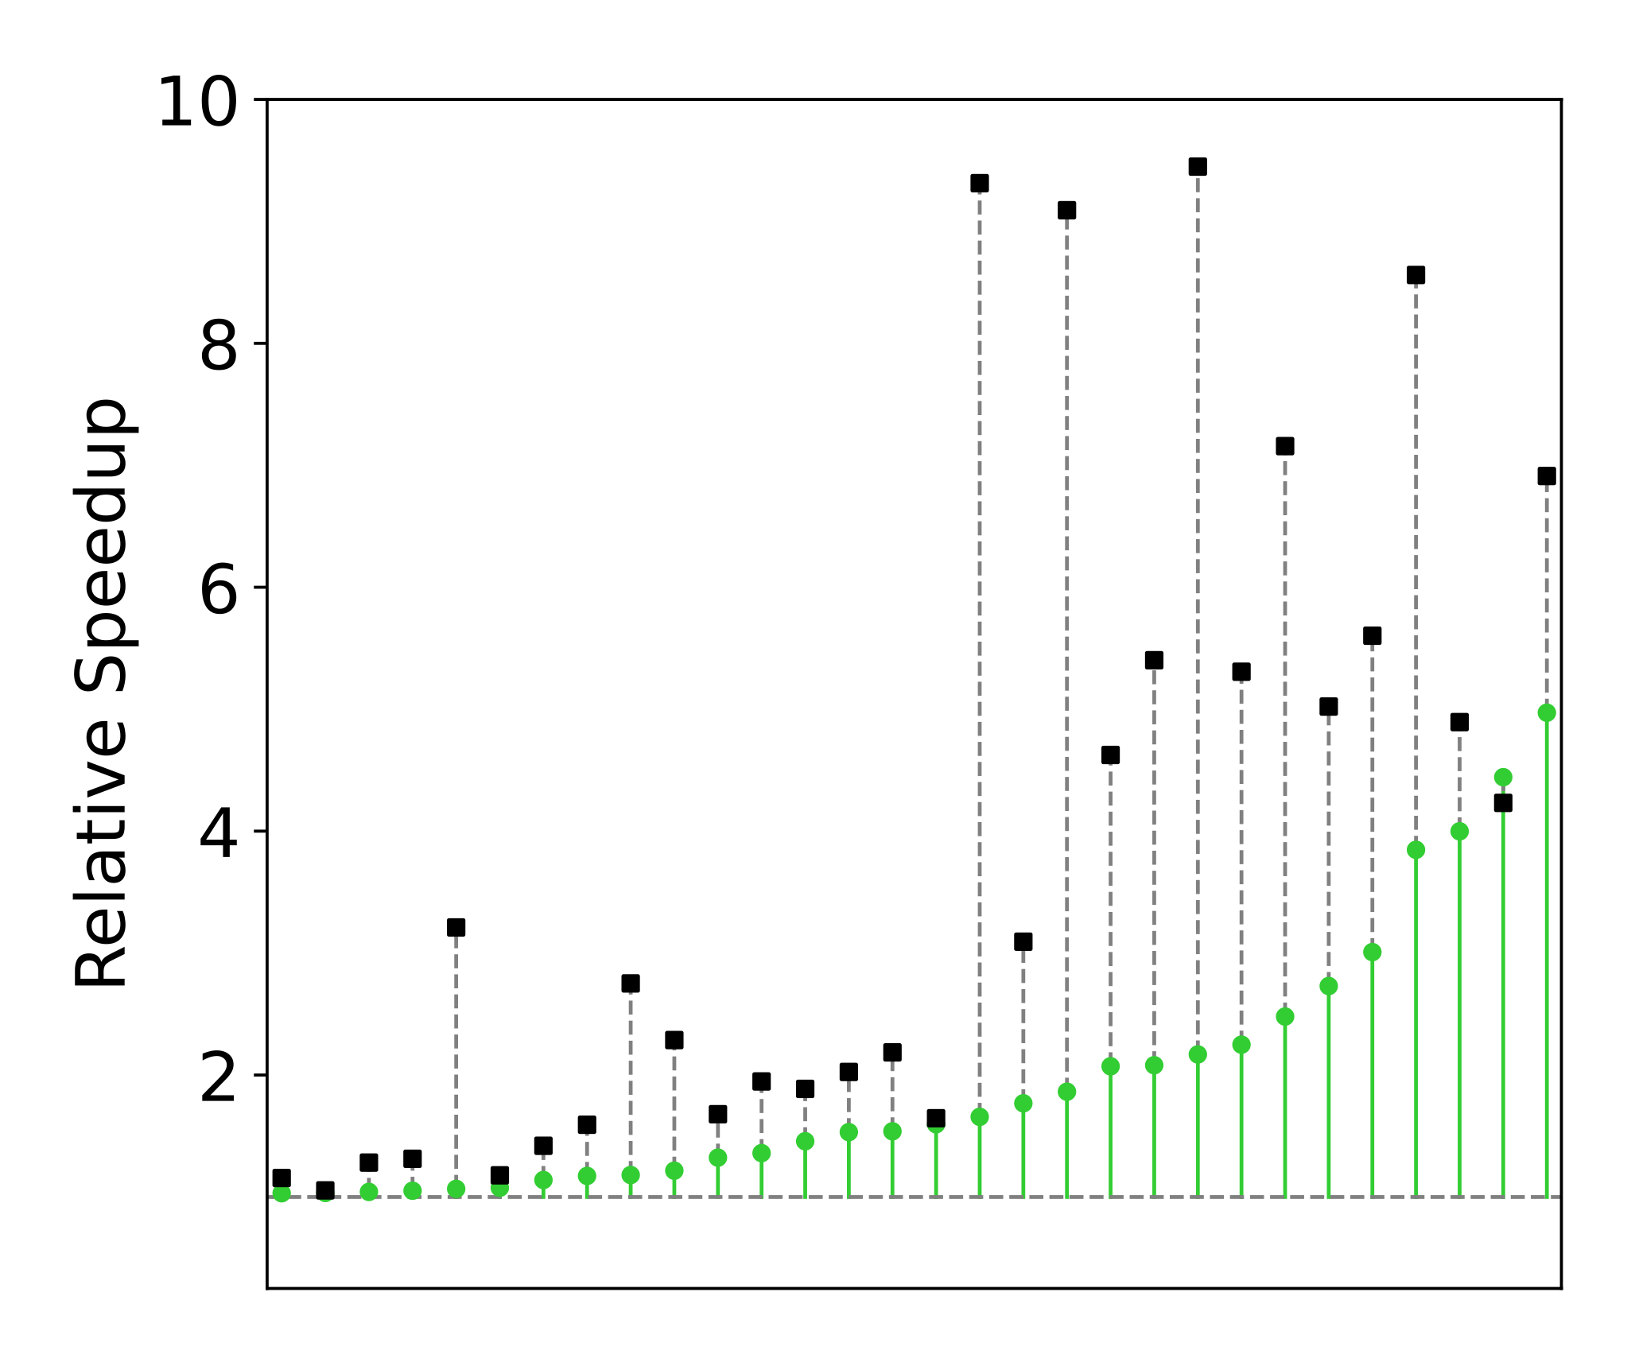
Fast Effect-safe Extraction in Practice
LLVM-O3-O0
eggcc
LLVM-O0-O0
Polybench Benchmark Suite

Slide 21
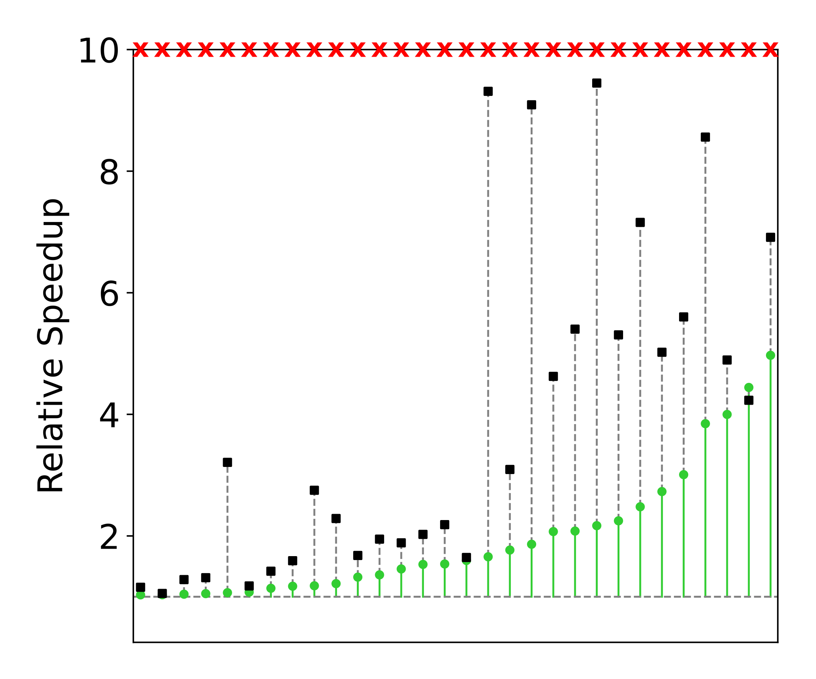
Fast Effect-safe Extraction in Practice
Solver Approaches
LLVM-O3-O0
Non-trivial
e-graphs!
eggcc
LLVM-O0-O0
Polybench Benchmark Suite

