Slide 1












Efficient Extraction from Effectful E-Graphs
Oliver Flatt, Anjali Pal, Yihong Zhang, Ryan Tjoa, Kirsten Graham, Alex Fischman,
Chandrakana Nandi, Eli Rosenthal, Zachary Tatlock, Haobin Ni

Slide 2
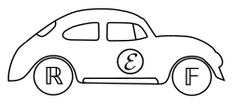




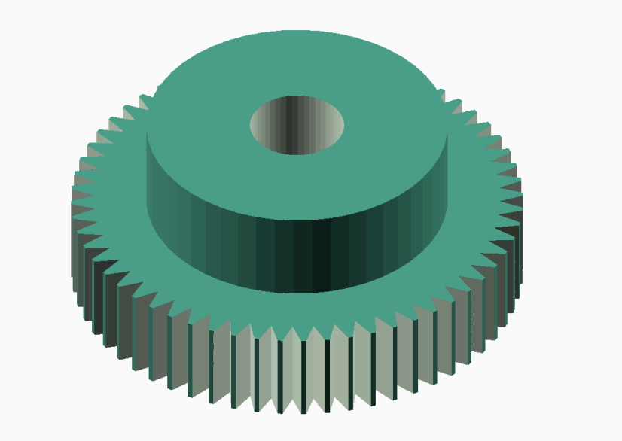


E-Graphs are Super Useful!
ML Kernels
Floating point
Python Simulations
RTL Optimization
Luminal
SQL
WASM
User DSL Optimizations
CAD
…and more!

Slide 3
E-Graphs Explore a Big Space
Input term:
(a + 1) - 1

Slide 4
E-Graphs Explore a Big Space
Input term:
(a + 1) - 1
Rules:
(α + β) − γ ⇝ α + (β − γ)
α − α ⇝ 0
α + 0 ⇝ α

Slide 5
E-Graphs Explore a Big Space
Input term:
(a + 1) - 1
Rules:
(α + β) − γ ⇝ α + (β − γ)
α − α ⇝ 0
−
α + 0 ⇝ α
+
a
1

Slide 6
E-Graphs Explore a Big Space
Input term:
(a + 1) - 1
Rules:
(α + β) − γ ⇝ α + (β − γ)
α − α ⇝ 0
−
+
α + 0 ⇝ α
+
−
a
1

Slide 7
E-Graphs Explore a Big Space
Input term:
(a + 1) - 1
Rules:
(α + β) − γ ⇝ α + (β − γ)
α − α ⇝ 0
−
+
α + 0 ⇝ α
+
−
0
a
1

Slide 8
E-Graphs Explore a Big Space
Input term:
(a + 1) - 1
Rules:
(α + β) − γ ⇝ α + (β − γ)
α − α ⇝ 0
−
+
α + 0 ⇝ α
+
−
0
a
1

Slide 9
E-Graphs Explore a Big Space
Input term:
(a + 1) - 1
Rules:
(α + β) − γ ⇝ α + (β − γ)
α − α ⇝ 0
−
+
α + 0 ⇝ α
+
−
0
a
1

Slide 10
E-Graphs Explore a Big Space
extract a resulting term (todo turn into bubble)
Input term:
(a + 1) - 1
Rules:
(α + β) − γ ⇝ α + (β − γ)
α − α ⇝ 0
−
+
α + 0 ⇝ α
+
−
0
a
1

Slide 11
E-Graphs are Super Useful!
Floating point
Python Simulations
ML Kernels
None handle side-effects!
RTL Optimization
(Herbie)
(Luminal)
SQL
CAD
TODO point at luminal, numba, wasm, and mlir with a bubble for “need side effects!”
WASM
…and more!
(Szalinski)
(Cranelift)

Slide 12
Update
Rewriting
E-Graphs
Extraction
Effectful E-Graphs
Effectful Extraction

Slide 13
Update
Rewriting
E-Graphs
Extraction
Effectful E-Graphs
Effectful Extraction
v1 = update(a, x)
v2 = update(a, x)
v3 = update(b, y)
v4 = update(c, v2)

Slide 14
Update
Rewriting
E-Graphs
Extraction
Effectful E-Graphs
Effectful Extraction
v1 = update(a, x)
v2 = update(a, x)
v3 = update(b, y)
v4 = update(c, v2)
Write v to address a, return previous value at a

Slide 15
Redundant Update Elimination
Rewriting
E-Graphs
Extraction
Effectful E-Graphs
Effectful Extraction
x = update(a, v)
y = update(a, v)
update is idempotent
y
σʹʹ
update
x
σʹ
update
a
v
σ

Slide 16
Redundant Update Elimination
Rewriting
E-Graphs
Extraction
Effectful E-Graphs
Effectful Extraction
x = update(a, v)
y = update(a, v)
update is idempotent
y
σʹʹ
update
x
σʹ
update
a
v
σ

Slide 17
Redundant Update Elimination
Rewriting
E-Graphs
Extraction
Effectful E-Graphs
Effectful Extraction
x = update(a, v)
y=v
update is idempotent
y
σʹʹ
update
x
σʹ
Is this optimization safe?
update
a
v
σ

Slide 18
Redundant Update Elimination
Rewriting
E-Graphs
Extraction
Effectful E-Graphs
Effectful Extraction
(v1, σ1) = update(a, x)
(v2, σ2) = update(a, x)
(v3, σ3) = update(b, y)
(v4, σ4) = update(c, v2)

Slide 19
Redundant Update Elimination
Rewriting
E-Graphs
Extraction
Effectful E-Graphs
Effectful Extraction
(v1, σ1) = update(a, x)
(v2, σ2) = update(a, x)
(v3, σ3) = update(b, y)
(v4, σ4) = update(c, v2)
v1
σ1
update
a
x
σ

Slide 20
Redundant Update Elimination
Rewriting
E-Graphs
Extraction
Effectful E-Graphs
Effectful Extraction
(v1, σ1) = update(a, x)
(v2, σ2) = update(a, x)
(v3, σ3) = update(b, y)
(v4, σ4) = update(c, v2)
v2
σ2
update
v1
σ1
update
a
x
σ

Slide 21
Redundant Update Elimination
Rewriting
E-Graphs
Extraction
Effectful E-Graphs
Effectful Extraction
(v1, σ1) = update(a, x)
(v2, σ2) = update(a, x)
(v3, σ3) = update(b, y)
(v4, σ4) = update(c, v2)
v3
σ3
update
v2
σ2
update
v1
σ1
update
a
b
x
y
σ

Slide 22
Redundant Update Elimination
Rewriting
E-Graphs
Extraction
Effectful E-Graphs
Effectful Extraction
v4
σ4
update
(v1, σ1) = update(a, x)
(v2, σ2) = update(a, x)
(v3, σ3) = update(b, y)
(v4, σ4) = update(c, v2)
v3
σ3
update
v2
σ2
update
v1
σ1
update
a
b
c
x
y
σ

Slide 23
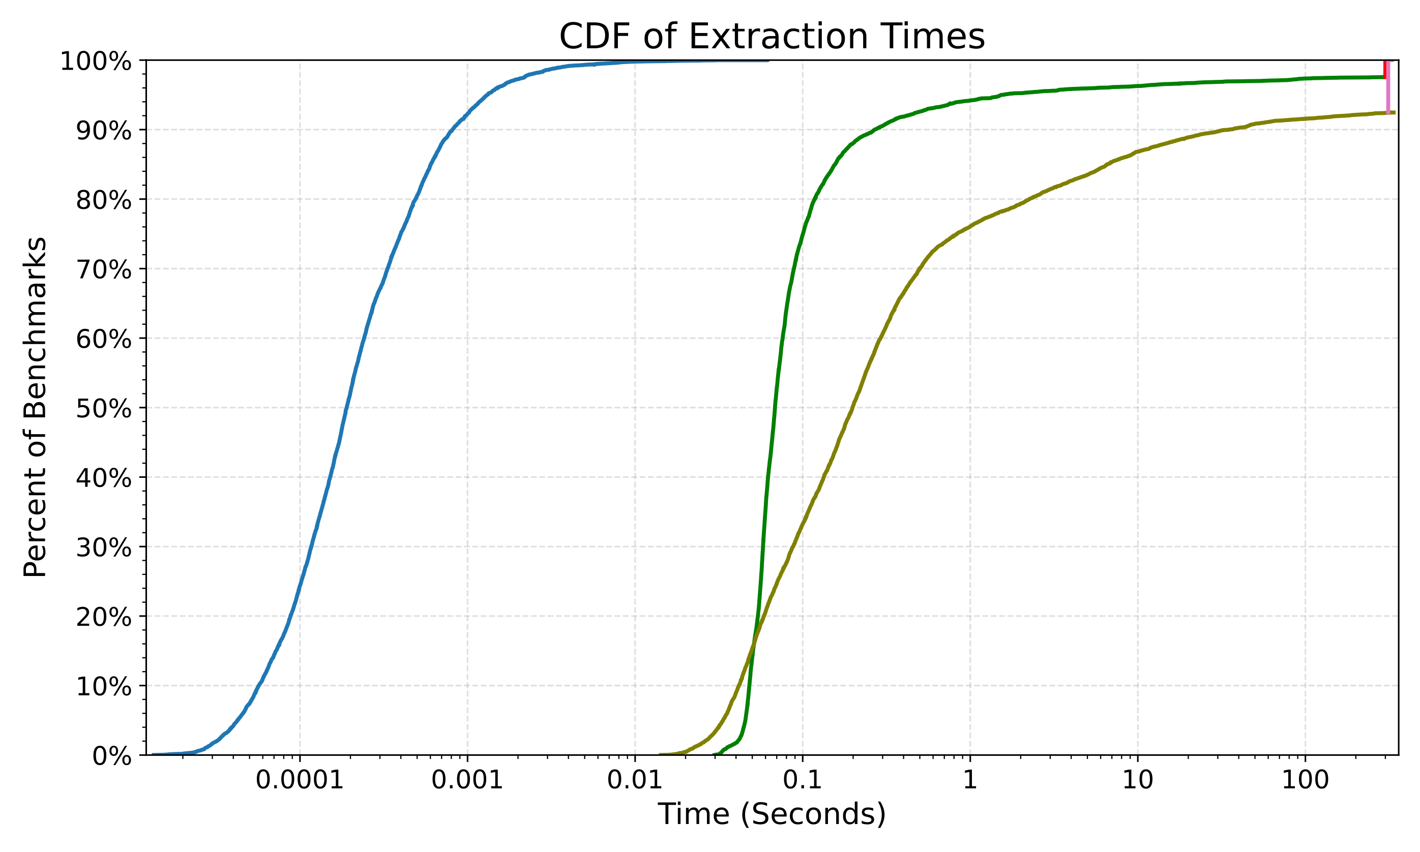
Fast Effect-safe Extraction in Practice
Solver Timeouts
Solver-Based Techniques
Our Approach
Extraction is fast
Log scale

Slide 24
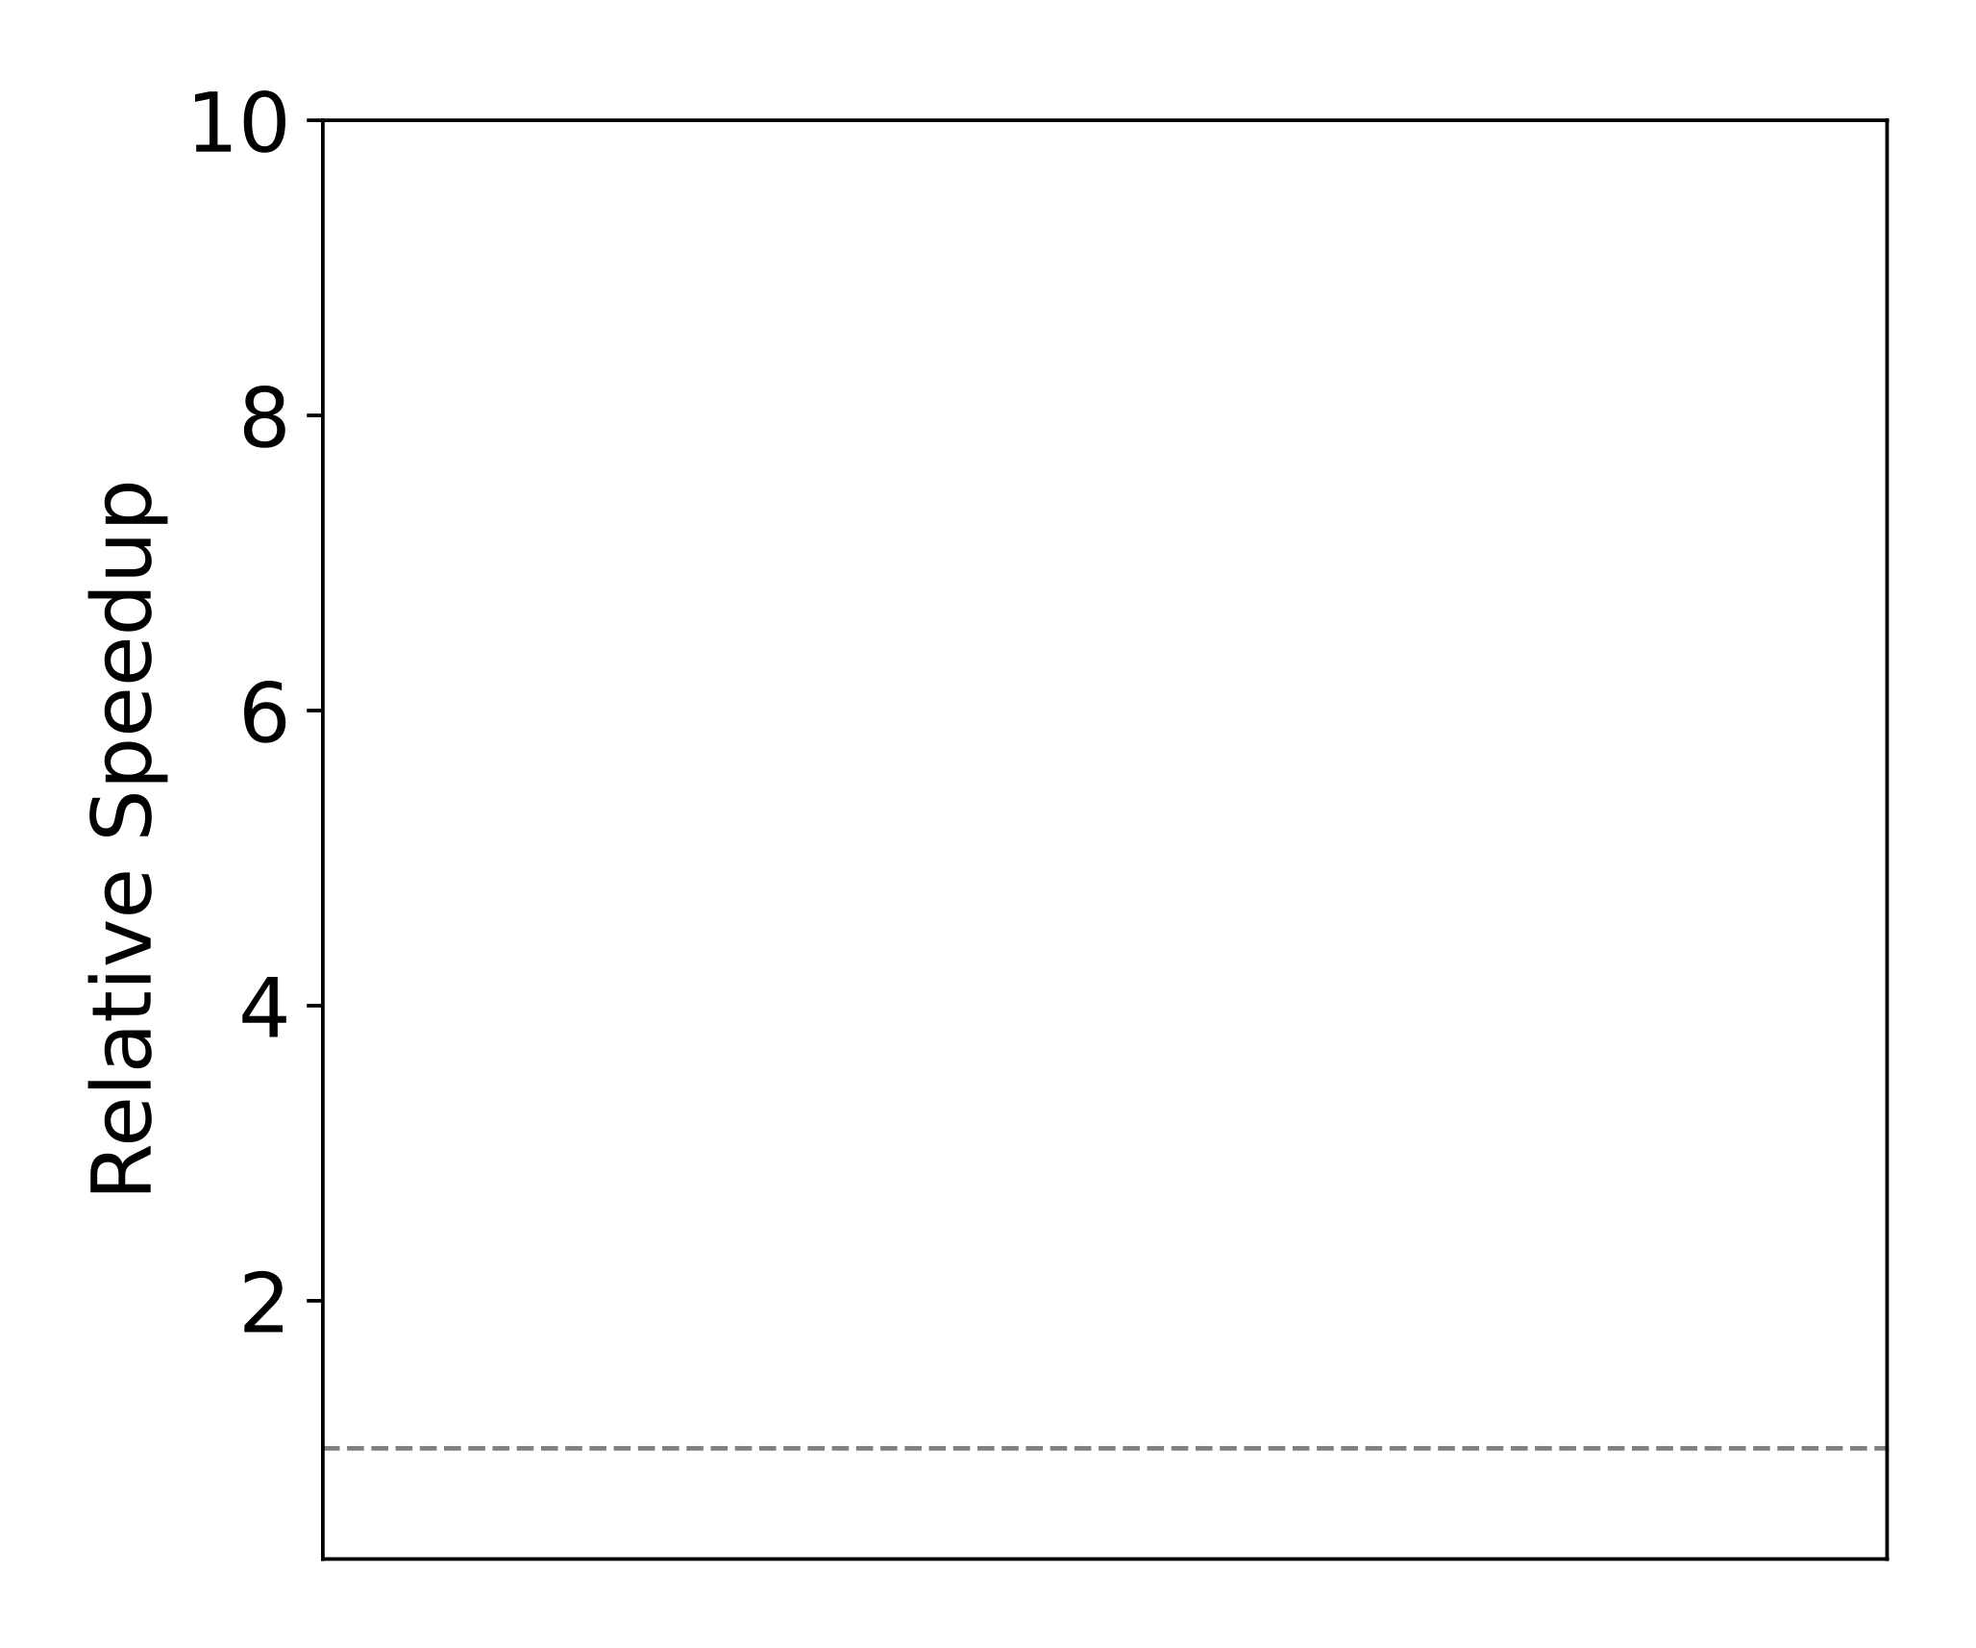
Fast Effect-safe Extraction in Practice
LLVM-O0-O0
Polybench Benchmark Suite

Slide 25
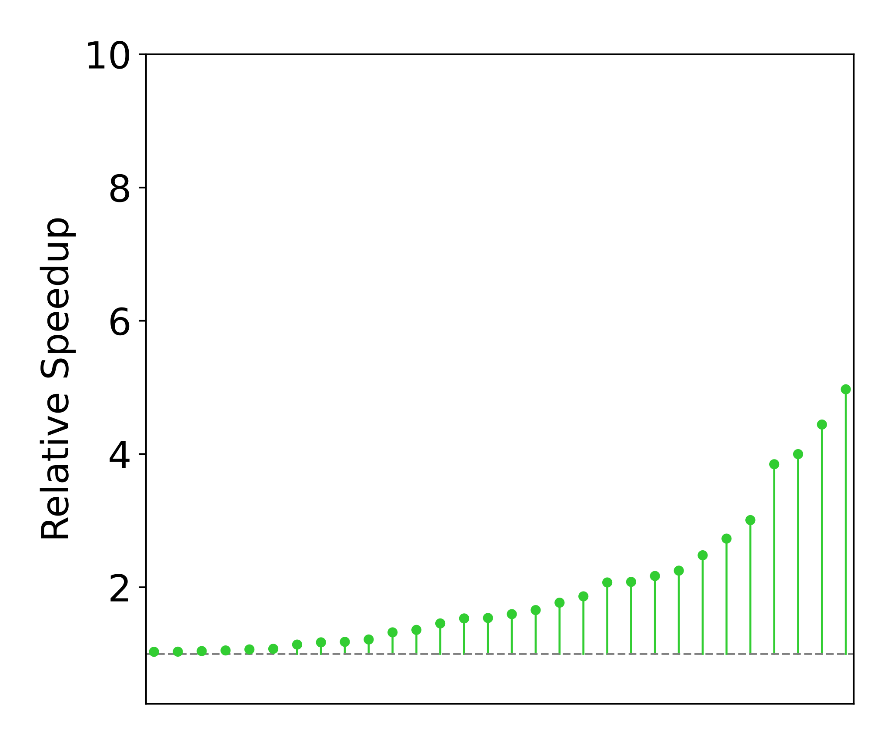
Fast Effect-safe Extraction in Practice
eggcc
LLVM-O0-O0
Polybench Benchmark Suite

Slide 26
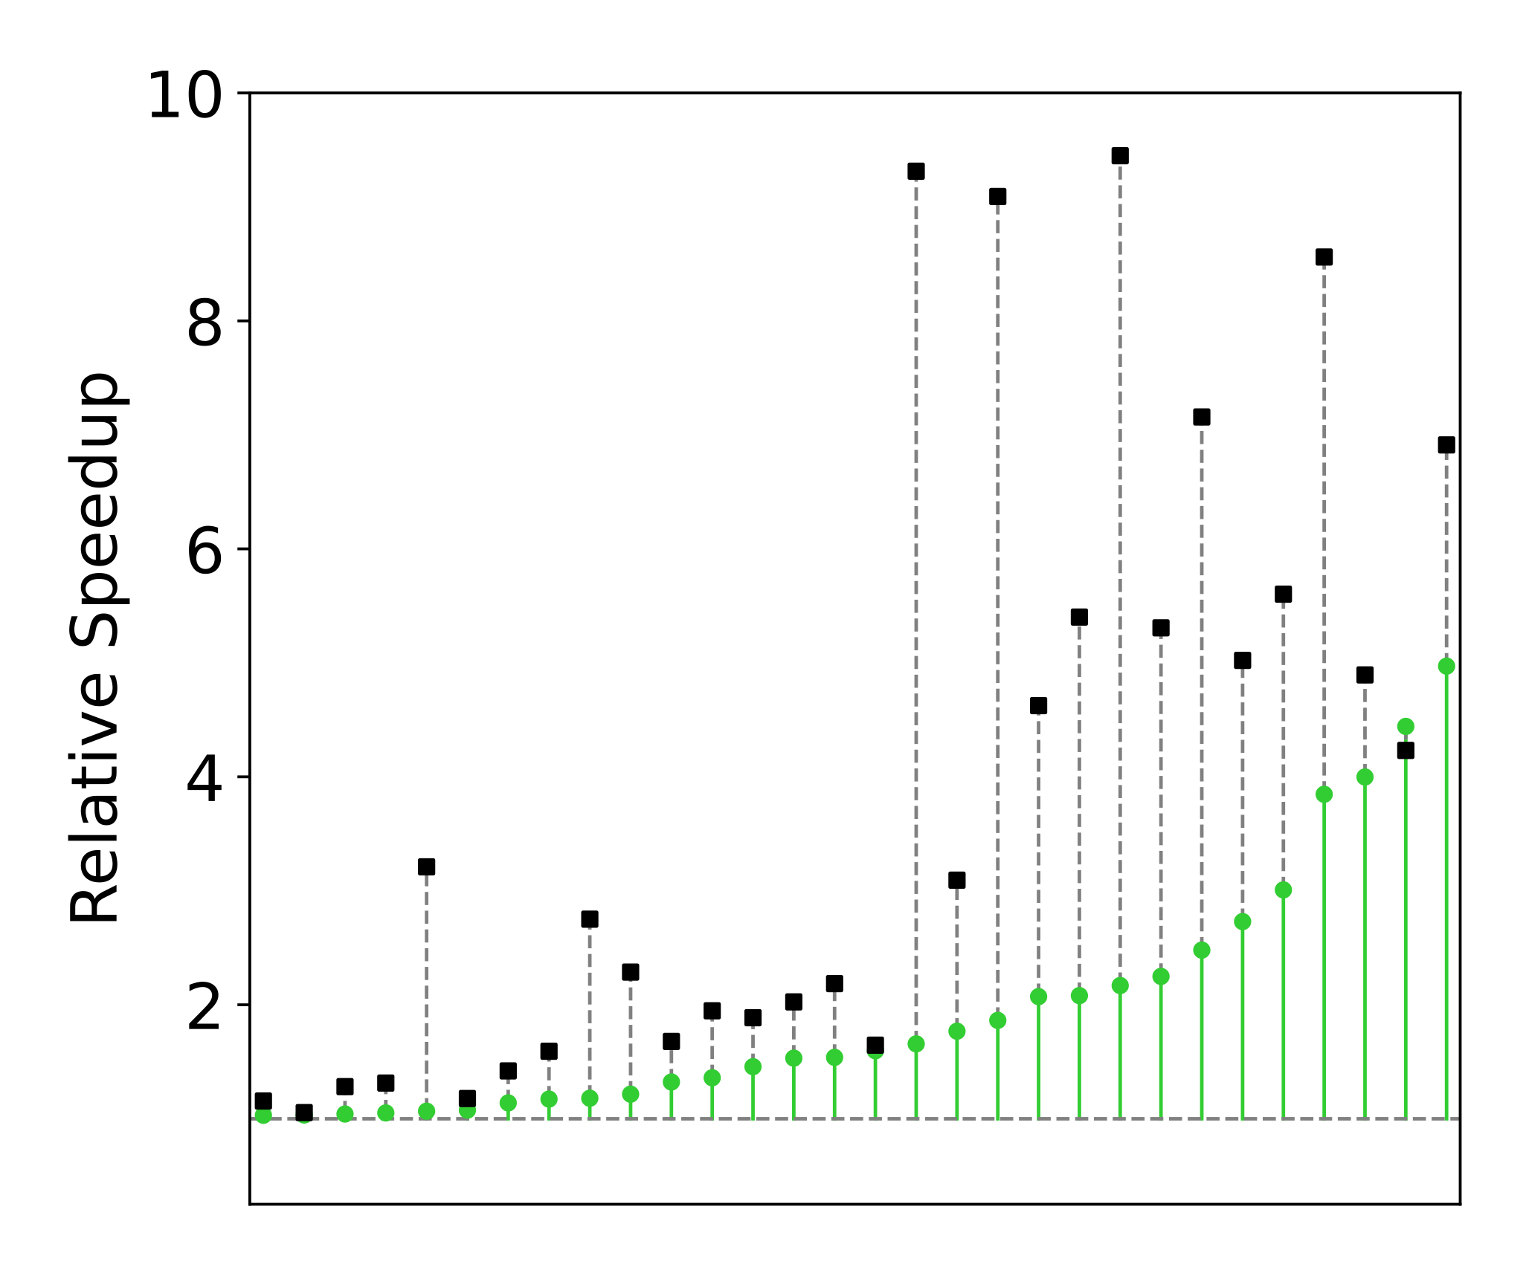
Fast Effect-safe Extraction in Practice
LLVM-O3-O0
eggcc
LLVM-O0-O0
Polybench Benchmark Suite

Slide 27
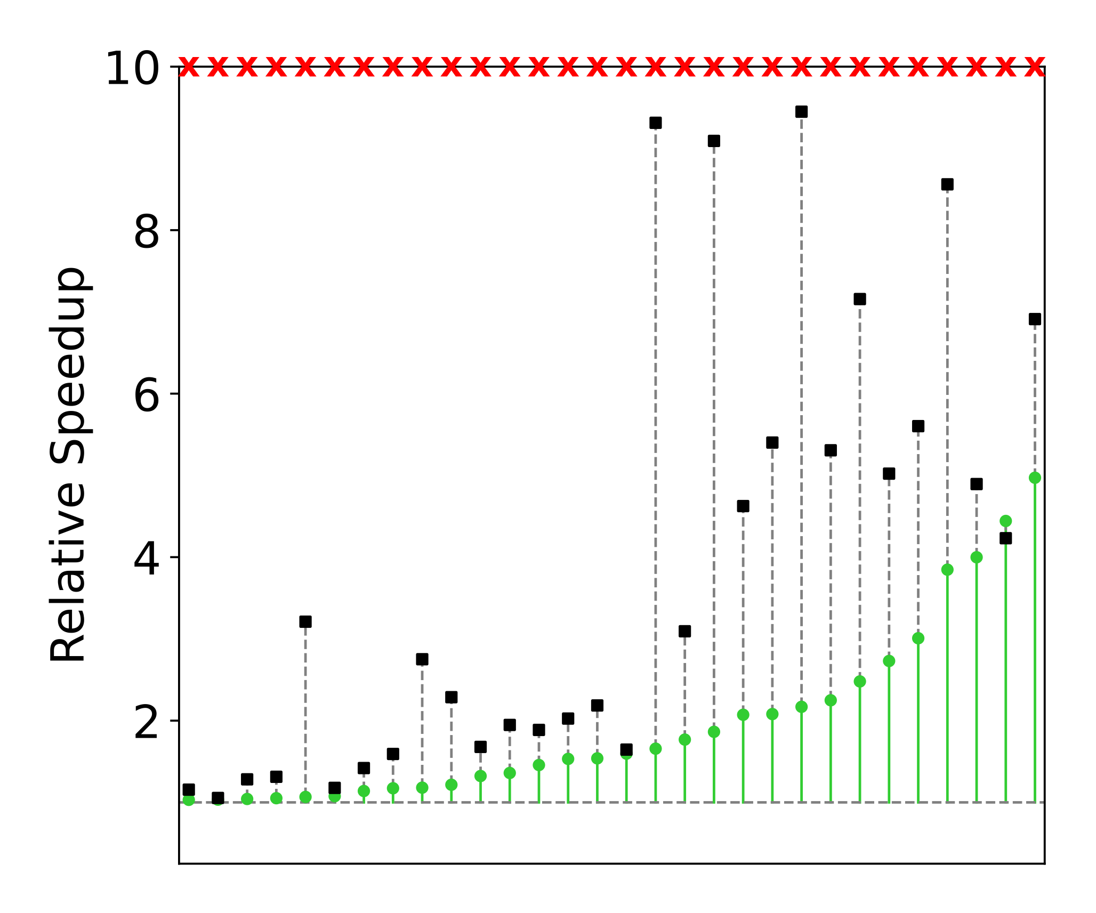
Fast Effect-safe Extraction in Practice
Solver Approaches
LLVM-O3-O0
Non-trivial
e-graphs!
eggcc
LLVM-O0-O0
Polybench Benchmark Suite

