Slide 1
OMS : Database structure

Slide 2
Old Architecture
New Architecture
DBOFM
DBOFM
Officemate
Officemate
DBOMS
New Serev
DBOMS

Slide 3
OMS : Migrate data
Customer
- Data master
Product
- Stock ?
- Printing
Sale transaction
- SO, QU,QX, DO
Other
- New master /Change

Slide 4
Customer
Old table | New Table
TBCustmaster | tbaccount_master
TBCustMaster | tbinvoice_address
TBCustmaster | tbcontact_master
TBCustContact
TBCustMaster | tbinvoice_address
TBCustShipping | tbshipping_master
TBCustContactEmail TBCustomerPhone | tbcontact_information
TBCustInformation | tbaccount_additional

Slide 5
Product

Slide 6
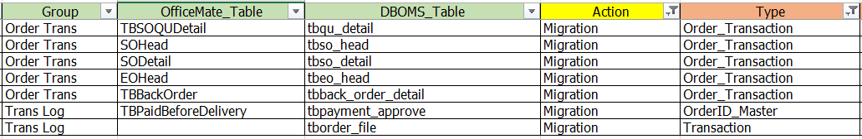
Sale Transaction

Slide 7
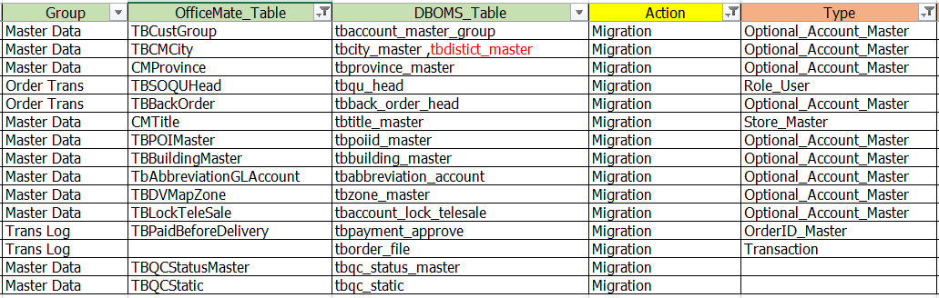
Other : Migration

Slide 8
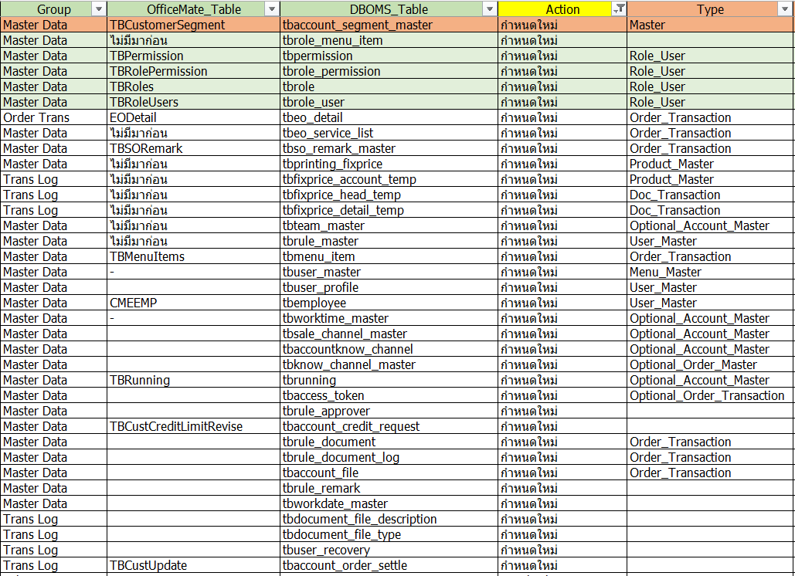
Other : New table

Slide 9
OMS : Timeline (DMS & BI)
1. SP (Customer/SO/QU/EO) --- ( Zai )
2. ETL --- ( Koy/Noi )
3. BI (Report) / ( ETL ) --- ( Noom )
4. Migration data ( PUI )
5. Saleforce : นัดคุยเรื่อง Customer ( OMS )

