Slide 1
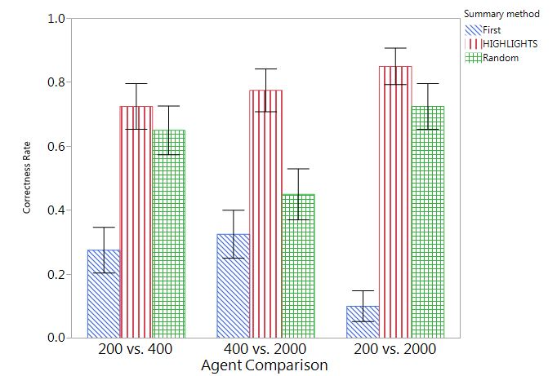
Correctness Rate
Agent Comparison

