Slide 1

Amoung Us - a way home

Slide 2
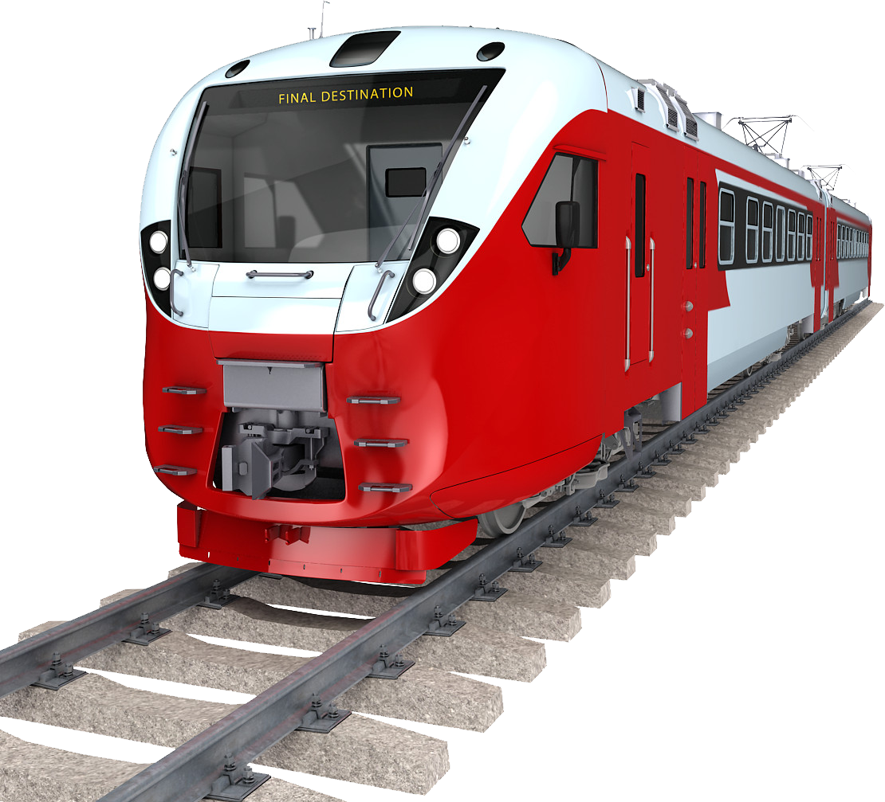
The setting
You need to go home… but there is an obstacle in your path. Someone has planted a bomb somewhere on the train. Team up with the other commuters to find and diffuse it before your time runs out.

Slide 3
The twist
The terrorists who planted the bomb are among us – the commuters. They will try to sabotage your plans through misdirection and waste your limited bomb disposal resources.

Slide 4
The stakes
A problem with high-stake games is that players often do not feel the severity of the situation
  leads to lower player engagement and retention.
To simulate our life-or-death scenario we decided to implement a new feature – shareable baking.

Slide 5


Our shareable banking experience
A simple fix for believable high-stake situations
The winners get the losers bank details.
(Winning) players will get to gain new insights and an improved experience with banking.

Slide 6
Technology Stack
Front-end: Godot Engine x Paired Programming
Backend: WebSockets x NodeJS
Presentation: LibreOffice Impress

Slide 7
Frequently Asked Question

Slide 8
Question
Your project sounds amazing!! Can we see it?

Slide 9
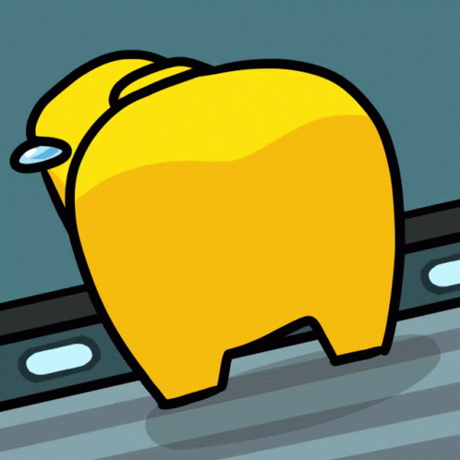
Answer

Slide 10

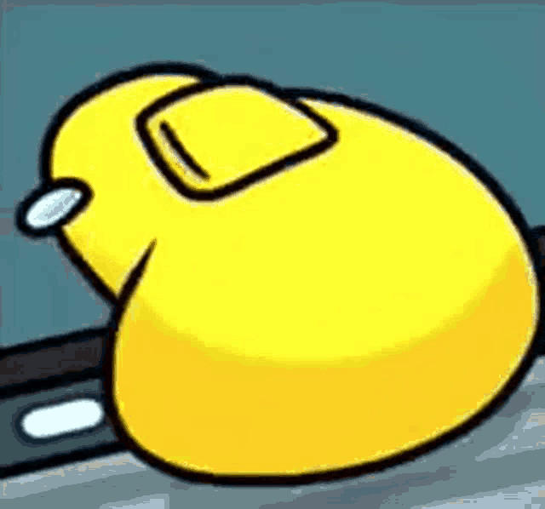

thank you! any questions?

Slide 11
This work is licensed under a Creative Commons Attribution-ShareAlike 3.0 Unported License.
It makes use of the works of
Kelly Loves Whales and Nick Merritt.

