Slide 1

Information needs context…
?
Notes:
When reading news or an article often more context info needed
Persons or other entities mentioned …
… and you wonder who/what they are and how they are connected

Slide 2



Entity Annotation and Context from LOD
Notes:
When reading news or an article often more context info needed
Persons or other entities mentioned …
… and you wonder who/what they are and how they are connected

Slide 3











Architecture
Chrome Extension
Java Server
Sources
Named Entity Recognition
SPARQL Engine
DBpedia
Options
Content
Named Entities
YAGO2
…
Context and Properties
Notes:
Chrome Extension with Config sends text
NER identifies entites in text
Sources are queried and processed -> consolidated in local context model
In context releveant information are collected
Result returned to CE and visualized

Slide 4




SPARQL Engine
(.*)
Sources
Jena Queries
Jena Queries
Jena Queries
Named Entities
Jena
DBpedia
OWL
Ontology Model
Custom Ontology
Source Model
URI Identification
YAGO2
Inference Model
…
Options
Context and Properties
Notes:
Reg-ex search in sources for entities, and there context: Direct and in-direct relations of first order
Apply logic to identify most relevant URIs and store locally
Load of custom OWL specifying the properties across sources
Combine via reasoner to inference model
Use custom property selection to filter the relevant properties + context -> return

Slide 5
Server: REST API
GET https://localhost:8443/RetrieveAvailableProperties
Retrieves available properties per entity type
URI and label
Chrome extension
Server
1
2
POST https://localhost:8443/RetrieveTriples
Retrieves named entities
Type, URI and properties
Retrieves context triples (connections between entities)

Slide 6




Chrome extension
Browser
Background script
Chrome Extension
Server
Generate button
JavaScript
Content
Options
Content
Website
CSS stylesheets
Named entities
Generate Popup

Slide 7
Chrome extension
Browser
Background script
Chrome Extension
Server
Generate button
Options
Content
JavaScript
Content
Website
CSS stylesheets
Context and Properties
Generate Popup

Slide 8
Demo
Notes:
Demo script:
User visits his favourite website (Spiegel, bbc, CNN)
Reads an article about foreign politics: Trump is filling his cabinet (example: http://www.bbc.com/news/world-us-canada-38168382)
Now Trump obviously he knows, but who is this other person that is mentioned here?
Select the text and click the button!
View information about the named entities that were found:
Information about Trump (there seems to be a lot) and the other person
Now this is useful, but what connects Trump to this person? View visualization

Slide 9


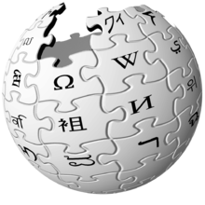


Conclusion
Extensible architecture
Easy installation
Shows
Named entities
Connections
No Wikipedia lookups!
Notes:
On the technical side: architecture is extensible, as in new sources can easily be added
Chrome extension gets pretty much everything from the server, so this would not need any updates
Chrome extension shows a customizable popup
Retrieves additional information about entities
Visualizes connections between entities
➔ User saves time: No Wikipedia lookups necessary

Slide 10
Backup

Slide 11
Agenda
Architecture
Named Entity Recognition
SPARQL Engine
Server
Chrome Extension
Demo
Conclusion

Slide 12
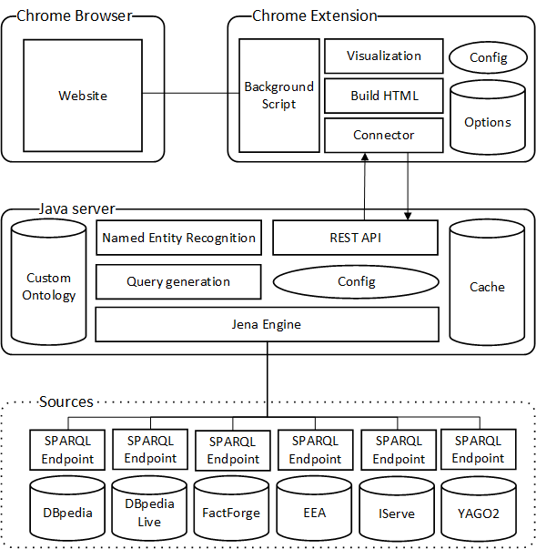
Architecture

Slide 13
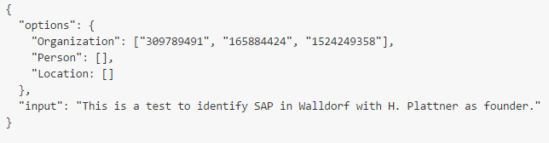
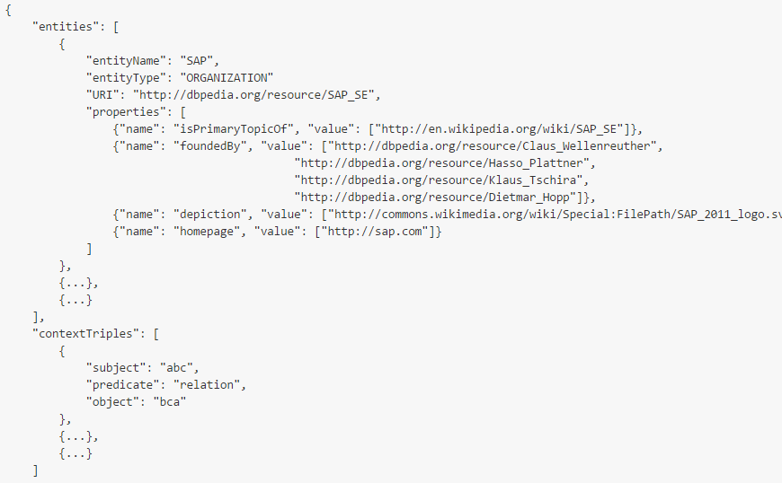
Server: REST API (1)
POST https://localhost:8443/RetrieveTriples Request body:
Response body:

Slide 14
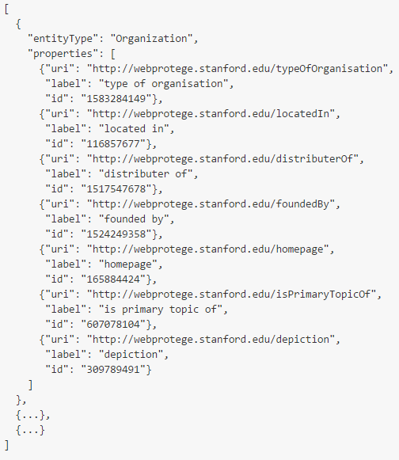
Server: REST API (2)
GET https://localhost:8443/RetrieveAvailableProperties Response body:

