Slide 1
Integrating geographical and financial data about companies
Yi-Ru Cheng
Oliver Frendo
Dandan Li
Zehui Wang

Slide 2
Agenda
1
Use Case
Data Collection
3
Identity Resolution
4
5
Conclusion
Data Fusion
2

Slide 3
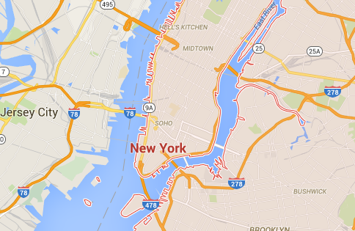
Use Case
Data Science perspective
Company perspective
Analyze relationships between attributes of company and location
Distributions of companies over locations
Analyze data in regard to own position vs positions of other companies
Company
Size
Revenue
Location
Language
Population

Slide 4



Data Collection (1)
Entities: 2,000
Attributes (7): name, countries, industries, revenue, …
Entities: 3,182
Attributes (9): name, countries, industries, numberOfEmployees, dateFounded, …
Forbes (companies)
Freebase (companies)
Entities: 16,051
Attributes (9): name, countries, industries, numberOfEmployees, dateFounded, …
Entities: 3,270
Attributes (5): name, population, area, elevation, country
DBpedia (companies)
DBpedia (locations)
Notes:
Reason for choosing these 4?

Slide 5
Data Collection (2)
Need slide on data translation? E.g. USA, UK

Slide 6

Identity Resolution (1)
Forbes (companies)
Freebase (companies)
Gold standard
Training data: 220 cases (100 true, 120 false)
Test data: 27 cases (12 true, 15 false)
Corner cases:
“Chevron“ vs “Chevron Corporation“ (true)
“BP“ vs “TNK-BP (false)
“Makita“ (U.S.) vs “Makita“ (Japan) (true)

Slide 7
Identity Resolution (2)
Forbes (companies)
Freebase (companies)
Correspondences
n=509
Matching rules
Name: Levenshtein
Good: “Prudential“ vs “Prudential plc“
Bad: “West Japan Railway“ vs “East Japan Railway“
Industries:
“Computer, Transportation“ vs “Transport, Computers“
Jaccard (0.00) vs Levenshtein (0.00) vs Hybrid (0.75)
Locations:
“New York, London“ vs “New York City“
Jaccard (0.00) vs Highest Jaccard (0.67)

Slide 8
Identity Resolution (3)
Forbes (companies)
Freebase (companies)
Correspondences
n=509
Blocking functions
CrossProduct:
509 matches, reduction ratio: 1.00
SortedNeighbourhood (country)
319 matches, reduction ratio: 6.80
Partitioning (country)
425 matches, reduction ratio: 20.19

Slide 9
Identity Resolution (4)
Forbes (companies)
Freebase (companies)
Correspondences
n=509
Correspondences
n=671
DBpedia (companies)

Slide 10
Identity Resolution (5)
Forbes (companies)
Freebase (companies)
Correspondences
n=509
Correspondences
n=671
Learning matching rules (linear regression)
Important attributes:
name: 0.689 keyPeople: 0.377 locations: 0.218
Unimportant attributes:
revenue: 0.000 numberOfEmployees: 0.000
DBpedia (companies)

Slide 11
Identity Resolution (6)
Forbes (companies)
Freebase (companies)
Correspondences
n=509
Correspondences
n=671
Blocking functions
Partitioning (country)
576 matches, reduction ratio: 15,92
Partitioning (dateFounded)
496 matches, reduction ratio: 9,43
Partitioning (combination)
671 matches, reduction ratio: 6,13
DBpedia (companies)

Slide 12
Identity Resolution (7)
Forbes (companies)
Freebase (companies)
Correspondences
n=509
Correspondences
n=671
Correspondences
n=7,921
DBpedia (companies)
DBpedia (locations)

Slide 13

Data Fusion (1)
Datasets
Attribute
name | IBM
industries | Computer hardware, Information technology consulting, Software
revenue | 92,800,000,000
keyPeople | Virginia Rometty
countries | United States of America
Fusion
Fused results
……

Slide 14

Data Fusion (2) : Conflict resolution functions
Attributes Name | Contained in which Datasets | Conflict resolution function | Accuracy
industries | Forbes, DBpedia, Freebase | Intersection | 0.88
 |  | Union | 0.94
dateFounded | DBpedia, Freebase | MostComplete (date) | 0.94
 |  | MostComplete (sample) | 0.94
 |  | Combination | 0.94
marketValue | Forbes | SingleSource | 0.94
keyPeople | DBpedia, Freebase | Intersection | 0.93
 |  | Union | 0.94
locationName | DBpedia (companies), DBpedia (locations), Freebase | Intersection + MostComplete | 0.93
 |  | Union+ MostComplete | 0,94

Slide 15
Data Fusion (3): Results
Attribute Densities
Attribute | Forbes (n=2000) | Freebase (n=3182) | DBpedia (n=16051) | Consistencies | Fused (n=6470)
name | 1.00 | 1.00 | 1.00 | 0.97 | 1.00
countries | 1.00 | 0.40 | 1.00 | 1.00 | 1.00
industries | 0.98 | 0.54 | 0.61 | 0.93 | 0.65
numberOf-Employees | 0.00 | 1.00 | 0.32 | 1.00 | 0.38
locations | 1.00 | 1.00 | 1.00 | 0.90 | 1.00
Integrated Attributes: 15
Eg. Name, country, revenue, keyPeople

Slide 16
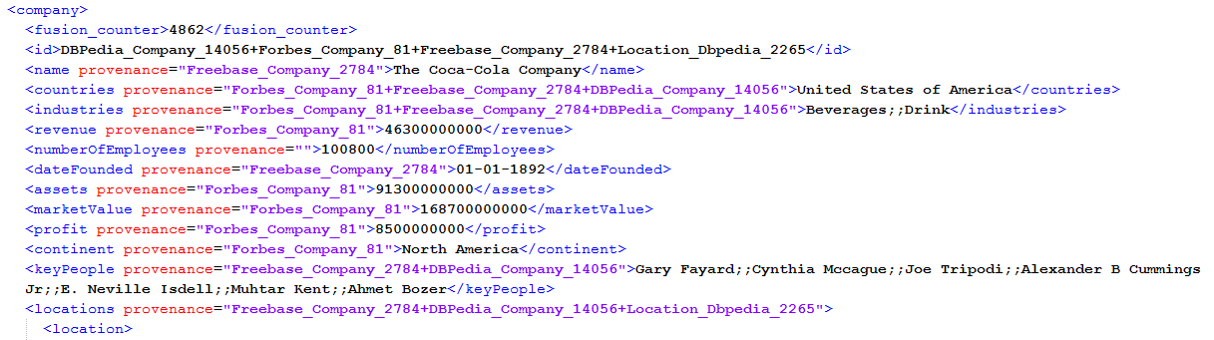
Data Fusion
Notes:
If showing this: take out provenance information, or take only a couple of attributes

Slide 17
Conclusion
Data Collection
Flexible data collection from Freebase and DBpedia via queries
➔ Goal: Find balance between enough data and sparsity of attributes
Identity Resolution
Relatively low number of correspondences from Freebase to Forbes Data Fusion
➔ Many companies not available in Freebase dataset
High number of correspondences for locations
Data Fusion
Improved densities espcially among shared attributes
Fused entities: 6,470
Outlook
Select metadata from DBpedia and Freebase (e.g. most recent date modified)
➔ Use as basis for conflict resolution functions

Slide 18
Conclusion
Data Collection
The data is collected from DBpedia and Freebase via flexible queries
Goal: Find balance between enough data and sparsity of attributes
Data Fusion
For the data fusion we not only tried many different conflict resolution functions learned from lectures but also implemented other functions
Outlook
In a word,it’s a promising approach to improve accuracy if selecting metadata per attribute from DBpedia and Freebase.

Slide 19
Backup slides
Basic profile of each dataset table
Integrated schema table
Matching rule accuracies table
Blocking functions table
Attribute densities/consistencies
Conflict resolution functions

