Slide 1

By Matthias Liedtke, Emil Abramov, Oliver Frendo, Jörn Hübner, Jascha Krüper & Max Hofmann

Slide 2
Agenda
Architecture
Collect data
Create Objects
Observe State
Finite state machine
Definition
UML Diagramm
Data storage
Data analysis
Visualization demo

Slide 3
Architecture

Slide 4
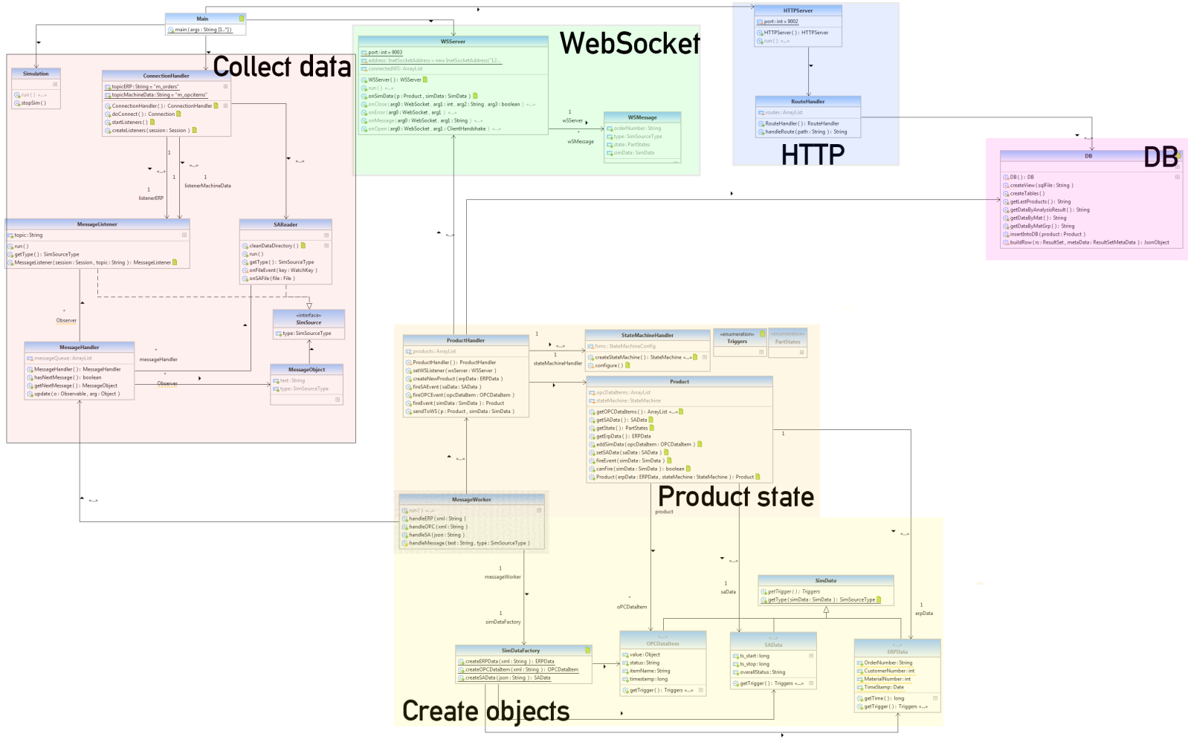

Slide 5
Architecture: Collect data

Slide 6
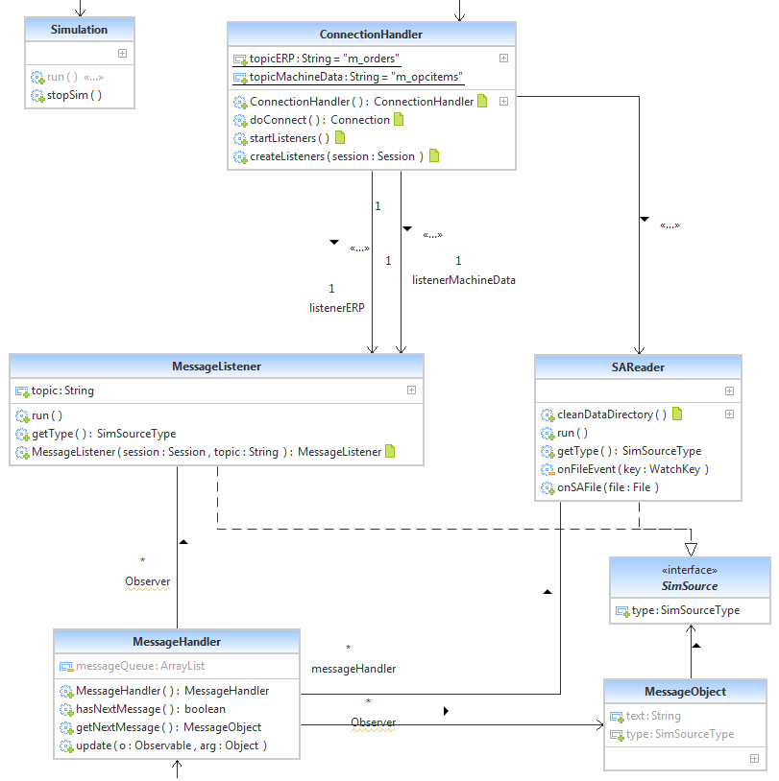

Slide 7
Architecture: Create objects

Slide 8
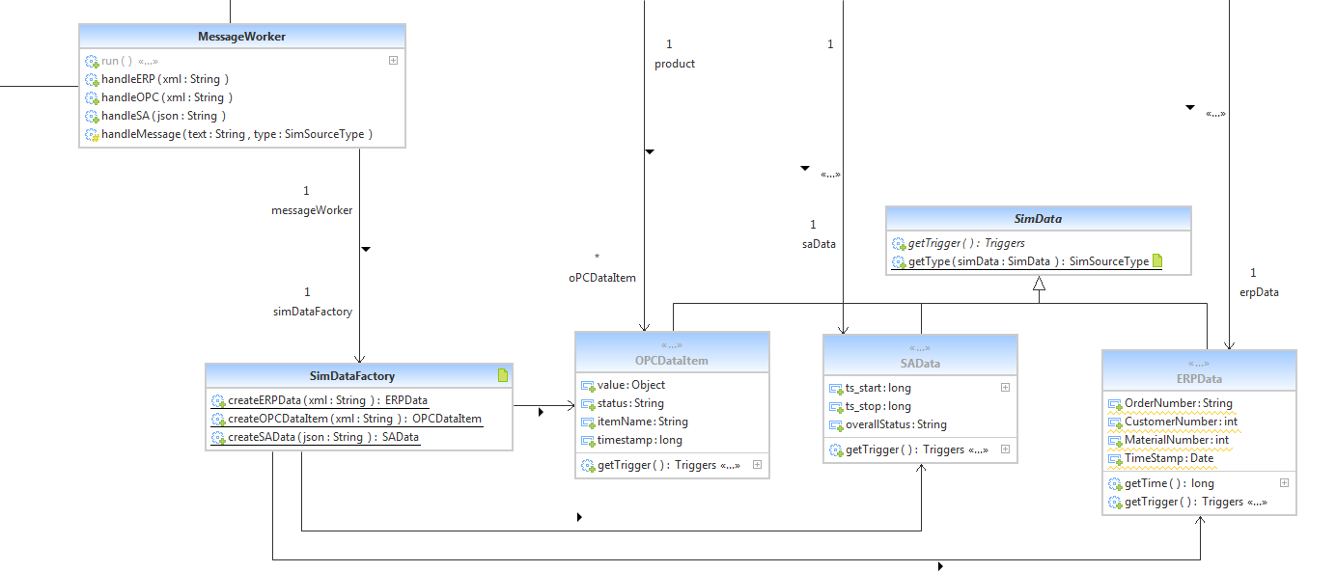
Scope: Create Objects

Slide 9
Architecture: Product state

Slide 10
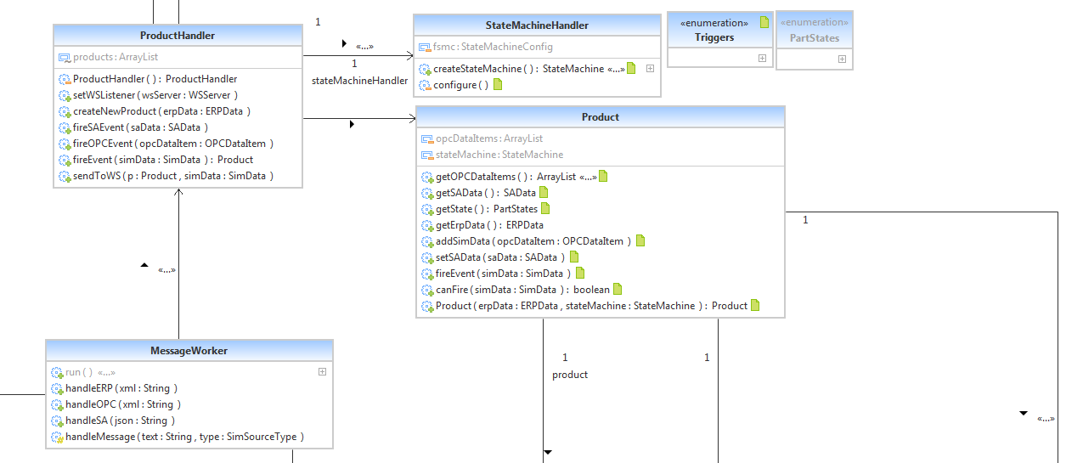

Slide 11

Finite state machine
Q = {INIT, LIGHTBARRIER_1, BETWEEN_L1_L2, LIGHTBARRIER_2, BETWEEN_L2_L3, MILLING_STATION, BETWEEN_L3_L4, DRILLING_STATION, BETWEEN_L4_L5, LIGHTBARRIER_5, END_OF_PRODUCTION, SPECTRAL_ANALYSIS}
∑ = {LIGHTBARRIER_1_INTERRUPT, LIGHTBARRIER_1_CONNECT, LIGHTBARRIER_2_INTERRUPT, LIGHTBARRIER_2_CONNECT, LIGHTBARRIER_3_INTERRUPT, MILLING_STATION, LIGHTBARRIER_3_CONNECT, LIGHTBARRIER_4_INTERRUPT, DRILLING_STATION, LIGHTBARRIER_4_CONNECT, LIGHTBARRIER_5_INTERRUPT, LIGHTBARRIER_5_CONNECT, SPECTRAL_ANALYSIS}
ԛ₀ = {INIT}
F = {SPECTRAL_ANALYSIS}

Slide 12
Finite state machine δ = ∑ x Q
δ = {
Event | INIT | L_1 | B_L1_L2 | L_2 | B_L2_L3 | M_S | B_L3_L4 | D_S | B_L4_L5 | L_5 | END | S_A
LIGHTBARRIER_1_INTERRUPT | L_1 | - | - | - | - | - | - | - | - | - | - | -
LIGHTBARRIER_1_CONNECT | - | B_L1_L2 | - | - | - | - | - | - | - | - | - | -
LIGHTBARRIER_2_INTERRUPT | - | - | L_2 | - | - | - | - | - | - | - | - | -
LIGHTBARRIER_2_CONNECT | - | - | - | B_L2_L3 | - | - | - | - | - | - | - | -
LIGHTBARRIER_3_INTERRUPT | - | - | - | - | M_S | - | - | - | - | - | - | -
MILLING_STATION | - | - | - | - | - | M_S | - | - | - | - | - | -
LIGHTBARRIER_3_CONNECT | - | - | - | - | - | B_L3_L4 | - | - | - | - | - | -
LIGHTBARRIER_4_INTERRUPT | - | - | - | - | - | - | D_S | - | - | - | - | -
DRILLING_STATION | - | - | - | - | - | - | - | D_S | - | - | - | -
LIGHTBARRIER_4_CONNECT | - | - | - | - | - | - | - | B_L4_L5 | - | - | - | -
LIGHTBARRIER_5_INTERRUPT | - | - | - | - | - | - | - | - | L_5 | - | - | -
LIGHTBARRIER_5_CONNECT | - | - | - | - | - | - | - | - | - | END | - | -
SPECTRAL_ANALYSIS | - | - | - | - | - | - | - | - | - | - | S_A | -
}

Slide 13
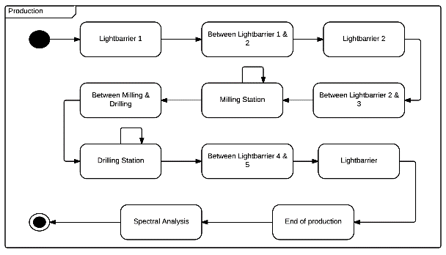
Finite state machine UML

Slide 14
Data storage

Slide 15
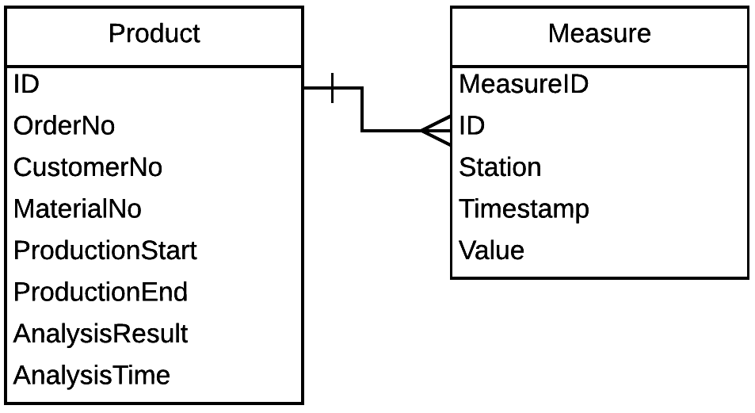
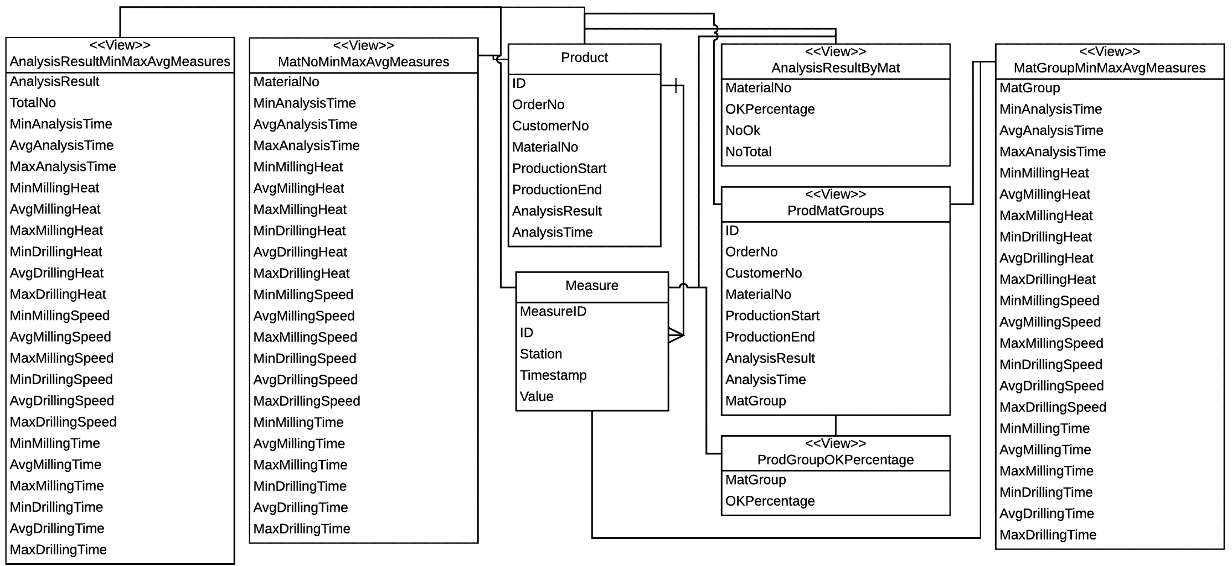
Data storage

Slide 16
Data analysis
Notes:
Data size of 1068 samples, so 1068 products

Slide 17
Data analysis: Customer

Slide 18
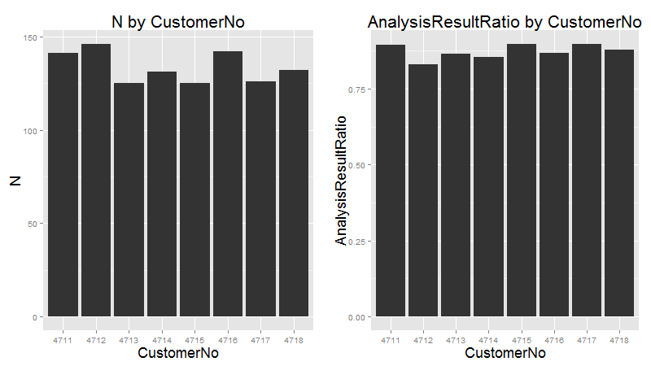
Notes:
Grouped by customer number
First we have N products per customer: Not significant, pretty random
Same thing with the result from the spectral analysis

Slide 19
Data analysis: Material

Slide 20
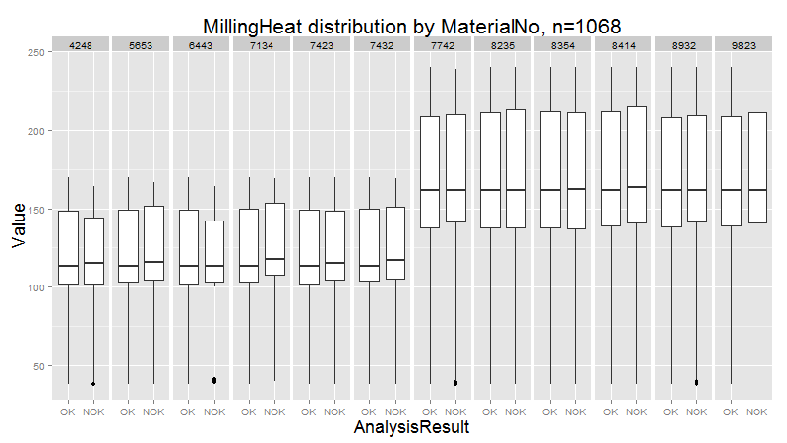
Notes:
So to explain some things first: There are 12 different material types
In this graph we see the distribution for the average of the variable MillingHeat, grouped by the spectral analysis result and the material number
As we can see, this led us to our first assumption, that there might be two different material groups

Slide 21
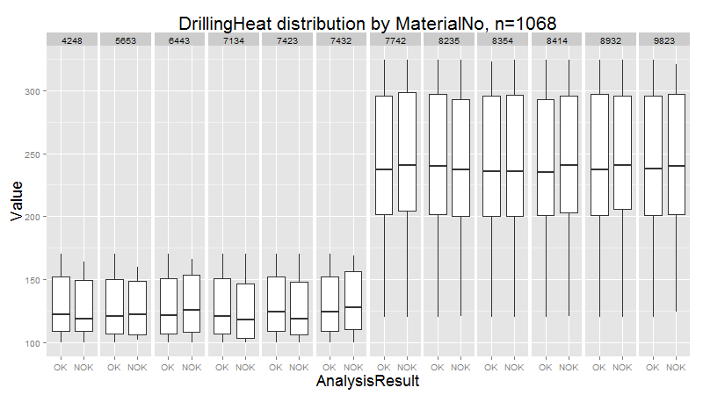
Notes:
Same thing with the drilling heat, the difference is a bit larger here

Slide 22
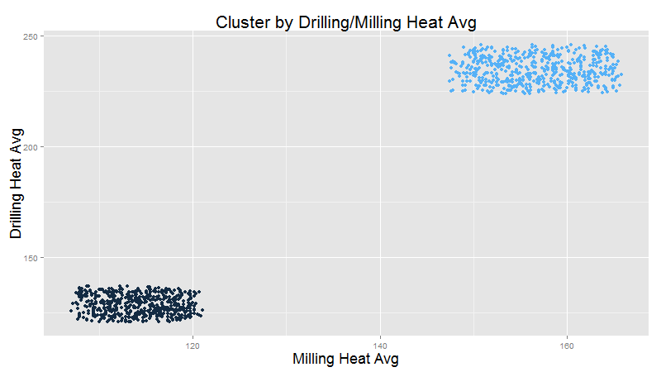
Notes:
Just to show this from a different perspective, we plotted the data before, so the milling and drilling heat averages against each other on a scatter plot
Again the results are pretty obvious
We even have a nice colouring here from using the Kmeans cluster analysis method

Slide 23
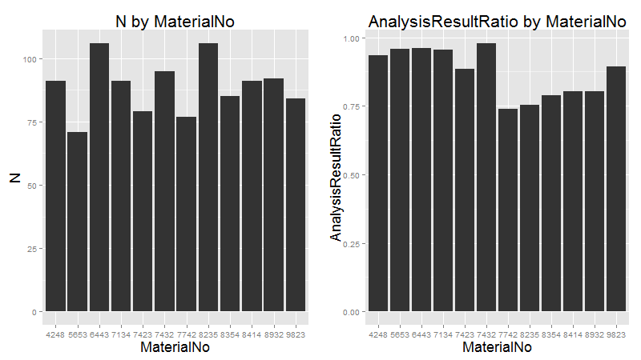
Notes:
So to confirm our assumption that the 12 material types are split into 2 material groups
Here we group by the assumed material groups
So the number N per material type seems to be random and insignificant
The ratio of OK to Not OK products however seems to be more telling

Slide 24
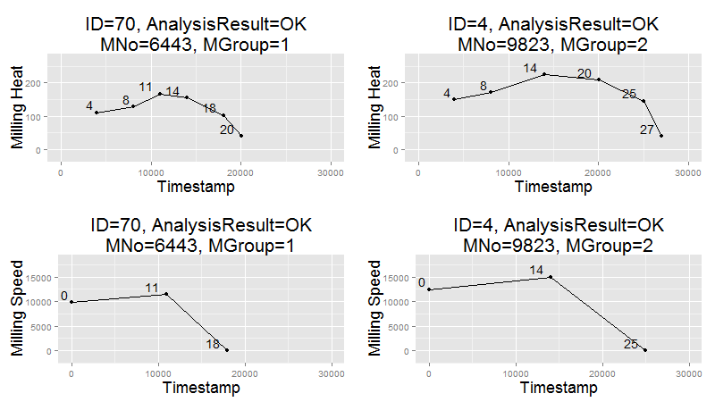
Notes:
So having pretty much confirmed the assumption that there are two different material groups we decided to further analyze the milling and drilling processes
Here we see the following:
6 values measured for Heat
3 values measured for Speed
Each material group shows equal Speed values depending on the process
The 2nd material group shows higher Speed and Heat values, for Milling as well as Drilling
The 2nd material group shows longer processes

Slide 25
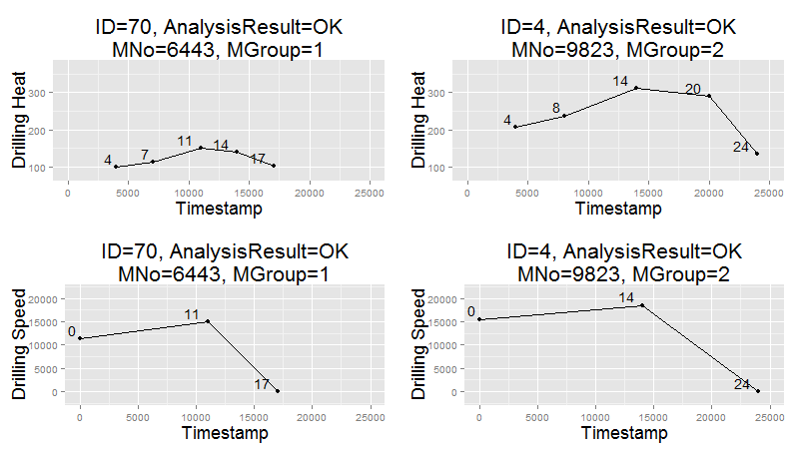
Notes:
Same thing for

Slide 26
Data analysis: Spectral analysis result
Notes:
So in this last section we try to predict the analysis result OK or Not OK on the basis of Heat values from the two processes

Slide 27
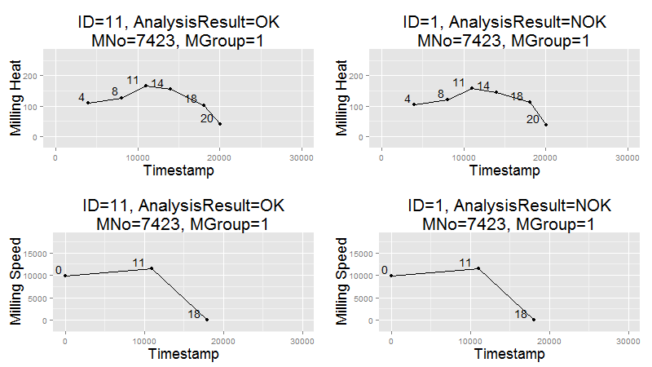
Notes:
So here on the left side we see a product that‘s OK, the one on the right is Not OK
Both products are from the same material type and same material group

Slide 28
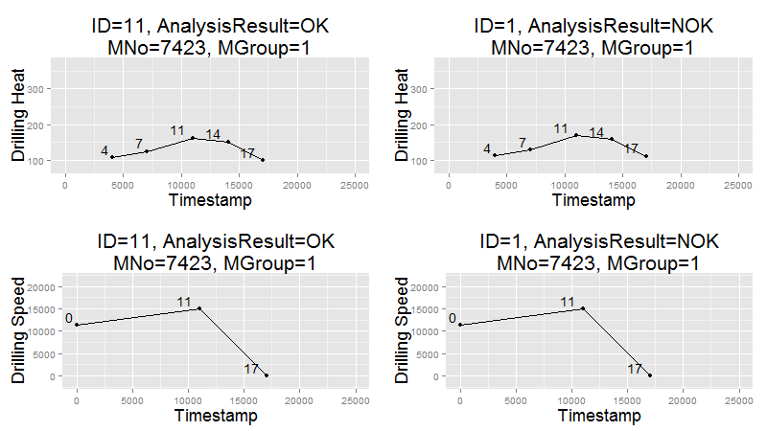
Notes:
Same thing with Drilling Heat values

Slide 29
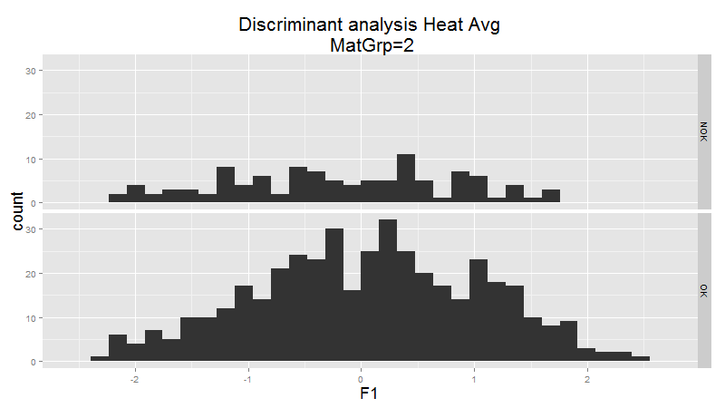
Notes:
So just to confirm the assumption that the milling and drilling heat values have no influence on the outcome of the spectral analysis we did a discriminant analysis
If we think back to our Business Intelligence lecture: From this method we get a function and several coefficients
Not going to go into depth here, but this is a pretty bad result for the two heat average variables per product, because it means we can‘t predict the result on the basis of those two variables

Slide 30
Data analysis: Conclusion
Material and spectral analysis result are not dependant on the customer
The 12 material types are split into 2 material groups
Each material group shows different Milling and Drilling processes
Each material group shows different ratios of the spectral analysis result
Each material group and processes show equal speed values
The spectral analysis result is not dependant on heat values from the two processes
Notes:
So to conclude the section of data analysis

Slide 31
Visualization demo

Slide 32
Thanks! Any questions?

