Slide 1
Cronos (replace with logo)
By Matthias Liedtke, Emil Abramov, Oliver Frendo, Jörn Hübner, Jascha Krüper & Max Hofmann

Slide 2
Agenda
- UML Overall Architecture
Scope: Collect data
Scope: Create Objects
Scope: Observe State
Scope: Analyse Data
- Finite State Machine
Definition
UML Diagramm
- Data Analysis
- User Interface

Slide 3
UML Overall Architecture

Slide 4
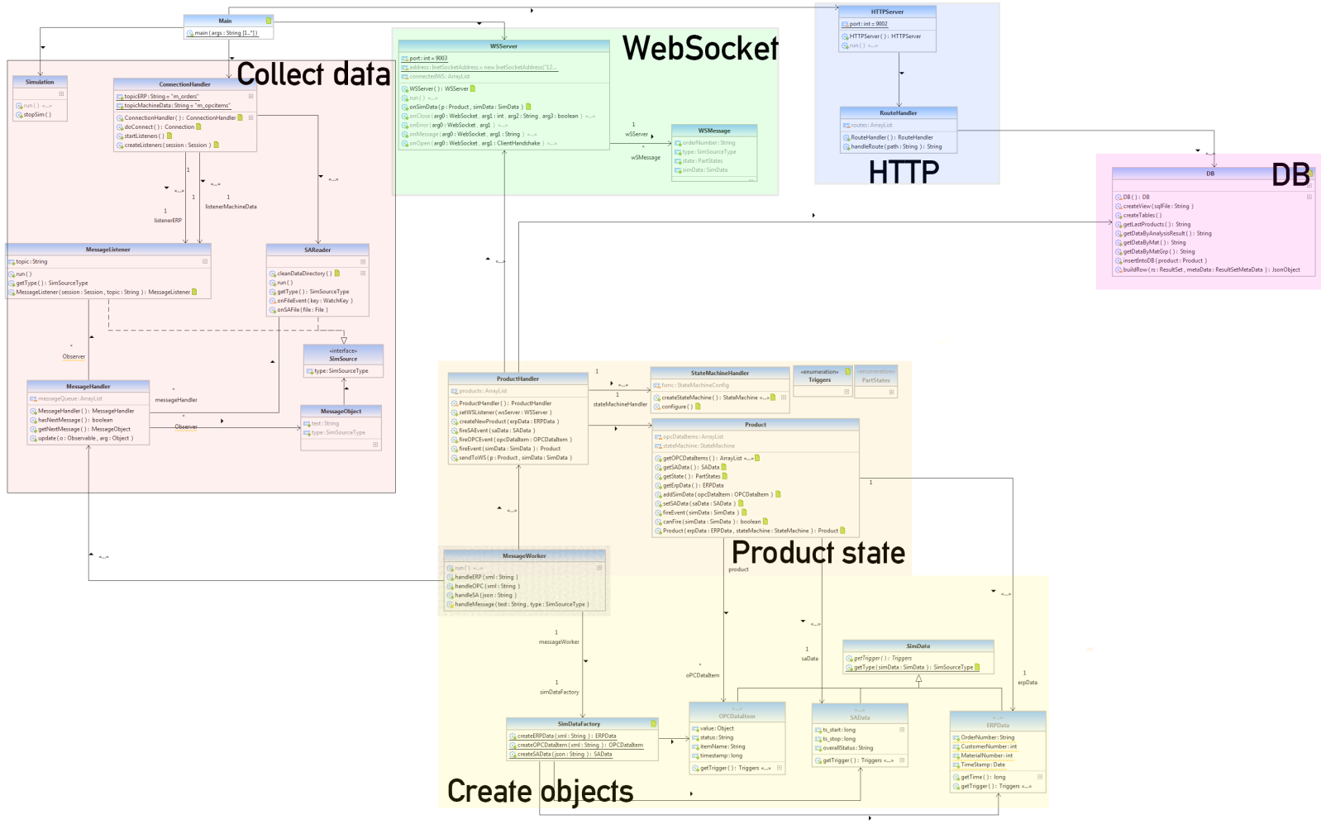

Slide 5
Scope: Collect data

Slide 6
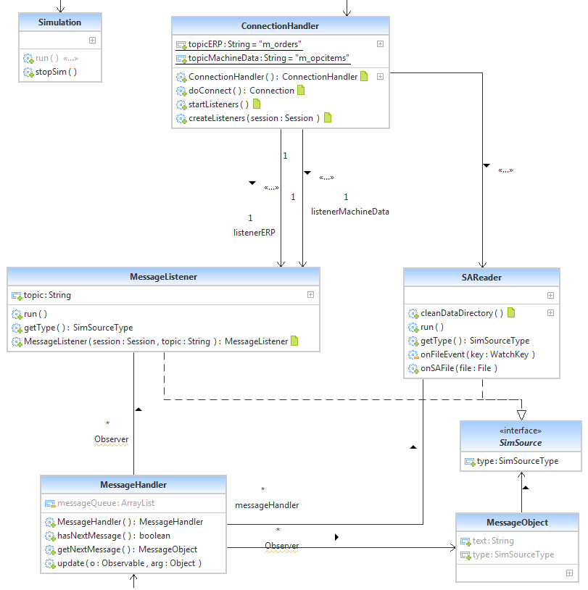

Slide 7
Scope: Create objects

Slide 8
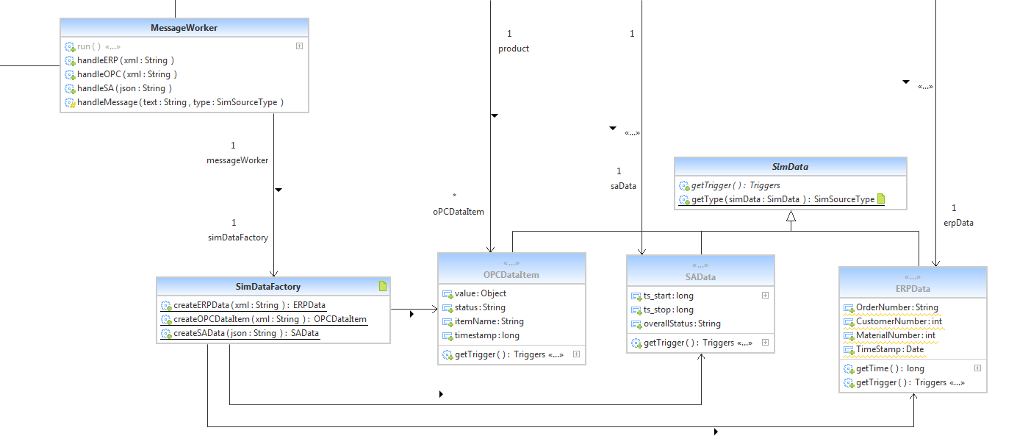
Scope: Create Objects

Slide 9
Scope: Product state

Slide 10
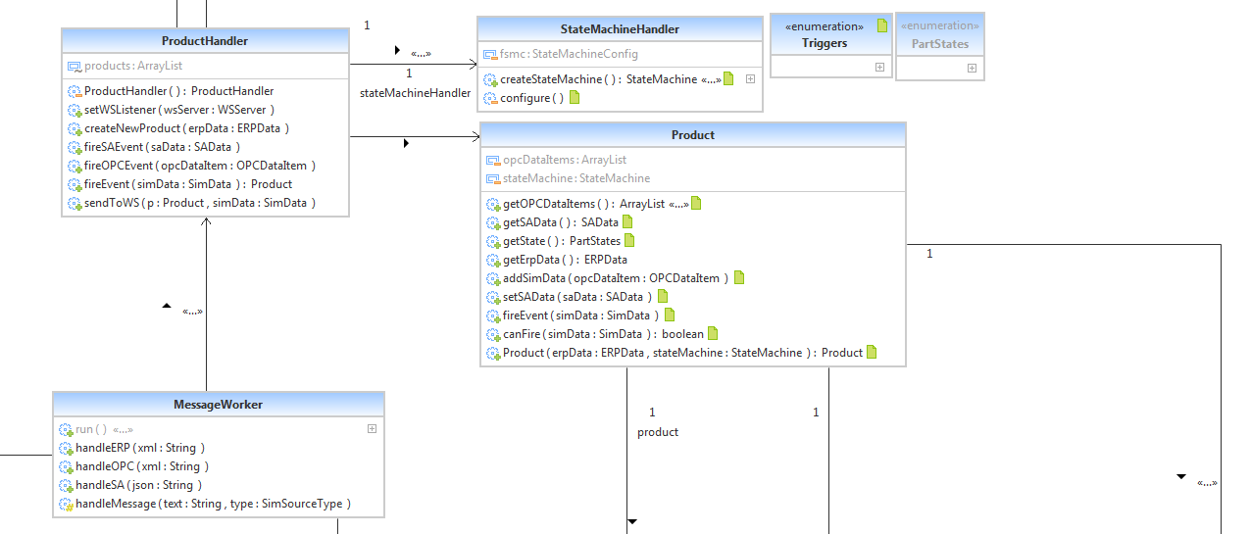

Slide 11
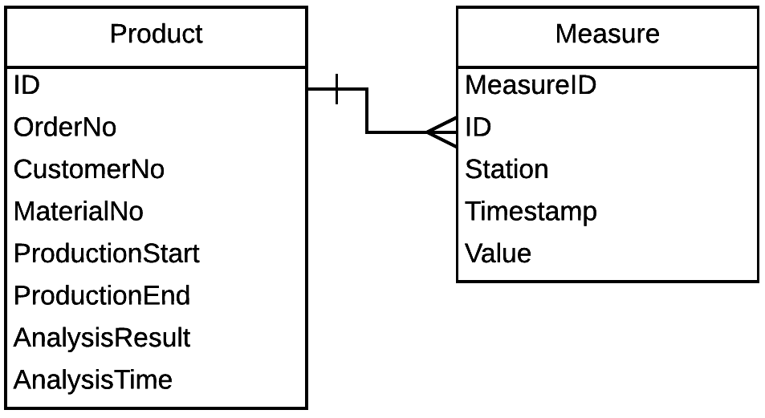
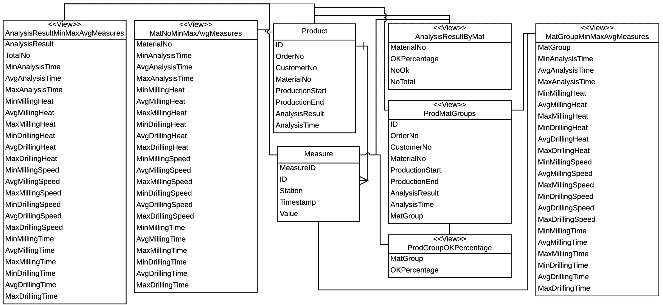
Scope: Database

Slide 12
Scope: Analyse Data

Slide 13
Finite State Machine
Q = {INIT, LIGHTBARRIER_1, BETWEEN_L1_L2, LIGHTBARRIER_2, BETWEEN_L2_L3, MILLING_STATION, BETWEEN_L3_L4, DRILLING_STATION, BETWEEN_L4_L5, LIGHTBARRIER_5, END_OF_PRODUCTION, SPECTRAL_ANALYSIS}
∑ = {LIGHTBARRIER_1_INTERRUPT, LIGHTBARRIER_1_CONNECT, LIGHTBARRIER_2_INTERRUPT, LIGHTBARRIER_2_CONNECT, LIGHTBARRIER_3_INTERRUPT, MILLING_STATION, LIGHTBARRIER_3_CONNECT, LIGHTBARRIER_4_INTERRUPT, DRILLING_STATION, LIGHTBARRIER_4_CONNECT, LIGHTBARRIER_5_INTERRUPT, LIGHTBARRIER_5_CONNECT, SPECTRAL_ANALYSIS}
ԛ0 = {INIT}
F = {SPECTRAL_ANALYSIS}

Slide 14
Finite State Machine δ = ∑ x Q
δ = {
Event | INIT | L_1 | B_L1_L2 | L_2 | B_L2_L3 | M_S | B_L3_L4 | D_S | B_L4_L5 | L_5 | END | S_A
LIGHTBARRIER_1_INTERRUPT | L_1 | - | - | - | - | - | - | - | - | - | - | -
LIGHTBARRIER_1_CONNECT | - | B_L1_L2 | - | - | - | - | - | - | - | - | - | -
LIGHTBARRIER_2_INTERRUPT | - | - | L_2 | - | - | - | - | - | - | - | - | -
LIGHTBARRIER_2_CONNECT | - | - | - | B_L2_L3 | - | - | - | - | - | - | - | -
LIGHTBARRIER_3_INTERRUPT | - | - | - | - | M_S | - | - | - | - | - | - | -
MILLING_STATION | - | - | - | - | - | M_S | - | - | - | - | - | -
LIGHTBARRIER_3_CONNECT | - | - | - | - | - | B_L3_L4 | - | - | - | - | - | -
LIGHTBARRIER_4_INTERRUPT | - | - | - | - | - | - | D_S | - | - | - | - | -
DRILLING_STATION | - | - | - | - | - | - | - | D_S | - | - | - | -
LIGHTBARRIER_4_CONNECT | - | - | - | - | - | - | - | B_L4_L5 | - | - | - | -
LIGHTBARRIER_5_INTERRUPT | - | - | - | - | - | - | - | - | L_5 | - | - | -
LIGHTBARRIER_5_CONNECT | - | - | - | - | - | - | - | - | - | END | - | -
SPECTRAL_ANALYSIS | - | - | - | - | - | - | - | - | - | - | S_A | -
}

Slide 15
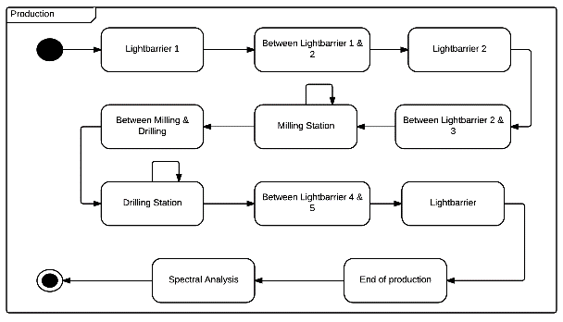
Finite State Machine UML

Slide 16
Data Analysis

