Slide 1
AOM 1

Slide 2
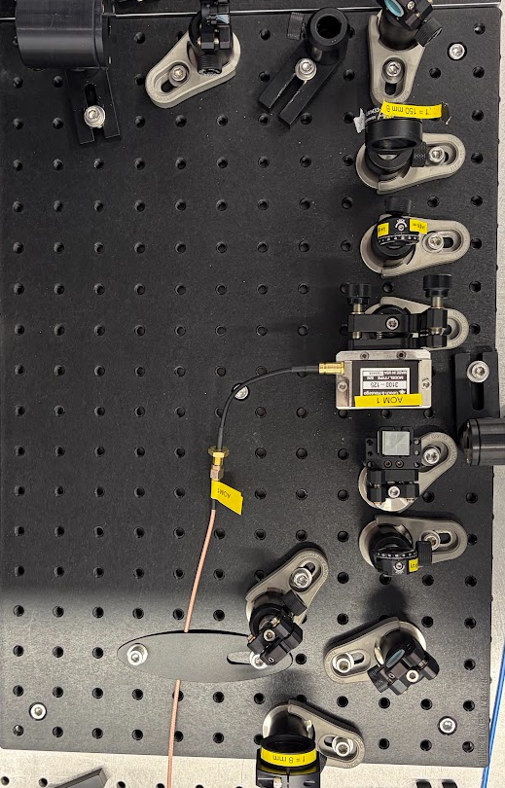




AOM 1
$$λ/4$$
$$λ/2$$
Beam dump
PBS
BS
$$λ/4$$
0.5/1inch Mirror
2 inch Mirror
AOM
Filter for 795
Variable collimator
Lens
$$λ/2$$
Telescope
Iris
795nm?
AOM
AOM

Slide 3
AOM 1
$$λ/4$$
$$λ/2$$
Beam dump
795nm?
PBS
BS
$$λ/4$$
0.5/1inch Mirror
2 inch Mirror
https://wavelength-oe.com/iw/acousto-optic-deflectors/
AOM
Filter for 795
Variable collimator
Lens
משימות:
לסמן קרניים חוזרות בירוק
$$λ/2$$
Telescope
Iris
795nm?
AOM
AOM

Slide 4
Mixer

Slide 5
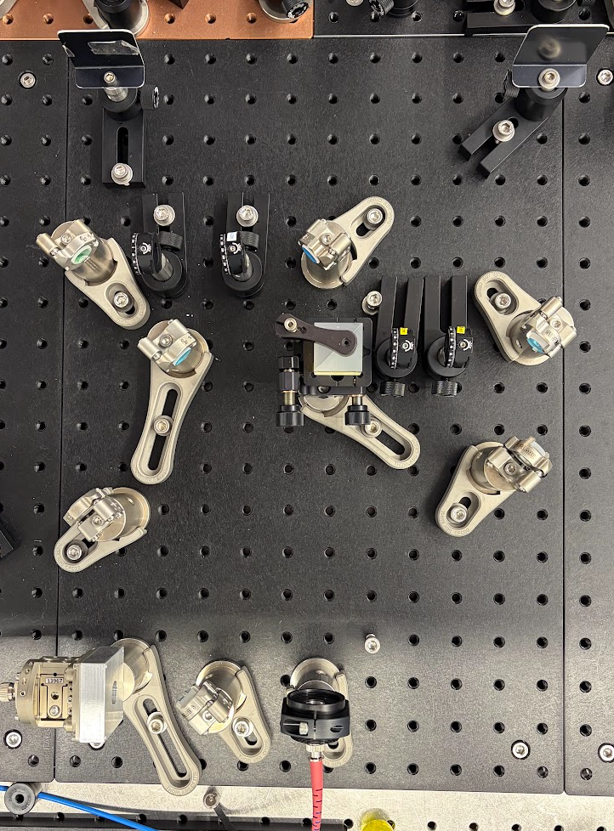

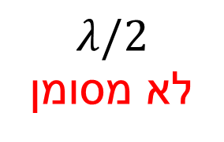


Mixer
$$λ/4$$
$$λ/2$$
Beam dump
PBS
BS
$$λ/2$$
לא מסומן
*
0.5/1inch Mirror
2 inch Mirror
$$λ/4$$
$$λ/4$$
$$λ/2$$
Filter for 795
Variable collimator
Lens
Telescope
Iris
AOM
AOM

Slide 6
Mixer
$$λ/4$$
$$λ/2$$
Beam dump
PBS
BS
$$λ/2$$
לא מסומן
*
0.5/1inch Mirror
2 inch Mirror
$$λ/4$$
$$λ/4$$
$$λ/2$$
Filter for 795
Variable collimator
Lens
Telescope
Iris
AOM
AOM

Slide 7
L1

Slide 8
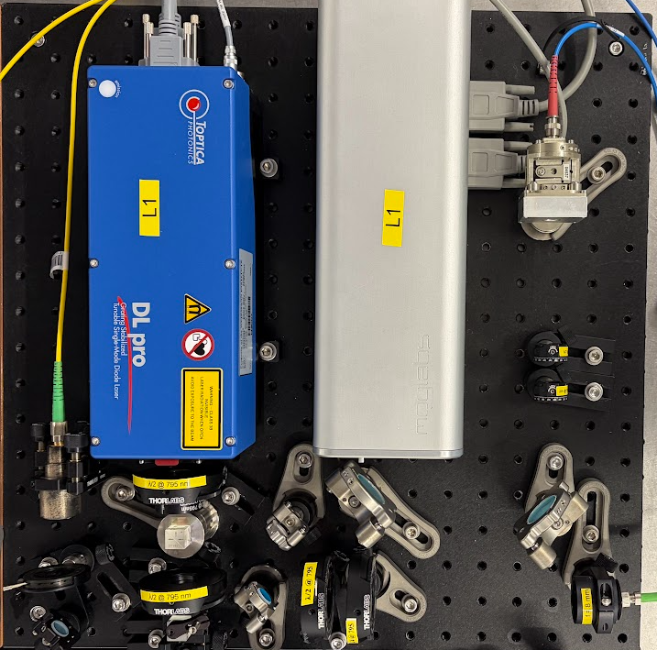





L1
L1 Amp
$$λ/4$$
$$λ/2$$
L1
Beam dump
PBS
BS
0.5/1inch Mirror
2 inch Mirror
Filter for 795
$$λ/2$$
Variable collimator
$$λ/4$$
Wavelength Measure
Lens
$$λ/2$$
Telescope
$$λ/2$$
$$λ/4$$
Iris
$$λ/2$$
AOM
AOM

Slide 9
L1
L1 Amp
$$λ/4$$
$$λ/2$$
L1
Beam dump
PBS
BS
0.5/1inch Mirror
2 inch Mirror
Filter for 795
$$λ/2$$
Variable collimator
$$λ/4$$
Wavelength Measure
Lens
$$λ/2$$
Telescope
$$λ/2$$
$$λ/4$$
Iris
$$λ/2$$
AOM
AOM

Slide 10
System

Slide 11



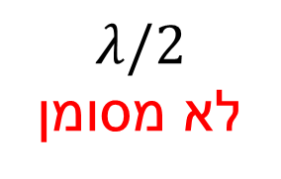







L1
L1 Amp
L1
$$λ/2$$
$$λ/4$$
Wavelength Measure
$$λ/2$$
$$λ/2$$
$$λ/4$$
$$λ/2$$
Mixer
AOM 1
$$λ/2$$
לא מסומן
*
$$λ/4$$
$$λ/4$$
$$λ/4$$
$$λ/2$$
AOM
$$λ/2$$
Experiment #2
795nm?
Experiment #1

