Slide 1
Innovation in Assessments
Brandt Redd, CTO, Smarter Balanced
SXSWedu 5 March 2014

Slide 2

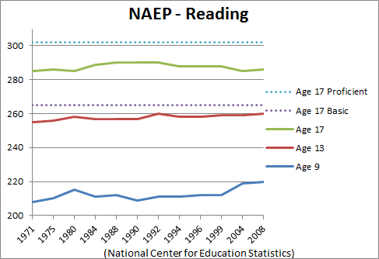
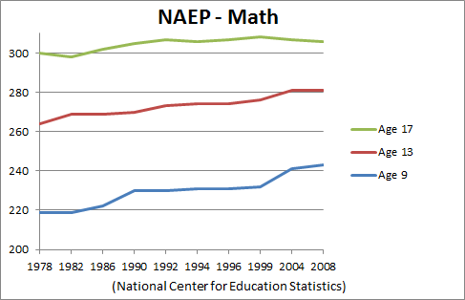
Theory 1: Standards and Accountability
NCLB delivered 50 states’ Standards and associated assessments
Result has been moderate improvement mostly in lower grades

Slide 3

Theory 2: Highly Qualified Teacher
Teacher quality is an important factor affecting student performance. But impact is insufficient to overcome student background.
Education Writers Association http://www.ewa.org/site/PageServer?pagename=research_teacher_effectiveness2

Slide 4

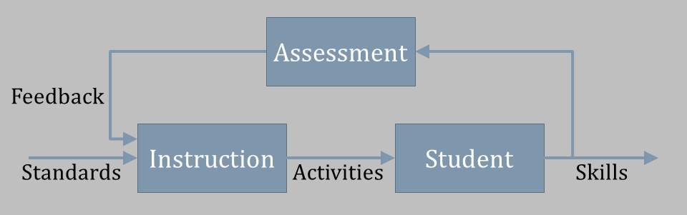
Theory 3: Personalized Learning
Personalized Learning programs consistently achieve 1-2 standard deviations better performance when compared with conventional instruction. This converts to roughly 2-4 times improvement in yearly progress.
See: http://www.ofthat.com/2013/01/blooms-two-sigma-problem-revisited.html
http://www.ofthat.com/2012/02/perverse-vocabulary-of-feedback-loops.html

Slide 5
Addressing Theories of Educational Improvement
Standards and Accountability
Better assessment of student skills encourages better teaching.
Highly Qualified Teacher
Teachers are supported in formative efforts, guided by interim results and informed by summative reports.
Personalized Learning
Interim assessments measure student progress and guide instruction during the school year.

Slide 6
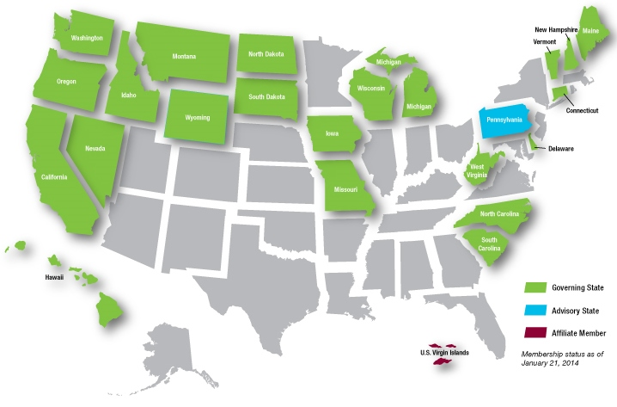
A National Consortium of States
24 member states and territories representing 39% of K-12 students
22 Governing States, 1 Advisory State, 1 Affiliate Member
Washington state is fiscal agent
UCLA Graduate School of Education will be permanent home.

Slide 7
A Balanced Assessment System
Summative assessments
Benchmarked to college and career readiness
Teachers and schools have information and tools they need to improve teaching and learning
Common Core State Standards specify
K-12 expectations for college and career readiness
All students leave high school college and career ready
Teacher resources for
formative assessment practices
to improve instruction
Interim assessments Flexible, open, used for actionable feedback

Slide 8
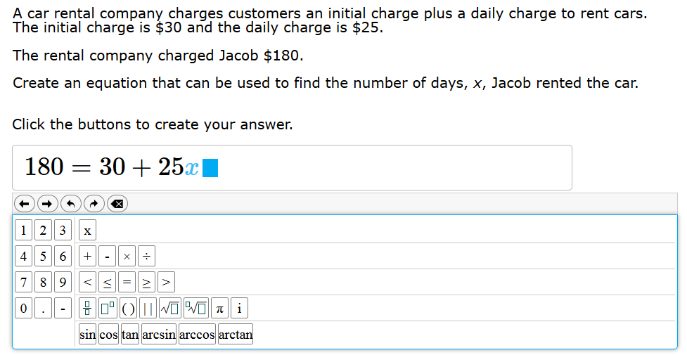

Slide 9
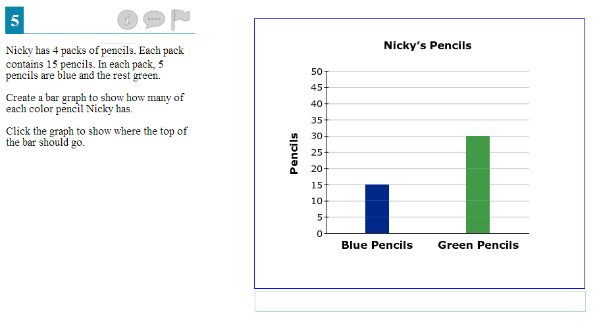

Slide 10
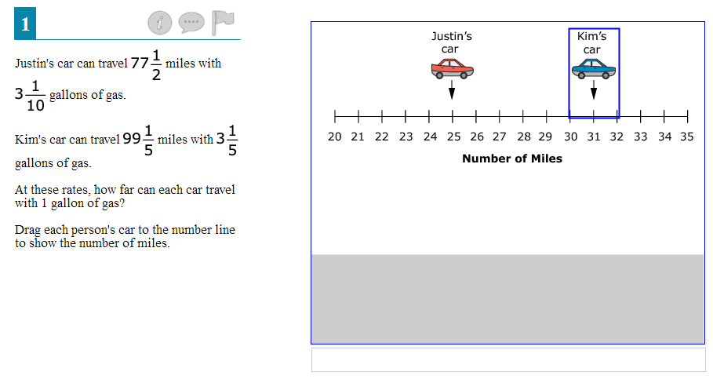

Slide 11
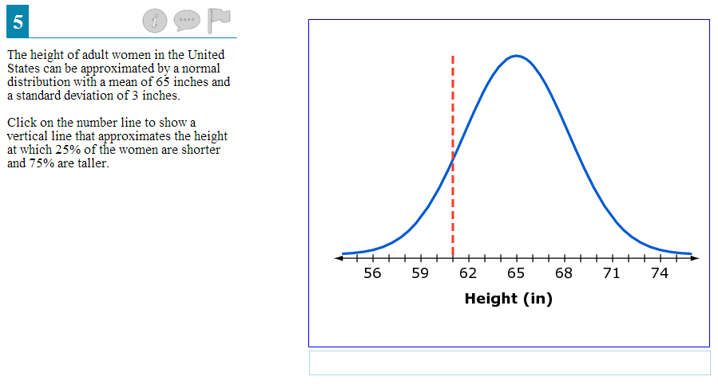

Slide 12
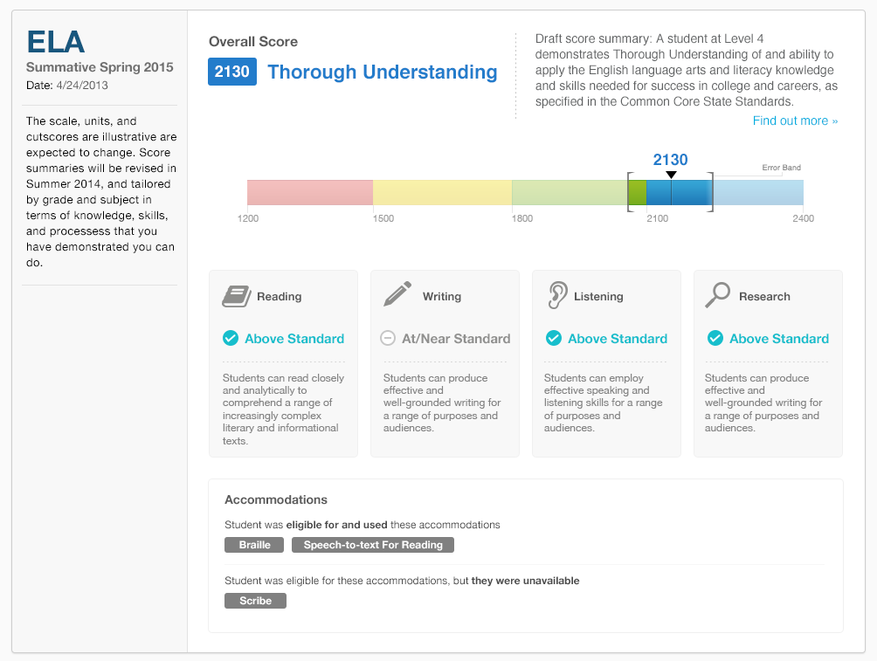
This is a mockup. Many things will change before the design is finalized.

Slide 13
Introducing SmarterApp.org
Smarter Balanced: A consortium of states developing common assessments for ELA and Mathematics that are aligned to the Common Core State Standards.
SmarterApp: A community of organizations devoted to collaboration on an open licensed software suite for the support of educational assessment.

