Slide 1
Summary of Scalable Security Modeling with Dynamics CRM
August 2016 Osha Fuangkasae

Slide 2
Terminology
Security Principal - an owner of access privileges
An individual user
A team of users
Privilege - the smallest unit of access
An (entity, action and scope)
An (action and scope)
Scope - the data range of a privilege
Basic/Owner - only to records the principal owns
Business unit - records within the business unit
Business unit and children - records within the business unit and its children
Organization - across the entire CRM

Slide 3
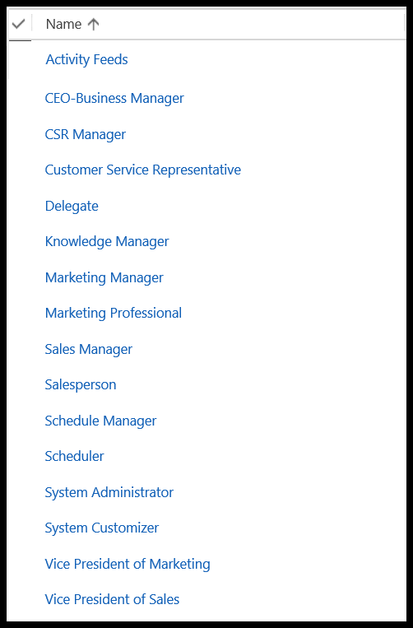
Default Security Roles
Dynamics CRM provides default security roles
An organization can use the existing roles, modify them or create new ones
When creating new roles, it’s easier to duplicate an existing one and modify it since there are so many privileges

Slide 4
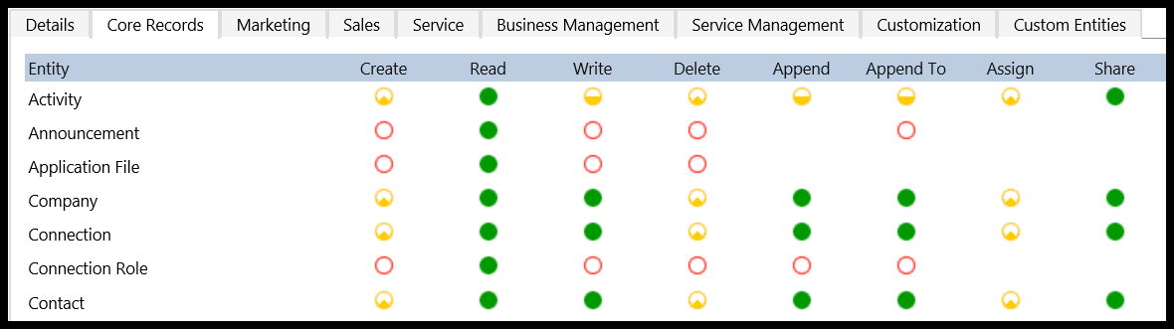
Inside a Security Role
Privileges are grouped by category
An entire vector of privileges can be modified by clicking the row/column header

Slide 5
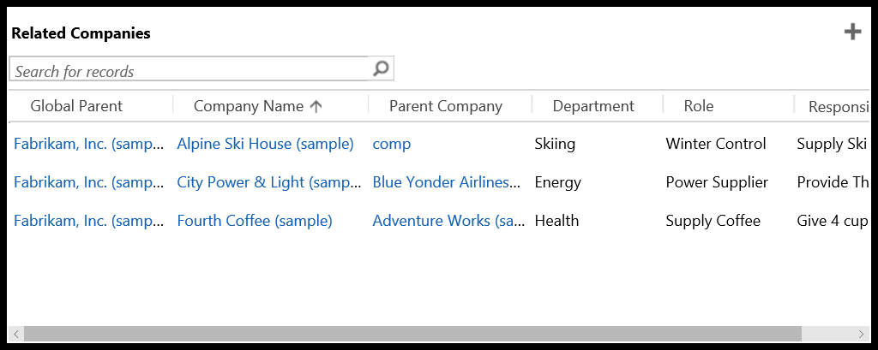
Append/Append To
Records can be associated with other records
For example, Accounts can be associated with other Accounts
The user creating the association must have the appropriate privileges for the action to succeed
When appending A -> B, the user must have Append with scope covering A and Append To with scope covering B
Add “me”
Best description: http://www.inogic.com/blog/2010/05/append-vs-append-to/

Slide 6
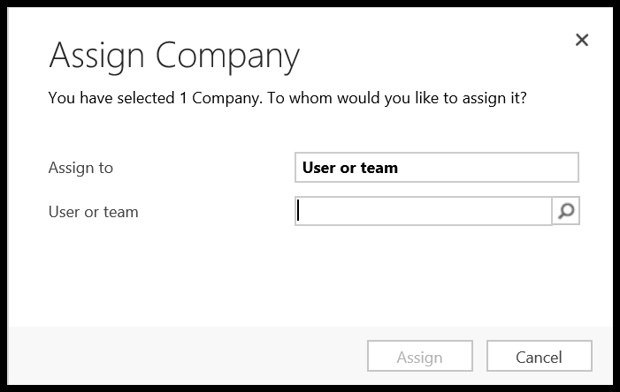
Assign
Assign simply changes the owner of a record
The new owner must at least have Read privilege for the Assign to work

Slide 7
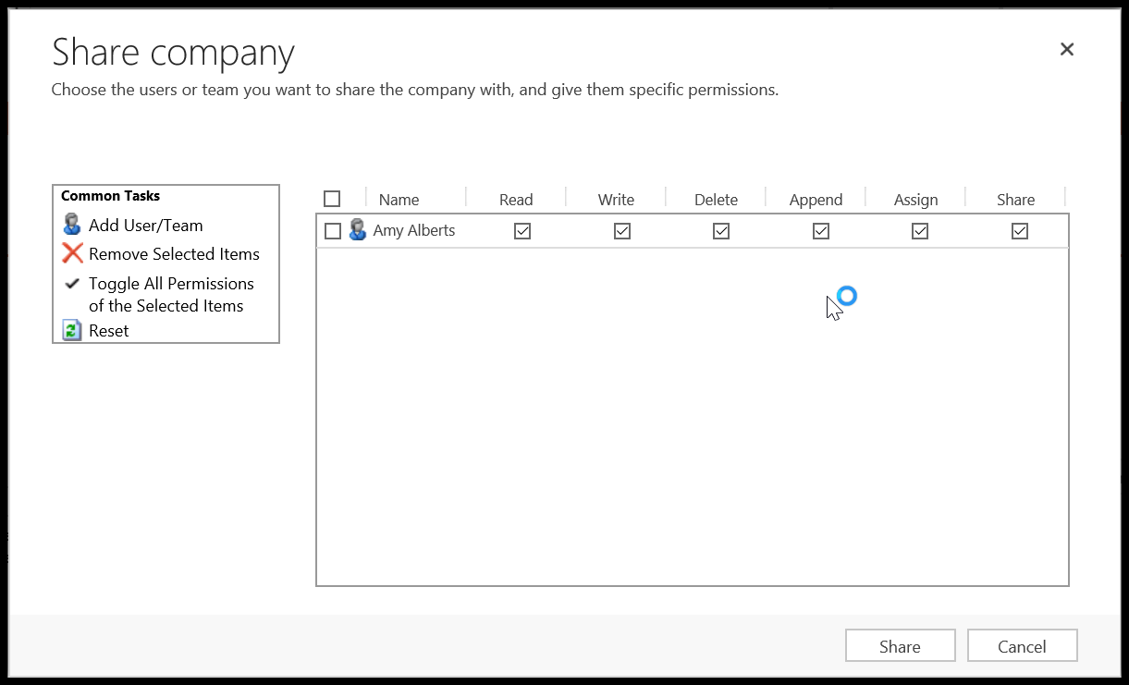
Sharing
A user A can share his/her privileges on a record R with another principal B (e.g. for coverage during a holiday)
A must have the Share privilege with scope encompassing the record R (e.g. Basic Share if A owns the record)
B must at least have Basic Read privilege on the Entity
You can’t share privileges that you don’t have
A new Activity is automatically shared with all of its participants

Slide 8
Sharing cont.
Sharing is expensive
Too much sharing has a negative impact on maintainability and performance
A single share is cascaded when sharing a record appended to other records
Microsoft discourages sharing with individual users and recommends sharing with teams to mitigate growth of sharing records

Slide 9
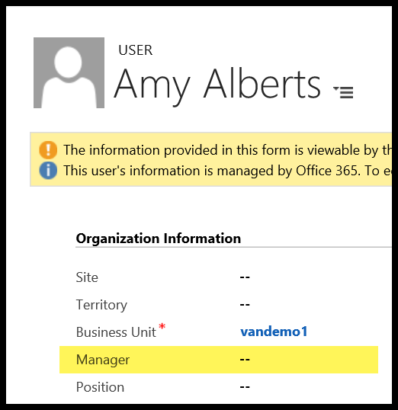
Managers
You can define a management hierarchy between users
You can enable inherited permissions for managers
Direct managers inherit certain privileges from their reports
Basic privileges only
Does not include secure fields
Transitive managers only inherit Read privileges from their reports

Slide 10
Access Teams
Every record could

Slide 11
Miscellaneous Thoughts

Slide 12
Link
http://www.microsoft.com/en-us/download/details.aspx?id=45905

