Slide 1


GDP and Life Expectancy Analysis
Team members:
Waleed Hanna
Olufunke Olaleye
Hiral Patel
Kush Patel
Tyler Turk
Project 1_2019

Slide 2
The relationship between GDP and life expectancy
To be present,
Correlation between world GDP and life expectancy
Continents with Highest and Lowest Life Expectancy
Continents with Highest and Lowest Population
Continents with the Highest and Lowest GDP
Happening to life expectancy over time
The correlation between major economic blocs
Data Source: Kaggel.com
contains data about each country GDP and its population, life expectancy from 1950 to 2007.

Slide 3
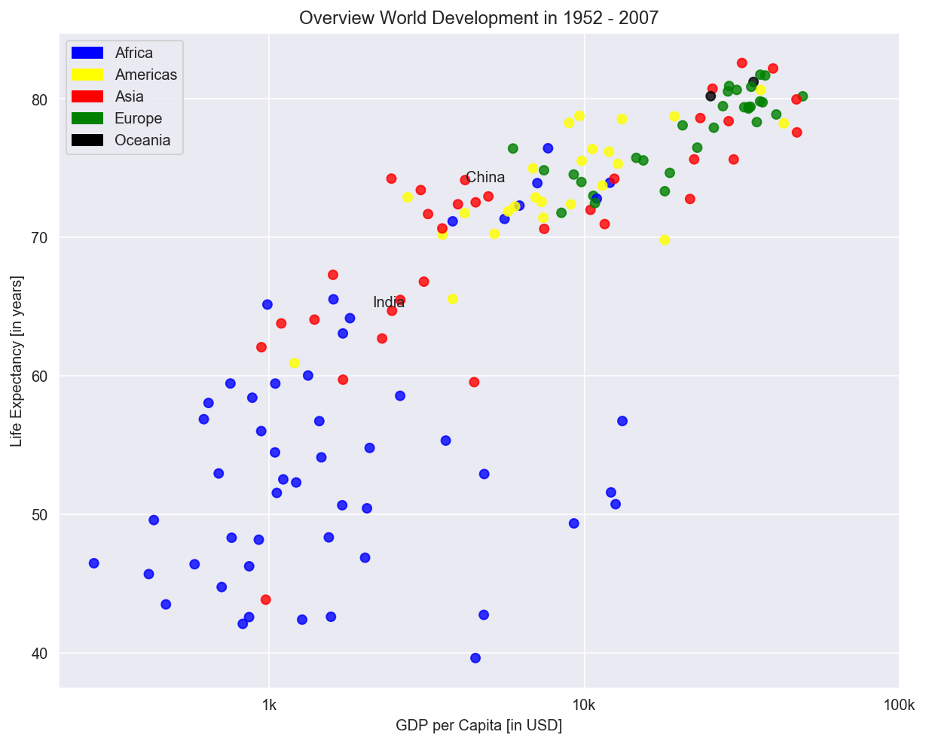
Higher GDP usually corresponds to a higher life expectancy.
In other words, there is a positive correlation.

Slide 4
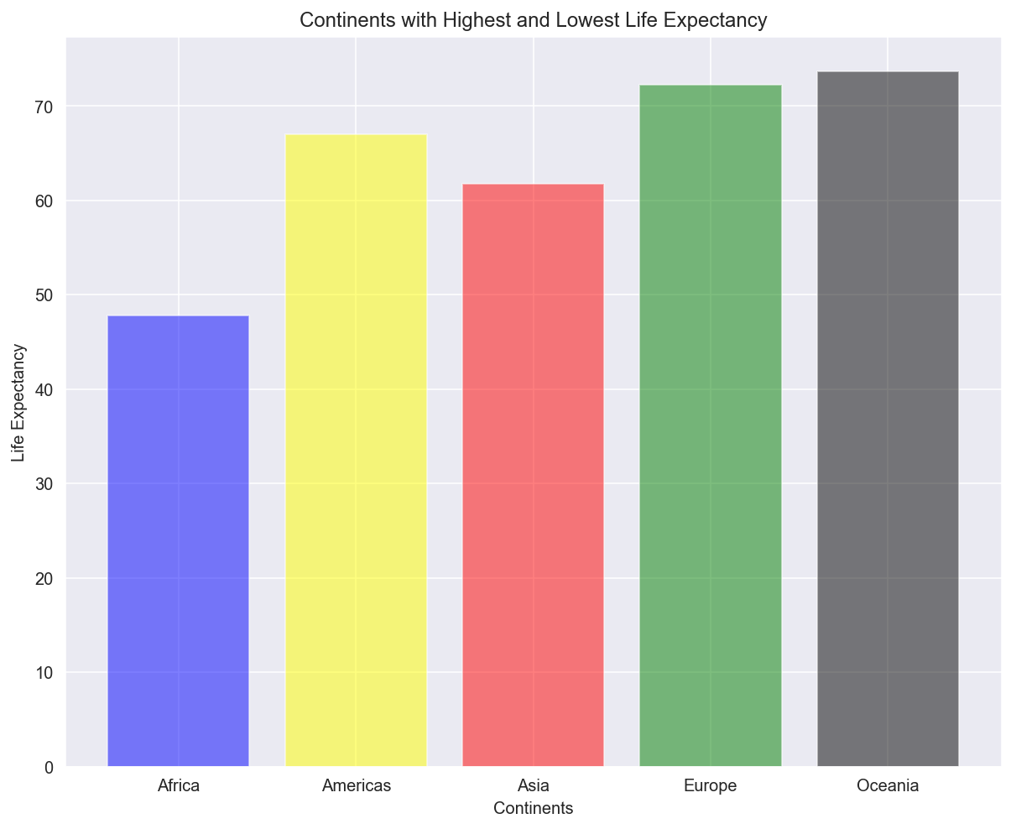
Continents with Highest and Lowest Life Expectancy
Highest Life Expectancy – Oceania
Lowest Life Expectancy - Africa

Slide 5
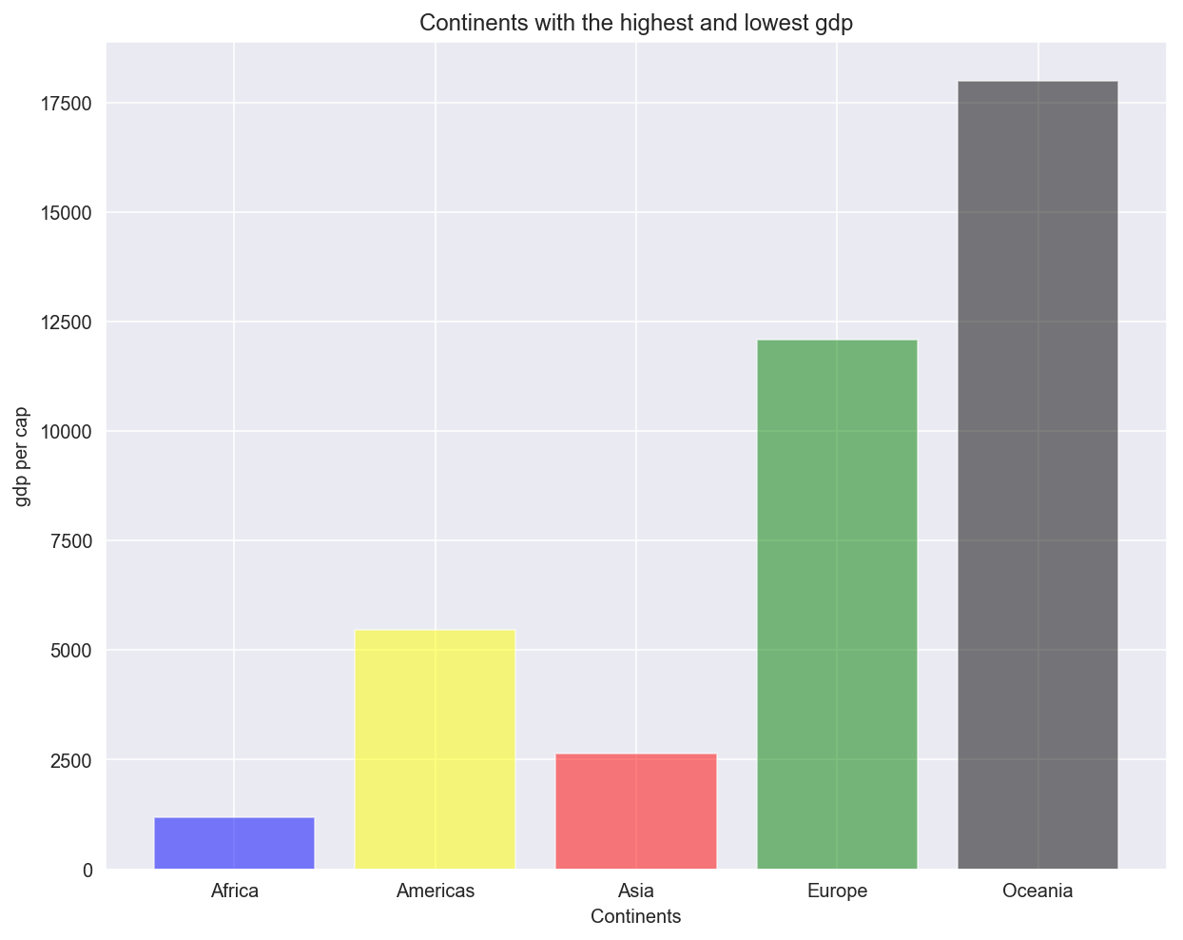
Continents with the Highest and Lowest GDP
Highest GDP – Oceania
Lowest GDP - Africa

Slide 6
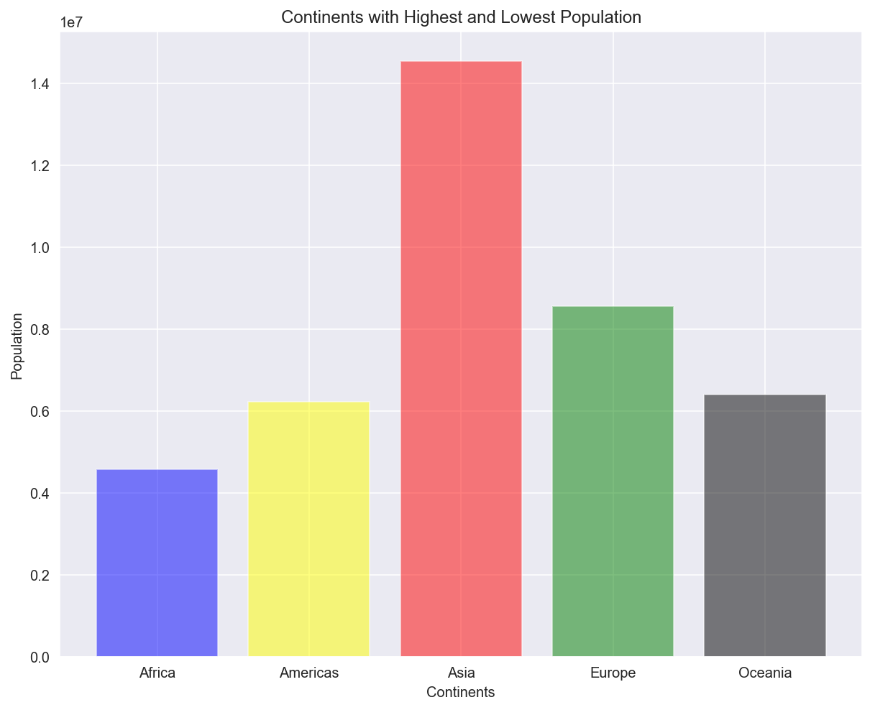
Continents with Highest and Lowest Population

Slide 7
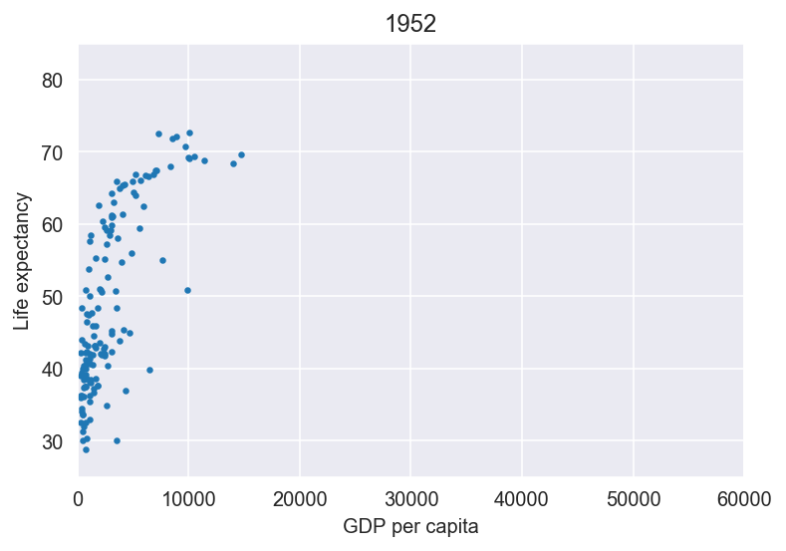
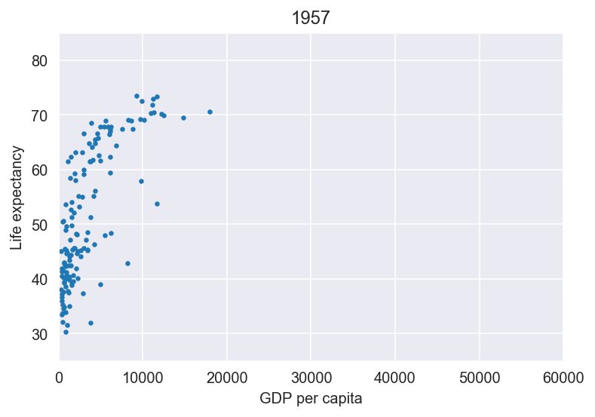
GDP vs Life Expectancy over a time
Shows what is happening to life expectancy over a time?

Slide 8
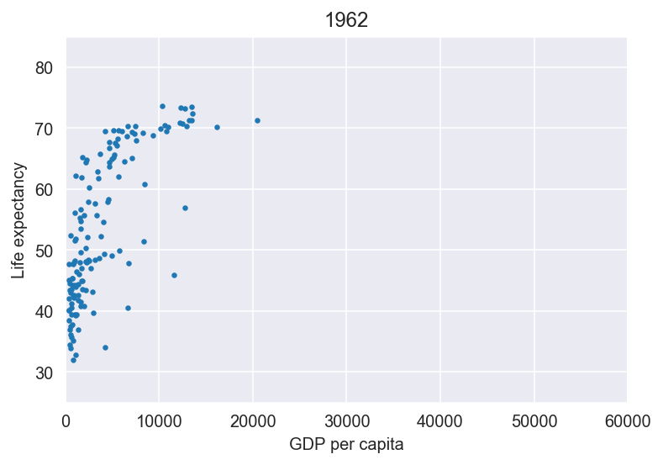
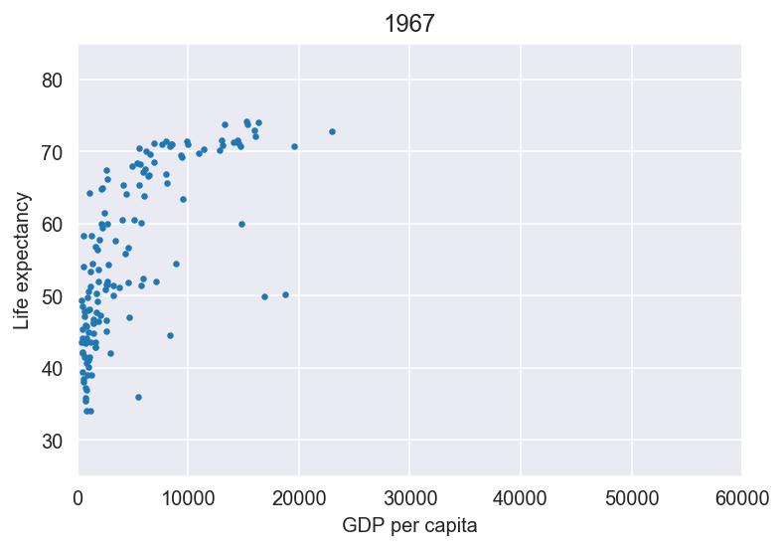
GDP vs Life Expectancy over a time

Slide 9
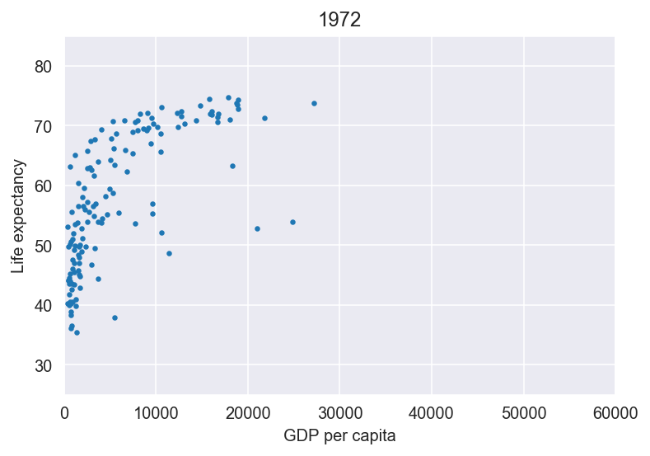
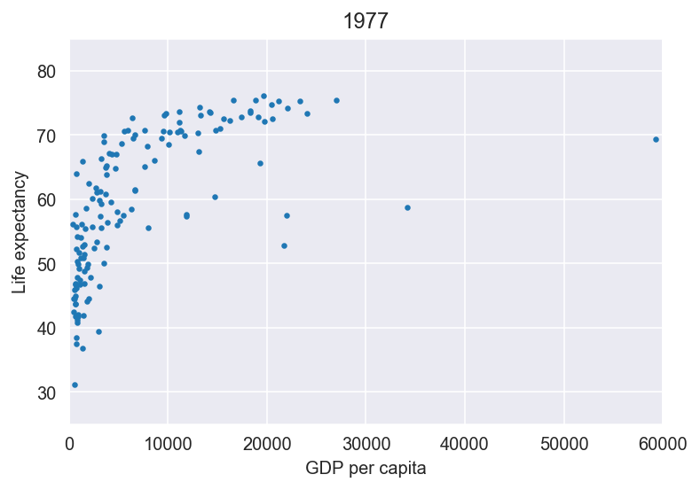
GDP vs Life Expectancy over a time
Shows what is happening to life expectancy over a time?

Slide 10
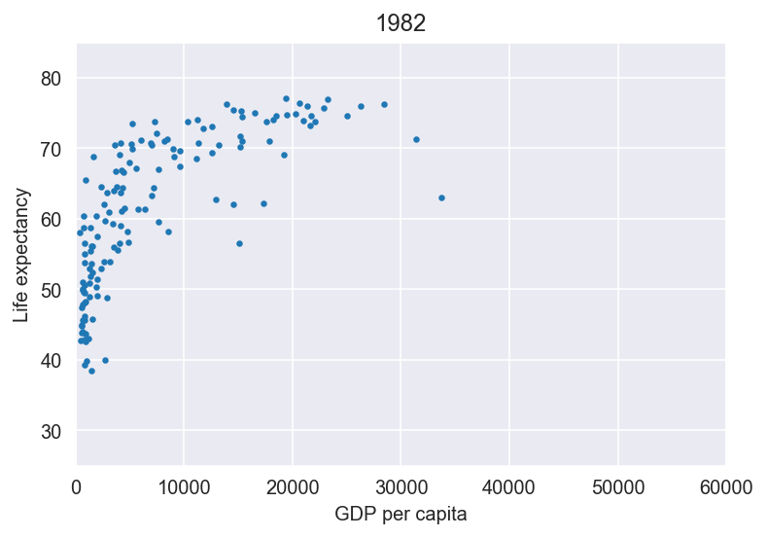
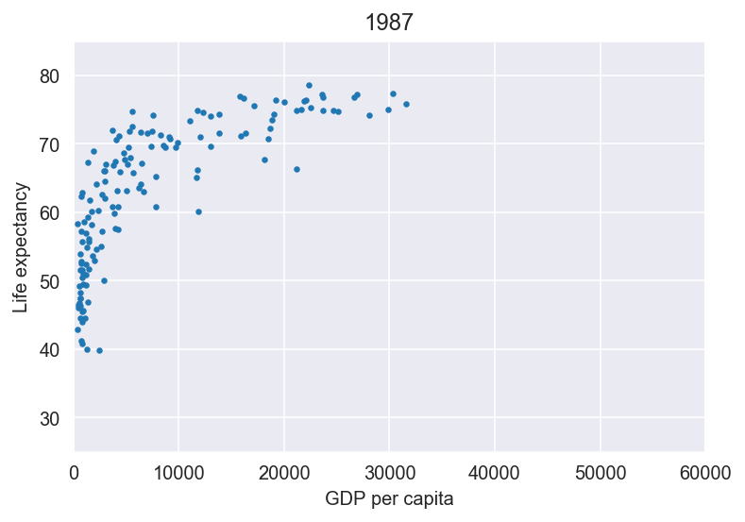
GDP vs Life Expectancy over a time
Shows what is happening to life expectancy over a time?

Slide 11
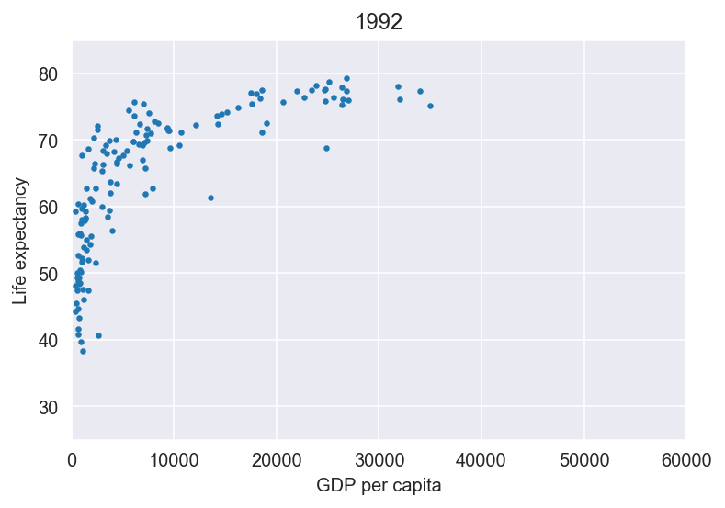
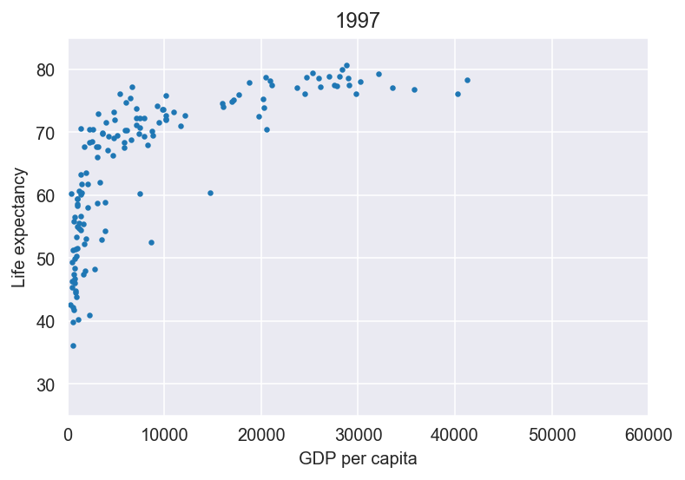
GDP vs Life Expectancy over a time
Shows what is happening to life expectancy over a time?

Slide 12
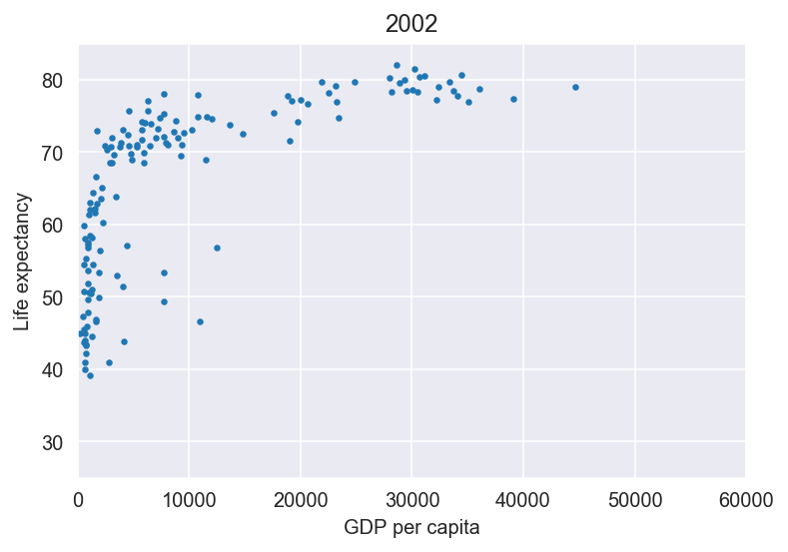
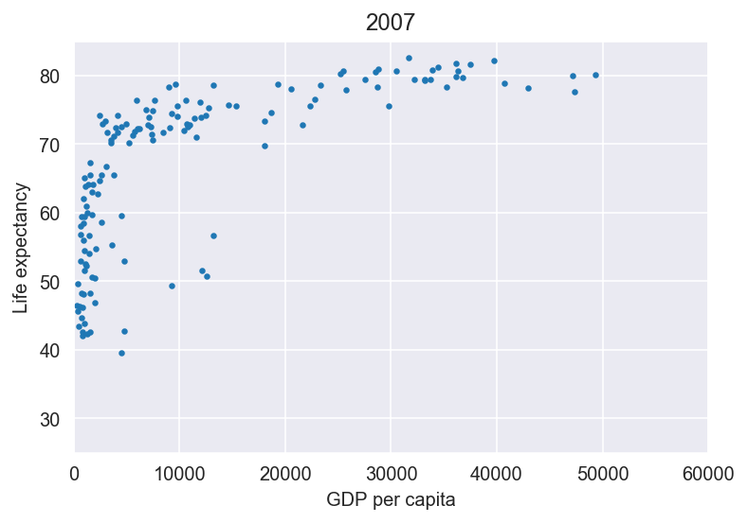
GDP vs Life Expectancy over a time

Slide 13
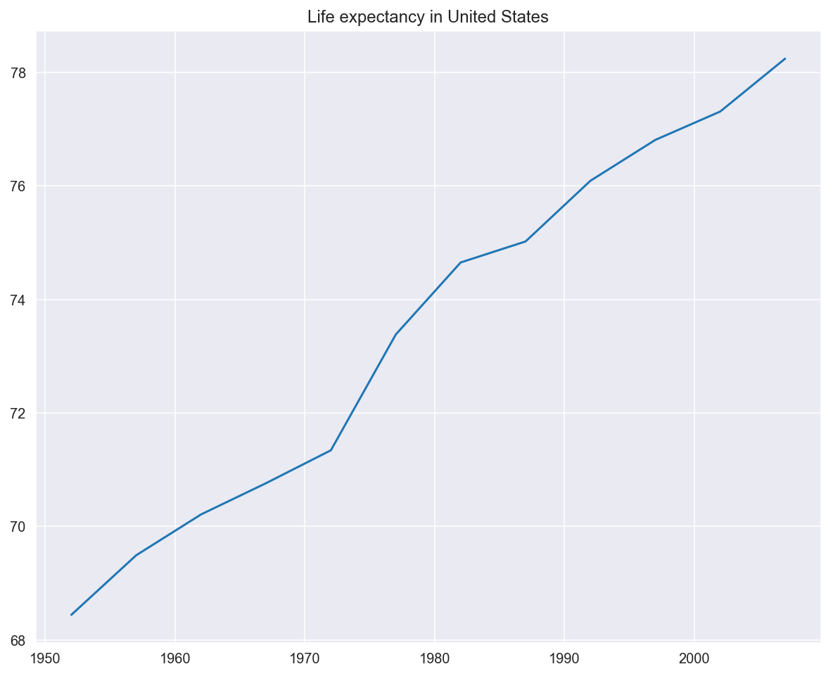
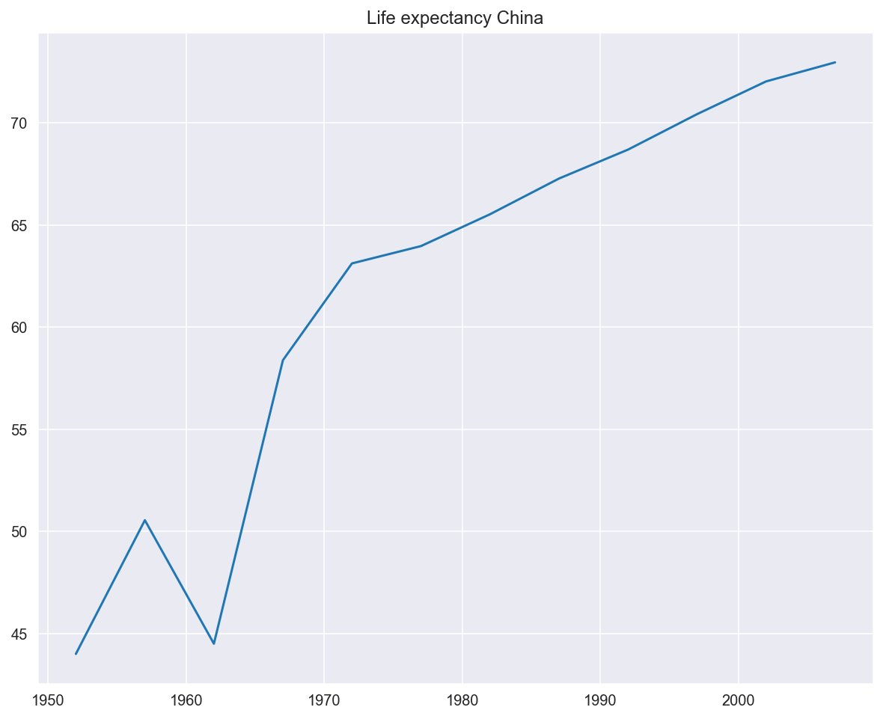
Life Expectancy per Country – USA & China

Slide 14
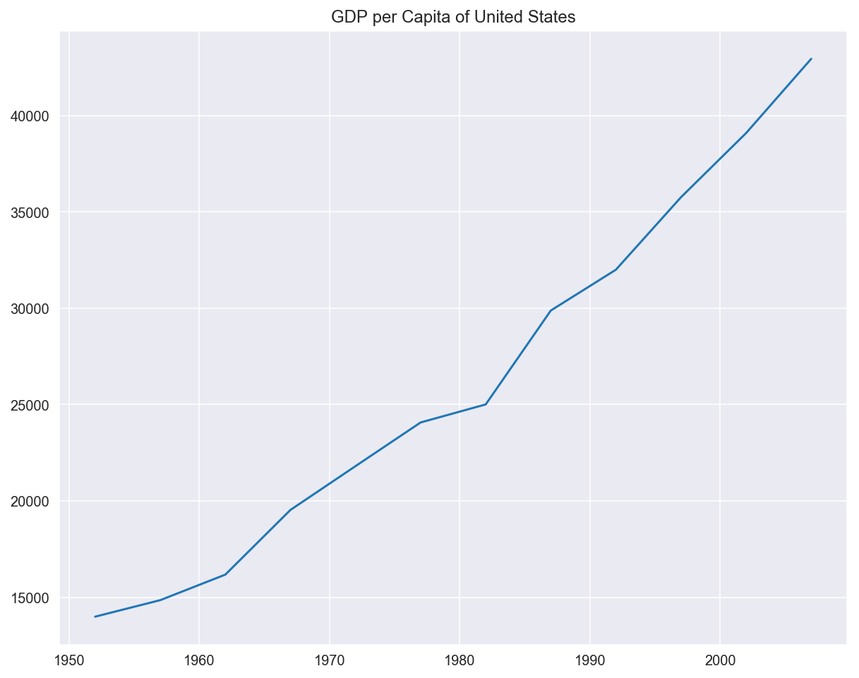
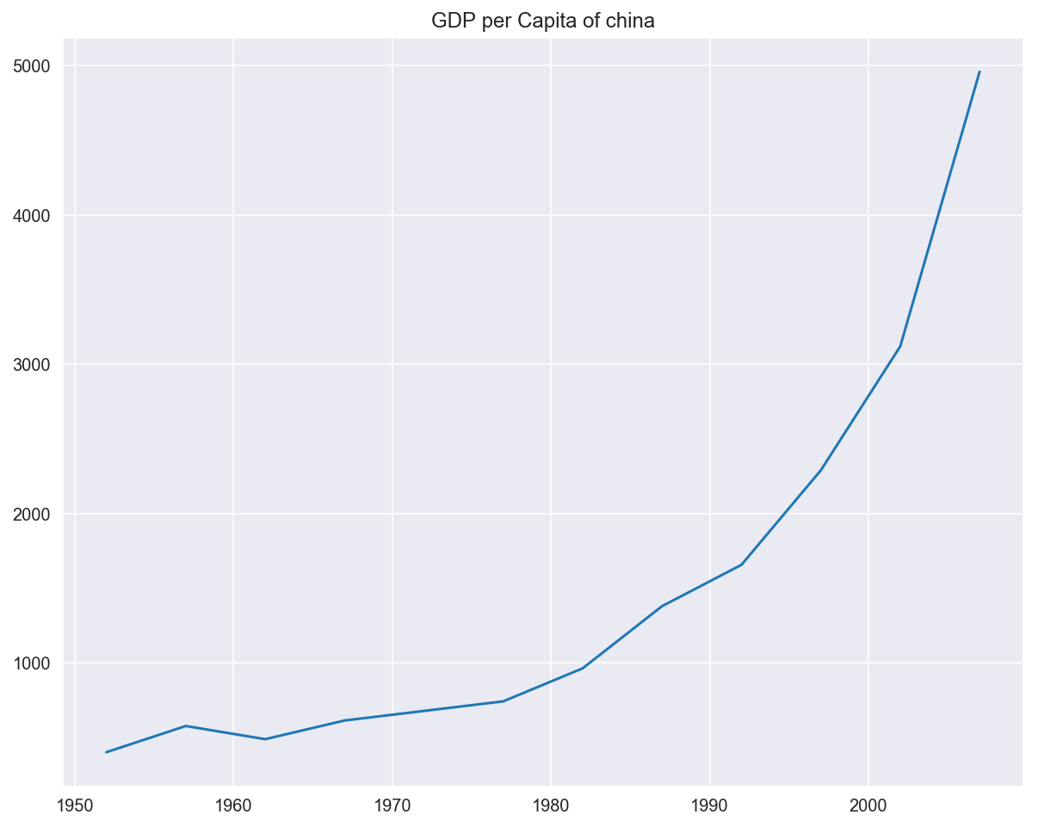
GDP per Country – USA & China

Slide 15
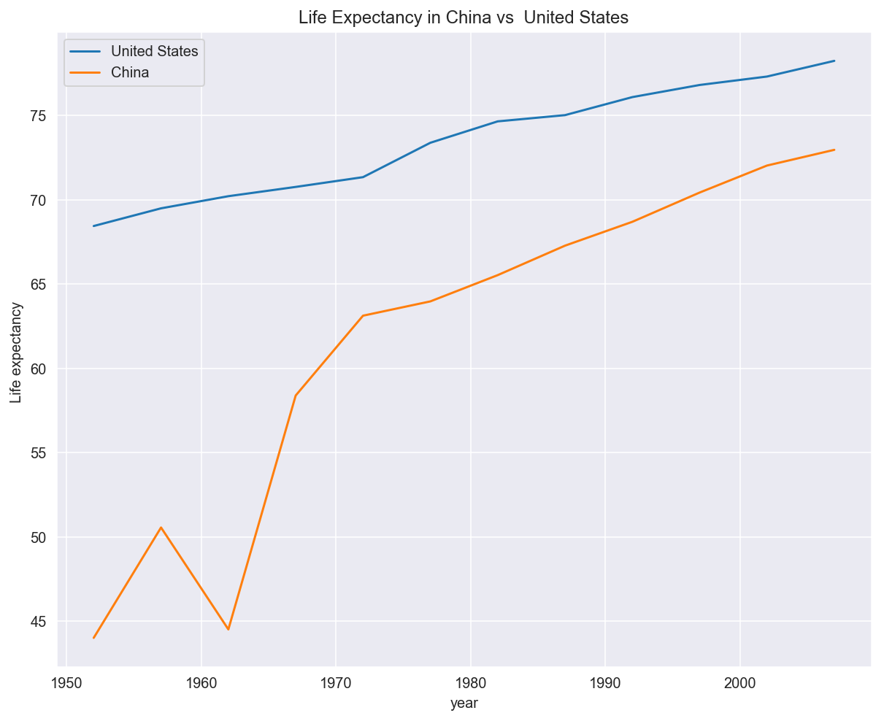
To compare the two largest countries - USA and China

Slide 16
Summary
the world is seeing an increase in GDP and Life expectancy over a time. Those countries which have a higher GDP for the most part tend to have a higher life expectancy.
The continents with the highest GDP and Life expectancy turn out to be Oceania.
The continent with the lowest GDP and life expectancy is Africa.
There is no correlation between China and USA for GDP as China is a communist country and they manipulate their currency making it difficult to find any correlation as we have a free floating currency.
As for life expectancy, China is starting to catch up to the USA and overtime both countries have seen an increase over time.

Slide 17


Thank you !

