Slide 1


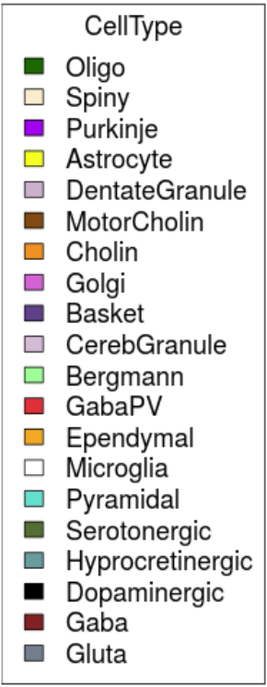
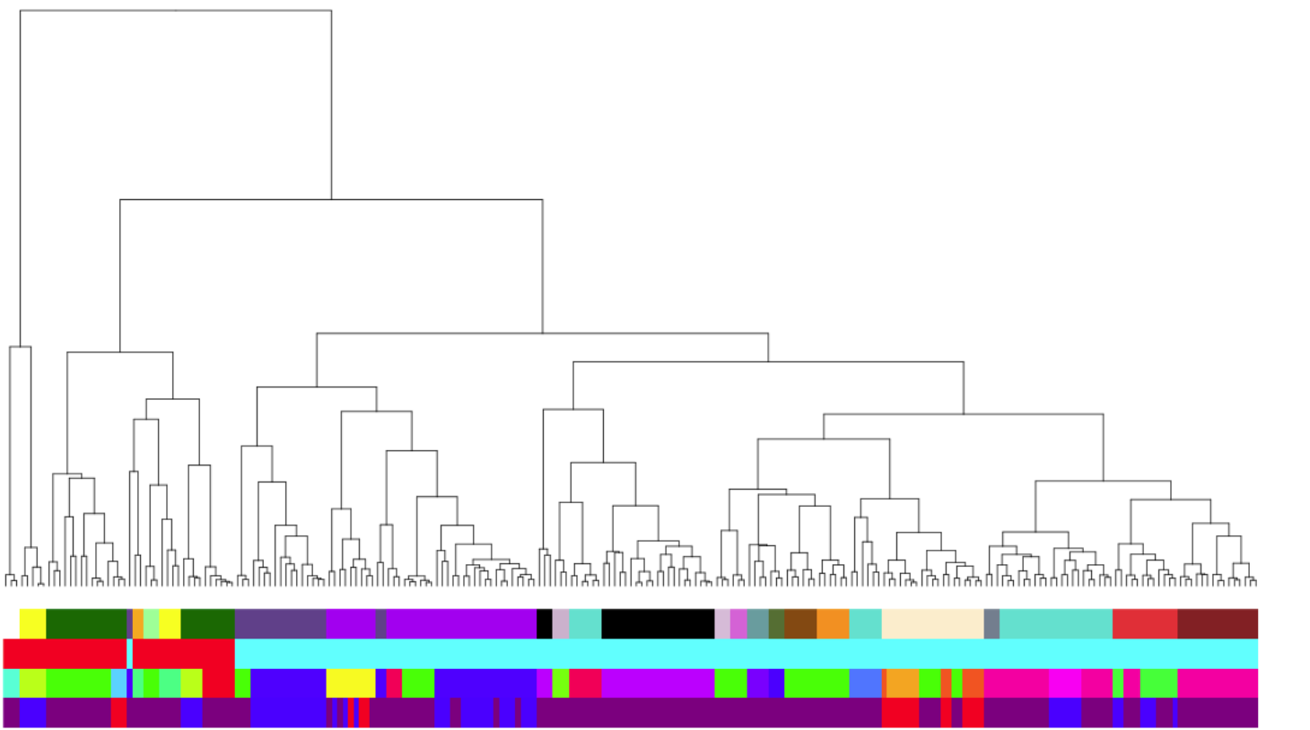
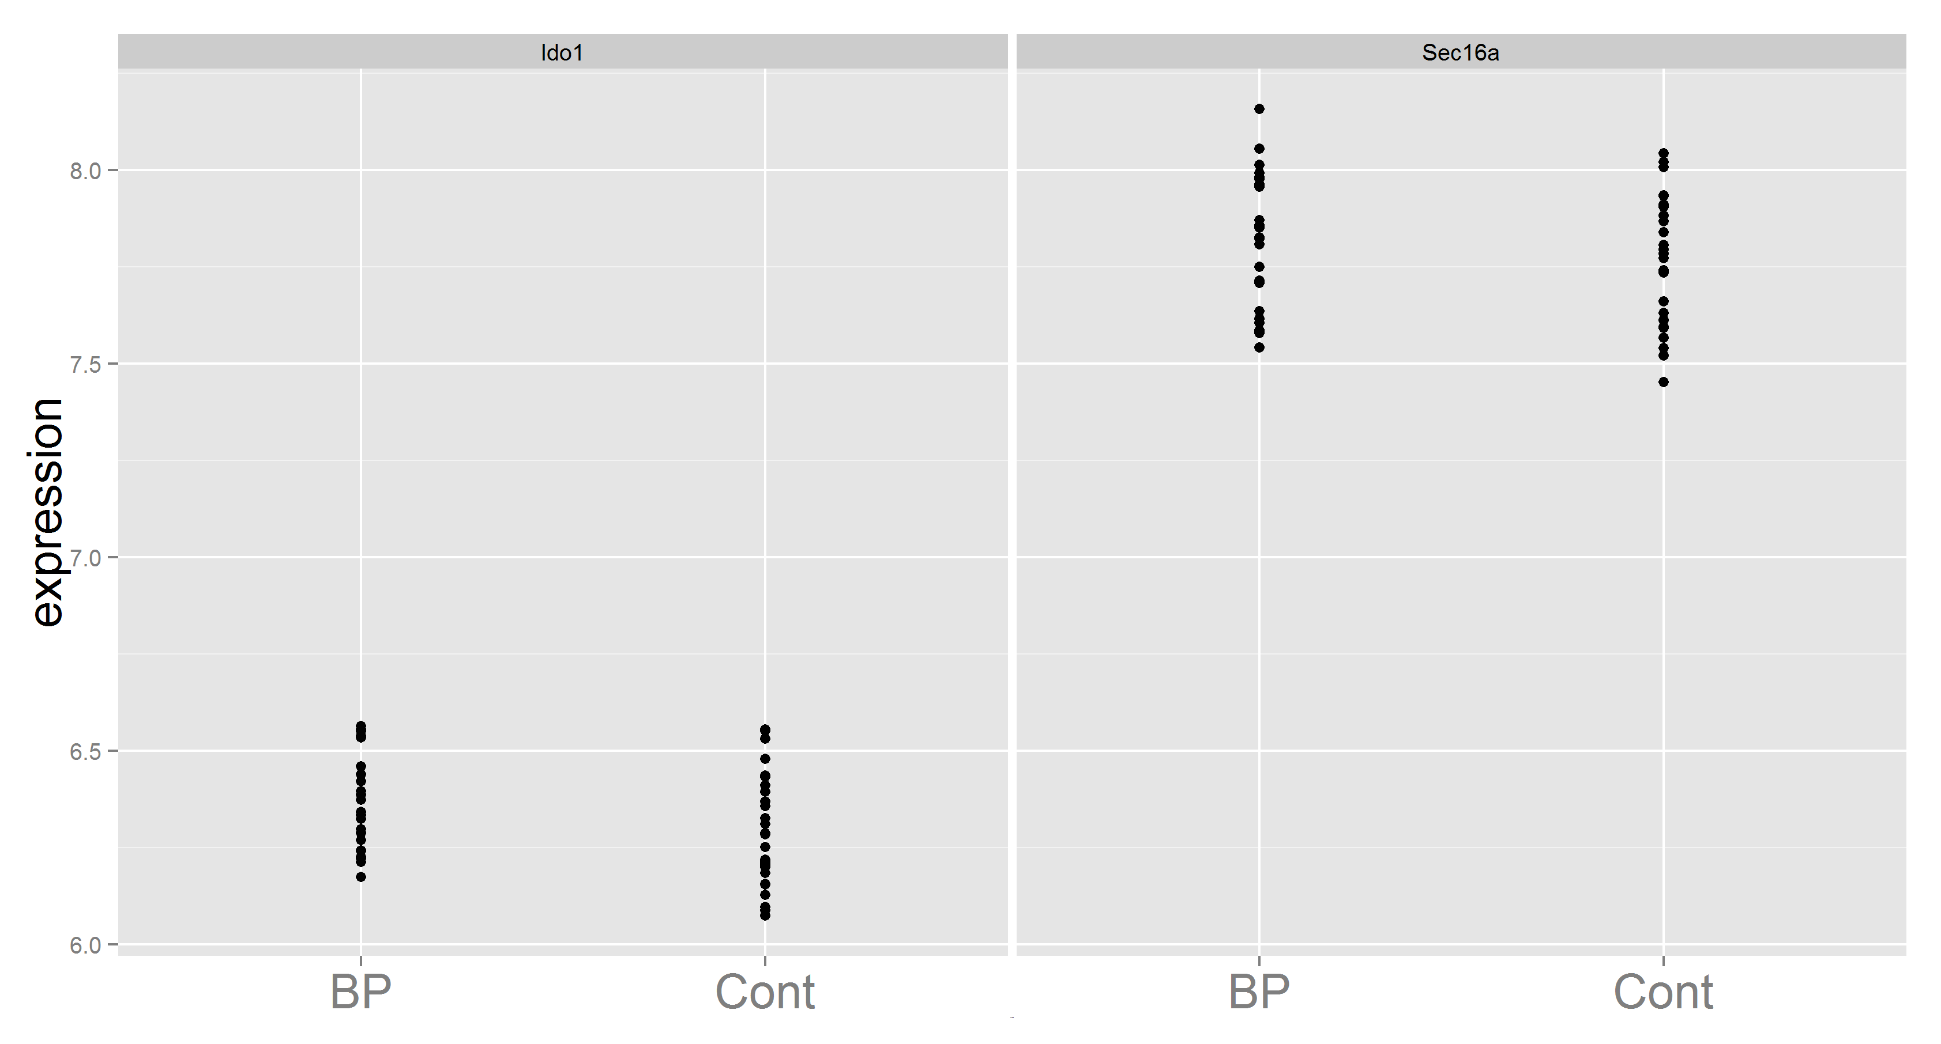
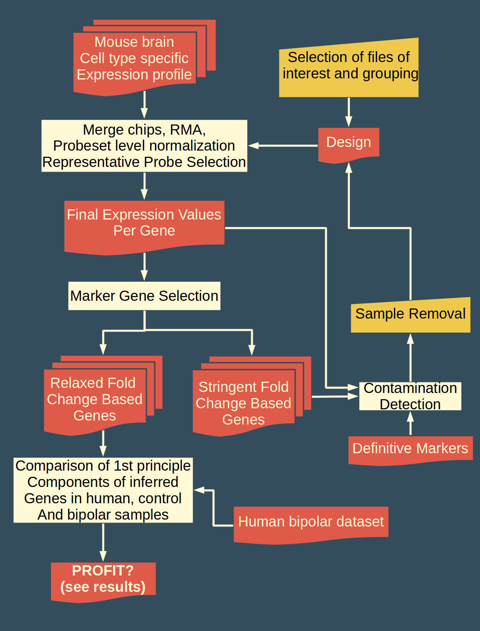
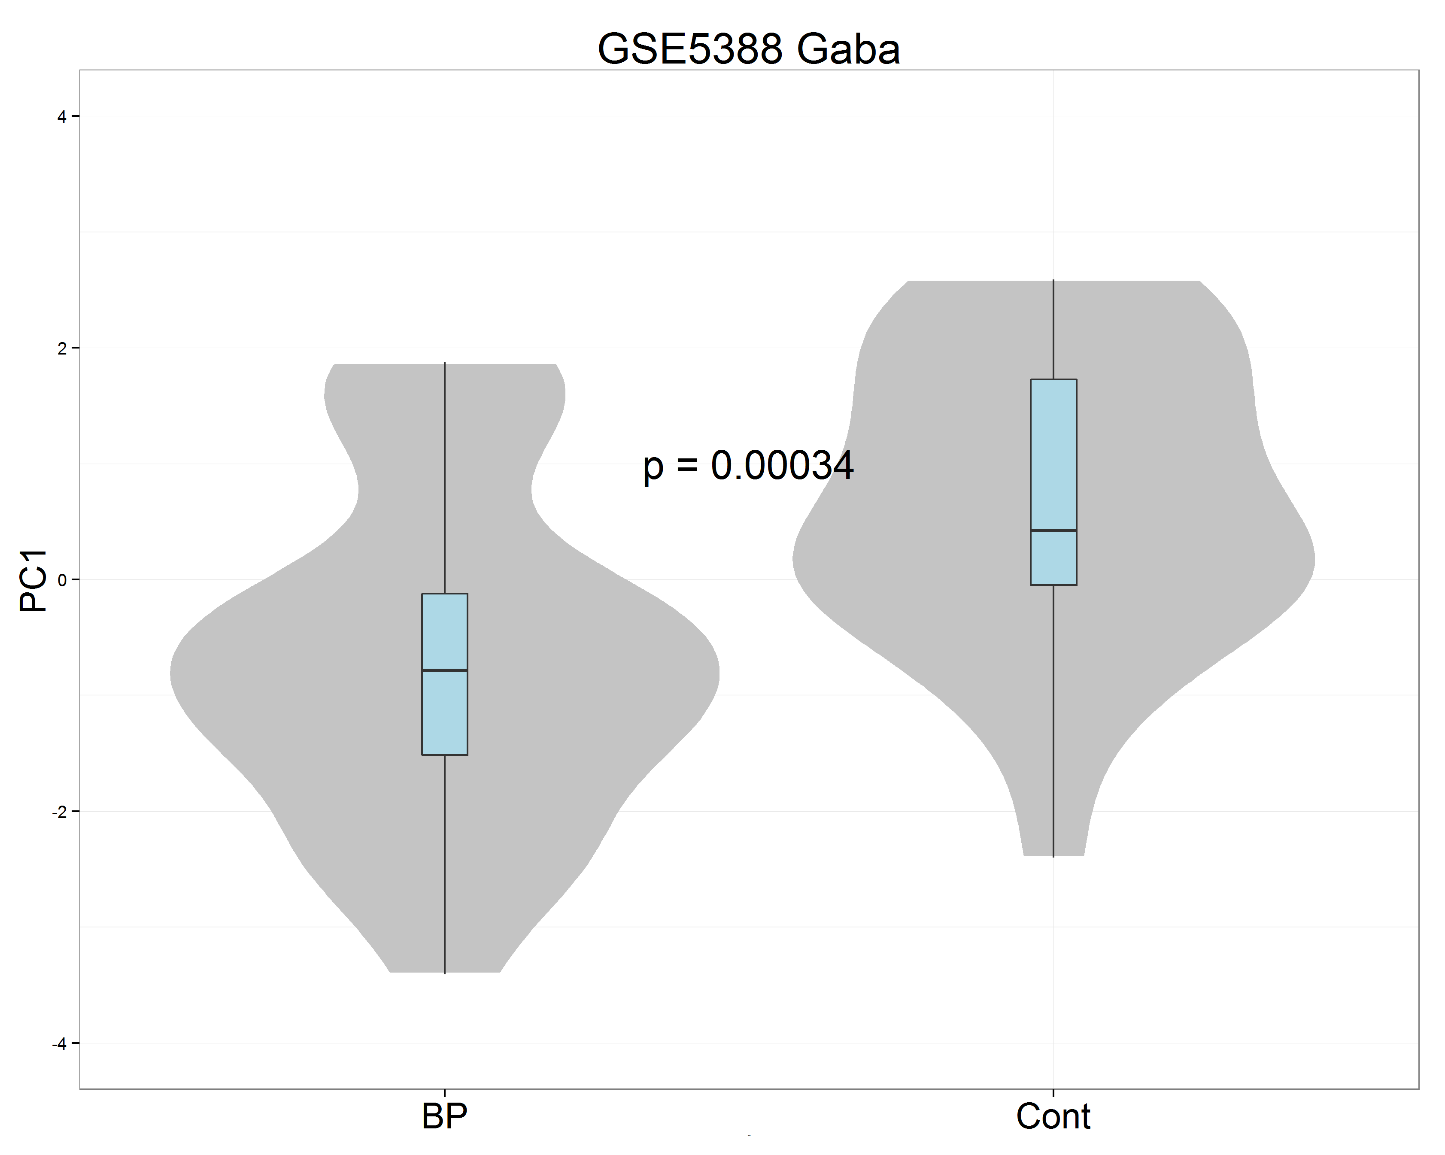
Inferrence of hidden information in mixed samples using cell type specific data
B. Ogan Mancarci, Lila(c)h Toker, Paul Pavlidis
Introduction
The Data
Why PC1
Even though it is known that many neurological diseases are related to loss of cell types, mainstream studies focus on differential expression. It is hard to acquire cell type specific samples for every study. We hope to address this problem by looking at the changes in expressions of cell type specific genes. To do this we used a set of mouse cell type specific data to identify cell type specific genes and a human bipolar study to observe the changes in their expression to infer changes in cell type contributions.
Bulk of it is compiled in a previous study¹ with some additions of our own. Contains data from 20 cell types compiled from 19 studies.
As the genes are cell type specific, we postulated most variation in their expressions should be explained by the changes in their relative abundances. Using PC1 also helps us reduce the effects of genes that are not expressed in humans or are not coexpressed with their peers.
Pipeline
Cell Type
Sex
Study
Age
Results
We observed an overall increase in most glial cell types while a decrease in most neuronal cell lines.
Methods
In relaxed selection, genes that had 10 difference to the median were selected. While in stringent selection, a gene needs to have a 10 fold diference to every other cell type.
Based on some known markers and the genes coming from the stringent gene selection phase, a contamination index was calculated as described in ---- et al². Based on this the results, samples that are found to be overly contaminated are removed.
In human control and bipolar samples, otrhologues of the genes were used. First principal component of the expression values were used to describe the overall occurence of the cell type in the sample. Genes with negative contributions to PC1 were removed.
References

