Slide 1
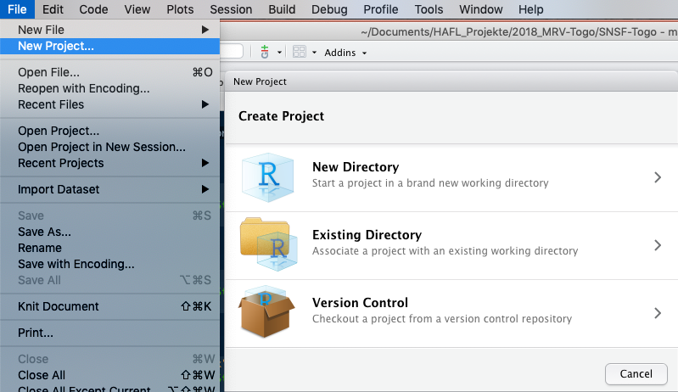
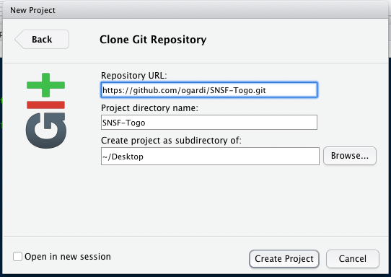

Slide 2
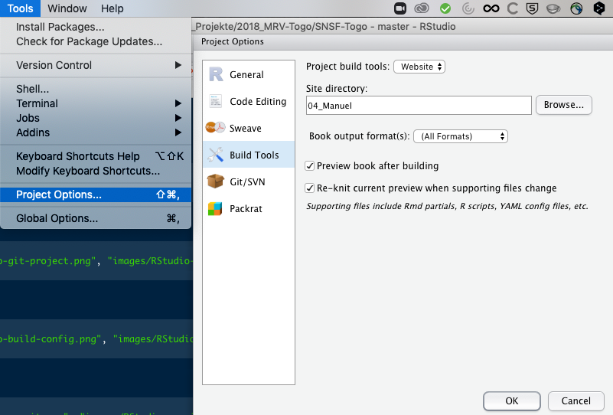
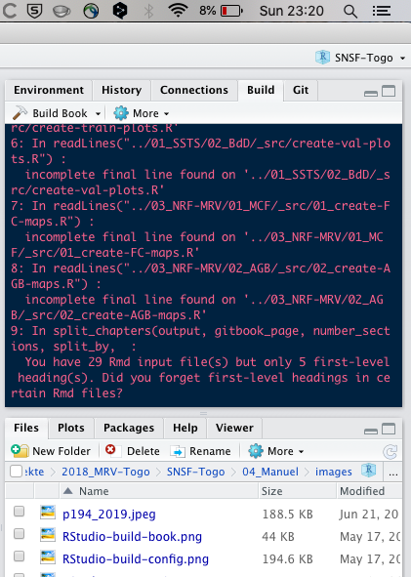

Slide 3
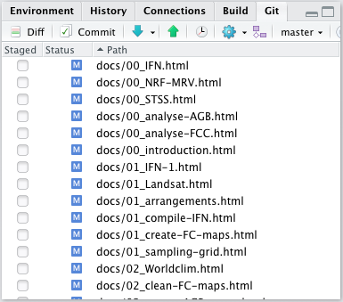
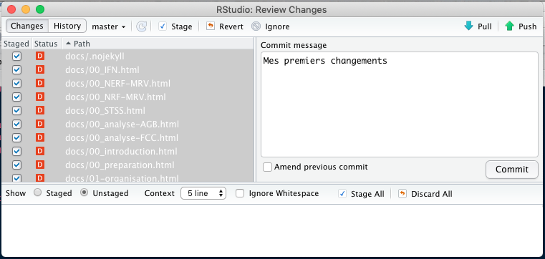
6.
2.
1.
7.
3.
4.
5.

Slide 4
… F x F … —> … F F F … | … N x x N … —> … N N N N …
taille = 5
taille = 3
1er tour: | F | F | F | N | N | F | N | F | F | N | F | F | F |  |  | F | F | F | N | N | N | N | F | F | N | F | F | F
2ème tour: | F | F | F | F | N | N | F | F | F | F | F | F | F |  |  | F | F | F | N | N | N | N | N | F | F | F | F | F
3ème tour: | F | F | F | F | F | F | F | F | F | F | F | F | F |  |  | – | – | – | – | – | – | – | – | – | – | – | – | –
*
*
*
*
*
*
 |  |  |  |  |  |  |  |  | F | x | x | N | —> | F | F | F | N
 |  |  |  |  |  |  |  |  | x | x | N | N | —> | N | N | N | N
N | N | N | F | F | F | F | F | N | N | N | N | N | —> | N | N | N | N | N | N | N | N | N | N | N | N | N
N | N | F | F | F | F | F | F | F | F | F | F | F | —> | N | N | P | P | P | P | P | P | P | P | P | F | F

Slide 5
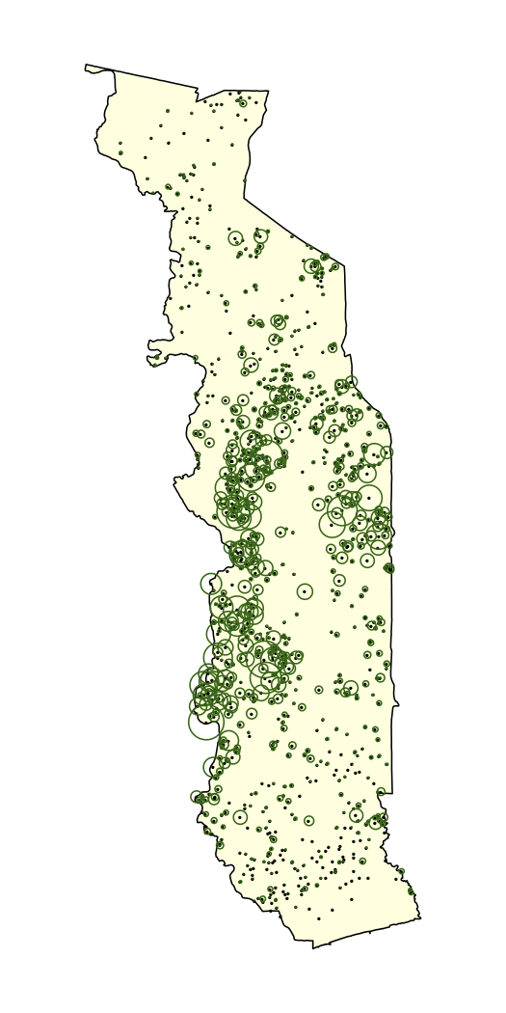
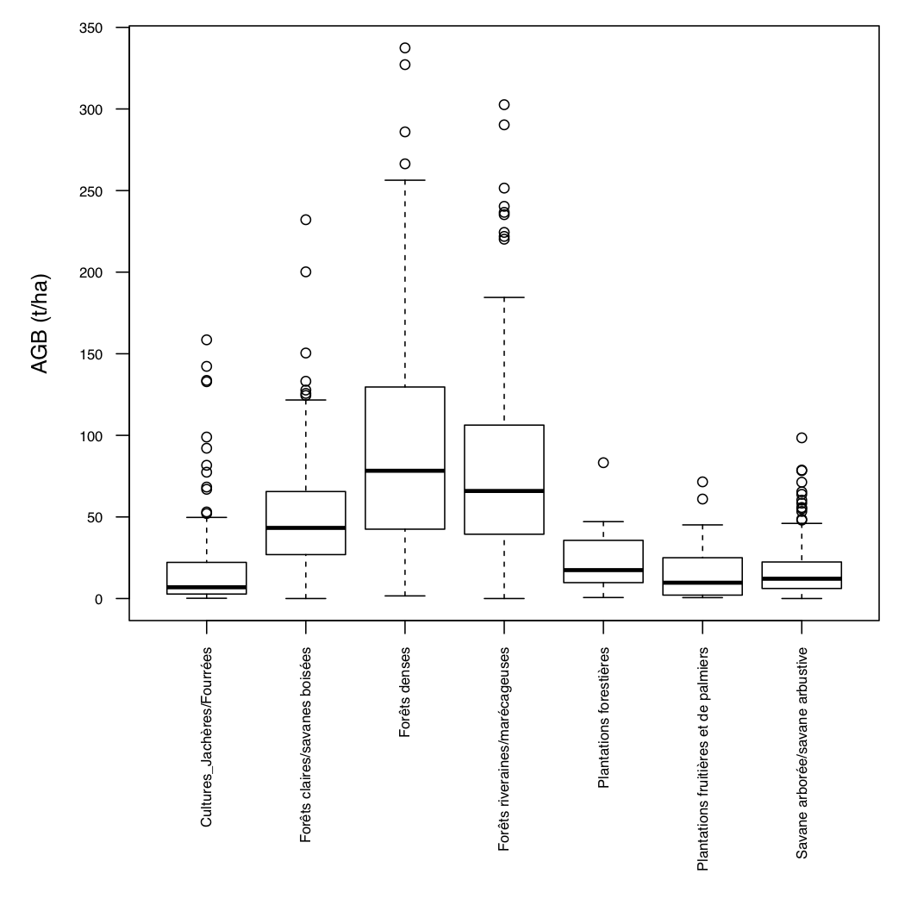

Slide 6
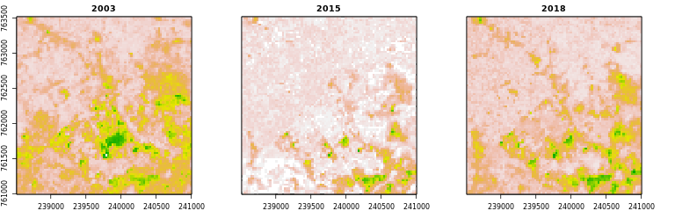
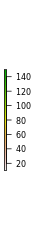

Slide 7
IFN 2015/16
Carte biomasse 2015

Slide 8
Densité des pixels
2003
2018
Biomasse aérienne (t/ha)

