Slide 1
Efficient Execution of Languages Like Java
(Java言語の高速化技術)
Satoshi Matsuoka
Tokyo Institute of Technology/
JST
JSSSTutorial 2001/03/31
Slide ver. 2001/03/03

Slide 2

Objective of The Tutorial
Identify the different assumptions of Java execution, and challenges imposed thereby
Describe history and technicalities of various work to overcome the challenges
Introduce some of the work that exploits Java’s execution characteristics
Convince people work on systems efforts on interesting and better languages like Java, instead of arcane languages like Fortran…
NOTE: Java is an exemplar for new generation of programming languages. Many issues discussed is applicable to languages “like Java”

Slide 3
Disclaimers
Can’t possibly cover all the research topics
  Too many research going on
  Have to write a book!
Can’t possibly cover all the slides
  Too many slides for too many topics
  Please read the slides, and/or ask me later
Can’t possibly finish the slides by camera-ready deadline (_o_)
  Latest slides at http://www.openjit.org

Slide 4
Audience Assumptions
Assume basic knowledge of object-orientation
  Objects, class, encapsulation, methods, constructors, etc.
Assume some familiarity with Java
Assume familiarity with traditional compiler technologies
  Program graphs, basic analysis techniques, basic optimization techniques

Slide 5
Table of Contents
1.Intro -- Overview of Java and Differences from Traditional Languages
2.General Optimization of Java Programs
3.Optimizing Concurrent Execution
4.Numerical Optimizations of Java Programs
5.Advanced Techniques and Research Trends Utilizing Java Characteristics
6.The Future and Conclusion

Slide 6
Intro -- Overview of Java and Diffs from Traditional Languages (e.g., Fortran)
Historical Perspective: Bits and Pieces of:
  Smalltalk (Simple OO Language Model, Class Library)
  CLU/Modula (Strong Typing, Modules)
  Lisp (Dynamic Memory Management)
  C/C++ (Syntax, Protection, Exceptions)
Standardization of Object-Oriented Languages
  C.f. C in Systems Programming, Fortran in HPC, Scheme in Functional Prog.
  Resurgence of recent research in OO languages
  Language Standardization, Bytecode standardization, Library Standardization

Slide 7
Java Historical Perspective
(Cont’d)
Java Development
Oak Language
  Handheld device&STBs main apps
Java JDK 1.0
  HotJava browser, still very slow
Java JDK 1.1
  Fast JIT Compiler
Java JDK 1.2. and later (Java 2)
  Advanced Compilers, Runtime
  New Language/Library Features

Slide 8
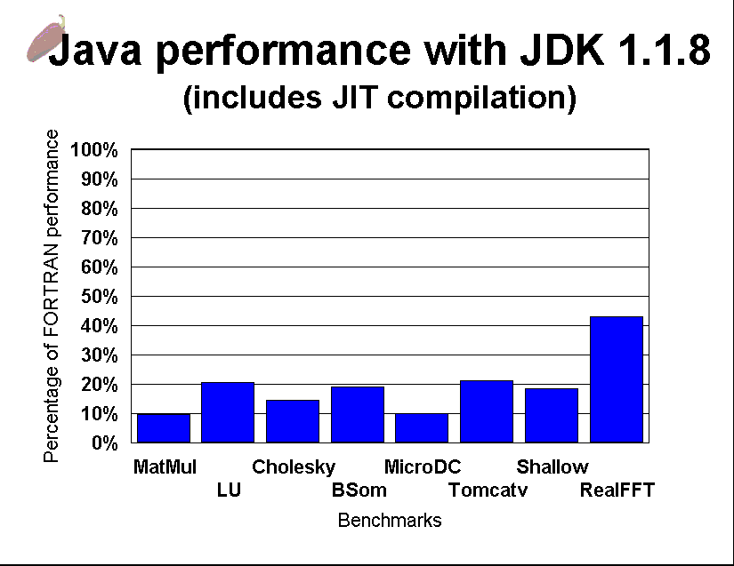
Is Java Slow in the First Place?
Not very much so for business apps
Yes, for numerical intensive stuff
Graph Courtesy of Vivek Sarkar @ IBM T.J.Watson,
ISCOPE99 Keynote Speech, San Francisco, Dec. 8, 1999

Slide 9
Review of the Java Execution Model
Compile Time
Class A {
…
}
Iload 1
…
Dyamic Loading
Java Classfile
(Bytecode + Constant Pool)
javac
Load
Time
Java source
Bytecode Stack Machine Interpreter
Internally Stored classes etc.
(Tables, BC, Constants…)
Class Loader
Object
Heap
Just-in-
Time
Compiler
Native
Code
Runtime
The Java Virtual Machine

Slide 10
What characterizes Java execution model, c.f. Fortran w.r.t. Optimization?
(1) Object-Orientation (Encapsulation)
(2) Inherent Semantical Dynamicity
(3) Language-Imposed Safety
(4) Strict Portability Requirements
(5) Language-Level Concurrency and Interaction with Memory Model, Portability
(6) Execution Environment?

Slide 11
(1) Object-Orientation
Must support semantical aspects of Object-Orientation
  Dynamic Object Creation
    Objects may not be allocated
  Polymorphism/Dynamic Dispatch
    Call target depends on the dynamic type of the receiver
  Encapsulation
    Breakage must be checked
    Can be exploited for optimization

Slide 12
(1) Object-Orientation (cont’d)
Different Program Style
  Very short methods frequent
    Accessor Methods
  Method Overrides Normal
    Class Framework
    Design Patterns
  Rapid Object Allocation/Deallocation
    Objects live on heap

Slide 13
(2) Inherent Dynamicity
Inherent Dynamicity prevalent in various aspects of language semantics
  Separate Compilation of classfiles
  Dynamic loading of classes
  User-defined class loaders
  Reflection
  Cannot assume many things to be static
=> Optimization techniques must account for these dynamicity

Slide 14
(3) Language-Imposed Safety
Language semantics impose various safety requirements against errors
  Some errors can be detected by the VM/Class Loader before execution
  Others must be detected at runtime
    Null references
    Exceeding array bounds
  (Nested) Exception Handling
    Inhibits MANY optimizations, esp. code motion
These must always be checked at runtime

Slide 15
(4) Strict Portability Requirement
Strict language semantics definition
  The Java Programming Language, JVM, Standard Libraries
Results cannot vary between different Java implementations
Arithmetic equivalence cannot be assumed
  Issue: precision, exception -> No reordering
Interactions with Concurrency and Memory Model
  Initial memory model too strict
Java book photo here
(Can’t show it)

Slide 16
(5) Concurrency & Memory Models
Concurrency Inherent in the Language (Threads)
  Must Guarantee every library to be thread-safe
    Overhead of locking, synchronization
  Interaction with the Memory Model, for portability semantics
    Some optimizations could be inhibited
    Series of recent work by Bill Pugh on Strict Definitions and Revision Proposal
Extreme # of synchronizations/sec.
  Most library methods are synchronized
  Can assume most are uncontended

Slide 17
General Strategy for Efficient Java Execution
Perform Static Analysis to identify static properties of program, transform
  Compile/Load/Run Time (JIT time)
  May further optimize/deoptimize
Identify when static assumptions are broken, and Compensate
Instrument Performance to guide (de)optimizations
  Harder than you might think
Diff from traditional compilers in RED

Slide 18
Chapter 2: General Optimization of Java Programs
In truth: General Optimization of Object-Oriented Programs
Although most results applicable to Java, most results predate Java, or recent results applicable to other OO languages like Java
Lesson to young people: RTFL (Read The F**king Literature)

Slide 19
Object Orientation (1) – Encapsulation of Control
Control Encapsulation = Dynamic Dispatch
  Classic Problem – since Smalltalk72
    Early work in [Krasner83]
Problem: Given callsite s, Set of classes and their relations C, receiver class r_{C} and method signature m, which method m_{k} to invoke?
  Dispatch(s, C, r_{C} , m) = m_{k}
Class A {
int m() {}
int n() {} }
Class B extends A {
int m() {} }
Class C extends B {
int m() {}
int p() {} }
Class D extends A {
int m() {}
int n() {} }
A: m_{A},n_{A}
B: m_{B}
D: m_{D},n_{D}
C: m_{C},p_{C}

Slide 20
Dynamic Dispatch (cont’d)
Computing Dispatch(s, C, r_{C} , m) =>
Dynamically Typed OO Languages
  E.g., Smalltalk, CLOS, Self
  No info of r_{C} at s on compile time
  Analysis may provide info for s
Statically Typed OO Langauges
  E.g., Modula3, C++, Java
  Callsite s has type info s_{C} => Dispatch(s_{C} , C, r_{C} , m)
Basic Strategy: Method Search (or Lookup)
  Traverse C from r_{C} to root, looking for m_{k} that matches m

Slide 21
Basic Dynamic Dispatch Method Lookup Techniques
Dispatch Table
  Assign a unique id to every m in C
  Create a table T indexable by all classes in C and all m. For each entry precompute m_{k} w/the search algorithm
  On dispatch, T(r_{C},m) = m_{k} (note: r_{C} != k)
For Single inheritance languages:
  Slice the table by columns (class)
  Possibly assign overlapping id’s to different method signatures of new methods defined for siblings
    A pointer from the object to this column.
    Usually called the Virtual Function Table or Vtable after naming in C++.
object
r_{C}
classes
methods
m
Table T
m_{k}
m=0 p=1
n=2 or 1
A: m_{A},n_{A}
B: m_{B}
D: m_{D},n_{D}
C: m_{C},p_{C}

Slide 22
Basic Dispatch Optimization Techniques (Runtime)
Method Caching
  Instead of creating the entire table T, construct a closed hashtable
  Hit ratio approx 93% on 1024 entry cache for early Smalltalk [Krasner]
Inline Caching[Deustch& Schiffman84]
  For each callsite s, patch code so that directly jumps to m_{k}
  At m_{k}, test if r_{C} is proper (usually r_{C} = k). If not then perform method search, and repatch
  Good for languages w/ multiple inheritance and/or multimethod (e.g., CLOS), c.f. dispatch table
s
jump
patch
Receiver
test
Body of m_{k}

Slide 23
Improving on Caching Techniques
Polymorphic Inline Caching [Hoelzle&Ungar91]
  Instead of jumping to m_{k}, a PIC stub has tests for multiple methods.
  PIC can be generated on-the-fly per each s
SmallEiffel work [Zendra97]
  Generalizes PIC into binary decision tree => search O(log(n)) instead of O(n)
  Clever method ID encoding to speed up search
  In practice tree not balanced
    Frequent methods placed higher in tree

Slide 24
Basic Dispatch Optimization Techniques (Compile Time)
Basic Strategy
  Use static analysis to determine, for each call site s, a set of possible receiver classes Sc
  If |Sc|=1, then Dispatch(s_{C} , C, r_{C} , m) has a unique precomputable solution m_{k}
    Can be converted to direct procedure call to m_{k}
  Even if |Sc|>1, if |Sc| is small we can employ PIC efficiently
  If receiver is unique we can do various optimizations such as inlining (later)
  Question: how powerful should analysis be?
    Flow/Context sensitivity (sensitive/insensitive)
    Intraprocedural vs. Interprocedural
    O(n) where n is the length of program

Slide 25
Simple Algorithms for Analyzing Receiver Classes
Class Hierarchy Analysis [Dean et.al.95]
  Applicable to Statically-Typed
  For each method signature m, precompute for each class c in C, set of all m_{k}’s that exist in the descendents of c: methods(c, m)
    Doesn’t look at program --- O(1)
  At s, possible methods are methods(s_{c}, m)
A: m_{A},n_{A}
B: m_{B}
D: m_{D},n_{D}
C: m_{C},p_{C}
A a; B b; C c;
a.m; //methods={m_{A},m_{B},m_{C}}
b.m; //methods={m_{B},m_{C}} c.m; //methods={m_{C}}
c.p; //methods={p_{C}}
a.p; //methods={p_{C}}
c.n; //error

Slide 26
CHA and Variants
Unique Name [Calder&Grunwald 94]
  Only look at unique method names
Rapid Type Analysis [Bacon&Sweeney96]
  Create global call graph conservatively
  Fast, flow insensitive analysis of call graph to detect possible calls to constructors
  Classes whose constructors are not called can be eliminated from the inheritance graph for CHA
SmallEiffel Type Anslysis [Collin,Colnet&Zendra97]
  RTA + Code Duplication to narrow down possible types

Slide 27
More Sophisticated Class Analysis
Basic Strategy
  Track program control and data flow
    Intraprocedural, Interprocedural
  Propagate type information along the call graph/dataflow graph, or construct constraints on types
  Infer possible types of receiver at each call site s
  Various techniques, algorithms [Grove97]
Problems
  Complex analysis => higher cost O(n^{k}), or exponential
    Not good for load/run/JIT-time optimizations

Slide 28
Some Representative Work
Various work predate and are applicable to Java
  Early work on Smalltalk Type Inference [Suzuki81, Borning83, Johnson88]
  0-CFA Algorithm [Shivers91]
  Constraint-based type inference [Palsberg&Schwartzbach91,92]
  Cartesian Product Algorithm [Agesen95]
  Type Directed Cloning [Plevyak&Chien95]
  (Combination w/) Pointer Analysis [Ryder97]
  Fast Dataflow-based Analysis [Diwan96]
  Fast Interprocedural Class Analysis [DeFouw98]
  Flow insensitive constraint solving [Hendren2000]
  Etc. etc.
Theoretical accounts and experiments e.g., [Grove OOPSLA97, Tip&Palsberg OOPSLA2K1]

Slide 29
Set Based Class Analysis
Basic Idea: Identify a set of types (classes) that “flow through” between language entities
Types created at object instantiation point
Types flow through the programs with assignments
Method calls and branch merge points cause merger of sets of possible types
CHA and RTA extreme simplification of Set Based Analysis where there is only one set (the entire program)

Slide 30
Classification of Set Based Analysis:
-Where we store class propagation info-
[Tip & Palsberg OOPSLA2000]
Cheaper,
Less
Precision
RA: Reachability Analysis (weakest)
CHA: Class Hierarchy Analysis
RTA: Rapid Type Analysis
CTA: Distinct Set per Class
FTA: Distinct Set per Class and Method
MTA: Distinct Set per Class and Field
XTA: Distinct Set per Class, Field, and Method
0-CFA: Distinct Set per Expression
  O(n³) – not scalable
Other variants: [DeFouw99][Hendren2000]
Only One Set
per Program
New
Costly,
More
Precision

Slide 31
Hendren’s Practical Type Anlysis [OOPSLA2K]
Variable Type Analysis (VTA) and Declared Type Analysis (DTA)
Conservatively create call graph using CHA
Construct type propagation graph according to all field&variable assignments
  Flow-insensitive
  VTA: One node per each variable, field, and array
  DTA: One node per declared type of variable
Identify SCC in graph, collapse into one node (no cast type kills)
Propagate types along graph edges

Slide 32
Hendren’s Algorithm (Example1)
C.main
a.m() b.m()
class A extends Object {
String m() {
return (this.toString()); }
class B extends A {
String m() {…} }
class C extends A {
String m() {…}
public static void main() {
A a = new A();
B b = new B();
String s;
…
s = a.m();
s = b.m(); }}
Object
A.m
this.toString()
B.m
C.m
A
m()
Object.toString
B
m()
C
m()
main()
(Conservative)
Call Graph
Class hiearchy

Slide 33
Hendren’s Algorithm (VTA)
A a1, a2, a3;
B b1, b2, b3;
C c;
a1 = new A(); a2 = new A();
b1 = new B(); b2 = new B();
c = new C();
a1 = a2; a3 = a1;
a3 = b3; b3 = (B) a3;
b1 = b2; b1 = c;
a1
a2
a3
a1
a2
a3
{A}
{A}
b1
b2
b3
b1
b2
b3
{B}
{B}
c
c
{C}
{A}
a1
a2
a3
a1
a2
a3
{A}
{A}
{A}
{A}
b1
b2
b3
b1
b2
b3
{B}
{B}
{B,C}
{B}
c
SCC
SCC
c
{C}
{C}

Slide 34
Hendren’s Algorithm (Result)
Analysis Essentially Linear to Program Size (~10s for DTA, ~100s for VTA)
Static Results and Dynamic Results
  Dynamic Results more important
For some apps (jack, javac, pizza), identifies and comes close to ideal case for removing virtual calls of monomorphic sites
Impact on performance comes from transformation, not on dispatch removal

Slide 35
Alternative: Type Feedback
Assume dynamic compiler
Profile at runtime for frequency of method invocation
  Ex.1 # of method invocations [Self93]
  Ex.2 Sampling [IBM Jalapeno]
If # profiled classes are small, then perform dynamic optimization
  All class assumptions must be preceded by a guard (Class Test or Method Test)
  Once guard is in place, can perform same optimization as static analysis

Slide 36
Profiling Techniques
Counter-based
  Invocation counter per method invocation
  Precise but need to cope with program transformation,
  Execution time more difficult to account for
  Example: Self93, HotSpot, IBM TRL JIT
Profile Based
  Periodically sample execution stack
  Imprecise but less intrusive
  Examples: Kistler work on Oberon, [Whaley2000], IBM Jalapeno

Slide 37
Static Analysis vs. Type Feedback: Which is better?
Various work
  Comparative work [Agesen&Holzle95]
    Both similarly effective 95% for Self
  Profile-guided receiver class prediction [Dean95]
  Work on C++ Inlining [Holzle96]
For Java: whole program static analysis still difficult
  Takes too much time AND memory for JITs
  In practice, simple analysis (e.g., CHA, RTA) + type feedback employed (e.g, Hotspot)

Slide 38
Program Transformations for Optimizing Dynamic Dispatch
Generally called Devirtulization
(Method) Inlining
  If we know that target receiver class is unique (or a few) at callsite s via analysis or profiling, we can inline the body of the target method
  Aggressive use pioneered in Self89 [Chambers89]
  Principle Optimization Technique for Java JITs
  Allows other traditional optimizations
    Propagation of control/data/type flow info
    Aggressive program transformations
C.f., Backpatching [Ishizaki et.al.2000]
  Combines inlining and inline Cache

Slide 39
Method Inlining (Cont’d)
Inlining Very Effective
  Recall “very small methods”
But what do we inline?
  Everything [Self89] => Excessive compilation time, memory
  Compilation Stubs [Self91]
  Various Heuristics：
    Ex. Sun ExactVM: Statically bound, straight-line, no exceptions, < 15 bytecodes
  Profile-Directed Inlining [Self93]
    Inline based on Type-Feedback info
    Used in Hotspot, Jalapeno [Alpern@IBM, OOPSLA99]

Slide 40
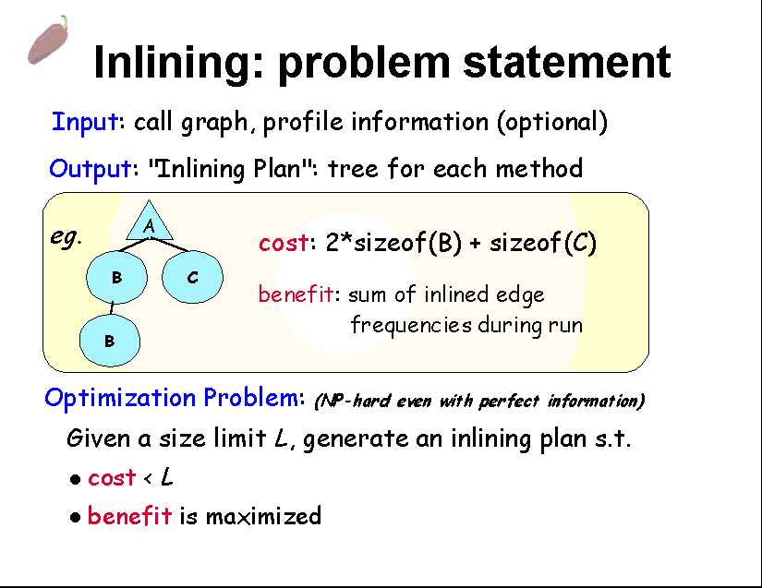
Inlining: Problem Generalization
Slide Courtesy of Vivek Sarkar @ IBM T.J.Watson,
ISCOPE99 Keynote Speech, San Francisco, Dec. 8, 1999

Slide 41
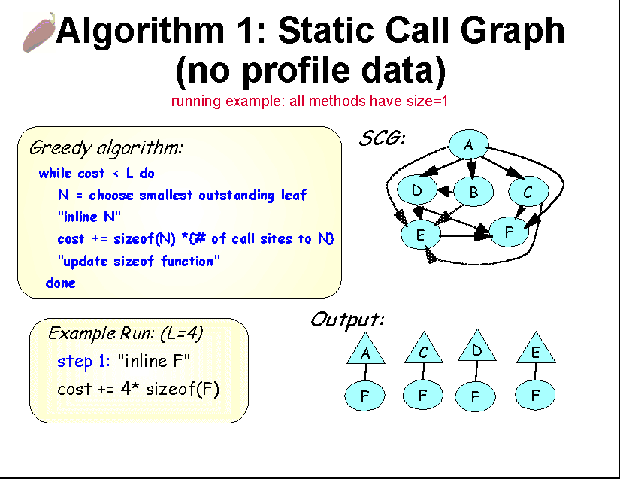
Vivek Inlining Slide 2
Slide Courtesy of Vivek Sarkar @ IBM T.J.Watson,
ISCOPE99 Keynote Speech, San Francisco, Dec. 8, 1999

Slide 42
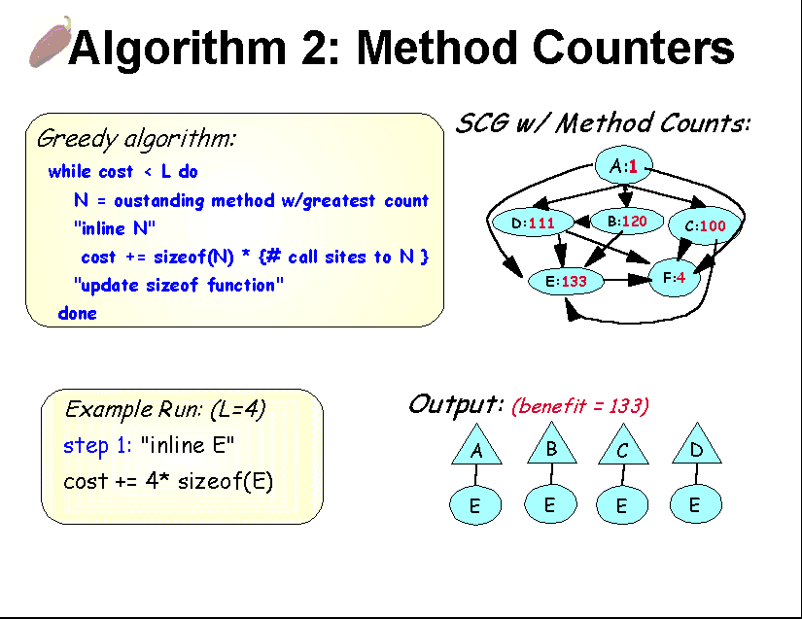
Vivek Inlining Slide 3
Slide Courtesy of Vivek Sarkar @ IBM T.J.Watson,
ISCOPE99 Keynote Speech, San Francisco, Dec. 8, 1999

Slide 43
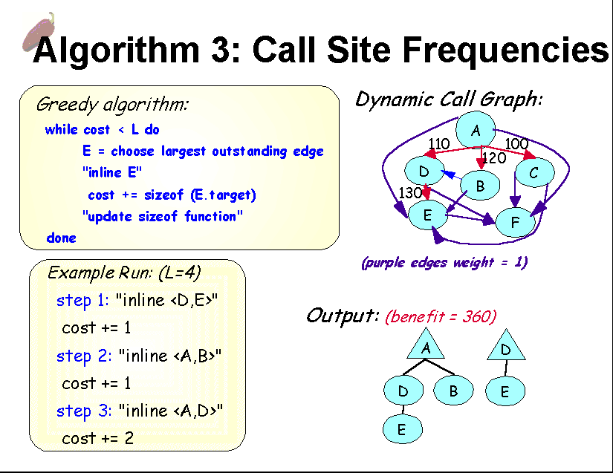
Vivek Inlining Slide 4
Slide Courtesy of Vivek Sarkar @ IBM T.J.Watson,
ISCOPE99 Keynote Speech, San Francisco, Dec. 8, 1999

Slide 44
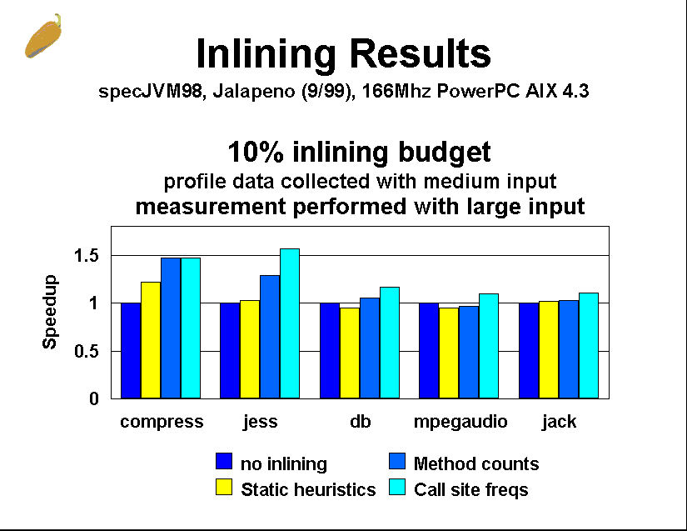
Vivek Inlining Slide 5
Slide Courtesy of Vivek Sarkar @ IBM T.J.Watson,
ISCOPE99 Keynote Speech, San Francisco, Dec. 8, 1999

Slide 45
Problems in Optimizing Dynamic Dispatch for Java
Closed-world assumption not valid
General problem: class loading invalidates assumptions about C => invalidates most analysis
Ex.
Dynamic Load of Class D
A: m_{A},n_{A}
A: m_{A},n_{A}
A a=getAorSubclass();
a.n; //bad if n is inlined
B: m_{B}
B: m_{B}
C: m_{C},p_{C}
D: m_{D},n_{D}
C: m_{C},p_{C}
Methods(A,n)={n_{A}}
Methods(A,n)={n_{a},n_{D}}

Slide 46
Preparing for Dynamic Class Loading
call o1.a
Deoptimization
  Revert to non-optimized dynamic dispatch
  difficulties of on-stack replacement
    Replace method while there is an active context on stack
    Even more difficult due to multiple threads
Preexistence Analysis [Detlefs&Agesen99]
  Analysis to avoid on-stack replacement
  o prexisting in a ⬄ o exists prior to exec. of a
  If a is preexisting then single-impl. assumption of b will be valid for the duration of invocation of a
  Guarantees that invocation completes safely even if class loading invalidates inlining for future invocations
  In practice, very little recompilations
(call o2.b)
Method
b (inlined)
Method a
call o.b
Method a

Slide 47
Other Sophisticated Optimizations of Control
Java Exceptions
Threads (Later)
Control Speculation (not covered)
  Java for Itanium, etc.

Slide 48
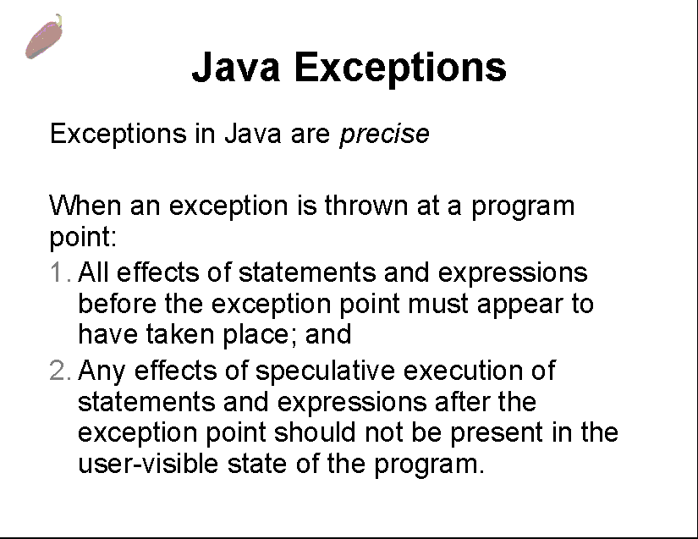
Sarkar Exceptions Slide1
Slide Courtesy of Vivek Sarkar @ IBM T.J.Watson,
ISCOPE99 Keynote Speech, San Francisco, Dec. 8, 1999

Slide 49
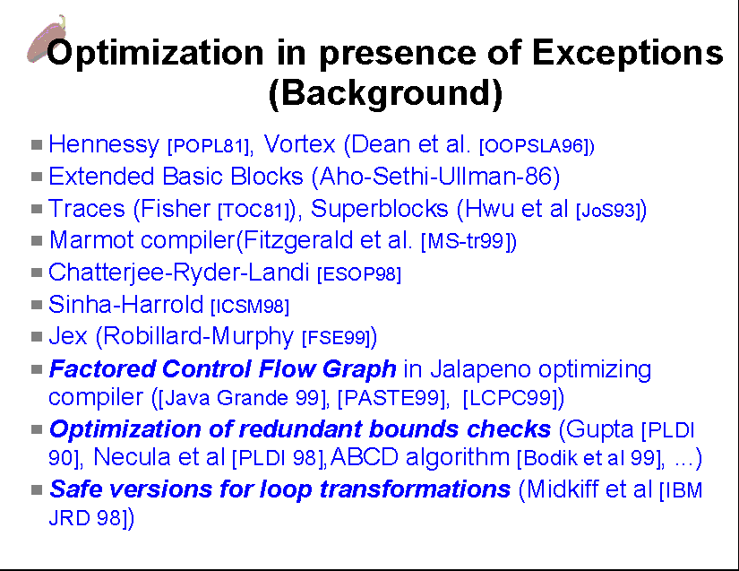
Sarkar Exceptions Slide2
Slide Courtesy of Vivek Sarkar @ IBM T.J.Watson,
ISCOPE99 Keynote Speech, San Francisco, Dec. 8, 1999

Slide 50
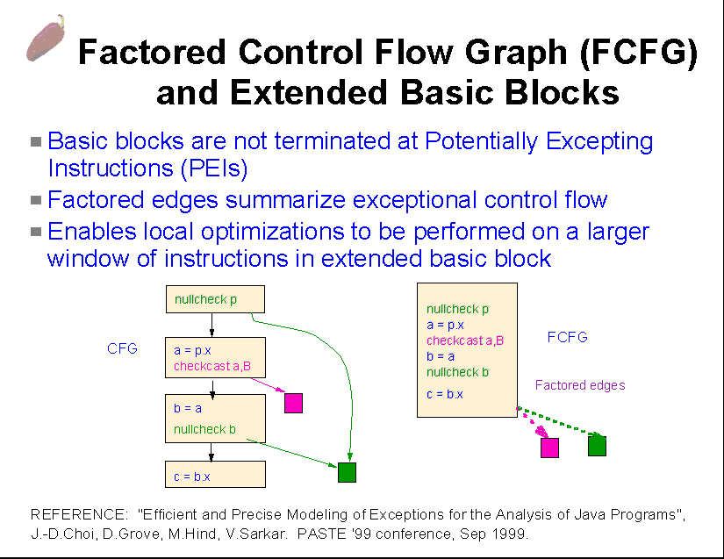
Sarkar Exceptions Slide3
Slide Courtesy of Vivek Sarkar @ IBM T.J.Watson,
ISCOPE99 Keynote Speech, San Francisco, Dec. 8, 1999

Slide 51
Optimizing Objects with Data Encapsulation
Not as extensively studied as dynamic dispatch
Implementation of object fields of don’t matter
  C.f., C/C++ structures/classes
Various work on Object Layout
  Bidirectional Object Layout [Myers95]
  Class Hiearchy Specialization [Tip&Sweeney OOPSLA97,99]
    IBM Application Extractor
  Efficient Object Layout [Sweeney&Gil99]
Object Inlining [Dolby&Chien2000]
Disclaimer: will be covered in detail in future version of slide (_o_)

Slide 52
Other Interesting Optimizations
Quasi-Static Compilation
Sealed Package Optimization
Background Compilation
Checkcast Removal
Dynamic Partial Evaluation
Garbage Collection Assistance via Liveness Analysis
Many more! Still various research opportunities…ｄ

Slide 53
Quasi Static Compilation
[Serrano et.al., OOPLSA2000]
IBM QuickSilver system (for Jalapeno)
Statically Compiled Modules into Java VM
  May seem straightforward, but difficult:
    Security Checking (w/digital signatures)
    Version Management
    Binary Relocation (non-trivial--- type/GC maps, exception tables, etc.)
    Maintenace of inter-method optimization info
  Basic strategy: check if QSI (Quasi-Static Image) is resuable. If so then perform “stitch”, otherwise default to standard interpretation/JIT compilation.
  Performance very good

Slide 54
Optimizing Java Packages
[Zaks et.al., OOPSLA2K]
Identify “Sealed”, non-final calls that are confined within Sealed (JAR) Packages
  All files in package either loaded or not loaded at all
Create Package Based Class Hierarchy Graph, analyze all methods based on class modifiers
Subject to aggressive optimizations
  rt.jar
    10% of packages 20-60% sealed calls
    >50% packages >5% sealed calls

Slide 55
Chapter 3
Optimizing Java Concurrency

Slide 56
Java Concurrency
Java supports (rather unrestricted) concurrency
  No special synchronization object- ANY object can be locked
Huge number of synchronizations, mostly uncontended
  javac (no parallelism) does nearly 1 million syncs/sec
Requirements
  Time- and space-efficient
  Scalable – no global bottlenecks

Slide 57
Techniques for Optimizing Java Concurrency
Compile/JIT time – static analysis
  Escape Analysis: identifies objects that do (not) escape a given scope, e.g., method or thread
  Local (non-escaping) objects of threads need not be locked
Runtime – fast, lightweight locking
  Applicable to ALL objects being a Monitor
Note: both optimizes uncontended cases.
  For contended cases: previous research on lightweight threads [Cilk][StackThreads]
  Recent work on Java lightweight thread library [Lea2000]

Slide 58
Run-time Techniques for Fast Synchronization
Naïve Solutions
Classic JDK Monitor Cache
IBM “Bacon Bits” [Bacon98]

Slide 59
Some Naïve Solutions to ubiquitous object locking
class ptr
Naïve solution: big headers
  Too much space
Less naïve: on-demand allocation of monitor
  32 bit overhead per object
  How to install/reclaim monitors?
Naive
hash age
mutex
condvar
count
owner
Less Naive
user
defined
fields
Class ptr
Hash age
mutex_t m;
condvar_t c;
int count;
thread_t owner;
Monitor ptr
User
defined
fields
Monitor
Slide Courtesy of Dave Detlefs and Ole Agesen @ SunLabs East

Slide 60
Classic JVM Monitor cache
obj1
mutex_t m;
condvar_t c;
int count;
thread_t owner;
object
monitor
obj2
obj2
Monitor
obj3
monitor cache
hash table
Good: no space overhead
Bad: Hash lookup costs
Monitor reclamation?
Global lock protects monitor cache
objN
Heap
Slide Courtesy of Dave Detlefs and Ole Agesen @ SunLabs East

Slide 61
Thin locks - overview
Reserve 24 bits in object header
Handle common case "inline": flat lock
Inflate the lock for uncommon cases (e.g., contention)
Slide Courtesy of Dave Detlefs and Ole Agesen @ SunLabs East

Slide 62
Thin locks - flat case
shape
bit
lock
user def.
fields
thread id
count
locked
0
1 bit 15 bits 8 bits 8 bits
0
0
0
unlocked
Use compare-and-swap to do locking
Max 32767 threads
Contention, wait/notify, counter overflow => inflate the lock
Slide Courtesy of Dave Detlefs and Ole Agesen @ SunLabs East

Slide 63
Thin locks - inflated case
Accomplish inflation using compare-and-swap
shape
bit
monitor id
inflated
1
1 bit 23 bits 8 bits
mutex_t m;
condvar_t c;
int count;
thread_t owner;
Inflated lock supports wait/notify,
deep recursion
Monitor
Slide Courtesy of Dave Detlefs and Ole Agesen @ SunLabs East

Slide 64
Thin locks properties
Advantages
  Fast: 10 instr for locking, less for unlocking (must verify ownership)
  Compact: 24 bits
Disadvantages
  Flat lock contention: unbounded busy-wait
  No deflation
    But work-in-progress may add it at a certain cost
    (Onodera & Kawachiya)
  Reclamation of inflated locks
Slide Courtesy of Dave Detlefs and Ole Agesen @ SunLabs East

Slide 65
Improved Run-time Synchornization Optimization
Metalocking [Detlefs99]
  Sun EVM
  Variant used in Hotspot [Bak99]
Bi-modal Locking [Onodera99]
  IBM Tokyo JVM 1.1.8
Both very sophisticated
  Very low instruction count on uncontended fast path

Slide 66
Metalocking [Detlefs,Agesen, OOPSLA99]
2 bits per object
Basic scheme for lock, unlock, wait, notify:
obtain meta-lock on object
/* exclusive access to sync. data */
manipulate sync. Data of object
release meta-lock
Slide Courtesy of Dave Detlefs and Ole Agesen @ SunLabs East

Slide 67
Properties of meta-lock
Fast: 1 atomic instr. per acquire/release plus half dozen other instrs (uncontended case)
Compact: two bits of space per object
Fair: FIFO ordering (no starvation)
No unbounded busy-wait
Flexible (few constraints on data structures protected by meta-lock)
  E.g.: monitor fairness/performance trade-offs
Slide Courtesy of Dave Detlefs and Ole Agesen @ SunLabs East

Slide 68
Meta-lock performance
Fast path acquire/release: 11 SPARC(tm) instructions:
! getMetaLock:
or %i0, 3, %l0 ! %l0 = my busy value
add %i1, 4, %l1 ! %l1 = lock word address
swap [%l1], %l0 ! swap out busy value
and %l0, 3, %l2 ! %l2 = meta-lock state
cmp %l2, 3 ! is lock state busy?
beq slowGetMetaLock ! branch if yes
sub %l0, %l2, %l0 ! high 30 bits of lock word
! releaseMetaLock:
or %i0, 3, %l0 ! %l0 = my busy value
cas [%l1], %l0, %l2 ! if [%l1] == %l0 then swap [%l0],%l2
cmp %l0, %l2 ! did we do the swap?
bne slowReleaseMetaLock ! branch if no
Slide Courtesy of Dave Detlefs and Ole Agesen @ SunLabs East

Slide 69
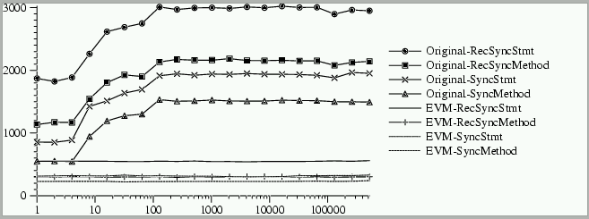
Monitor-lock performance
(MicroBenchmark)
Synchronization cost per iteration (ns)
Number of Objects
SyncMethod, SyncStmt=
Single Lock/Unlock
RecXXX=pair of nested
Lock/Unlock
Slide Courtesy of Dave Detlefs and Ole Agesen @ SunLabs East

Slide 70
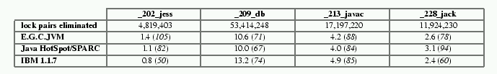
Performance comparison
Approach: desynchronize (single-threaded) prgs
  Sync cost: timeWithSync - timeWithoutSync
  Count sync ops
  Cycles per sync op = timeSaved / count / clock
sync-time-in-seconds (cycles)
Slide Courtesy of Dave Detlefs and Ole Agesen @ SunLabs East

Slide 71
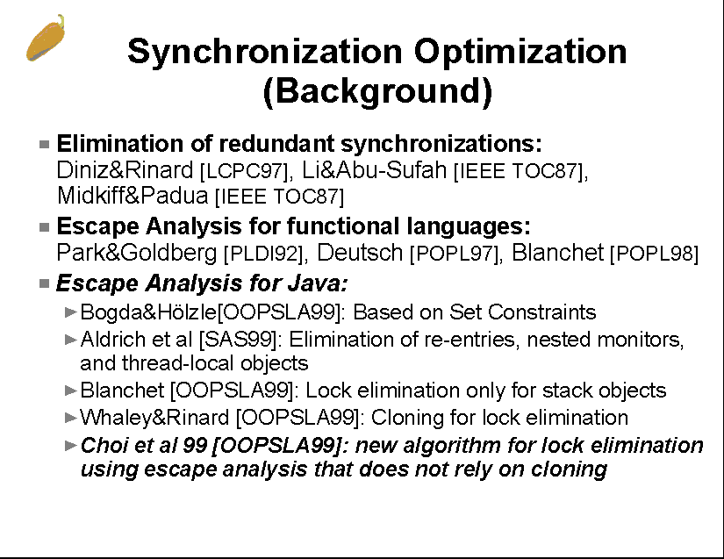
Sarkar Escape Analysis 1
Static Optimization-Escape Analysis
Slide Courtesy of Vivek Sarkar @ IBM T.J.Watson,
ISCOPE99 Keynote Speech, San Francisco, Dec. 8, 1999
Varying Degree of Precision, Complexity

Slide 72
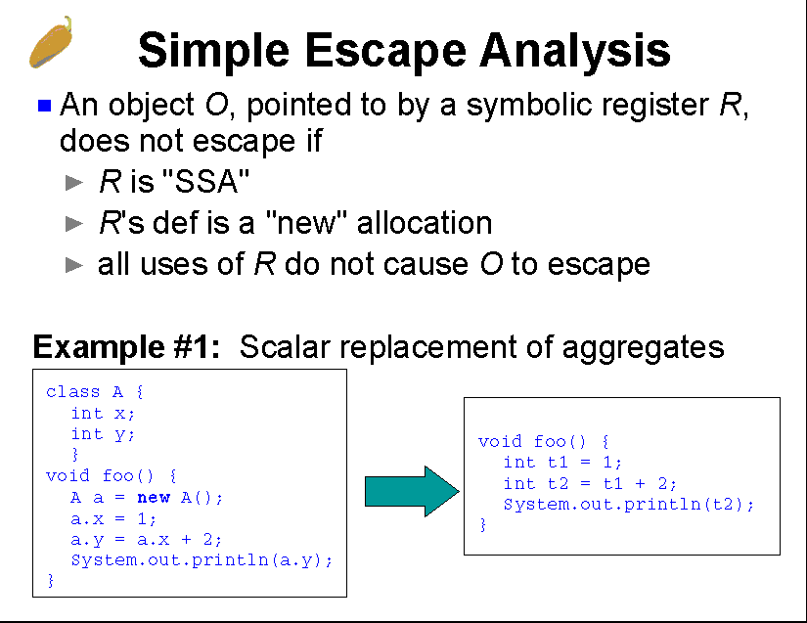
Sarkar Escape Analysis 2
Slide Courtesy of Vivek Sarkar @ IBM T.J.Watson,
ISCOPE99 Keynote Speech, San Francisco, Dec. 8, 1999

Slide 73
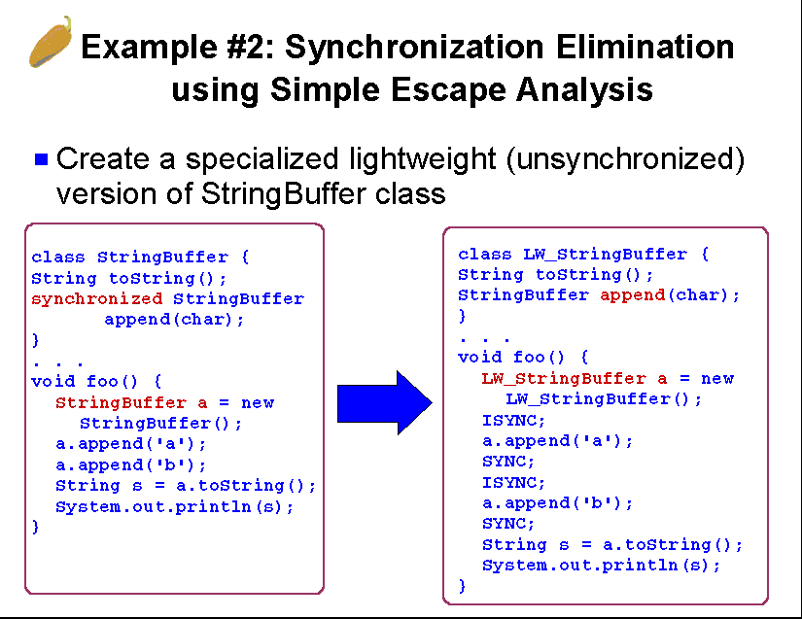
Sarkar Escape Analysis 3
Slide Courtesy of Vivek Sarkar @ IBM T.J.Watson,
ISCOPE99 Keynote Speech, San Francisco, Dec. 8, 1999

Slide 74
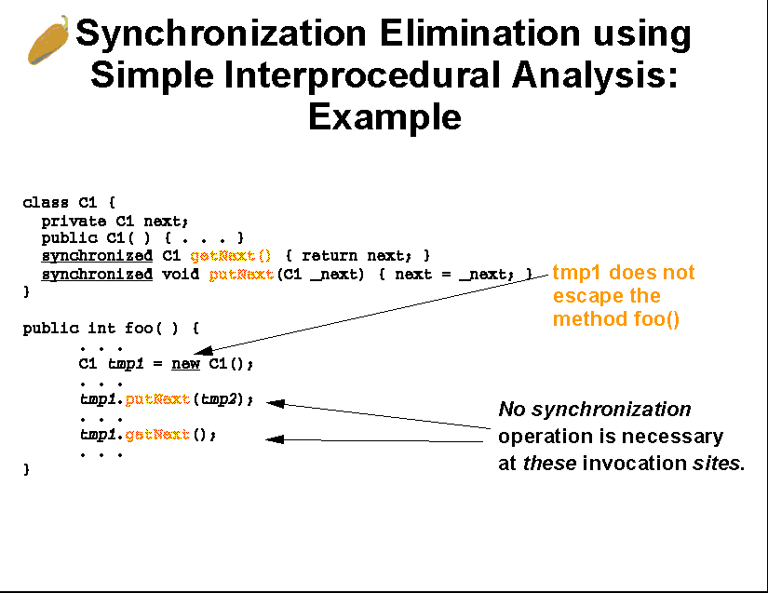
Sarkar Escape Analysis 4
Slide Courtesy of Vivek Sarkar @ IBM T.J.Watson,
ISCOPE99 Keynote Speech, San Francisco, Dec. 8, 1999

Slide 75
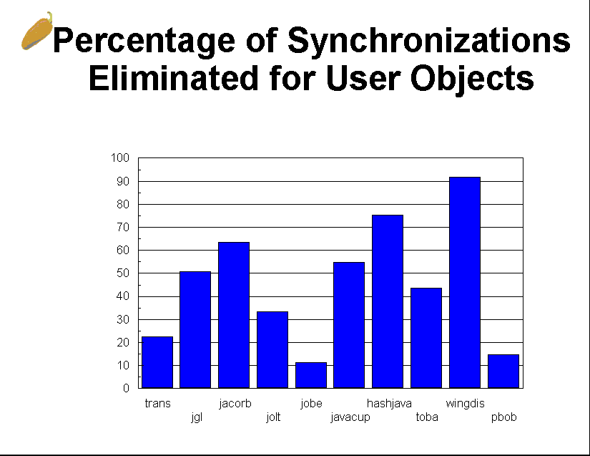
Sarkar Escape Analysis 5
Slide Courtesy of Vivek Sarkar @ IBM T.J.Watson,
ISCOPE99 Keynote Speech, San Francisco, Dec. 8, 1999

Slide 76
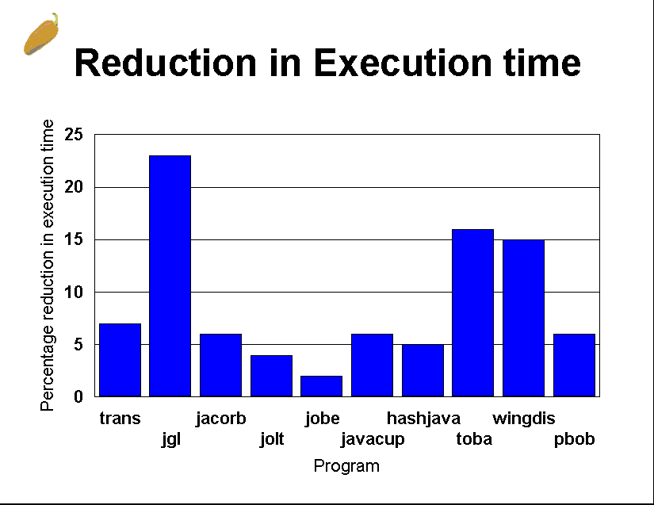
Sarkar Escape Analysis 6
Slide Courtesy of Vivek Sarkar @ IBM T.J.Watson,
ISCOPE99 Keynote Speech, San Francisco, Dec. 8, 1999

Slide 77
New: Optimizing Contentious Locks [ECOOP2001]
Use Formalization of Memory Model of [Maessen, OOPSLA2001]
Systematically Transform Monitor Calls so that Optimistic Reads are Performed
Defaults to Standard Monitor when conflict is detected
Shown to increase concurrency in contentious cases, perform better than ‘pessimistic’ monitor locking

Slide 78
Some Major Java Systems
IBM
  JDK 1.1.8 (Tokyo Research Lab JVM)
  Jalapeno (Watson, Entire Java system in Java)
  HPCJ (Watson, High-Performance Java Compiler)
Sun Microsystems
  Research VM (ExactVM)
  Hotspot
Other commercial systems (research?)
Various Research VMs and JITs
  OpenJIT1, OpenJIT2 [TIT&Fujitsu]
  Kaffe
  Etc.
Future slides will have explanations of these

Slide 79
Chapter 4: Numerical Optimizations of Java Programs

Slide 80
Java sequential numerical performance inhibitors
(Slide courtesy of Jose Moreira@IBM Watson)
A precise exception model coupled with array
bounds and null- pointer checking.
The lack of true, dense, multidimensional arrays.
No built- in complex data types.
High- order loop transformations, which change the
order of computations, are implicitly prohibited.
No standard libraries for well- tuned numerical
operations (e. g., LAPACK and ESSL for Fortran).
Strict floating- point semantics that prevent the use
of fused multiply- add operations.
Most issues can be fixed without language changes!

Slide 81
IBM High Performance Compiler for Java
Static Compiler --- produces PPC native code
Traditional Fortran-like numerical optimizations
No language extensions--- idiom recognition for typical cases, special class libraries
Almost Fortran-like performance as a result

Slide 82
Array checks optimization
(Slide courtesy of Jose Moreira@IBM Watson)
Consider standard dot- product matrix- multiply:
for (int i= 0; i< m; i++)
for (int j= 0; j< p; j++)
for (int k= 0; k< n; k++)
C[i][j] += A[i][k]* B[k][j];
Each iteration requires 6 null- pointer checks (C,
C[i], A, A[i], B, B[k]) and 6 index checks ( i
and j for C , i and k for A , k and j for B ).
The possibility of exceptions prevents any iteration reordering.

Slide 83
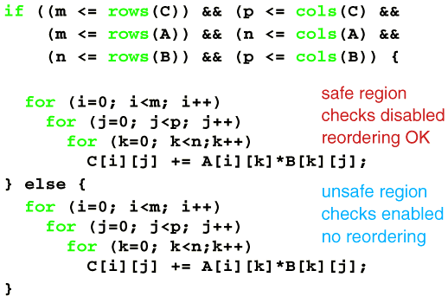
Safe regions through versioning
(Slide courtesy of Jose Moreira@IBM Watson)
Traditional optimizations now applicable!

Slide 84
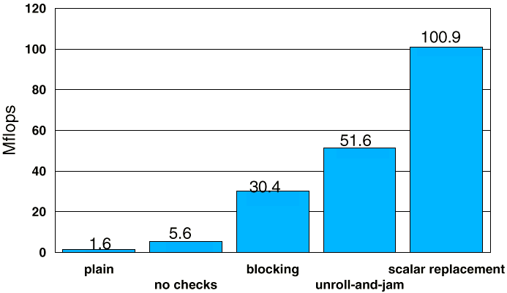
500x500 MATMUL on RS/ 6000 590
(Slide courtesy of Jose Moreira@IBM Watson)

Slide 85
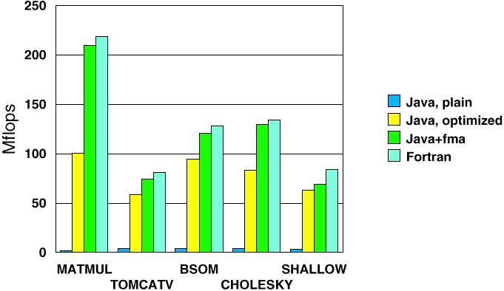
Results of Java x Fortran on RS/ 6000 590
(Slide courtesy of Jose Moreira@IBM Watson)
Note: fma=Fused Multiply&Add, not strictly legal in Java

Slide 86
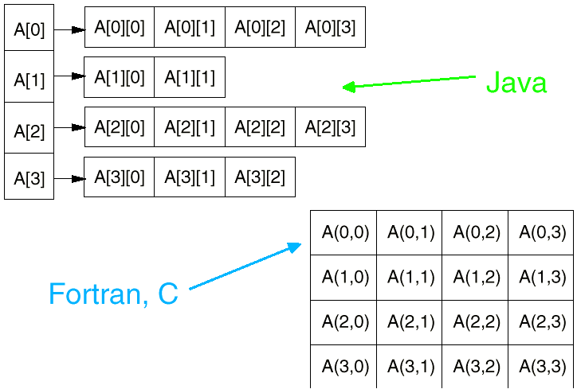
Java Language Array layouts
(Picture courtesy of Jose Moreira@IBM Watson)
Contiguous only on rows
Row Aliasing Possible
Influence from Lisp, Smalltalk
Memory hiearchy optimizations harder

Slide 87
JavaGrande (IBM) Propsal: Java Array Package
Initially define and implement Fortran 90-like arrays as 100% pure Java class library.
One class for each elemental data type and rank,
e. g., doubleArray2D, intArray1D, ComplexArray3D.
Compiler optimizes/parallelizes the Array class method calls as intrinsic operations.
Example:
doubleArray2D A, B, C;
for (i=0; i<m; i++)
for (j=0; j<p; j++)
for (k=0; k<n; k++)
C.set(i,j,C.get(i,j)+A.get(i,k)* B.get(k,j));

Slide 88
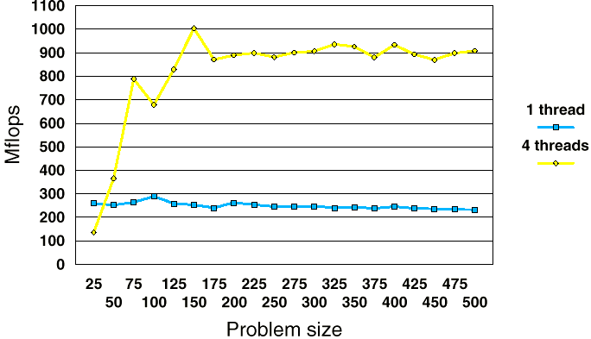
Java DGEMM for the Array Package
(Slide courtesy of Jose Moreira@IBM Watson)
Close to ESSL speed (~1200MFlops)

Slide 89
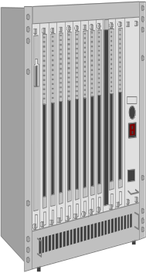

Code /Performance Portability
Code Portability
  × : C, Fortran (executes native code directly)
  ○ : Java (Portable Code (bytecode) execution)
Performance Portability
  When a certain optimization is performed on the code, the code exhibits measurable performance improvement over different machines
  ○?×? : C, Fortran
  ? : Java
80% Peak.
xxx MFLOPS, etc.
80% Peak.
xxx MFLOPS, etc.
Performance
on environment A
Performance
on environment B
Notes:
まず用語の定義です。 Javaは可搬性ポータビリティが特徴のひとつですが、
後で説明する性能の可搬性は満足しないという問題があります。
我々の本研究における提案はDownloadable Self-tuning Potable Libraryです。
これは、Javaの特徴であるPortablityを活かしつつ、
ここで性能の可搬性という言葉を定義します。
ある最適化を施したとき, それが全ての処理系やほかの環境（CPU、OS、言語ランタイム、言語ミドルウェアetc）上で同程度に効果的か否か。
たとえば、ある環境Aでの性能がピーク性能の80％でたとすると、
ほかの環境Bでの性能がピーク性能の80％でたという状況で
性能の可搬性があるといいます。
各環境(プラットフォーム)できちんとした性能が出ることが重要

Slide 90
“Performance Portability” in Java
(or lacks thereof)
Advanced JITs, VMs
BUT! Java portability thru bytcode
IBM High-Performance Compiler (static)
  ~100 Mflops on dense code (266 Peak)
  half of optimizing Fortran (close w/fma)
  not a JIT compiler --- not exactly Java
How good can we do? In a portable way?
  Optimization at the bytecode level + JITs that could further exploit it

Slide 91
Problems in Java wrt Performance Portability
Source
(.java)
javac
Bytecode
gen
Bytecode
gen
In Java, bytecode generation and execution are different phases
Execution Env
Interpreters
JIT compilers
Native Compilers
Java Bytecode
（.classfile）
Info on optimizing for memory
hierarchy, etc., lost
JVM
JIT
Static
comp
Different from Fortran/C,
where program performance
scaled with machine performance
Lower
Performance
A technique that applies to a single compiler, VM, class lib, or an app is not enough!

Slide 92
Optimization in Java:
Current Status
Optimization in OO Languages (Smalltalk, Self, Java)
  Message Dispatching
    Caching
    Fast Subclass determination
    Type analysis
  Fast Threads
    Does not consider numerical computing
Java Benchmarks
  Java microbenchmark
  Sieve, Dhrystone, Whetstone, Queen
  javac, Richards, etc.
  CaffeineMark, Volanomark
  SpecJVM98
  → Not appropriate as HPC benchmarks
Not many HPC benchmarks, except for the JavaGrande benchmark (www.javagrande.org)

Slide 93

AJaPACK : Automatic Optimization using Downloadable Self-tuning Portable Library
[ACM JavaGrande 2000]
The package includes BLAS library and a tuning tool for its core routine
tunes the BLAS core to achieve highest performance on any environments
(this process is portable and hidden from users)
server
download
Self-tuning on
every machine
High performance
Global Computing
Notes:
Java 版の…

Slide 94
Prototype : AJaPACK
[Itou etc、JavaGrande2000]
= ATLAS for Java + JLAPACK [Blount,’99]
AJaPACK as a prototype
  →Not downloadable, but self-tunable
  Equivalent to LAPACK
Achievements
Evaluate validity of Self-tuning on java
  ATLAS for Java[Hokke’99]
speed-up with parallelizing the library
  parallelization of GEMM [JavaGrande2000]
xmmsearch
LAPACK
xemit
BLAS
ATLAS
for Java
mm
GEMM
mm
JLAPACK
fc
AJaPACK
Tuning for own machine (only onｃe)

Slide 95
ATLAS for Java
[Matsuoka et. al., FGCS2000]
ATLAS [Whaley, Dongarra etc 98]:
  automatic generator for optimized BLAS3 codes
This part is ported to Java
The parameter searcher (xmmsearch) surveys optimal mm parameter
ATLAS parameter
  Loop unrolling factors
  Blocking size
  Latency (mul/add operations)
  Whether separate mul and add
Parameter Searcher
(xmmsearch)
parameter
Code
generetor
(xemit)
result
generate
Driver
(fc)
Generated
kernel
(mm)
test
Notes:
我々は, 各Java処理系の行列積のピーク性能をシステマティックに得るために, ATLASをJavaに適用できるように変更したATLAS for Javaを開発しました。ATLAS for Javaは主にJavaで記述されている. オリジナルのATLASに対し, 新たに作成した部分は, 図の点線内です. ブロック内コード生成器がxemit.java, 性能のチェック部がfc.javaである. xemit.javaは指定されたパラメータに応じて行列最内周ループ計算を最適化したソースを出力する. 具体的にはATLASと同じアルゴリズムでブロッキング, アンローリング, ソフトウェアパイプライニングを行う最適化されたJavaのソースを生成する. fc.javaはテストルーチンであり, ATLASのxmmsearchによって呼び出され, 行列を格納するための配列を生成し, 必要数のループを行い, 実行時間を測定した後Mflops値を得る.
先に述べたCとJavaの違いにより, ATLAS for Javaの実装では単純なソースの書き換えのみならず, 以下のような変更が必要であった:
･Javaでは配列ポインタがないため, 配列のインデックスと内容を保持するクラスを定義した. Javaではオブジェクトは参照渡しのため, このクラスのインスタンスを渡すことで, 配列全体およびそのインデックスを一度に参照渡しすることが可能となる.
･関連するが, Javaではスカラ値への参照渡しができない. しかし, ATLASでは探索の結果の複数のパラメタを参照渡しで得てさらに返すことをしている. そこで, 変数を参照渡しのためのWrapperクラスを定義した.
･オリジナルのATLASはfloat, double型をサポートしているが,ATLAS for Javaで使用するデータ型はdouble型に制限する.

Slide 96
Parallelizing GEMM
-multi-threaded parallelization
Evaluates validity of Java parallelization
Fine-grained Master-Worker (FMW)
  Allocates a single small blocked matrix multiply to each Worker
Coarse-grained Master-Worker (CMW)
  Allocates multiple small blocked matrix multiplies to each Worker
Statically-Decomposed Fork-Join (SFJ)
  Decompose the outermost loop statically
( )
1 2
3 4
…
…
Thread
5 6
7 8
…
…
9 10
11 12
…
…

Slide 97
Evaluation Environment
PC(Ath)
  Athlon 600MHz 1CPU L1cache Inst-64KB + Data 64KB L2cache 512KB
  Linux Redhat 6.1 + IBM JDK1.1.8 JVM with optimizing JIT compiler
Enterprise 10000(E10K)
  UltraSparc 250MHz x 60CPU L1cache Inst-16KB + Data-16KB L2cache 1MB
  Solaris 2.6 + Solaris Production Release JDK 1.2.1_04a with optimizing JIT compiler (JBE) (-Xoptimize)
Enterprise 4000(E4K)
  UltraSparc 300MHz x 10CPU L1cache Inst-16KB + Data-16KB L2cache 1MB
  Solaris 2.6 + Solaris Production Release JDK 1.2.1_04a with optimizing JIT compiler (JBE) (-Xoptimize)
Origin 2000(O2K)
  R10000 250MHz x 16CPU L1cache Inst-32KB + Data-32KB L2cache 4MB
  IRIX 6.5 + SGI SDK 1.2.1
Notes:
ここで逐次および並列の GEMM の測定結果を示します.

Slide 98
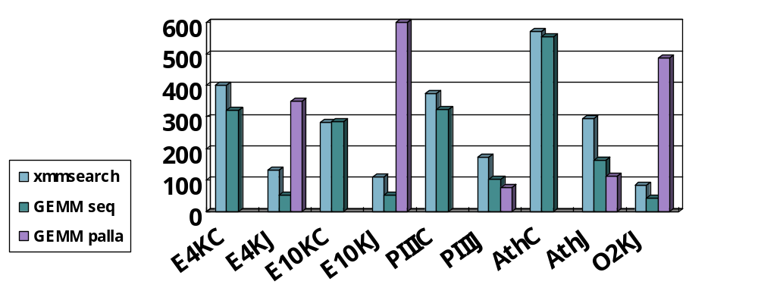
Peak Performace of AJaPACK
Peak (Mflops) | E4KC | E4KJ | E10KC | E10KJ | PIIIC | PIIIJ | AthC | AthJ | O2KJ
xmmsearch | 401.9 | 132.9 | 281.2 | 110.4 | 375.6 | 171.7 | 570.5 | 296.0 | 81.95
GEMM seq | 321.5 | 52.10 | 286.0 | 52.6 | 325.0 | 102.6 | 555.7 | 165.1 | 43.04
GEMM pala |  | 349.9 |  | 1365.4 |  | 77.3 |  | 112.5 | 487.3
1365.4Mflops
C : C
J : Java

Slide 99
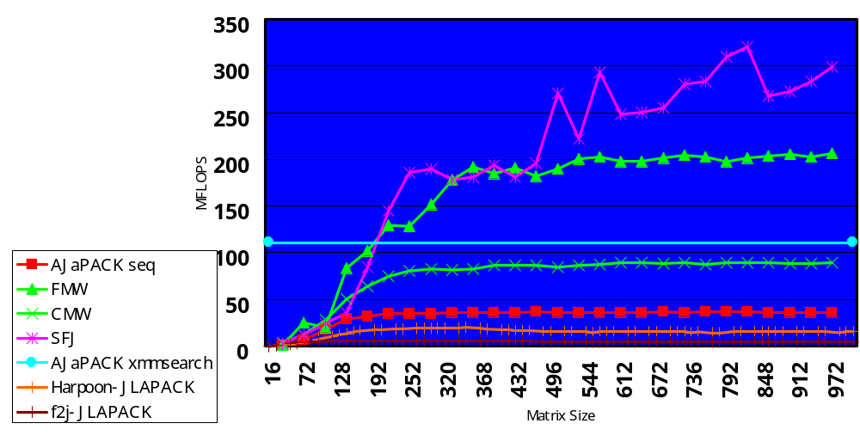
Performance of AJaPACK(8 threads)
Enterprise4000(UltraSparc 300MHz x 10CPU, Solaris Production Release JDK 1.2.1_04a)
Machine peak ：３２１MFlops

Slide 100
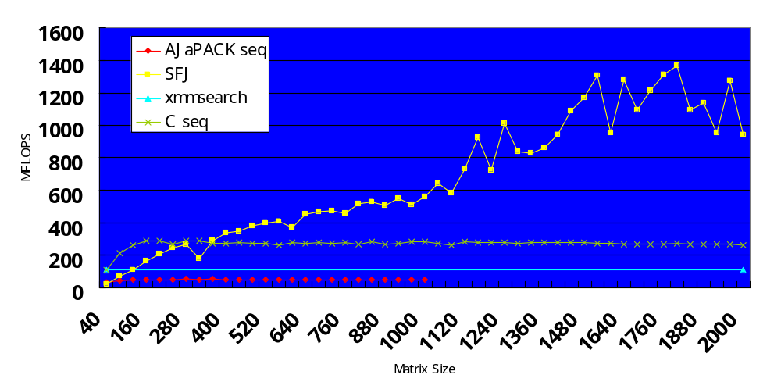
Performance of AJaPACK(60 threads)
Enterprise10000(UltraSparc 250MHz x 60CPU,
Solaris Production Release JDK 1.2.1_04a)

Slide 101
Chapter 5: Advanced Techniques and Research Trends Utilizing Java Characteristics
Partial Evaluation and Specialization
Reflective Systems

Slide 102
Partial Evaluation
Slide Courtesy of Hidehiko Masuhara @ Univ. Tokyo
1. Binding Time Analysis:
Static: Computable at Specialization Time
Dynamic:Code to Compute remains in the specialized program (residual code)
2. Specialize w/Static Input
Execute Static Statements
Output Residual Code
int power(int x, int n) {
if ( n == 0 )
return 1;
else
return x * power(x, n-1) ;
}
Interpreter Exec.
Compile Specialized
Program
x * ( x * ( x * 1 ) )
Specialized Program (n=3)

Slide 103
Partial Evaluation in Java
Specialization Classes - Partial evaluation of classes [Consel et. al., OOPSLA97, ECOOP99]
C++ Doubler [Fujinami ISCOPE97,99]
Bytecode Specialization [Masuhara99]
  Dynamic Compiler => Can customize at runtime using run-time info
Pure Java Version of Masuhara’s System [Maruyama, Matsuoka2001]
  Seamless Integration of PE into Java system?

Slide 104
Specialization Classes - Partial evaluation of classes [Consel et. al., OOPSLA97, ECOOP99]
  Specifies which input argument to customize, generate customized methods with PE
  Use Predicate Classes [Chambers] to specify customization conditions
class ColorPoint {
private int red;
private int blue;
private int green;
public ColorPoint(int r,int g,int b)
public void displayPoint() {
//body of displayPoint()
}
…
specclass WhitePoint {
red==255;blue=255;green=255;
displayPoint();
}
WhitePoint::displayPoint() is specialized so that red=blue=green=255, used automatically when this holds

Slide 105
Bytecode Specialization
[Masuhara99]
Slide Courtesy of Hidehiko Masuhara @ Univ. Tokyo
Basic idea:
  run-time specialization
  in an intermediate language
  optimization after specialization
Java Virtual Machine Language
as an intermediate language
  stack machine
  Typed
  (relatively) language independent
  Interpreted or JIT compiled
[Lindholm97]

Slide 106
Overview of BCS
Slide Courtesy of Hidehiko Masuhara @ Univ. Tokyo
Language Independent
Static Input
Dynamic Input
Bytecode
Specializer
Native Code
Bytecode Generation
BTA:
Type System
+ Flow Analysis
JIT Compilation (Optimization)
Bytecode
+Binding-Time Info
Specialized
Bytecode

Slide 107
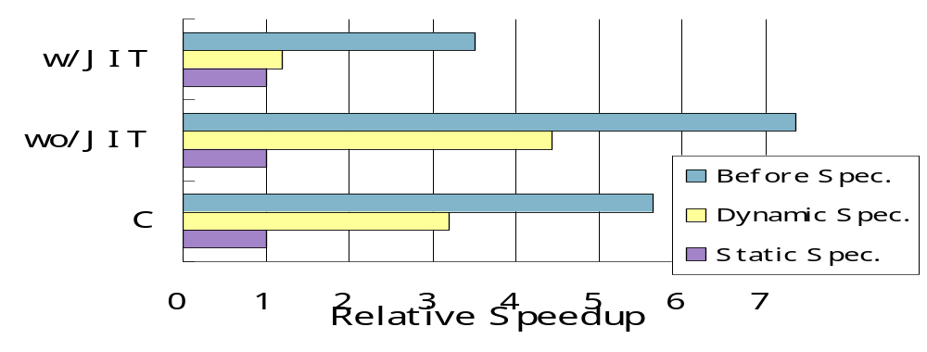
Preliminary Benchmarks
- Partial Evaluation of Power(x,n) –
Slide Courtesy of Hidehiko Masuhara @ Univ. Tokyo
Should result in straightline code x * x * x …
Same Speed as Static Partial Evaluation
BCS
0.25μs
0.21μs
7.1μs
1.6μs
0.83μs
0.26μs
Pentium II 300MHz, Sun JDK 1.1.7+Symantec JIT, GCC 2.7.2
Note: Does not include time for specialization

Slide 108
Reflection
A Mechanism for Constructing an Open-ended languages and systems
Has roots in logic, AI, universal Turing Machine, etc.
3-Lisp [B.Smith, 1982]
  Can access its own interpreter during computation
  Introspection - Reference to computational state
  Reflection - Modification of computational state
3-KRS [ P. Maes, 1987]
  Reflection in OO languages
  Metaobject - describe computation of object
  Metaclass => Smalltalk
Metaobject
(Interpreter, VM)
Interpret/
Execute
Introspect/
Reflect
Object
(Base Level)

Slide 109
Early Work: the ABCL/Rx project
Reflection with Concurrent Objects
Hybrid Group Reflective Architecture (ECOOP91)
ABCL/R2 and fast runtime (OOPSLA92)
Experimental optimization of parallel scheduling
ABCL/R3: efficient compilation via partial evaluation (OOPSLA95, ECOOP98[Masuhara,Matsuoka,Yonezawa])
  Application of the 1st Futamura Projection
  Close to C + Message Passing
Optimizing parallel programs with ABCL/R3 (Reflection96)

Slide 110
Open Compiler, Compile-Time Metaprogramming
“Static” or “Compile-Time” Reflection
  No Interpreter Intervention
  Eliminating Run-Time Interpretation
Disciplined Macro Preprocessor
  Compile-time Source-to-source Transformation
  C++ Language described in terms of C++
Customization according to classes
  Type-based analysis & compilation (EPP)
Standard Compiler Analysis
  Flow Analysis (OpenC++ extension)

Slide 111
C++ Metaprogramming/ Open Compilers (1)
Expression Templates
  Extend STL(Standard Template Library)
  Encode structure of expression into types
  Compiles X = A + B + C into for i X[i] = A[i] + B[i] + C[i] loop into compile time (not for i T[I] = A[I]+B[I]; for i X[I]=T[I]+C[I] )
Template Metaprogramming
  Generalize Expression Templates
    Similar to Type-directed partial evaluation
  High-performance numerical computing
    A++/P++ Blitz++, MTL (Matrix Template Library), etc.

Slide 112
Open Compilers in C++ (2)
MPC++ (Ishikawa, RWCP)
  Define a metaprogramming language for extending C++ at compile time
    Library Optimizations
    Extending C++ for Parallel Computing
Open C++ (Chiba, Tsukuba Univ.)
  Similar to MPC++
  Use C++ itself for compile-time extensions
  Per-class customizatio
Other work such as IBM SOM, Iguana C++

Slide 113
Reflection in Java (1)
Java Reflection API （JDK1.1.x~)
  Structural Reflection, Introspection only
  Change w/Java 1.3?
Java // (parallel) [Caromel97]
  Implements computational reflection w/Preprocessor+ReflectionAPI
EPP (Extensible PreProcessor] [Ichisugi 97]
  Open Compiler, Preprocessor Plugins
OpenJava, Javassist [Chiba98,2000]
  Open Compiler, Similar to OpenC++

Slide 114
Reflection in Java (2)
Various other work
  Java and Reflection workshop OOPSLA98
  Reflection Conference 99
  Reflection Workshop OOPSLA99
    MetaJava, etc.

Slide 115
Case Study: OpenJIT:
An Open-Ended, Reflective JIT
(http://www.openjit.org)
[Ogawa, Matsuoka et. al. ECOOP2000, etc.]
Background: Existing JIT Compilers
  (c.f., Lisp, Smalltalk, Self)
  Focus only on standard platforms (e.g., WSs, PCs)
  Speed up single-threaded execution of general programs on desktop env.
  Never consider trade-offs between memory consumption, execution speed, and compilation speed

Slide 116
Our Claim
JIT compilers could be utilized and exploited much more for:
  Platform-specific optimizations
  Application-specific optimizations
  Language-extending compilations
  Environment- or Usage-specific compilations and Optimizations

Slide 117
OpenJIT Compiler System http://www.openjit.org
A Joint effort with Fujitsu’s Java compiler group
A Reflective Just-in-time (Open JIT Compiler)
  Based on Reflection/OI principle (Java JIT in Java)
  A Java framework for JIT compiler
  Can download/compile various customization & optimization modules into a JIT compiler “just-in-time”
“Plugs in” to Standard JavaVM (JDK 1.1.x, 1.2.x)
  Works just like off-the-shelf JIT
  JCK (Java Compatibility Kit) Compiliant
  Initially “self-compiles” on startup

Slide 118
OpenJIT Compiler System (2)
Java
Classfile
(methods)
Standard JIT Compiler
Ad-hoc construction
Limited optimization
Not so efficient
Restricted portability
Native
code
Java
Classfile
(methods+
Compiler
metacode)
OpenJIT Compiler
Reflective/OI construction
Flexible cutomization/
optimization
High portability
Native
code
“Just-in-time” customization
JIT compiler
Self-application
(compile)

Slide 119
OpenJIT High-level Motivations
Applets and libraries are downloaded and executed on-the-fly, in a safe and secure manner, within JVM
Why not have the JIT compiler be downloaded and executed, on-the-fly!?
  Within the easy, safe, and portable Java execution env.
Example:
  The user wants to instrument his code
  Instrumentation component (w/compiler support) is downloaded off the network automatically
  Instrumented native code is generated on-the-fly

Slide 120
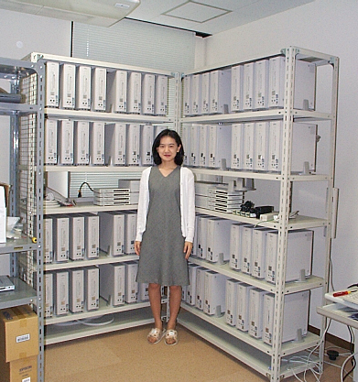
JDSM [JavaGrande2001] w/OpenJIT
Portable DSM on PC clusters
  Using OpenJIT to insert DSM read/write barriers etc. at JIT compile time
  (c.f. DEC Shasta)
  Develop OpenJIT JDSM compilet
Assume no source code is available
Currently being implemented on PC Cluster/VIA environment
Precursor work: OMPC++ (Portable DSM w/OpenC++)

Slide 121
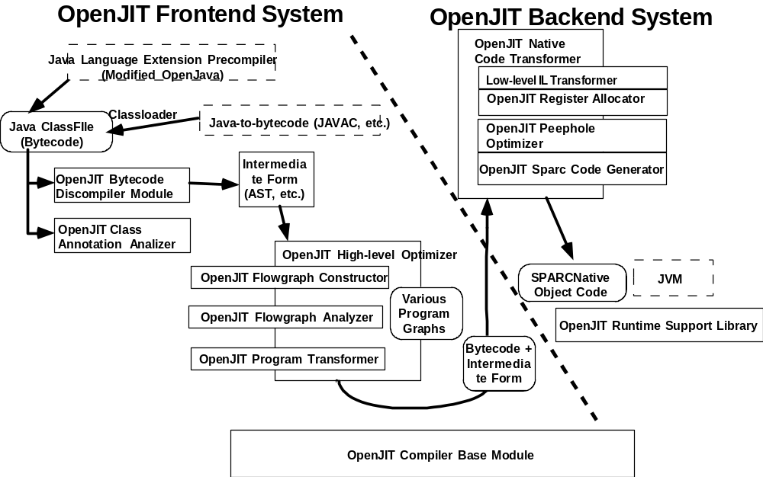
Overview of the OpenJIT Framework

Slide 122
Overview of the OpenJIT Framework (2)
OpenJIT Frontend System
  Preprocessor for Backend System
    Java class framework for JIT-optimizer and/or JIT-customizer, on Java bytecode or higher-level Intermediate Representation (e.g. Backend RTL)
  Classfile Annotation support
    Embed various information to classfiles, and utilize them at JIT-compile phase
OpenJIT Backend System
  Compact and efficient Java JIT Compiler written in Java itself
  Microscopic optimization on RTL
    stack-to-register allocation
    peephole optimization

Slide 123
The OpenJIT Frontend System
OpenJIT Bytecode Decompiler
  Translates bytecode streams into augmented AST
  Utilizes a new algorithm for systematic AST reconstruction using dominator trees
OpenJIT Class Annotation Analyzer
  Extracts classfile annotation information
  Adds the annotation info onto the AST
OpenJIT High-level Optimizer Toolkit
  The toolkit for constructing “compilets”
  Compilet: A module to specialize the OpenJIT frontend for performing customized compilations and optimizations
Abstract Syntax Tree Package
  Provides construction of the AST and rewrite utilities

Slide 124
Architecture of OpenJIT Frontend
OpenJIT Bytecode
Decompiler
Java bytecode
of the methods
Decompile
AST
OpenJIT Class
Annotation Analyzer
Embed call-back functions
OpenJIT High-level
Optimizer Toolkit
Annotated AST
Call-back
Flowgraph
Generator
Compilets
Compilets
(user defined)
Flowgraph
Analyzer
Low-level
bytecode
for backend
Modified AST
Program Transformer
transform

Slide 125
OpenJIT Bytecode Decompiler
Convert Bytecode into AST w/analysis info
Systematic control-flow recovery using dominator trees [Maruyama99]
  Lower cost c.f. direct analysis of CFG
  C.f. Compared to pattern-matching methodologies e.g., Krakatoa[PLDI98?]:
    Potentially more efficient
    Robust to code obfuscation

Slide 126
Classfile Annotations
Annotation info attached to classfiles to perform class-specific optimizations & customizations
Attach to method attribute area of classfiles
  Attach to each node of AST, callback
  Passes the security checker
  Portable execution on other JVMs
Need customized compilers and tools to generate attribute info

Slide 127
Classfile annotation (examples)
User-defined compiler metaclasses as attribute
  Encode metaclass name or metaclass body as annotation
Usage in JDSM
  Insert Read/Write at appropriate places
  List of Immutable objects
Support special-case (numerical) optimizations
  E.g., High-level, expensive loop transforms as is with Fortran (too expensive in general for JITs)
  Statically annotate loops that could be effectively transformed

Slide 128
OpenJIT High-level Optimizer Toolkit
Flowgraph Constructor
  Generate Data/Control Dependence Graph etc. from the AST/CFG
  Each generator is defined as a constructor of subclass of Flowgraph class using the Factory Method design pattern
  Other types of glow graphs can be easily defined by the user
Flowgraph Analyzer
  Implements general analysis algorithms over flowgraphs
  Each algorithm defined as the execute() method of subclass of the Analyzer class using the Command design pattern
C.f. SUIF

Slide 129
OpenJIT High-level Optimizer Toolkit (3)
Program Transformer
  Register transformation pattens
    register_pattern(Expression src, Expression dst)
    register_pattern(Statement src, Statement dst)
  Specify the root of a subtree in the augmented AST, search the tree depth first, replace the matching pattern w/the registered replacement pattern
    substitution(Expression root)
    substitution(Statement root)
Experience shown strategy useful but too low level
  Hard to generate all the patterns
Need higher-level API to generate the patterns

Slide 130
Abstract Syntax Tree Package
Utility routines to express and process AST
Every Java syntactic entities
Node
  Expression
    BinaryExpression
      AddExpression
      SubtractExpression
      …
    UnaryExpression
    ConstantExpression
    …
  Statement
    IfStatement
    ForStatement
    …

Slide 131
Abstract Syntax Tree Package(2)
public class MultiplyExpression extends BinaryExpression {
int op; // ID
Expression left; // LHS expression
Expression right; // RHS expression
Type type; // Type of this expression
Annotation ann; // Embedded Annotation (default: null)
void code() { // Convert AST to backend-IR or bytecodes
if (ann) ann.execute(); // call-back for metacomputation
left.code(); // generate code for LHS
right.code(); // generate code for RHS
add(op); // generate code for “operator”
}
… }

Slide 132
Abstract Syntax Tree Package(3)
public class IfStatement extends Statement {
int op; // ID
Expression cond; // Conditional expression
Statement ifTrue; // Statement of True-part
Statement ifFalse; // Statement of False-part
Annotation ann; // Embedded Annotation (default: null)
void code() { // Convert AST to backend-IR or bytecodes
if (ann) ann.execute(); // call-back for metacomputation
codeBranch(cond); // generate code for Condition
ifTrue.code(); // generate code for Then-part
ifFalse.code(); // generate code for Else-part
addLabel(); // add label for “Break” statement
}
… }
Considering direct use of SSA (Single Static Assignment form) instead of full syntax

Slide 133
Overview of the OpenJIT Backend System
bytecode
Peephole Optimizer
Bytecode parser
RTL
Intermediate Lang
Native Code generator
RTL converter
RTL
Register allocation
Native Code

Slide 134
Overview of the OpenJIT Backend System (2)
Bytecode Parser
  Parses the bytecode stream and produces an IL(Intermediate Language) stream
  The IL is a RISC-based, 3-operands instruction set, encode stack instructions
  36 instruction types; complex bytecode instructions encoded as subroutine call (backpatched later)
RTL Converter
  Translates the stack-based IL code to register based RTL code
  RTL has infinite number of registers in this process
  Intraprocedural dataflow analysis to determine type and offset of stack operands

Slide 135
Overview of the OpenJIT Backend System (2)
Peephole optimizer
  Eliminates redundunt instructions in RTL
Native code generator
  Generate native code for given ISA/OS
    Sparc – Solaris
    X86 – Linux, FreeBSD, BSD/OS, Solaris(debugging)
  Insert necessary register spill code
  ISA-specific peephole optimizations

Slide 136
OpenJIT backend – the technical issues
OpenJIT: self-descriptive JIT in Java
  →Initially interpreted by JVM, gradually self-compiled for faster execution
Technical Issues
  How do we invoke Java-based JIT from within JVM?
  Recursive compilation and deadlock-freedom
    OpenJIT compilation and Application compilation coexsists at runtime
    Is the entire JVM reentrant? Multithreading?
  Performance of OpenJIT – time vs. memory
  Lack of appropriate JIT APIs in JVMs

Slide 137
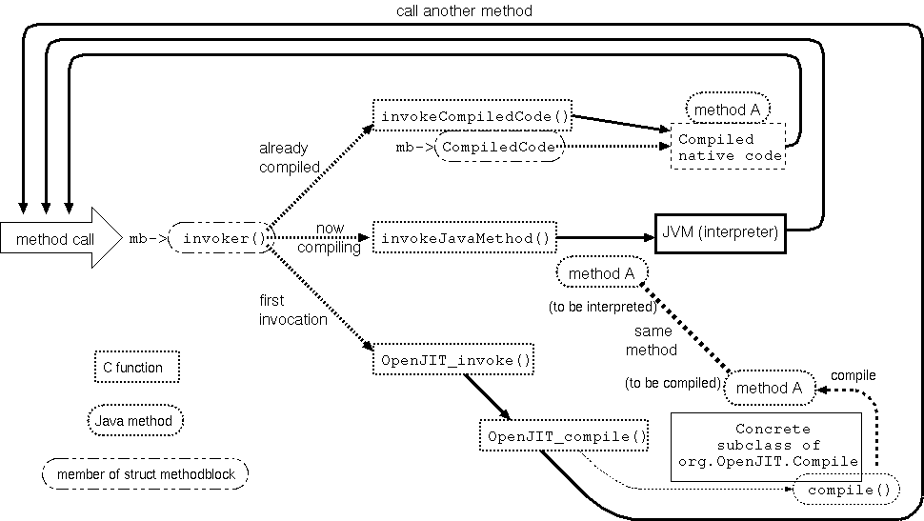
Invoking OpenJIT

Slide 138
Recursive Compilation
Locking scheme
  COMPILE_LOCK(ee);
  if (COMPILE_ON_THE_WAY(mb)) {
  /* now compiling this methods. Avoid from double compiling */
  COMPILE_UNLOCK(ee);
  return;
  }
  START_COMPILE(mb);
  mb->invoker = (mb->fb.access & ACC_SYNCHRONIZED) ? invokeSynchronizedJavaMethod : invokeJavaMethod;
  /* reset dispatcher temporarily */
  mb->CompiledCode = (void *)dispatchJVM;
  COMPILE_UNLOCK(ee);

Slide 139
Lack of Appropriate JVM JIT APIs
17 new JNI calls added as new JIT API
  Constant pool introspection methods
    Public final native int ConstantPoolValue(int index)
    Private final native int ConstantPoolTypeTable(int index)
    Public final int ConstantPoolType(int index)
    Public final boolean ConstantPoolTypeResolved(int index)
    Public final String ConstantPoolClass(int index)
    Private native byte[] ConstantPoolClass0(int index)
    Public final String ConstantPoolName(int index)
    Private native byte[] ConstantPoolName0(int index)
    Public final native int ConstantPoolAccess(int index)
    Public final native byte[] ConstatntPoolMethodDescriptor(int index)
    Public final native int ConstantPoolFieldOffset(int index)
    Public final native int ConstantPoolFieldAddress(int index)

Slide 140
New JVM JIT APIs Contd
  Native method allocation and reflection
    Public final native void NativeCodeAlloc(int size)
    Public final native int NativeCodeReAlloc(int size)
    Public final native void setNativeCode(int pc, int code)
    Public final native int getNativeCode(int pc)
    Private native byte[] MethodName()
  Class resolution methods
    Public final native void initParser(int caller_cp, int index)
    Public final native void resolveClass(int caller_cp, int index)

Slide 141
Performance Analysis
Execution Performance
  →Hello, SPECjvm98
Memory Consumption
  →Heap Profiling
  All the OpenJIT objects, except for the small C runtime, are allocated in the heap with the target application
  Standard C-based JIT compilers allocate working space outside the Java heap
  Due to the recursive compilation, multiple compilation contexts are accumulated in the heap
  → Increased GC, memory (c.f., parseBytecode)

Slide 142
Comparison on the size of JIT compilers
class# method# #lines class(binary) bytes
Frontend 243 1,439 24,148 629,062
Backend(sparc) 23 182 7,560 118,592
Backend(x86) 21 182 8,085 118,125
C runtime(sparc) 3 42,556
C runtime(x86) 3 28,928
Sunwjit(sparc) 234,112
Sunwjit(x86) 146,508

Slide 143
Benchmarking Environment
Target Machine
  Sun Ultra60 (UltraSparc II 300Mhz x 2, 256MB memory)
  Solaris 2.6-J
  JDK 1.2.2 (ClassicVM)
Applications(1+6)
  Hello
  _201_compress (file compression)
  _202_jess (expert system)
  _209_db (DBMS simulator)
  _213_javac (JDK 1.0.2 compiler)
  _227_mtrt (Multithreaded raytracer)
  _228_jack (parser generator)

Slide 144
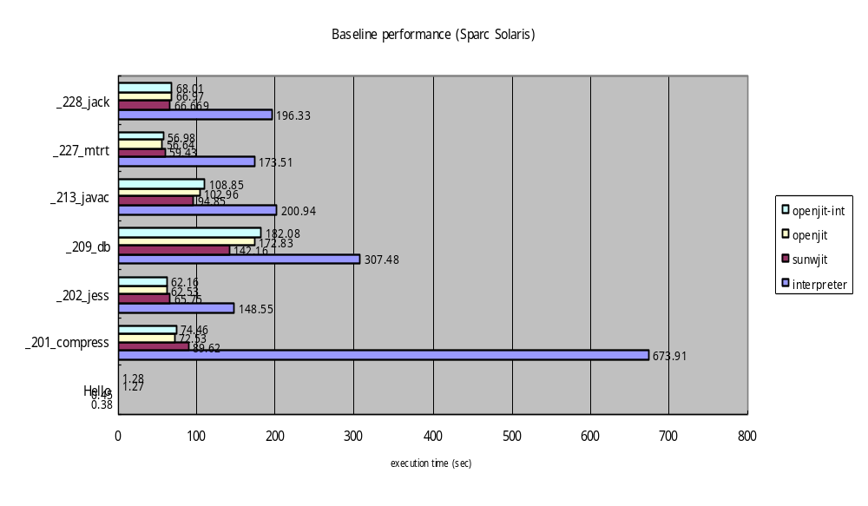
Baseline performance (1)

Slide 145
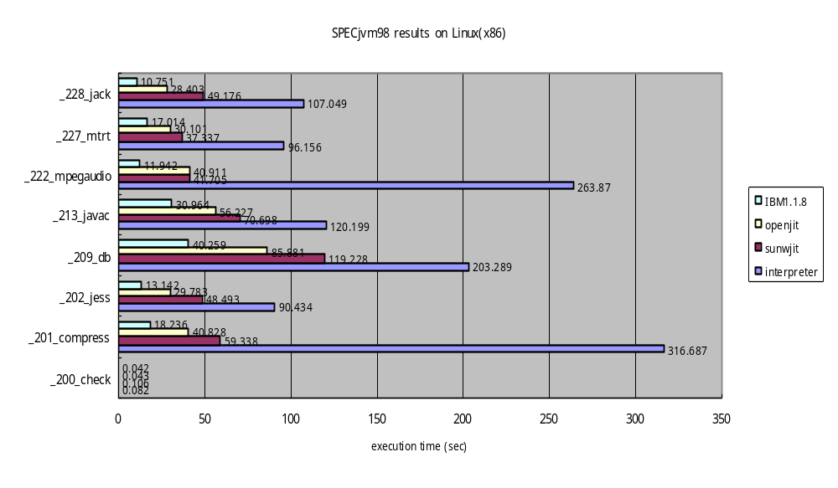
Baseline Performance (2)

Slide 146
Heap profiling USING OpenJIT
Measureable run-time profile values
  A profiler using JVMPI(JavaVM Profiler Interface)
  →Plug in to the JDK 1.2(ClassicVM)
    Number, Type, Size of allocated objects
    Number of GCs, etc.
  A Profiler created w/OpenJIT customization
  → Output various info generated from backend paths
    Number of methods compiled
    Number, type, size, and lifetime of objects that OpenJIT allocated
    Size of generated native code
Direct execution, c.f., simulation [Diekman99]

Slide 147
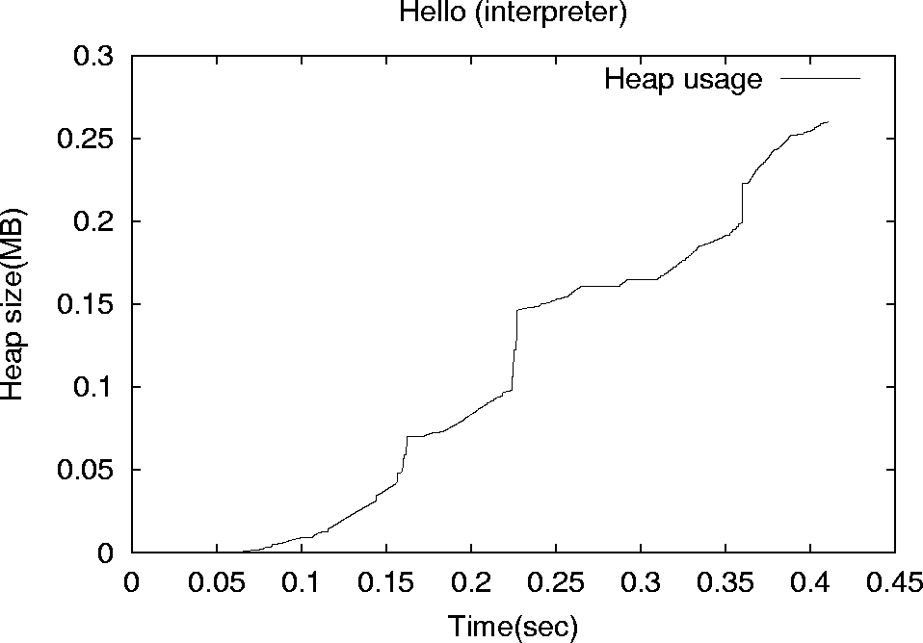
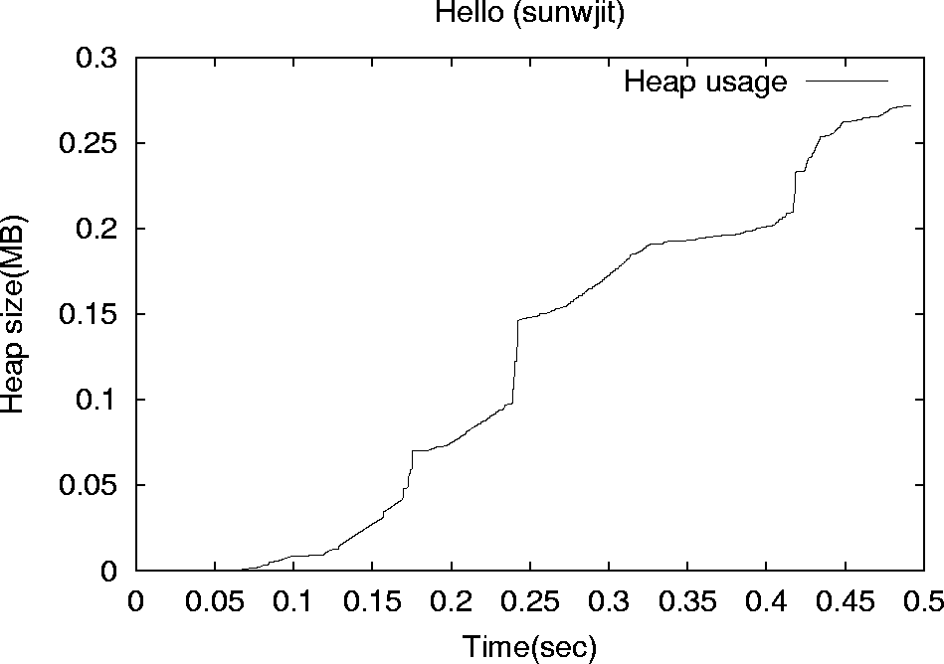
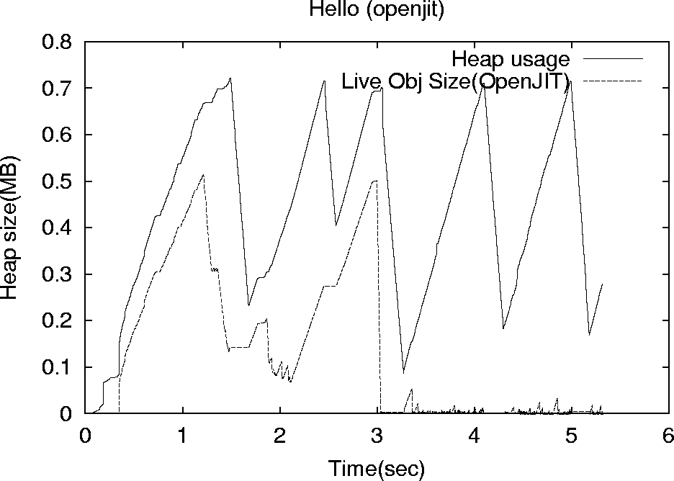
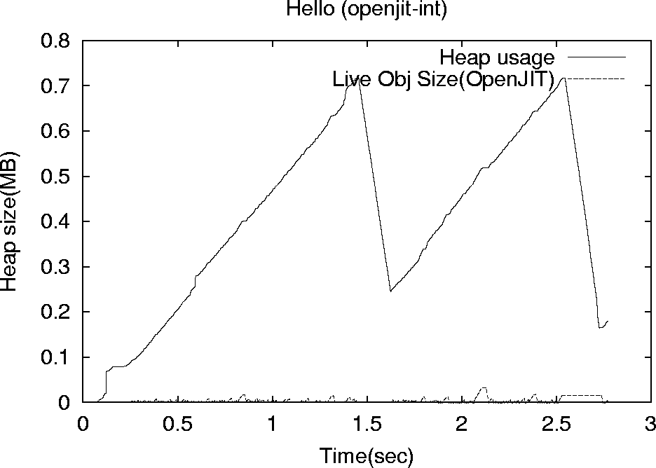
Heap usage on Bootstrap

Slide 148
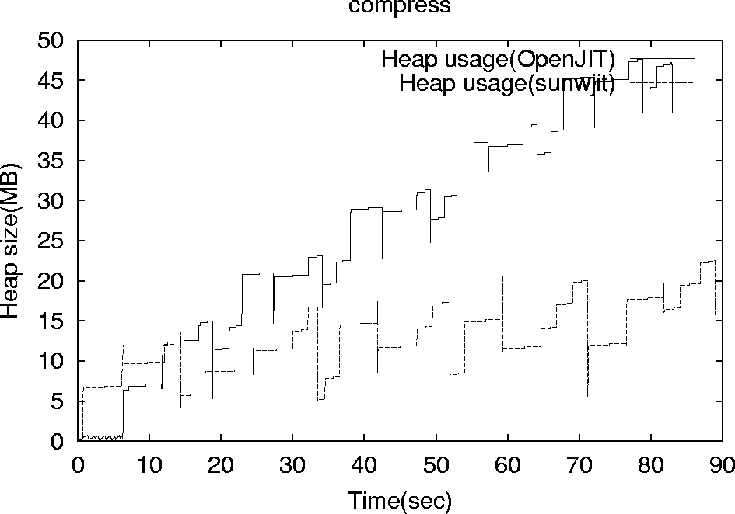
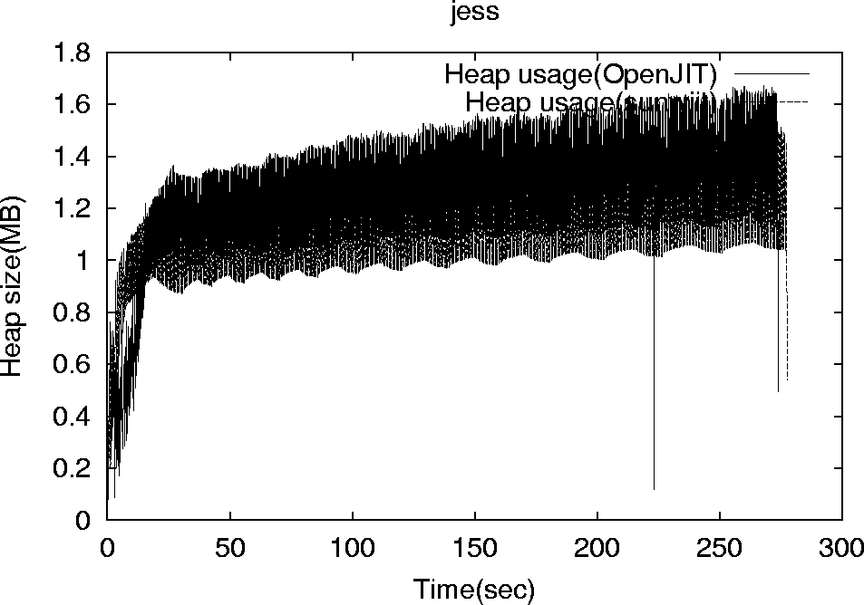
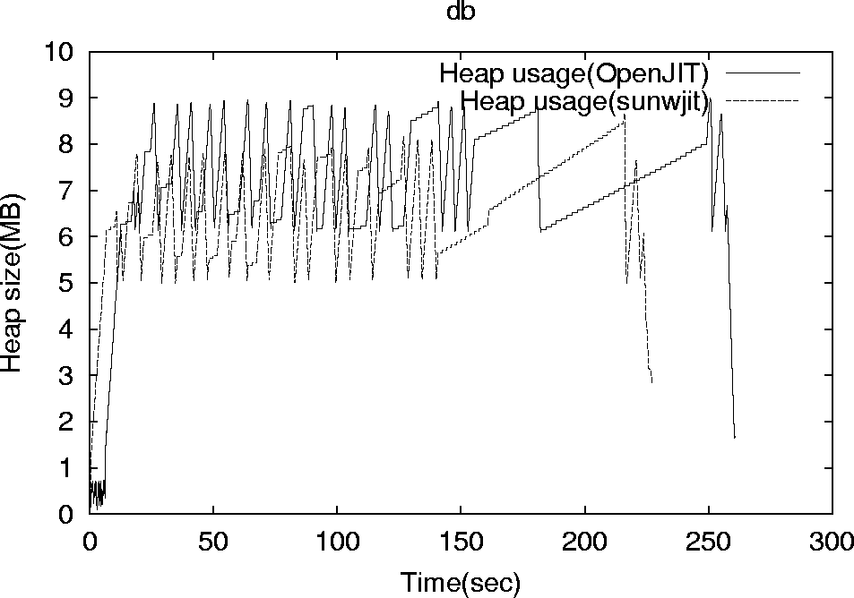
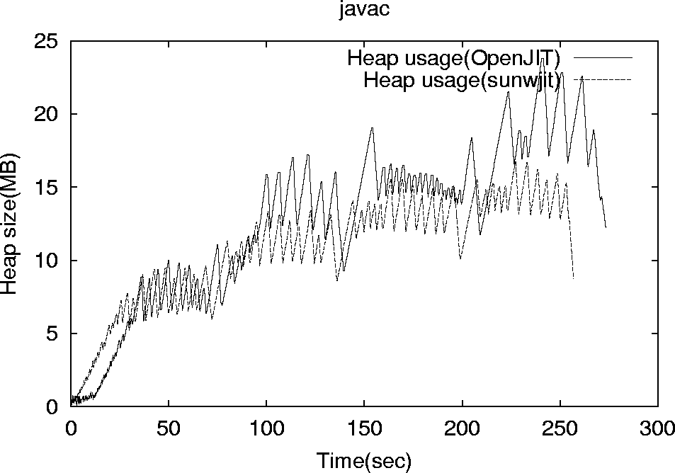
SPECjvm98 Heap Usage

Slide 149
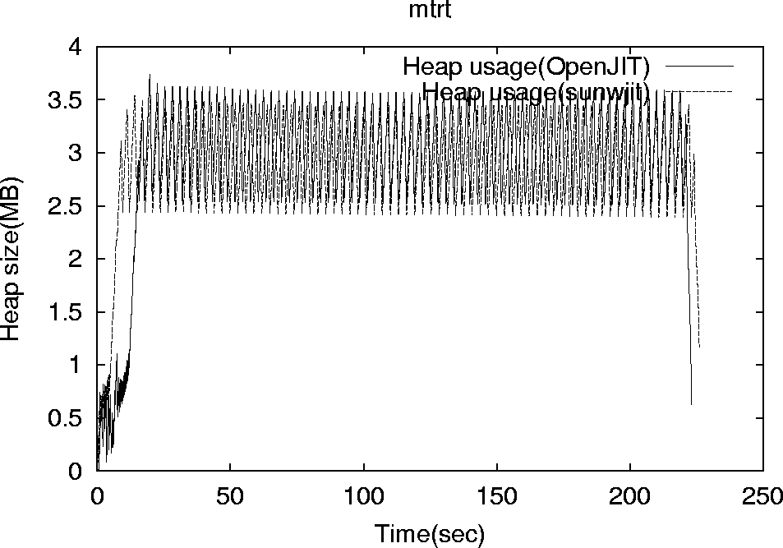
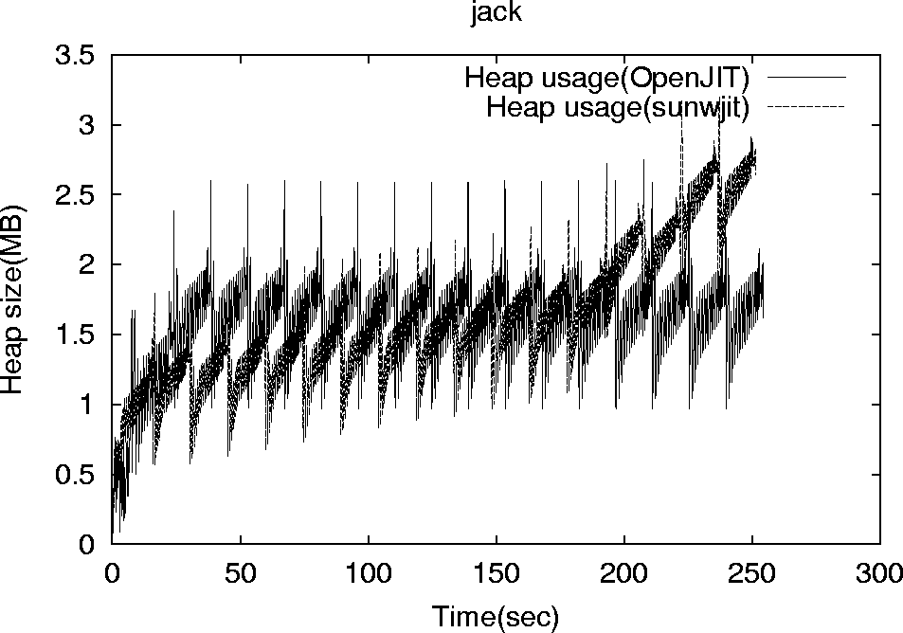
SPECjvm98 Heap Usage (2)

Slide 150
Analysis of Heap Usage on Bootstrap
Two reasons for Heap pressure
  Working data structure proportional to method bytecode size
  Accumulating chain of contexts due to recursive compilation on bootstrap
Former: example: parseBytecode
  Parses 165 JVM instructions
  14,279bytes, 6,861 JVM instructions
  Solved via refactoring
Latter: avoidance via restricting self-compilation
  What strategy is effective?

Slide 151
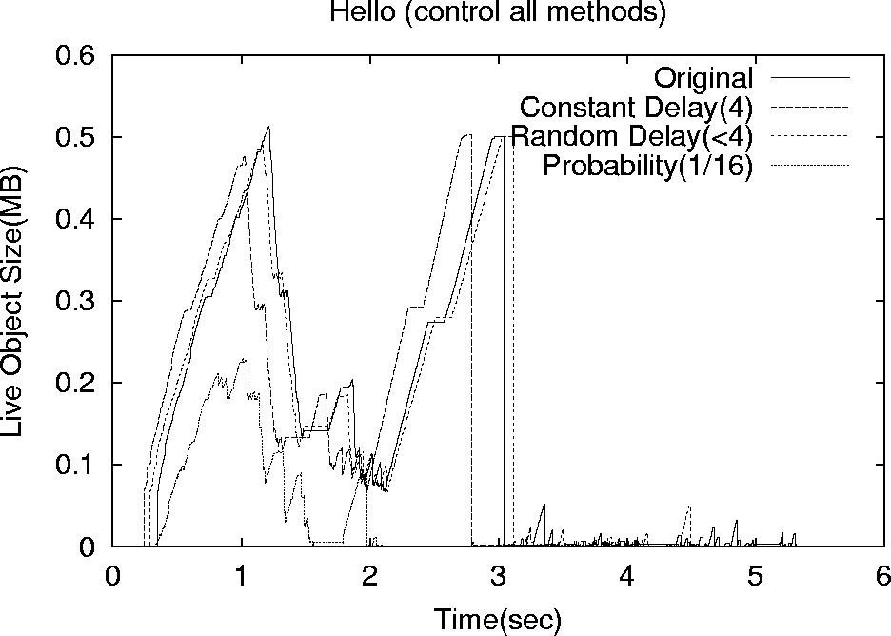

Slide 152
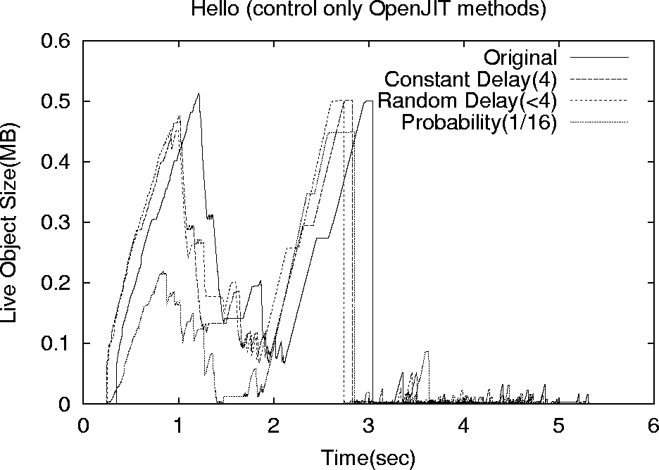

Slide 153
Summary of OpenJIT1
OpenJIT shown to be matching performance of C-based JIT compilers
Achieved flexibility
  Profiling customization
  Some small numerical optimization examples
  JDSM (in the works)
  Jaguar-style communication optimizations
Frontend/Backend being redesigned for v.2.0
  More modular, simpler to use
http://www.openjit.org/
  Free distribution

Slide 154
Now and Future: OpenJIT2
インタプリタは遅い⇒コンパイルして実行
Nativeコードは機種依存、安全性が不明
⇒仮想機械による実行（インタプリタ）
トレードオフ
JITコンパイラの利用で良いとこ取り！
実行時情報による更なる最適化
⇒静的なコンパイラの上を行く可能性も

Slide 155
OpenJIT2
コンパイル時間と性能の関係
JIT
性能
実行時間
インタプリタ
コンパイル時間
コンパイル時間
コンパイル時間と性能の関係は離散的
最適な実行時間を与えるコンパイラは問題依存

Slide 156
従来のJITコンパイラ
処理速度至上主義的職人芸実装
厳選された最適化
  一般的に効果のある最適化のみ適用
  ⇒特定の場面にのみ効果的な最適化はしない
  特定のアプリケーション（ベンチマーク）で最適
マルチレベルJITコンパイラ
  最適化の度合いの高低の使い分け
    実行頻度 (e.g. Research VM, Jalapeno)
    場面 (ループ、e.g. IBM JVM)

Slide 157
最適なJITコンパイラ？
最適な最適化度
最適な最適化度
メソッド
メソッド
実行時間最小を与える最適化度はメソッド毎に異なる
アプリケーションによる差異も大きい

Slide 158
更なる高性能を実現するために
メソッド毎に、より適切に最適化
  実行頻度
  ループなどの場面
  アプリケーション特有の知識の利用
JITコンパイラの多様化
適用する最適化の異なる様々なJITコンパイラ

Slide 159
JITコンパイラの多様化による問題
コンパイラを複数用意するコスト
  構築のコスト
    全く違うコンパイラ（e.g. 速さ重視、コードの質重視）
  同時利用のコスト
    コンパイラ自体の占めるメモリ
複数コンパイラの構築と選択
  自動的に使い分ける話
  実行時に生成する話
  ユーザ指定で選択する話

Slide 160
関連研究（1/2）
コンパイラツールキット
  SUIF, Zephyr, PROMIS, Vortex, GCCなど
  中間表現の一般化
    特に多言語→多ISAという面では成功
    コンパイラの各パスの独立性が高い
      最適化器の追加や変更に有効
⇒コンパイラ構築の方法として確立されている

Slide 161
関連研究（2/2）
コンパイラ向けアプリケーションフレームワーク
  The RTL System[Johnsonら, ’91]
  CMCC[Adl-Tabatabaiら, ’96]
    データフロー解析、最適化、レジスタ割付、コード生成
アプリケーションフレームワーク
  オブジェクト指向によるプログラミング
    コンポーネント単位の再利用
    大きなシステムにはコンポーネントの単位が小さい
  コンポーネントの組み合わせを再利用
⇒複数コンパイラ間のコードの共用が可能

Slide 162
OpenJIT 2のデザイン
抽象度の高い中間表現
アプリケーションフレームワーク
  JITコンパイラ構築のコスト削減
  JITコンパイラ同時使用のコスト削減
  ⇒JITコンパイラの多様化を現実的に
Compilet
  Javaで書かれたJITコンパイラモジュール
  メソッド毎に指定可能
  JITコンパイラの静的な使い分け

Slide 163
OpenJIT 2の中間表現
Control Flow Graph
SSA形式の四つ組(org.openjit.compiler.rtl)
  生成にAbstract Factoryパターンで実装を隠蔽
    ISA依存情報
    コード生成フェーズ依存の情報
  ISA非依存の最適化フェーズを実現
  ⇒最適化器のコンポーネント化

Slide 164
OpenJIT 2の概要(全体)
OpenJIT Compiler
customized Compiler
Baseline Compiler
customized Compiler
Compilet
Compiled code
制御
OpenJIT C Runtime
データ
Java Virtual Machine

Slide 165
OpenJIT 2の概要(コンパイラ内部)
バイトコード解析
各種グラフ構築
コード生成
最適化
制御
各フェーズ内をOO設計
各フェーズをアプリケーションフレームワークに
コンパイラドライバ
データ
Baseline/Compilet

Slide 166
JITコンパイラ向けアプリケーションフレームワーク(1/2)
バイトコード解析支援(BytecodeParser)
  全てのJITコンパイラで必要な機能
  ２００種類以上あるバイトコードの解析は面倒
    Template Methodパターンにより異なる目的に使用可
CFG構築支援(MethodGraph)
  グラフ操作ライブラリは汎用性が高い反面、使い方が面倒
  解析済みJVM命令列からCFGを構築
  Factory MethodパターンによりCFGのノード表現を選択可能

Slide 167
JITコンパイラ向けアプリケーションフレームワーク(2/2)
中間言語生成支援(RTLGraph, RTLNode)
  スタックの状態を元に中間言語を生成
最適化器構築支援
  グラフの渡り歩き(CFGVisitor, DTVisitor)
  中間言語(SSA)文の繰り返し(SSAIterator)
  データフロー解析器フレームワーク(DFASolver)
    Forward/backward solverの構築を支援
個々の最適化器
  Baseline/Compiletの部品として利用可能

Slide 168
多様なコンパイル方針を実現
Baseline/Compilet
最適化1
中間表現生成
コード生成
バイトコード
最適化2
native
最適化3
新最適化
適用する最適化をメソッド毎に選択
新たな最適化器の追加も可能

Slide 169
OpenJIT2 実装の現状
バイトコードから中間表現への変換
非SSA形式⇔SSA形式の変換
一部の最適化
  dead-code elimination, copy propagation, constant propagation, trivial phi elimination
Liveness解析
グラフ操作などのクラスライブラリ
約4万行

Slide 170
評価
実装済みの部分について動作速度を測定
  デバッグ用ドライバを用いたbaselineコンパイラ
    本体は全てJava（時間計測用にネイティブメソッド）
  OpenJIT 2の全てのメソッドに対する処理時間
    309クラスファイル、2193メソッド、延べ85203バイト
  実験環境
    Pentium III 500MHz x 2 (SMP), 384MB
    RedHat Linux 6.2, kernel 2.2.18
    Sun JDK-1.2.2_006 (Classic VM, nojit, OpenJIT)
    Sun J2SDK-1.3.0_01 (HotSpot Client VM)
    IBM J2RE-1.3.0 (cx130-20001124)

Slide 171
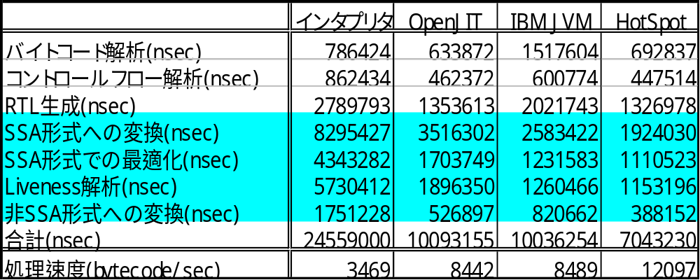
測定結果
SSA形式はコスト高（全体の60～80%）
実行環境の変化でインタプリタ比、２～３倍

Slide 172
考察
Javaで、アプリケーションフレームワークとして記述されたJITコンパイラによるコンパイル速度は3.5bytecode/ミリ秒～12bytecode/ミリ秒
  基本のコンパイラとしては遅い
    自己コンパイルに7秒～25秒
  最適化コンパイラとしては悪くない
  参考（PowerPC 604e, 166MHz上）
    IBM JVMは10bytecode/ミリ秒
    Jalapenoの最適化コンパイラは3～5bytecode/ミリ秒
  本当の評価はプログラムの実行性能を加味すべき

Slide 173
まとめ
高性能にはJITコンパイラの多様化が必要
OpenJIT 2のデザイン
  JITコンパイラ研究の基盤
  徹底したOO設計により幅広い目的に利用可
  JITコンパイラ向けアプリケーションフレームワーク
OpenJIT 2のbaselineコンパイラの処理速度
  SSA形式の利用は高価
  最適化コンパイラとしてはそこそこの速度
  生成コードの質との関係は現時点では不明

Slide 174
今後の課題
設計・実装の完了
  レジスタ割付、コード生成、OO言語向け最適化
  Release Q2, 2001
評価
  JITコンパイラとしての評価
  各最適化と性能の関係の考察
  コード再利用の度合いの考察(e.g. CMCC)
Compiletの自己適用（コンパイル速度の向上）
アダプティブな手法の実現
  メソッドの呼び出し回数のような単純なもの

Slide 175
JavaGrande Forum
An International Forum for HPC in Java
Forum Process and Membership
Forum is open to any qualified member of academia, industry or government who is willing to play an active role.
  http://www.javagrande.org
Forum secretary: George K. Thiruvathukal
  (george.k.thiruvathukal@ acm. org).
Academic coordinator: Geoffrey C. Fox
  (gcf@npac.syr.edu).

Slide 176
JavaGrande Activities
Working Groups
  Numerics Working Group
  Concurrency Working Group
  Etc.
Conferences
  ACM JavaGrande Workshops and Conferences since 1997
  ACM JavaGrande/ISCOPE Conference 2001, June, San Francisco, CA
International
  European Branch
  We are working on establishment of a Japanese Branch

Slide 177
JavaGrande Numerics Working Group
(Slide courtesy of Jose Moreira@IBM Watson)
Java must provide performance comparable to Fortran and C.
Language features and standard libraries to express mathematical algorithms.
Constraints:
  small changes to Java and JVM,
  good execution speed,
  predictability of results is important.
  http://math.nist.gov/javanumerics

Slide 178
What we did not have in the Slides Today
Memory Management, Garbage Collection
Profiling/Instrumentation
Other Numerical Stuff
  e.g, complex number
Benchmarks
  SpecJVM98, SciMark, Spec98fp ports
  Still early, no parallel benchmarks
Fast Communication
  Fast RMI [Phillipsen99]
  Jaguar [Welsch99]
  Etc.
Grid computing
  Many - Javelin, Ninflet, JavaParty, Dogma, etc. etc.
Applications
  Reports of competitive performance in sparse code
Language Extension Experiments
  SPMD, BSP support
  OpenMP for Java

Slide 179
Acknowledgements (_o_)
The JSPP Organizers (Earlier Version)
The TIT/Fujitsu OpenJIT Team
Ole Agesen, Dave Detlefs, Steve Heller, Sunlabs East
Jose Moreira, Vivek Sakar, IBM Watson
Hidehiko Masuhara, Univ. Tokyo
PDC (Parallel Distributed Consortium)
IPA, RISE (OpenJIT sponsors)
The TEA group, Ninf group
Audience Comments are Welcome
Will be fed back to the latest version of the slides

