Slide 1
The OpenJIT project --- Opening-up the Java JIT Compiler
Satoshi Matsuoka
Tokyo Institute of Technology
http://openjit.is.titech.ac.jp
OOPSLA98 Reflection Workshop Presentation
Vancouver BC, Oct. 17, 1998

Slide 2
Objectives of OpenJIT Project
A TIT/Fujitsu Project
A dynamically customizable Java JIT compiler
Apply “Open Compiler” “Reflection” to JITs
  Dynamic compilation
  Self-compiling
Basis for various JIT research
  Will be public domain (at least binaries)
  Plugs into standard Sun JVM (1.1.x)
Allow customization of JITs
  Dynamic loading of optimization classes
  Customize language (w/OpenJava)
  Optimize for apps and environment

Slide 3
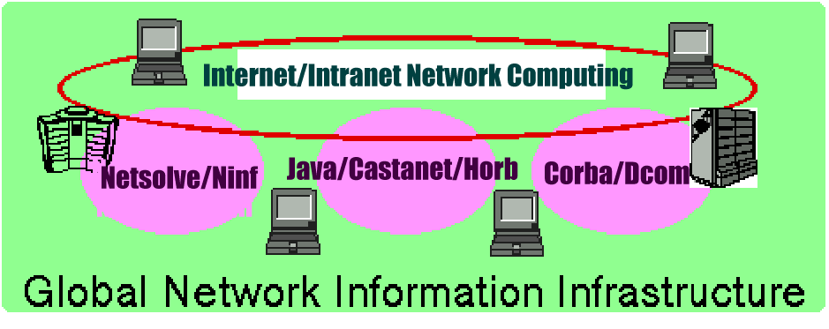
Bckgrnd1 - new comp. platforms
Network centric computing → Need high portability
From MICROSCOPIC (SmartCard, Ring) to MACROSCOPIC (Global Computing)
Java/JavaScript/HTML, new protocols, ...
$$ EC $$
Multimedia
NC

Slide 4
Current Projects Overview
Ninf Global Computing System
  w/ETL-RWC, RPC-based HPDC system
  Quantitative Global Computing Model, Architecture for Resource Scheduling, Global Computing Simulator, Security/Authentication, etc.
HPDC and Cluster Computing
  C++ (OpenC++/MPC++) Class Libraries, Reflection and HPDC (OpenDSM)
Java-based Open-ended, Turn-key HPDC
  Ninflet---Java-based global computing system
  OpenJIT --- Reflective Java JIT Compiler (w/Fujitsu)
    Adaptation and Optimization
  Java dynamic optimiazations for HPDC
Today’s
Talk

Slide 5
Java and Just-in-time Compiler
“Portable” languages e.g., Java
  Does not compile directly to CPU native code
  Interpretive execution of common bytecodes on JVMs (Java VM)
  Speed problem （1/10 ～ 1/100 vs. optim. native code)
Just-In-Time compiler to the rescue
  Rather old idea: Smalltalk, etc.
  Compile bytecode into native code at runtime
  1/2 ～ 1/10 vs. optim. native code
Sun, MS, IBM, Symantec, Fujitsu, etc., vigorously developing “the best” Java JIT. (e.g., HotSpot）

Slide 6
Java and JIT Compilers (2)
The Java “Portability Myth”
  Write once, debug everywhere
Optimizations not “Portable”
  traditional optimizations
  object-oriented optimization (CHA + inlining)
JIT itself non-portable
  hard to retarget (e.g., JIT on VPP)
Difficult to Customize
  E.g., Embedded apps → Need Memory Efficiency
Lack of “Performance Portability”
  Optimizations may not work
What do we do? → Use Reflection

Slide 7
Early Work: the ABCL/Rx project
Reflection with Concurrent Objects
Hybrid Group Reflective Architecture (ECOOP91)
ABCL/R2 and fast runtime (OOPSLA92)
Experimental optimization of parallel scheduling
ABCL/R3: efficient compilation via partial evaluation (OOPSLA95, ECOOP98)
  Application of the 1st Futamura Projection
  Close to C + Message Passing
Optimizing parallel programs with ABCL/R3 (Reflection96)

Slide 8
Open Compiler, Compile-Time Metaprogramming
“Static” or “Compile-Time” Reflection
  No Interpreter Intervention
  Eliminating Run-Time Interpretation
Disciplined Macro Preprocessor
  Compile-time Source-to-source Transformation
  C++ Language described in terms of C++
Customization according to classes
  Type-based analysis & compilation (EPP)
Standard Compiler Analysis
  Flow Analysis (OpenC++ extension)

Slide 9
C++ Metaprogramming/ Open Compilers (1)
Expression Templates
  Extend STL(Standard Template Library)
  Encode structure of expression into types
  Compiles X = A + B + C into for i X[i] = A[i] + B[i] + C[i] loop into compile time (not for i T[I] = A[I]+B[I]; for i X[I]=T[I]+C[I] )
Template Metaprogramming
  Generalize Expression Templates
  High-performance numerical computing
    A++/P++ Blitz++, MTL (Matrix Template Library), etc.

Slide 10
Open Compilers in C++ (2)
MPC++ (Ishikawa, RWCP)
  Define a metaprogramming language for extending C++ at compile time
    Library Optimizations
    Extending C++ for Parallel Computing
Open C++ (Chiba, Tsukuba Univ.)
  Similar to MPC++
  Use C++ itself for compile-time extensions
  Per-class customizatio
Other work such as IBM SOM

Slide 11
Reflection in Java (1)
Java Reflection API （JDK1.1.x)
  Structural Reflection, Introspection only
Java // (parallel) [Caromel97]
  Implements computational reflection w/Preprocessor+ReflectionAPI
EPP (Extensible PreProcessor] [Ichisugi 97]
  Open Compiler, Preprocessor Plugins
OpenJava [Chiba98]
  Open Compiler, Similar to OpenC++

Slide 12
Reflection in Java (2)
Partial evaluation of classfiles (Consel, OOPSLA97)
  specifies which input argument to customize, generate customized methods with PE
  Use Predicate Classes (Chambers) to specify customization conditions

Slide 13
Bckgrnd - Problems w/ JITs
Lack of Solid Technical Background
  JIT → No common framework, tools, libraries
    Difficult to incorporate new optimization techniques, etc.
Are JITs themselves “portable”? → Not really!
  Most JIT compilers are not “portable” (c.f., GCC)
  High-performance VLIW, embedded CPUs, multiprocessor-on-chip, etc., not supported well
Lack of optimization “scope/breadth”
  Sophisticated optimization → Difficult w/JITs due to time/space constraint (must be selective)
  Most optimizations speed-centric → no optim. for memory usage, etc.
continues

Slide 14
Bckgrnd3 - Problems w/ JITs (cont.)
Lack of Customizability
  New apps from HPC to Internet Appliances - need optimization and tuning for respective apps and environment
  (1) App/Env-specific code generation (e.g., DSM)
  (2) Customized optimization techniques
  (3) Language extensions if necessary
  Example: HPC on network of WS/PCs
    Distribution/parallelization directives (3)
    parallelized code generation/optimization (2)
    adaption to networked WS/PC env. (1)
No JIT compilers (nor JVM) today support these!

Slide 15
Our Proposal: OpenJIT Compiler
A Joint effort with Fujitsu’s Java compiler group
A Reflective Just-in-time (Open JIT Compiler)
  Based on Reflection/OI principle (Java JIT in Java)
  A Java framework for JIT compiler
  Can download/compile various customization & optimization modules into a JIT compiler “just-in-time”
Generic JIT Customization Library
Class-specific JIT customization → The library builder can embed class-specific customization of JIT into the classfile
  scope control

Slide 16
OpenJIT general schema
Java
Classfile
(methods)
Standard JIT Compiler
- Ad-hoc construction
- Limited/overspec optim
- restricted portability
Native
Code
(exec)
Just-in-time JIT customization
Java
Classfile
(methods
+
Compiler metacode)
OpenJIT Compiler
- Reflective/OI construction (JIT in Java)
- Flexible custom/optim
- high portability
Native
Code
(exec)
Self-application
(compile)

Slide 17
OpenJIT Applications
Large-scale metacomputing environment
    Adapting Java to different HPC platforms
Embedded Applications
    For embedded RISC processors
    resource efficient optimization
Others
  JIT technology experiments
  parallel languages
  other custom languages

Slide 18
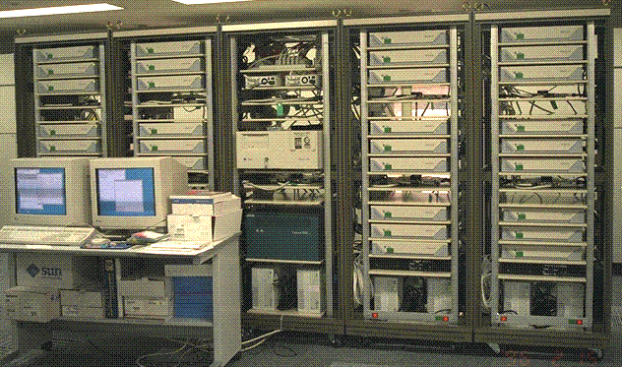
The “Simple App” Scenario
Software DSM on a Cluster of WS/PCs → need mods on compiler/runtime (c.f. DEC Shasta)
Assume source code is not available (e.g., Applets)
Java (VM) does not support such customization
OpenJIT → customize “DSM” class such that read/write barriers are automatically inserted, etc.

Slide 19
Implementing the Simple App Scenario
Proof-of-concept: OMPC++ DSM
  OpenC++ plus RWC MPC++
  Implement Software DSM as a Metaclass Library
  Portable, High-Performance
  Runs on 256-node RWC PC cluster
    Implementing SPLASH2 programs
  Future implementation in Java w/OpenJIT

Slide 20
OpenJIT Compiler Overview (1)
99% written in Java
  Need JNI native method support for JVM access
“Plugs in” to Standard JavaVM
  Works just like off-the-shelf JIT
    setenv JAVA_COMPILER OpenJIT
    setenv CLASSPATH <openjitdir>
    setenv LD_LIBRARY_PATH <openjitdir>
  Initially “self-compiles” on startup
Downloadable OpenJIT extensions
  Class Annotation + Interface
  Scope Control (class-only, general (except JIT), everything (incl. JIT)
  API still under design

Slide 21
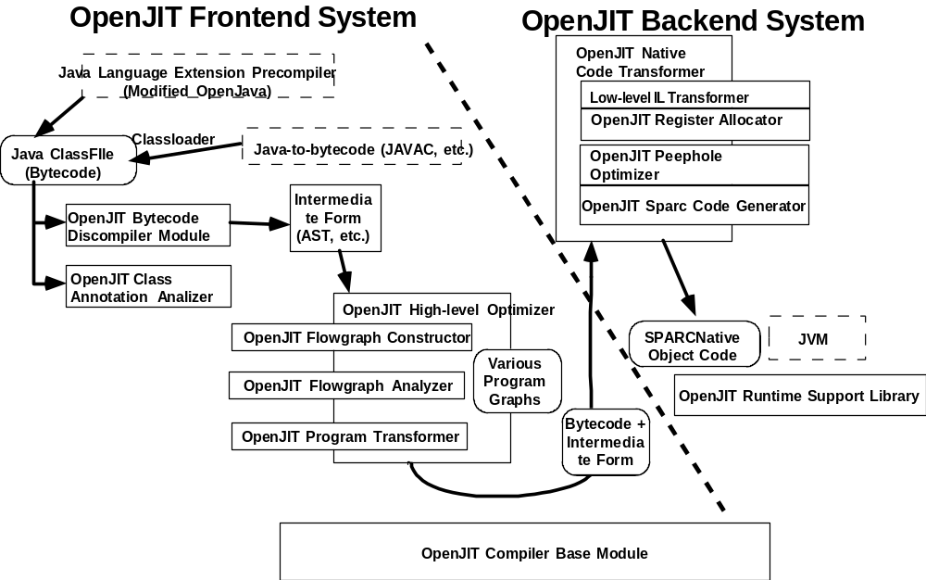
OpenJIT Compiler Overview (2)

Slide 22
OpenJIT Compiler Overview (3)
OpenJIT Frontend System
  Bytecode-to-bytecode optimizer
    “Discompiler” to recover Java source structure
    Class framework for standard program analysis
  Classfile Annotation Analysis
    Various info for optimization and extensions
OpenJIT Backend System
  A small Java JIT compiler in Java
  Standard optimizations
    stack-to-register allocation
    peephole optimization
    stack ops to RISC ops

Slide 23
OpenJIT Customization
3 levels of customization
  1. No changes in Java language syntax or semantics
    Standard Compiler incl. OO optimizations
    User-definable (like SUIF)
  2. Semantic extensions but no syntax change extensions
    Adaptation to Computing Env. (e.g., DSM)
    Both frontend and backend support
  3. Both Syntactic and Semantic Extensions
    New Language Primitives (e.g., Data distribution Directives)
    NOT directly supported
    New bytecode → Need javac equiv. to emit bytecode

Slide 24
OpenJIT and OpenJava
OpenJava Compiler (Univ. of Tsukuba, Chiba)
  An Open Compiler for Java
    c.f., OpenC++ v.2.x
  Sophisticated source-to-source macro processing
Collaboration w/ OpenJIT
  Open Java - language extensions (new bytecode), some static optimizations
  OpenJIT - main optimizations, run-time customization
    Inverse parsing + customization+ re-compilation

Slide 25
OpenJIT Project Member
Joint project between TIT & Fujitsu
Fujitsu Compiler Technologies Division
  Koichiro Hotta
Fujitsu Laboratories
  Fuminori Kimura
  Kouya Shimura
Tokyo Institute of Technology
  Satoshi Matsuoka
  Hirotaka Ogawa
    Other students
Electrotechnical Laboratory
  Hiromitsu Takagi

Slide 26
OpenJIT Current Status
Parallel Design & Development at TIT and Fujitsu
The first prototype backend is operational
  can run javac, reasonable speed
Frontend being designed
Frontend & Backend API being designed
Full prototype operational 3Q ’98, distributable version 1Q ’99
Will be PDS (under contract)

Slide 27
OpenJIT Preliminary Benchmarks (1)
Very early results - does not directly reflect final performance
  No Frontend
  Prototype Backend
    No good register allocation
    Little peephole optimizations
Still, good news is that it runs and works pretty well…
Comparison to Fujitsu’s commercial JIT and Sun’s JIT (JDK 1.1.x), UltraSparc 250Mhz
  written in C

Slide 28
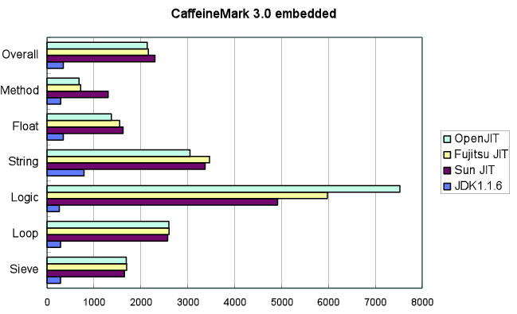
OpenJIT Preliminary Benchmarks (2) - CaffeineMark

Slide 29
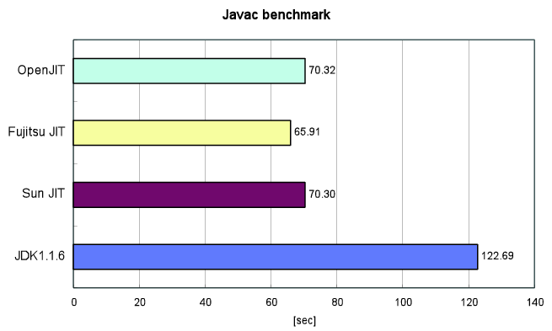
OpenJIT Preliminary Benchmarks (3) - CaffineMark

Slide 30
OpenJIT Preliminary Benchmarks (4) - Warmup Time
Coldstart, compile & execute an empty method (incl. self-compile time)
Execution Result (wo/Frontend)
class empty {
public static void main(String argv[]) {
}
}
OpenJIT(JDK1.1.5)
  real 1.138
  user 0.880
  sys 0.117
JDK1.1.5 Interpreter
  real 0.346 (diff = 0.79)
  user 0.142 (diff = 0.74)
  sys 0.075 (diff = 0.042)

Slide 31
Conclusion and Future Work
OpenJIT is the first reflective JIT compiler for Java
High portability, extensibility
Basis for work on dynamic compilation, Java extensions, AOP weavers, etc.
Many technical challenges remain
  Various techniques - e.g., Multithreading of self-modifying code
  Space/Time efficient frontend optimization
  OO Framework API design
  Various interesting research based on OpenJIT

