Slide 1
The OpenJIT project
Opening-up the Java JIT Compiler
Satoshi Matsuoka
Tokyo Institute of Technology
Presentation for the ICSE AOP workshop,
Kyoto, Japan, April 20, 1998

Slide 2
Objectives of OpenJIT Project
A TIT/Fujitsu Project
A dynamically customizable Java JIT compiler
Apply “Open Compiler” “Reflection” to JITs
  Dynamic compilation
  Self-compiling
Basis for various JIT research
  Will be public domain (at least binaries)
Allow customization of JITs
  Dynamic loading of optimization classes
  Customize language (w/OpenJava)
  Optimize for apps and environment

Slide 3
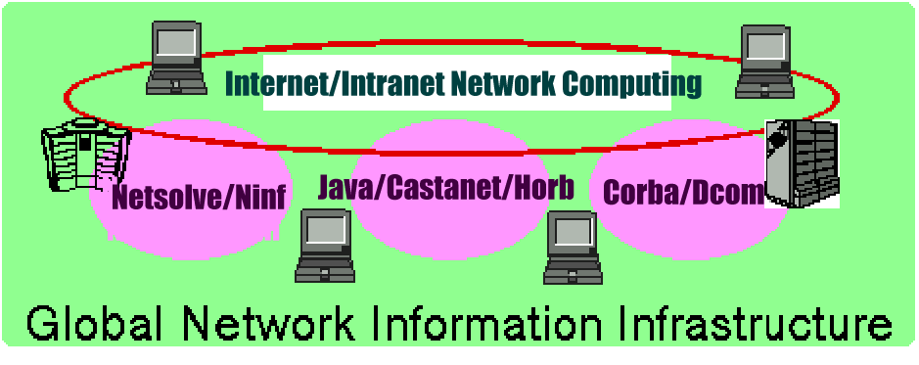
Bckgrnd1 - new comp. platforms
Network centric computing → Need high portability
Java/JavaScript/HTML, new protocols, ...
Multimedia
$$ EC $$
NC

Slide 4
Bckgrnd2 - JITs and Portability
“Portable” languages e.g., Java
  Does not compile directly to CPU native code
  Interpretive execution of common bytecodes on VMs
  Speed problem （1/10 ～ 1/100 vs. optim. native code)
Just-In-Time compiler to the rescue
  Rather old idea: Smalltalk, etc.
  Compile bytecode into native code at runtime
  1/2 ～ 1/10 vs. optim. native code
Sun, MS, IBM, Symantec, Fujitsu, etc., vigorously developing “the best” Java JIT.

Slide 5
Bckgrnd3 - Problems w/ JITs
Lack of Solid Technical Background
  JIT → No common framework, tools, libraries
    Difficult to incorporate new optimization techniques, etc.
Are JITs themselves “portable”? → Not really!
  Most JIT compilers are not “portable” (c.f., GCC)
  High-performance VLIW, embedded CPUs, multiprocessor-on-chip, etc., not supported well
Lack of optimization “scope/breadth”
  Sophisticated optimization → Difficult w/JITs due to time/space constraint (must be selective)
  Most optimizations speed-centric → no optim. for memory usage, etc.
continues

Slide 6
Bckgrnd3 - Problems w/ JITs (cont.)
Lack of Customizability
  New apps from HPC to Internet Appliances - need optimization and tuning for respective apps and environment
  (1) App/Env-specific code generation (e.g., DSM)
  (2) Customized optimization techniques
  (3) Language extensions if necessary
  Example: HPC on network of WS/PCs
    Distribution/parallelization directives (3)
    parallelized code generation/optimization (2)
    adaption to networked WS/PC env. (1)
No JIT compilers (nor JVM) today support these!

Slide 7
Our Proposal: OpenJIT Compiler
A Joint effort with Fujitsu’s Java compiler group
A Reflective Just-in-time (Open JIT Compiler)
  Based on Reflection/OI principle (Java JIT in Java)
  A Java framework for JIT compiler
  Can download/compile various customization & optimization modules into a JIT compiler “just-in-time”
Generic JIT Customization Library
Class-specific JIT customization → The library builder can embed class-specific customization of JIT into the classfile
  scope control

Slide 8
OpenJIT general schema
Java
Classfile
(methods)
Standard JIT Compiler
- Ad-hoc construction
- Limited/overspec optim
- restricted portability
Native
Code
(exec)
Just-in-time JIT customization
Java
Classfile
(methods
+
Compiler metacode)
OpenJIT Compiler
- Reflective/OI construction (JIT in Java)
- Flexible custom/optim
- high portability
Native
Code
(exec)
Self-application
(compile)

Slide 9
OpenJIT Applications
Large-scale metacomputing environment
    Adapting Java to different HPC platforms
Embedded Applications
    For embedded RISC processors
    resource efficient optimization
Others
  JIT technology experiments
  parallel languages
  other custom languages

Slide 10
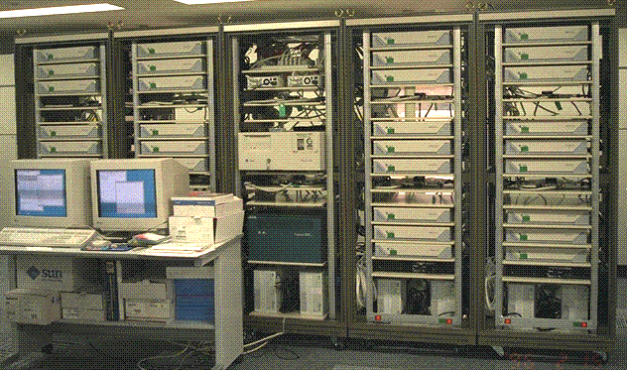
Simple App Scenario
Software DSM on a Cluster of WS/PCs → need mods on compiler/runtime (c.f. DEC Shasta)
Assume source code is not available (e.g., Applets)
Java (VM) does not support such customization
OpenJIT → customize “DSM” class such that read/write barriers are automatically inserted, etc.

Slide 11
Reflection in Java
JDK Reflection API: structural reflection only
Partial evaluation of classfiles (Consel, OOPSLA97)
  specifies which input argument to customize, generate customized methods with PE
  Use Predicate Classes (Chambers) to specify customization condition
OpenJava (Chiba), EPP (Ichisugi) → Compile-time MOP, e.g., self-applicative macro processor
  augments OpenJIT in language customization

Slide 12
OpenJIT Compiler Overview (1)
99% written in Java
  Need JNI native method support for JVM access
“Plugs in” to Standard JavaVM
  Works just like off-the-shelf JIT
  Initially “self-compiles” on startup
Downloadable OpenJIT extensions
  Class Annotation + Interface
  Scope Control (class-only, general (except JIT), everything (incl. JIT)
  API still under design

Slide 13
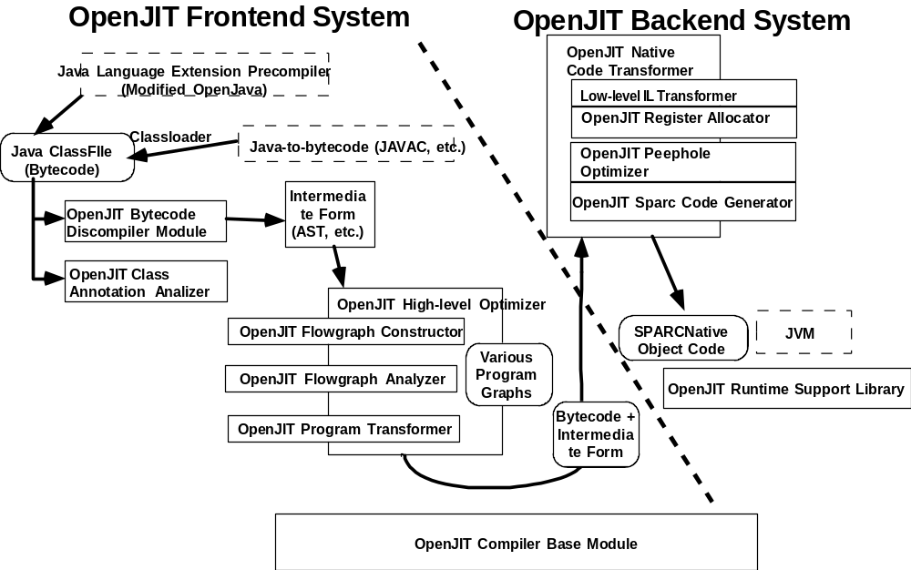
OpenJIT Compiler Overview (2)

Slide 14
OpenJIT Compiler Overview (3)
OpenJIT Frontend System
  Bytecode-to-bytecode optimizer
    “Discompiler” to recover Java source structure
    Class framework for standard program analysis
  Classfile Annotation Analysis
    Various info for optimization and extensions
OpenJIT Backend System
  A small Java JIT compiler in Java
  Standard optimizations
    stack-to-register allocation
    peephole optimization
    stack ops to RISC ops

Slide 15
OpenJIT Customization
3 levels of customization
  1. No changes in Java language syntax or semantics
    Standard Compiler incl. OO optimizations
    User-definable (like SUIF)
  2. Semantic extensions but no syntax change extensions
    Adaptation to Computing Env. (e.g., DSM)
    Both frontend and backend support
  3. Both Syntactic and Semantic Extensions
    New Language Primitives (e.g., Data distribution Directives)
    NOT directly supported
    New bytecode → Need javac equiv. to emit bytecode

Slide 16
OpenJIT Current Status
Parallel Design & Development at TIT and Fujitsu
The first prototype backend is operational
  can run javac, reasonable speed
Frontend being designed
Frontend & Backend API being designed
Full prototype operational 3Q ’98, distributable version 1Q ’99
Will be PDS (under contract)

Slide 17
OpenJIT Preliminary Benchmarks (1)
Very early results - does not directly reflect final performance
  No Frontend
  Prototype Backend
    No good register allocation
    Little peephole optimizations
Still, good news is that it runs and works pretty well…
Comparison to Fujitsu’s commercial JIT
  written in C

Slide 18
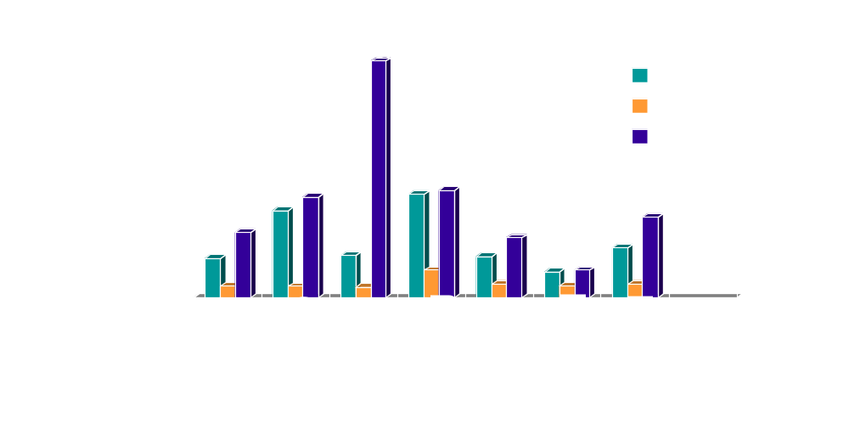
OpenJIT Preliminary Benchmarks (2) - CaffineMark

Slide 19
OpenJIT Preliminary Benchmarks (3) - Warmup Time
Coldstart, compile & execute an empty method (incl. self-compile time)
Execution Result (wo/Frontend)
class empty {
public static void main(String argv[]) {
}
}
OpenJIT(JDK1.1.5)
  real 1.138
  user 0.880
  sys 0.117
JDK1.1.5 Interpreter
  real 0.346 (diff = 0.79)
  user 0.142 (diff = 0.74)
  sys 0.075 (diff = 0.042)

Slide 20
Conclusion and Future Work
OpenJIT is the first reflective JIT compiler for Java
High portability, extensibility
Basis for AOP work on JIT and other compilers, weavers, etc.
Many technical challenges remain
  Various techniques - e.g., Multithreading of self-modifying code
  Space/Time efficient frontend optimization
  OO Framework API design
  Various interesting research based on OpenJIT

