Slide 1
OMPC++:
A Portable High Performance Implementation of DSM using OpenC++ Reflection
Yukihiko Sohda, Hirotaka Ogawa, Satoshi Matsuoka
Tokyo Institute of Technology
Notes:
Our work is OMPC++ a portable high performance implementation of DSM using OpenC++ Reflection.

Slide 2
Outline
Background
OMPC++ system
Software DSM
Program transformation
Performance Evaluation
Related work and comparison
Conclusion and future work
Notes:
The outline of this talk is..
First, the background of this research is described and the whole OMPC++ system as the solution is explained. Next implementation of the software DSM of OMPC++ and program transformation are described. And basic performance evaluation and the performance evaluation using SPLASH2 as real application are shown. Furthermore, we describe related work and comparison. Finally conclusion and future work are shown.

Slide 3
Background
Platform portability for parallel computers is required
  diversity environments support
    memory models, communication models
    PC-/WS-Clusters using commodity hardware
  high performance
    on any platforms
    optimize to each platform
  programming model
    supports diversity models
Notes:
Platform portability for parallel computers is required and must satisfy three points.
First, diverse environments must be supported. Unlike a normal computer there are many memory and communication models. And many PC/WS clusters using commodity hardware are developed.
Second, we must not only support platform portability but also get high performance. Programs should be optimized for each platform on any platforms.
Third, programming models must not be restricted due to the portability.
Now, it is asked for platform portability in parallel execution environment. It is mentioned that unlike a normal computer there are many memory and communication models with various parallel execution environment and PC/WS cluster using commodity hardware are developed.
Moreover it not only realizes portability, but it is the true portability to also attain high performance. That is, in order to realize platform portability, a performance must not fall victim. And programs must be optimized with the environment and executed on every platform.
Finally a programming model must not be restricted for the portability, and various programming models must be able to be supported.

Slide 4
Current solutions - problems
Parallel programming languages (e.g HPF)
  restriction on programming models
automatic parallelizing compiler (e.g. PDG Fortran Compiler)
  difficult to port a compiler itself
  some programs not parallized well, scalability problems
message passing libraries (e.g. MPI, PVM)
  restriction on programming models
  complexities of programming
Notes:
Although there are some systems to realize platform portability, but each of them holds problems.
First, in the parallel programming languages like HPF, they archive high performance, but programming models will be restricted.
Automatic parallelizing compilers such as those for FORTRAN are difficult to port the compiler itself and there are often performance problems.
Although messaging libraries such as MPI and PVM offer portability up to certain degree, programming models are restricted and programming becomes complicated.
That is, by the current solutions, it is difficult to realize platform portability.
So what kind of solution can we take for the platform portability?
Java is portable language, but Java can work only on shared memory machine. Moreover, Java has only the portability which JavaVM offers. That is, functional extensions or the optimization suitable for runtime environment cannot be performed

Slide 5
Solution: Reflection or “Open Compiler” strategy
Provide portability using Reflection or “Open Compiler”
  diverse programming models
  easy to support diverse environments
    only write compiler metaclasses for each environment
  good performance
    Program transformations by an open compiler either statically or with dynamic info.
    customized optimization for particular environment or application
Notes:
SO, we propose providing the platform portability in parallel programming using reflection or Open Compiler.
We can support diverse programming models by language extension. We can easily support diverse environment with the only writing compiler metaclasses for each environment.
And good performance can be expected, if we properly design the system.
Since program transformation by Open Compiler can performed statically at the compile time or with runtime information, the optimization suited for runtime environments or applications can be applied.
What is the present most portable language? Probably, it is Java language. However, this Java language also has only the portability which JavaVM offers. That is, functional extensions or the optimization suitable for runtime environment cannot be performed.

Slide 6
Solution: OpenJIT Project
A TIT/Fujitsu Open Source Java JIT Project
A dynamically customizable Java JIT compiler in Java
Apply “Open Compiler” “Reflection” to JITs
  Dynamic compilation
  Self-compiling (JIT in Java and coexist w/app objects)
Basis for various JIT research (c.f. Stanford SUIF)
  Will be public domain this summer
  Plugs into standard Sun JVM (1.1.x) (as is w/standard C- JITs)
  Solaris-SPARC JDK 1.1.x, 1.2 (ref JVM), Linux x86
  Second fastest JIT on x86 Linux
Allow customization of JITs
  Dynamic loading of optimization classes (Compilets)
  Customized behavior
  Optimize for apps and environment
Notes:
For this purpose, We are developing the OpenJIT system.
OpenJIT is a JIT compiler for Java which is written in Java and which can be customize dynamically using Reflection and Open Compiler.
In OpenJIT, users can customize compile operation of JIT. So we can apply optimization specialized for a certain application or some runtime enviroment. OpenJIT can also be used for extending Java.
Despite being reflective, OpenJIT is the second fastest JIT compiler on Linux, and will be released later this summer.
What is the present most portable language? Probably, it is Java language. However, this Java language also has only the portability which JavaVM offers. That is, functional extensions or the optimization suitable for runtime environment cannot be performed.
Then, we are developing OpenJIT which is the system which applied the technique of reflection and open compiler to Java. OpenJIT is the project which we TIT and Fujitsu are developing. OpenJIT is, simply saying, the JIT compiler of Java which was written in Java and which can be customize dynamically.
OpenJIT is based on many researches about JIT including SUIF. The first release is already due to be performed soon.
In OpenJIT, a user can customize compile operation of JIT. The class which performs the optimization at the time of compile is dynamically read at the time of compile. We say this class compilets. The compilets changes processing of usual JIT compile and performs the optimization to which it specialized in application and runtime environment.

Slide 7
OpenJIT general schema
Java
Classfile
(methods)
Standard JIT Compiler
- Ad-hoc construction
- Limited/overspec optim
- restricted portability
Native
Code
(exec)
Just-in-time JIT customization
Java
Classfile
(methods
+
Compiler metacode)
OpenJIT Compiler
- Reflective/OI construction (JIT in Java)
- Flexible custom/optim
- high portability
Native
Code
(exec)
Self-application
(compile)
Notes:
This is a comparison of OpenJIT and the general JIT.
A general JIT compiler gets a bytecode, and performs the general optimization and then generates native code.
OpenJIT gets the bytecode and metacode, customization which followed the metacode in addition to general optimization is performed, and a native code is generated. In JIT compiling phase, self-application will be also performed.
The conventional JIT is adhock construction, but OpenJIT is based on Reflection and Open Implementation. Most of OpenJIT is written in Java. In the future, all of OpenJIT code will be written in Java.

Slide 8
This work - Open Compiler DSM Experiment in C++
Precursor work to OpenJIT parallel programming support
Provides a parallel programming system - OMPC++
Implements Software Distributed Shared Memory (DSM) using OpenC++ and MPC++
Shows Reflection can provide platform portability in high-performance parallel programming
Notes:
So far, we have covered our motivation and our background work.
Now THIS research is a precursor work to portable parallel programming in Java using OpenJIT.
In this research, wehave experimented a parallel programming language system named OMPC++, which implements a PORTABLE software DSM using OpenC++ and MPC++.
We showed Reflection can provide platform portability, and we will be applying our results in the context of Java and OpenJIT.

Slide 9
Overview of OMPC++
Transforms shared memory based multithreaded programs into DSM supported programs for non shared memory environment
Program transformation is provided by Open Compiler (OpenC++)
DSM support routines is written in MPC++ MTTL
Notes:
This is the outline of the OMPC++ system.
OMPC++ system transforms the C++ shared-memory multithreaded program into the DSM supported program for non shared memory environment. Program transformation is performed by OpenC++ which is Open Compiler of C++ language. The DSM routine is written in MPC++ MTTL.
Next, I describe the feature of OpenC++ and MPC++ .

Slide 10
OMPC++ components
OpenC++ [Chiba96]
Compile-Time MOP
  static source-level program transformations
  metaclass for program transformations is compiled by OpenC++ compiler
  generates a compiler includes program transformations
MPC++ [Ishikawa96]
extends C++ only using Template and Inheritance
provides
  user-level threads
  remote / local thread creation
  remote / local method invocation
  remote memory access
Notes:
OpenC++ offers Compile-Time MOP. The compiler containing program transformation is generated by the OpenC++ metaprogram and processing this with the OpenC++ compiler. When the program of a base level is processed with this compiler, a program will be transformed and a suitable execution program will be generated.
MPC++ is the parallel programming language which extend C++ only by the template and inheritance. MPC++ provides the user-level thread, local/remote thread creation, local/remote method invocation, and remote memory access.

Slide 11
Work flow of
OMPC++
source
program
OpenC++
metaclass
for translation
DSM Program Transformation via metaprogramming
  Users write standard multihreaded code
Compiles OpenC++ DSM metacode to generate a DSM C++ compiler
The generated compiler performs program transformation
Transformed programs
compiled by the MPC++ compiler + PM + DSM Lib
program
translator
compile
with OpenC++
translated
source code
compile
with MPC++
MPC++
RTL
DSM
Library
target program
with DSM support
Notes:
This is the program transformation and compile flow of OMPC++ .
A user writes a shared memory multithreaded program. The OpenC++ metaclass for program transformation is compiled with OpenC++ compiler, and the compiler containing program transformation is generated. A source program is transformed by the generated compiler into the program which added DSM function. The generated program is compiled by MPC++ and linking with MPC++ RTL and DSM library. Finally, the execution program with DSM support is generated

Slide 12
Software DSM
Distributed Shared Array class
  template class
  flexible & portable
Write-Invalidate style
DSA class includes:
  contents of array
  divided into blocks
    unit of memory transfer
    block size is BlockSize
  management table
    pointer to real memory
Overriding [], () operators
  for miss checking
when write accessing, requires block locking
  writeStart(), writeEnd() must be inserted
invalidations are invoked asynchronously w/ MPC++ threads
inlining
Notes:
We describe the implementation of software DSM. This DSM implementation adopts sharing array. So we defined distributed shared array class as a template class. Taking such a way, compared with page-based DSM, it is advantageous in respect of flexibility and portability. The Write-Invalidate style is adopted as a memory consistency protocol.
Distributed shared array class includes contents of array and management table. Array is divided into blocks. Block is the unit of memory transfer. The size of the block is BlockSize.
Management table has pointer to the real memory and the share status …
To access to memory from program, we overrides [](bracket) and the ()(parentheses) operators. The misscheck of memory access is performed in these operators.
Moreover, at the time of write access, you have to insert WriteStart() and WriteEnd() function before and after the access. Because it must have the ownership of the block for writing.
For reduction of the overhead of memory access, Invalidation is asynchronously invoked, methods are inlined.

Slide 13
Software DSM(2)
read access
  check local copy
  if there is no valid local copy, requests copy to owner PE
write access
  check ownership
  if this PE doesn’t have owner ship, requests ownership to owner PE
  send an invalidation to all copy owner PEs
read
local copy?
yes
read
no
send copy
(remote)
request copy
(local)
communication
write
owner?
local copy?
no
no
yes
yes
request
copy
invalidation
request
ownership
write
: communication occurs
Notes:
Next I explain briefly the processing of read and write accesses. The algorithm is basically the standard strrongly-coherent invalidation-based protocol with ownership transfer.
In read access, it checks whether to have the memory block accessed locally first. If not had, a copy is demanded from the owner of the block and the copy of the block is made locally. And it accesses to a memory.
In write access, it check whether to be the owner of the memory block to access first. If it is an owner invalidation will be invoked to the processor with a copy. If it is not an owner, ownership will be required of an owner. When if does not have the copy locally at this time, the memory block is also got. And it accesses to a memory.
In the figure, the yellow arrow means that communication has happened.

Slide 14
Rules for source programs written by users
OMPC++ sdsm APIs
  sdsm_init()
    initializes shared data structures, execute on 1 PE
  sdsm_main()
    main routine, run in parallel
  sdsm_done()
    cleanup/finalization, execute on 1 PE
Notes:
In OMPC++ system, you can easily write shared-memory-style multithreaded programs, using the following 3 APIs.
sdsm_init() initializes shared data structure etc.
It is executed on one processor.
Sdsm_main() is the main routine run in parallel.
sdsm_done is finalization routine such as release of memory, it is executed on one processor.
Compared with the conventional object based software DSM, it is easy to port programs.

Slide 15
Program Transformation(1)
OpenC++ Metaclasses for transformation
  named SharedClass
  define how to transform
  defined as subclass of OpenC++ Class
  overriding methods to change existing transformations
    TranslateInitializer()
    TranslateAssign()
    FinalizeInstance()
  metaclass size is about 250lines
Notes:
Next, I describe the program transformation by OMPC++.
First, we prepare the metaclass which performs program transformation. The metaclass describes how a program is changed. This metaclass SharedClass is written as a subclass of OpenC++ Class. And the transformation is written by the overriding existing methods for transformations. The overridden methods are the following three. In the first stage, these methods are empty.

Slide 16
OMPC++ metaclass sample code
in TranslateAssign() ...
Ptree* SharedClass::TranslateAssign(Environment* env, Ptree* obj, Ptree* op, Ptree* exp){
Ptree* exp0 = ReadExpressionAnalysis(env, exp);
Ptree* obj0 = WriteExpressionAnalysis(env, obj);
return Ptree::List(obj0, op, exp0);
};
Ptree* SharedClass::WriteExpressionAnalysis(Environment* env, Ptree* exp){
Ptree *obj = exp->First();
Ptree *index = exp->Nth(2);
if (!index->IsLeaf())
index = ReadExpressionAnalysis(env, index);
InsertBeforeStatement(env, Ptree::qMake("`obj`.WriteStart(`index`);\n"));
AppendAfterStatement(env, Ptree::qMake("\n`obj`.WriteEnd(`index`);\n"));
return Ptree::qMake("`obj`(`index`)");
};
Notes:
This is a sample code of a OpenC++ metaclass for OMPC++.
This shows a part of TranslateAssign and one of the methods called from TranslateAssign. In TranslateAssign, the environemnt, RHS, LHS expression, and an operator are received, suitable transformation is performed, then the result is returned. Here, analysis and transformation are performed about RHS and LHS.
WriteExpressionAnalysis is the method which analysis and transform about write accessing. WriteStart and Writeend Statement are inserted before and after the statement accessed.

Slide 17
Program Transformation(2)
TranslateInitializer()
  to get object information (size, type..)
TranslateAssign()
  to insert access checking
FinalizeInstance()
  adds initialize, finalize routine
    allocate / free memory and objects
    initialize memory management tables
    main routine(sdsm_main()) invocation
Notes:
We show what transformation is executed in each method.
In TranslateInitializer, the size of a shared object and the information on a type are obtained.
The access check to a shared memory is inserted in TranslateAssign.
The routine of initialization / finalization is generated and inserted in FinalizaInstance. Specifically, the routine for calls of the allocation and release of a shared memory, initialization of memory management tables and usr wrote routine such as sdsm_main() is generated and inserted.

Slide 18
Example: before and after the transformation
Shared<double> a(100);
Shared<double> b;
sdsm_main(){
b = (double*)
malloc(sizeof(double) * 10);
b[0] = a[0];
};
sdsm_init(){
a[0] = 10.0;
};
sdsm_done(){ ... };
Shared<double> a(100);
Shared<double> b;
sdsm_main(){ b.allocate(10);
{ double _sym52501_8 = a[0];
b.WriteStart(0);
b[0] = _sym52501_8;
b.WriteEnd(0);} }
sdsm_init(){ { a.WriteStart(0);
a[0] = 10.0;
a.WriteEnd(0);} };
sdsm_done(){ ... };
Initialize(){ a.allocate(100); };
Finalize(){ a.free(); b.free(); };
mpc_main(){
invoke Initialize() on all PEs.
sdsm_init();
invoke sdsm_main() on all PEs.
sdsm_done();
invoke Finalize() on all PEs. };
Notes:
This is an example of the program transformation by OMPC++.
The left list is before the transformation, the right is after the transformation.
A shared object is declared like shared<double>.
Before and after write accessing to a share object, writestart and writeend are inserted.
Malloc statement is transformed into allocate method of a shared object.
Initialize, Finalize and mpc_main function are added by transformation executed by overridden FinalizeInstance method. Initialize function calls memory allocation, and Finalize function calls memory release method of each shared object. A mpc_main function is equivalent to the main function of an MPC++ program.
Mpc_main function calls initialization and finalization function, and user defined sdsm_init,main,done functions.

Slide 19
Evaluation
Basic DSM performance
  read/write accessing throughput /w several BlockSize
    all accesses invoke memory copies but no invalidation
CG Kernel, SPLASH2 FFT, LU
  LU: small(16k) and large(261k) problem size
  FFT: size 64Kpoints
  LU: matrix size 1024x1024
porting SPLASH2 to OMPC++
  small, non-fundamental modifications
    basic declarations etc.
    core computation routines unchanged
    about 70line modifications within 1000lines total
Notes:
We show the result of performance evaluation of OMPC++ system.
We investigated the throughput of read/write access as a basic DSM performance. Here, we changed various BlockSize and saw the influence. In all accesses, although the copy of memory is occurred, but no invalidation are invoked.
Next, we take up CG Kernel and FFT and LU kernel from SPLASH2 benchmarks generally used as performance evaluation of DSM system as examples of real applications.
We needed to be corrected with small in order to run SPLASH2 by the OMPC++ system. The main correction parts are declaration statement etc. and there is no change of the core program. Needed correction for each of FFT and LU was about 70 lines to the program of about 1000lines.

Slide 20
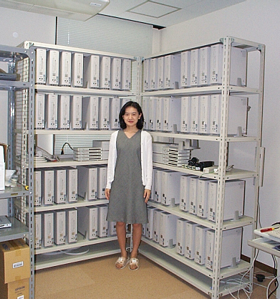
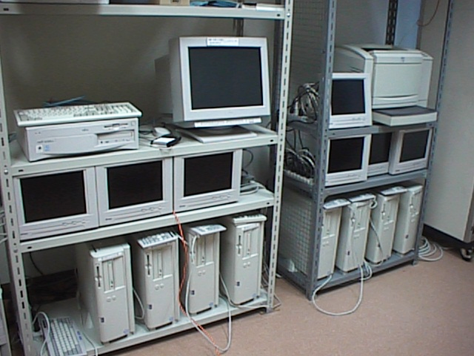
Evaluation - Environtent
PC Cluster
  RWCP PC-Cluster II
  PentiumPro 200MHz
  128MB Memory
  Myrinet/PM
    Linkspeed 100MB/sec
  Linux 2.0.36
  SCore 2.4
    user-level parallel programming environment
A subset of PC-ClusterII
at Matsuoka Lab.
New 64-proc. Cluster
Notes:
PC cluster which we used as evaluation environment is a subset of PCC2 developed by RWCP.
CPU is PentiumPro200MHz, memory is 128MB, interconnected network is myrinet which has 160MB/sec link speed. OS is Linux 2.0.36, and user-level parallel runtime environment is SCore2.4.

Slide 21
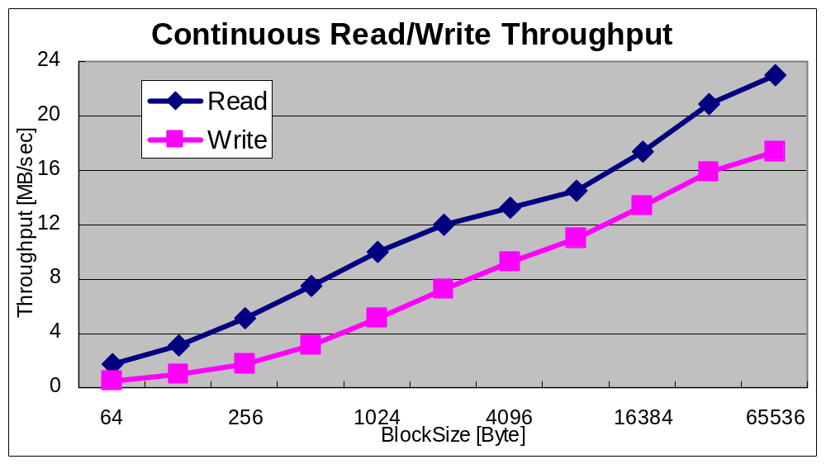
Continuous Read/Write
Effective thruput approx 23MB/sec@Blocksize 65Kbytes
Notes:
This is a result of continuous Read/write accesses.
A horizontal axis is BlockSize, A vertical axis is throughput.
The throughput becomes large as blocksize becomes large.
This is because the cost of memory copy per access becomes small so that throughput becomes large.

Slide 22
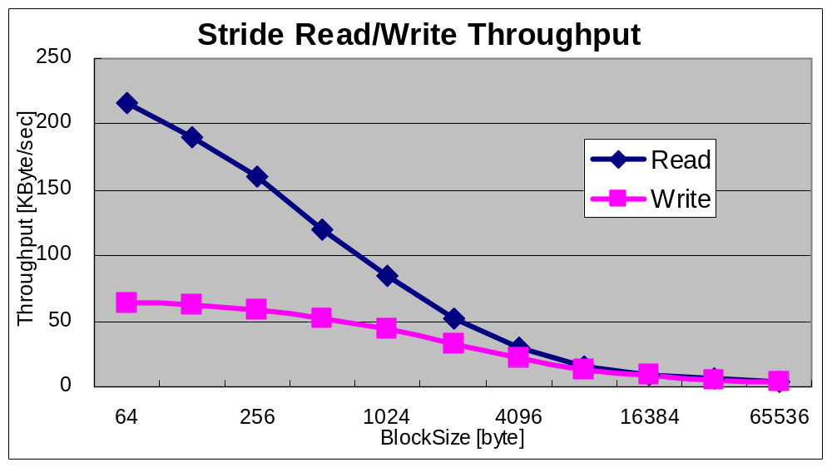
Blocked Stride r/w (worst case)
Throughput decreases along with the increase in BlockSize
Notes:
Next, this is a result of stride read/write accesses. Only one word of per each coherency Block is accessed in stride access. So, this is the worst-case scenario. For this reason, if BlockSize becomes large, the overhead which takes the memory copy becomes large and throughput goes down.

Slide 23
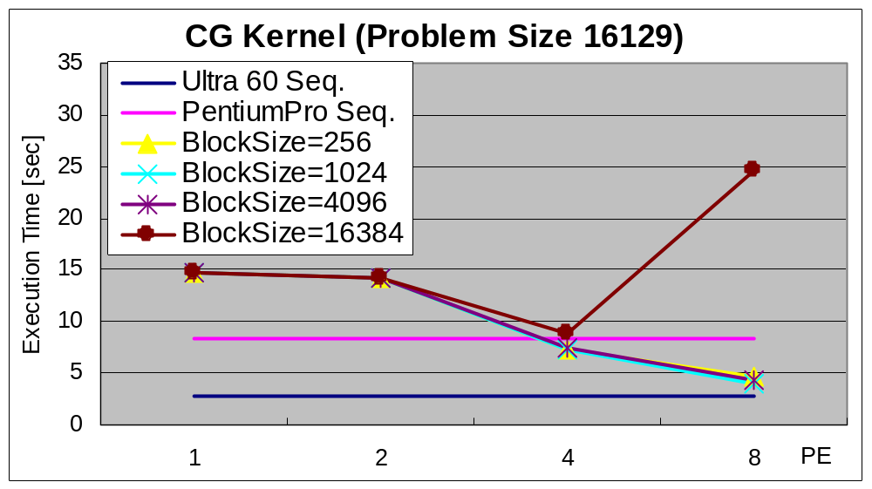
CG Kernel (1) - Small Problem
Notes:
This is CG kernel with small problem size.
Relative speedup is shown in 2-8 processors.
The low performance up in 1-2 processor is because it offsets the overhead of memory access against the effect of parallelization
Moreover, when BlockSize is 16K, the performance greatly drops at eight processors.Since problem size is small, the memory copy occurred frequently.

Slide 24
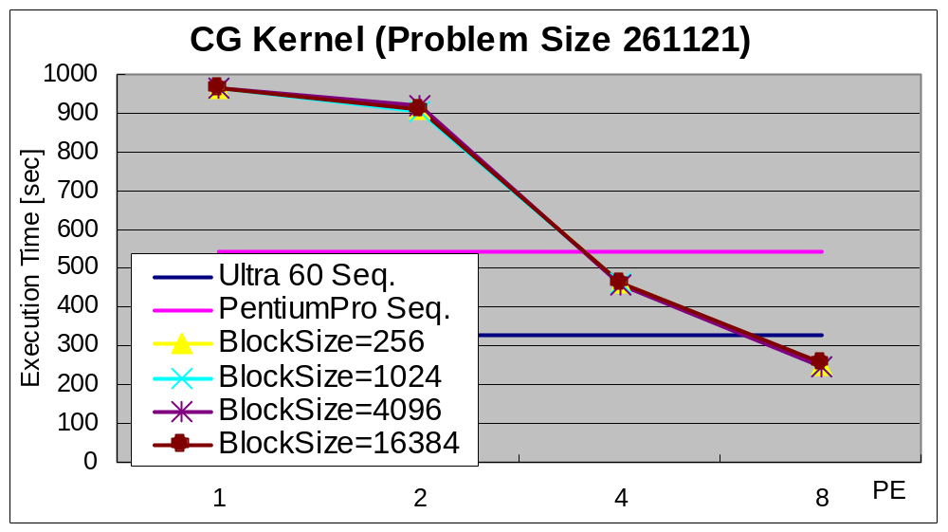
CG Kernel (2) - Large Problem
Good speedup irrespective of BlockSize
Notes:
We measured the performance with enlarged problem size. Now, we obtain good speedup irrespective of the BlockSize. So, for realistic programs, OMP++ demonstrates to have good performance.

Slide 25
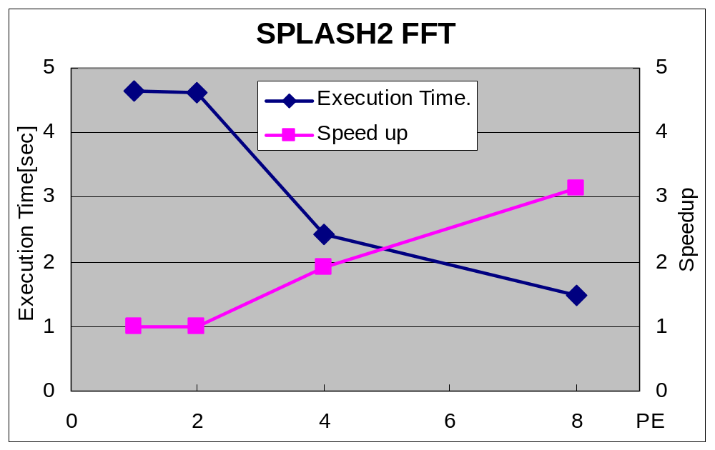
SPLASH2 FFT
3.2 times speedup with 8PEs
Notes:
This is the performance and its number effect in FFT of SPLASH2. We obtain 3.2 times performance improvement at eight processors.

Slide 26
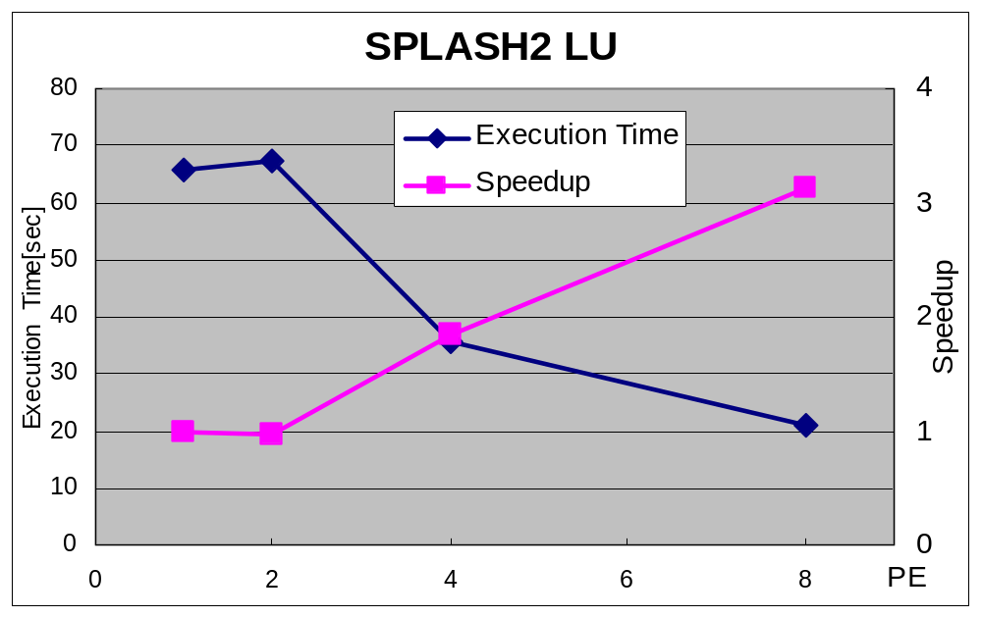
SPLASH2 LU
3.3 times speedup with 8PEs
Notes:
It is LU of SPLASH2. We obtain 3.3 times performance improvement at eight processors.

Slide 27
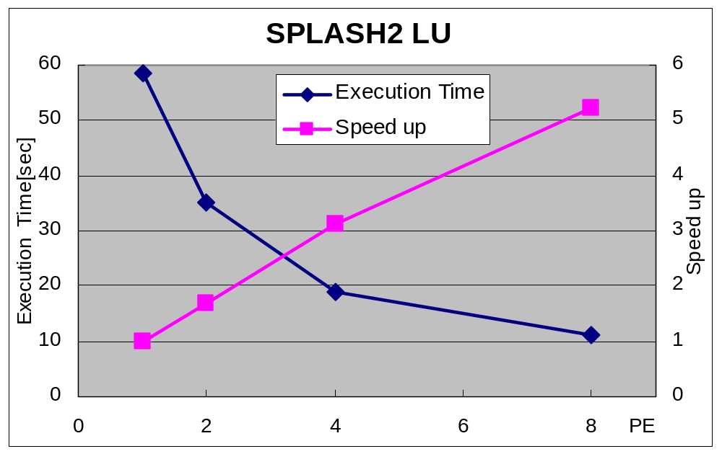
SPLASH2 LU (2)
Applied batched checks to the inner-loop daxpy function
5.3 times speedup with 8PEs
Notes:
Most overhead in software DSM are the cost of the check at the time of memory access. In this system, whenever it accesses, it is checking. Then, it is expectable that a performance improves if batch processing of the access checking is executed per BlockSize. So, we technique was applie by hand on memory accesses within the daxpy function, which occupies the major portion of calculation in LU kernel. As a result, we obtain 5.3 times performance improvement at eight processors.

Slide 28
Related work
Shasta[scale ‘96]
  Transforms SMP-based programs into DSM-based programs for Alpha cluster environment
  binary level transformation
    difficult to port
  high performance
    specialized to Alpha memory channel
Notes:
Here we show a related research.
Shasta transforms transforms SMP-based programs into DSM-based programs for Alpha custer environment.
Shasta performs program transformation in binary level. Many low level optimizations are applied, for example, the check of memory access is pressed down to the average of 2 operations. Its memory access overhead is very small. Furthermore, since Shasta implementation is specialized in the Alpha memory channel, the high performance is attained. On the other hand, Shasta is less portable.
The Performance of Our system is not comparable to that of Shasta.
However, employing optimization techniques used in shasta, the performance improvement can be expected. As I show in the result of LU, the bunching of access checks is very effective. Furthermore, our system has higher portability.
There is Shasta as a system to which program transformation is performed and a shared memory program is executed in a distributed memory environment.

Slide 29
Comparison with other Software DSM systems
Page-based software DSM (e.g. TreadMarks)
  OS-dependent (e.g. trapping page fault)
Class-based software DSM
  users have to insert memory operations
binary-level transformation (e.g. DEC Shasta)
  efficient, but processor-binary dependent
Macro or ad-hoc preprocessor
  portable, but hard to build and implement
using Reflection
  easy to build and use, portable and efficient
Notes:
We Compare our system with other systems about the portability.
The software DSM of the traditional page-based like TreadMarks are low portability because of OS dependent. For example, the trap of the page fault must be carried out etc..
The class-based software DSM like midway, can give a certain amount of portability. However, a user has to manually insert all memory operations carefully.
Program transformation systems using a macro or preprocessor are portable. However, the support of the full set of language and implementing of the system itself is difficult.
On the other hand, our system is easy to implementation. Moreover, our system is simple for a user to use. Our system gives still high platform portability and efficient DSM.

Slide 30
Conclusion
Platform portability can be achieved by Reflection
OMPC++ adds DSM support C++ parallel programs in a portable way
good performance software DSM
  still need optimization work
Notes:
We show that platform portability can be attained using the reflection, especially Open Compiler. Specifically, the OMPC++ system was built using parallel programming language and Open Compiler.
OMPC++ adds the support of DSM to parallel program by the portable way.
Software DSM offered by OMPC++ shows the good performance. However, a performance needs to be improved more.

Slide 31
Future work
Higher performance
  applying other optimizing techniques
    c.f. Shasta(e.g. batching miss checks)
  Object-based DSM
Other benchmarks
    e.g. SPLASH2 Barns, Radix…
Evaluation on other environments
  Demonstrate OMPC+++ portability
Apply to Java -- Using OpenJIT
  JDSM: Software DSM for Java
Notes:
We will attain higher performance. Specifically, the optimization which is used in Shasta is applied. Moreover, we will evaluate performance using other benchmarks. To demonstrate the portability of OMPC++ more clearly, we will evaluate in other execution environments. Finally the technique used this system will be applied to Java language. Of course, OpenJIT is used for Open Compiler.

Slide 33
OMPC++ Components hierarchy
Application
(for Shared Memory environment)
DSM environment support
DSM Template Library
Program Transformer
OpenC++ Metaclass
Backend Runtime Environment
(User-Level thread, Message Passing Libraries)
MPC++
Compile-Time MOP
OpenC++
Process Management /Messaging Layer
Score/PM
Parallel Machine using Commodity Hardware
RWC PC Cluster, Beowulf, etc

Slide 34
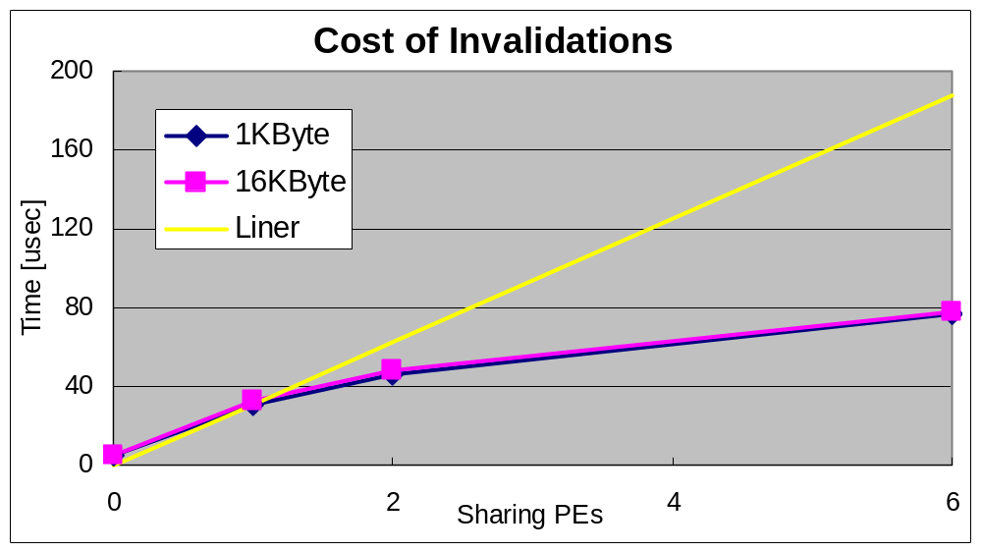
Cost of invalidations
Asynchronous invalidation invocation

