Slide 1
HubberBub
Simplify Your Life

Slide 2
Life is full of Lists
Things to buy (grocery list, gift list, …)
Things to do (task list)
Schedules and appointments (reminder list)
Important dates (birthday list)
Things you want (wish list)
People you know (family list, friend list, …)

Slide 3
We manage our “Lists” in many ways
Paper, pen, and post-it notes
Calendars and appointment books
Email/calendar, mobile devices, social sites
Difficult to consolidate, organize and manage
Difficult to share and collaborate

Slide 4
Connect & Organize Your Life
Not just another productivity tool, but a way to connect and integrate the tools you use
A hub for consolidating, organizing, and managing the lists in your life
Pull list items from existing tools
Push list items to existing tools
Assist in managing lists and completing tasks
Share and collaborate lists with others

Slide 5
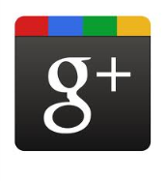






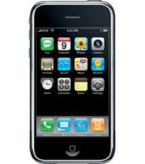
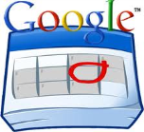
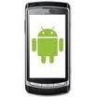
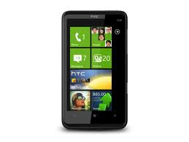

Social
Email
Family
Friends
My Hub
Work
Calendar
Mobile

