Slide 1

Dance through life with TwoStep.

Slide 2
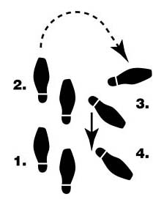
Wouldn’t life be so much easier if you always knew the next step?

Slide 3













TwoStep keeps you two steps ahead. You tell it what you already do in your life and what you want to do more of, and it will help you select and organize the steps to get it done.

Slide 4

TwoStep keeps track of all your next steps and helps you carry them out.

Slide 5
TwoStep remembers what you did last time and makes it easier to do it this time.

Slide 6
Procrastinate less, get more done. Dance through life with TwoStep.

