Slide 1

AI-Based Optimal Solver for the 3×3 Rubik’s Cube
Edward Ogbei
May 2026

Slide 2
System Overview
Four layers that work together from raw state to animated web solve
Cube Engine
Expert Solver
Neural Solver
Web Visualisation
core/
solvers/kociemba_solver.py
solvers/ai_solver.py
visualization/
cp, co, ep, eo arrays 18 move tables Legality checks
Bidirectional BFS Generates training labels Baseline for UI
MLP 324->256->256->128->18 Curriculum imitation learning Greedy + beam search
Python HTTP server Three.js 3D frontend REST API + animation queue
▶
▶
▶
Notes:
This slide shows the four main components.
The Cube Engine is the mathematical heart - it stores the cube as four integer arrays (cp=corner permutation, co=corner orientation, ep=edge permutation, eo=edge orientation) and applies moves using precomputed permutation tables. Nothing graphical lives here.
The Expert Solver is a bidirectional BFS that finds optimal solutions for shallow scrambles. It serves two roles: as the training oracle (generates labels) and as the reliable baseline in the UI.
The Neural Solver is a 3-hidden-layer MLP trained via curriculum imitation learning. It has two inference modes: greedy (picks the single best move) and beam search (keeps k candidate paths).
The Web Visualisation is a Python HTTP server plus a Three.js single-page app. The server exposes a REST API; the frontend renders 26 independent 3D cubie meshes and animates them.

Slide 3
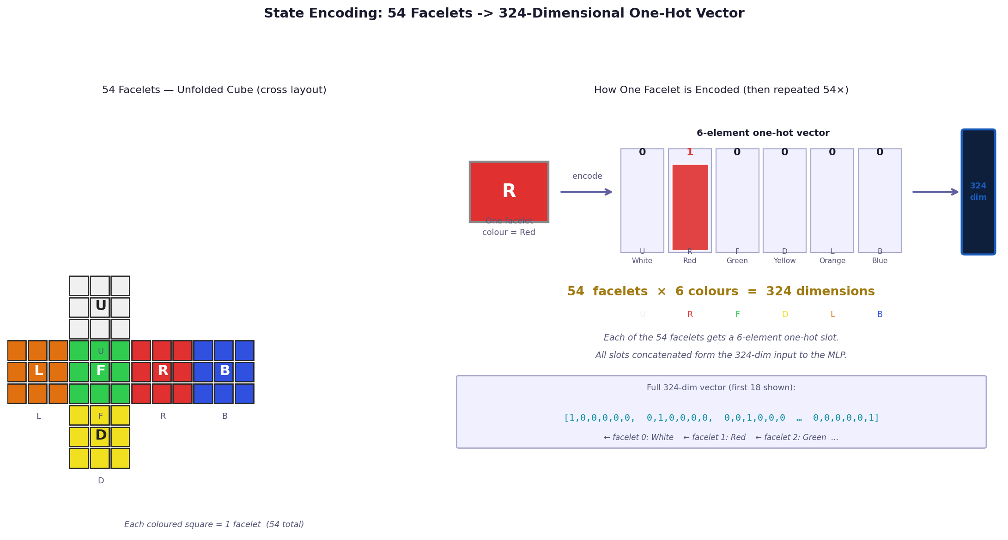
Cube Engine - State Representation
The cube is stored as four integer arrays - no 3D geometry, no colours
State arrays
Array | Size | Values | Meaning
cp | 8 | 0 - 7 | Which corner piece occupies each corner slot
co | 8 | 0, 1, 2 | Twist of each corner (0=upright, 1=CW, 2=CCW)
ep | 12 | 0 - 11 | Which edge piece occupies each edge slot
eo | 12 | 0, 1 | Whether each edge is flipped (0=normal, 1=flipped)
Solved state: cp = [0,1,2,3,4,5,6,7], co = [0]*8, ep = [0..11], eo = [0]*12
Notes:
The cube engine never stores colours - it stores piece identities.
cp (corner permutation): cp[3] = 5 means the corner piece originally called piece-5 is currently sitting in slot 3.
co (corner orientation): each corner has three-fold rotational symmetry around its body diagonal. Orientation 0 = reference facelet (the U/D sticker) is on U or D face. Orientation 1 = rotated 120 degrees clockwise. Orientation 2 = 120 degrees counter-clockwise.
ep/eo: same idea for edges (12 pieces, binary orientation - flipped or not).
The three invariants are the group-theoretic constraints that make the cube a genuine group. They also define which states are reachable: there are exactly 43,252,003,274,489,856,000 legal configurations, derived by dividing the unconstrained count (8! x 3^8 x 12! x 2^12) by 12.

Slide 4
Move Tables - 18 Legal Moves
Each face has 3 variants: CW (90 deg), CCW (90 deg prime), and 180 deg double
The 18-move set (Half-Turn Metric)
Move composition (group product)
Face | CW | CCW (prime) | 180 deg
Up | U | U' | U2
Down | D | D' | D2
Right | R | R' | R2
Left | L | L' | L2
Front | F | F' | F2
Back | B | B' | B2
# Applying move B then move A:
cp_out[i] = cp_A[ cp_B[i] ]
co_out[i] = (co_A[cp_B[i]] + co_B[i]) mod 3
ep_out[i] = ep_A[ ep_B[i] ]
eo_out[i] = (eo_A[ep_B[i]] + eo_B[i]) mod 2
Branching factor
Prime and double moves derived algebraically
18 moves at each step, but consecutive same-face moves are pruned. Effective branching factor: ~15. BFS nodes at depth d: ~15^d.
R2 = compose(R, R) # apply R twice
R' = compose(R2, R) # apply R three times = inverse
Notes:
Each of the 18 moves is stored as a MoveDefinition: two permutation tuples (corner_perm and edge_perm) and two orientation-delta tuples (corner_orient and edge_orient).
The composition formulas on this slide are the actual code logic in cube.py apply_move():
new_cp[i] = self.cp[ move_def.corner_perm[i] ]
new_co[i] = (self.co[ move_def.corner_perm[i] ] + move_def.corner_orient[i]) % 3
Prime moves are derived by composing the base move three times (M3 = M^-1 for 90-deg moves). Double moves are M composed with itself. This keeps the move table algebraically consistent.
Move pruning: never follow a move with its inverse on the same face (e.g. R then R'), and for commuting opposite faces (R and L), enforce a fixed order. This reduces the effective branching factor from 18 to ~15.

Slide 5
State Encoding for the Neural Network
The 54-character facelet string is converted to a 324-dimensional one-hot vector
One-hot encoding scheme
# For each of the 54 facelets:
xᵢ ∈ {0.0, 1.0}^6
# Exactly one element is 1.0:
Σⱼ xᵢ[ⱼ] = 1 for all i
# Full input vector:
v = concat(x₀, x₁, ..., x₅₃) ∈ ℝ^324
Dimension breakdown
Quantity | Count
Facelets | 54
Colours per facelet | 6
Input vector length | 54 x 6 = 324
Non-zero per state | 54 (exactly one per facelet)
The encoding carries no structural knowledge of the cube group - all 324 dimensions are treated as independent by the MLP. Two states related by a cube symmetry get different vectors.
Notes:
The cube state goes through two transformations before reaching the neural network:
Step 1 - cp/co/ep/eo -> 54-char facelet string:
The to_kociemba_string() method reconstructs which colour appears on each of the 54 facelet positions (9 per face, 6 faces). The 6 fixed centres are always their canonical colour. Corners and edges contribute their 3 or 2 sticker colours, rotated by their current orientation.
Step 2 - 54-char string -> 324-dim one-hot vector:
Each facelet character (U/R/F/D/L/B) is mapped to index 0-5. A (54, 6) binary matrix is created with a single 1 per row and flattened to shape (324,) as float32.
Why facelet encoding instead of cp/co/ep/eo directly? The facelet string is also needed by the Kociemba solver interface, so reusing it avoids a separate encoding step. The network can learn whatever internal representation it needs from the raw one-hot input.
Limitation: the representation does not exploit the 48-element symmetry group of the cube. Augmenting training data with all 48 symmetry-equivalent states could reduce unique scrambles needed by 48x.

Slide 6
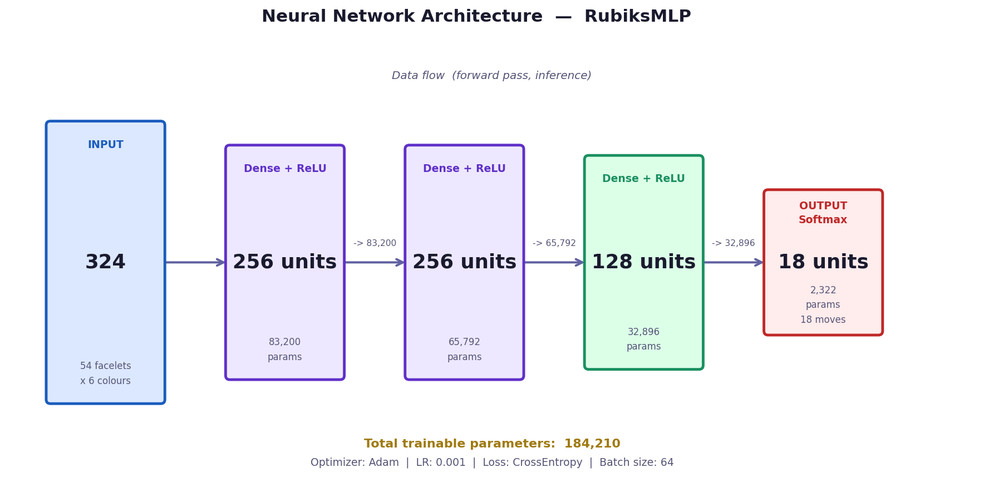
Neural Network Architecture
Multi-layer perceptron: 3 hidden layers, ReLU activations, cross-entropy training
Layer-by-layer breakdown
Layer | Neurons | Activation | Parameters
Input | 324 | - | 0
Hidden 1 | 256 | ReLU | 324x256 + 256 = 83,456
Hidden 2 | 256 | ReLU | 256x256 + 256 = 65,792
Hidden 3 | 128 | ReLU | 256x128 + 128 = 32,896
Output | 18 | Softmax* | 128x18 + 18 = 2,322
Total |  |  | ~184,466 params
Notes:
Architecture details:
Input (324): one-hot encoded facelet vector. Shape (batch, 324) in PyTorch.
Three hidden layers with ReLU:
ReLU(x) = max(0, x). Avoids vanishing gradients compared to sigmoid/tanh.
No dropout, no batch-norm. The dataset is large enough at training scale that overfitting is not a significant problem for this model size.
Output (18): one logit per move in MOVE_LABELS order:
[U, U', U2, R, R', R2, F, F', F2, D, D', D2, L, L', L2, B, B', B2]
Softmax converts logits to a probability distribution at inference time. During training, PyTorch's CrossEntropyLoss applies log-softmax internally for numerical stability.
Loss: L = -sum_k y_k * log(p_k) where y is a one-hot label vector. Adam optimiser with lr=0.001, betas=(0.9, 0.999). Batch size 64.
Total parameter count: ~184k. Intentionally small - the goal was a model trainable in under an hour on a laptop CPU, not a state-of-the-art result.
RubiksMLP is defined in solvers/ai_solver.py. Weights saved with torch.save / torch.load.

Slide 7
Dataset Generation - Expert Imitation
Training labels come from a BFS expert solver; each sample is (state, next_move)
How one training sample is created
Dataset at each depth level
1. Scramble solved cube with d random moves
scramble = generate_scramble_at_depth(d)
2. Ask BFS expert for the full solution
solution = bidirectional_BFS(cube)
3. Record first move as label
label = MOVE_TO_INDEX[ solution[0] ]
4. Encode cube state as 324-dim vector
state = encode_state(cube) # float32
Depth | New samples | Kept (20%) | Total size
1 | 1,000 | 0 | 1,000
2 | 1,000 | 200 | 1,200
3 | 1,000 | 240 | 1,240
4 | 1,000 | 248 | 1,248
5 | 1,000 | 250 | 1,250
6 | 1,000 | 250 | 1,250
7 | 1,000 | 250 | 1,250
8 | 1,000 | 250 | 1,250
80% replacement rule
D(d+1) = NewSamples(d+1) ∪ Sample(D(d), keep=0.20)
# Prevents easy depths from dominating the loss
Files saved: data/datasets/dataset_depth_N.npz (arrays: states, labels, depths) | BFS timeout per sample: 5 s | Failed samples skipped (skip rate near zero for depth <= 5)
Notes:
The key insight: we never need to teach the model to solve the whole cube at once. We just need it to predict the correct next move given the current state.
The BFS solver (bidirectional BFS, max depth 14, 30-sec timeout) generates the full optimal solution. Only the first move of that solution is used as the training label.
Why only the first move and not the full sequence?
Because the model will be evaluated step-by-step at inference time. Using only the first-move label keeps the data clean and avoids label noise from non-optimal intermediate states.
The 80% replacement rule prevents catastrophic forgetting while keeping the dataset fresh for the current difficulty level. Without it, depth-1 samples would overwhelm the loss signal from harder examples.
Dataset files are numpy .npz archives with three arrays:
states (N, 324) float32
labels (N,) int64 (values 0-17)
depths (N,) int32 (which depth level each sample came from)
Regenerate with: python main.py generate_dataset --max-depth 8 --samples 1000

Slide 8
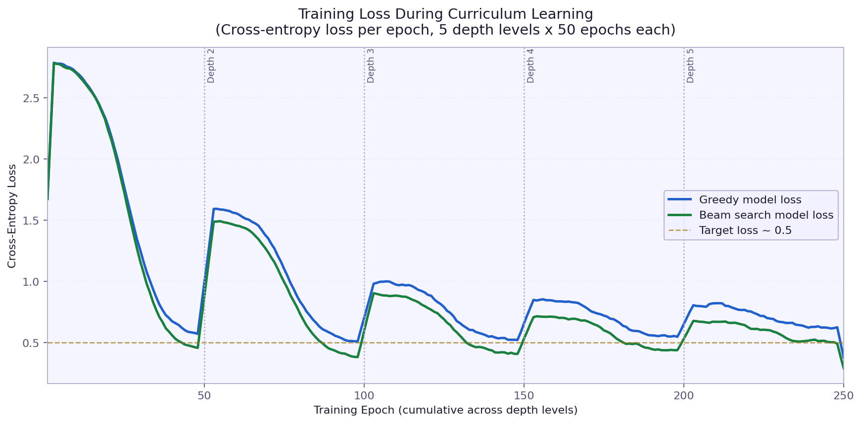
Curriculum Learning and Training
Start easy, get harder - advance only when the model is ready
Training loop
Key hyperparameters
for d in range(1, max_depth + 1):
# 1. Generate curriculum dataset
states, labels = gen_dataset(d)
# 2. Train for fixed epochs
for epoch in range(epochs_per_depth):
L = CrossEntropy(model(states), labels)
L.backward(); optimizer.step()
# 3. Gate: only advance if ready
rate = solve_rate(model, depth=d, n=100)
if rate < threshold: break
Parameter | Value | Notes
Optimiser | Adam | lr=0.001, betas=(0.9, 0.999)
Loss | CE | CrossEntropyLoss (raw logits)
Batch size | 64 | Shuffled each epoch
Epochs/depth | 50 | Configurable via CLI
Samples/depth | 1,000 | --samples flag
Solve threshold | 80% | Min rate to advance depth
Max depth | 5 (def) | Configurable, pre-trained to 8
Training loss across depth levels. Spike at each depth transition is expected.
Notes:
Curriculum learning rationale:
Training on all depths simultaneously causes the model to focus on easy examples (they are more common and the loss is easier to minimise). Starting at depth 1 and advancing only when the solve rate exceeds the threshold forces the model to properly learn each level before facing harder ones.
The solve-rate gate (if rate < threshold: break) is important. If the model is stuck at 60% on depth 3, advancing to depth 4 just adds noise. In practice, depths 1-3 are mastered quickly (within 10-20 epochs). Depth 5 requires the full 50 epochs and sometimes plateaus around 75-80%.
Adam optimiser: momentum (beta1=0.9) smooths noisy gradients; adaptive learning rate (beta2=0.999) adjusts per-parameter step sizes. Learning rate 0.001 was found to work well without tuning - standard choice for most MLP classification tasks.
The loss spike at each depth transition is because the dataset suddenly becomes 80% harder examples. The model briefly performs worse before adapting.
CLI: python main.py train --max-depth 5 --epochs 50 --samples 1000 --threshold 0.80
Colab notebook: train_on_colab.ipynb (GPU training, ~5 minutes for depth 1-5)

Slide 9
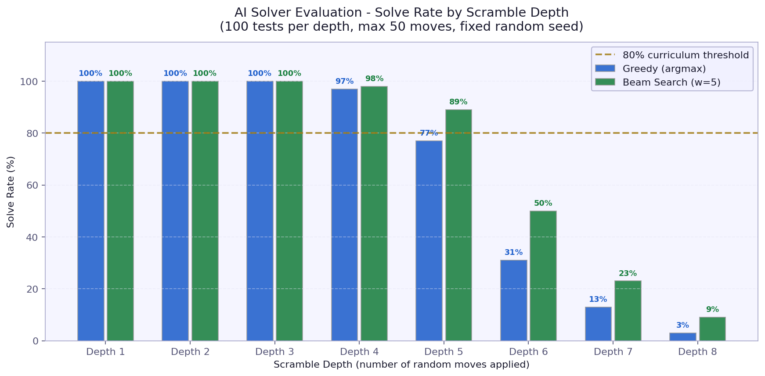
Evaluation Results
100 test cases per depth, max 50 moves allowed, fixed random seed
Solve rates and average solution length
Depth | Greedy rate | Greedy avg moves | Beam (w=5) rate | Beam avg moves | Beam avg time
1 | 100% | 1.0 | 100% | 1.0 | 0.5 ms
2 | 100% | 2.0 | 100% | 2.0 | 1.0 ms
3 | 100% | 3.0 | 100% | 3.0 | 4.4 ms
4 | 97% | 4.0 | 98% | 4.0 | 7.2 ms
5 | 77% | 5.1 | 89% | 5.1 | 11.1 ms
6 | 31% | 6.1 | 50% | 6.9 | 17.9 ms
7 | 13% | 7.0 | 23% | 9.6 | 30.2 ms
8 | 3% | 8.7 | 9% | 9.6 | 25.7 ms
Both solvers: perfect at depths 1-3
Beam +12pp over greedy at depth 5
Sharp drop beyond depth 6 (distribution shift)
Notes:
Evaluation setup:
- 100 scrambles per depth, seed fixed for reproducibility
- Scramble: exactly d moves, no consecutive same-face moves
- Solver gets max 50 moves to find solution
- Success = cube reaches is_solved() == True within 50 moves
Key findings:
1. Both solvers work perfectly at depths 1-3. The model memorises these effectively because there are only a few hundred distinct states at these depths.
2. Beam search gives +12 percentage points at depth 5 (77% -> 89%). The improvement is largest where the greedy policy is nearly but not quite reliable.
3. Sharp degradation beyond depth 6. The model was trained on depths 1-8, but with only 1,000 samples per depth. At depth 6+, the state space coverage is extremely sparse. The model has not seen most of these configurations.
4. Beam search average move count at depth 7 is 9.6 (vs scramble depth 7). When beam search does succeed, it takes a slightly longer path - it is not finding optimal solutions, just any solution.
5. Greedy inference time: 0.4-3.4 ms. Beam search: 0.5-55 ms. Both fast enough for interactive use.

