Slide 1
Finger-electrode ECG
Does it measure the same heartbeat as a chest lead?
First simultaneous two-site measurement · 29 September 2026
99.4 %
99.4 %
0.02 bpm
0.98
beats found
beats correct
heart-rate bias
agreement (ICC)
Dhruv · ECG ring project · progress report
Notes:
Headline: a finger electrode reproduces chest-lead beat timing to within a tenth of a bpm. One subject, 105 seconds, at rest.

Slide 2
The question
A ring can only touch fingers. A clinical ECG touches the chest.
The chest lead is the reference every clinical device is judged against.
A finger electrode sits far from the heart, on thick dry skin, on a limb that moves.
So the signal is smaller and noisier — but is the beat timing still right?
Timing is what heart rate and every HRV measure are built from.
Chest device
Finger device
reference site
ring site
identical board · identical firmware · identical settings
one variable only:
where the electrode sits
Both devices record the same heart at the same instant,
so any disagreement is the measurement, not the physiology.
Notes:
The design point: because both devices are identical, a difference between them can only come from the electrode site.

Slide 3
What we did
One recording, both devices running at the same time
1
2
3
4
Record
Clean
Find beats
Compare
Two boards, MAX30003 sensor, 256 samples/s. 105 seconds, seated, at rest, hands still.
Zero-phase 0.5–40 Hz filter with a 50 Hz mains notch. Same filter on both channels.
Pan–Tompkins detector: bandpass, differentiate, square, integrate, adaptive threshold.
Align the two clocks, match beats within 150 ms, then score timing and rate.
Integrity checked first: 27,046 samples on each device, 0 missing, 0 gaps, 0 duplicates, 0 corrupted. Nothing below this means anything if this fails.
Notes:
Emphasise that data integrity is verified before any result is computed — the analysis refuses to run on a stream with gaps.

Slide 4
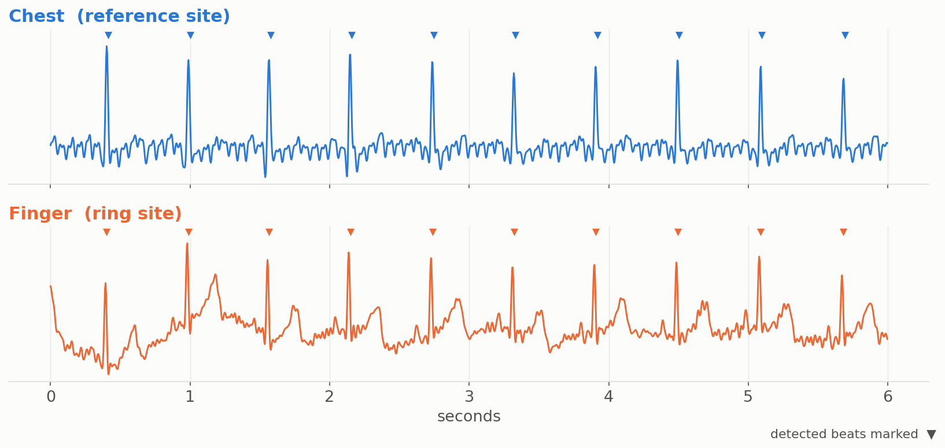
Both devices see the same heartbeats
Six seconds of the recording — a typical stretch, not the cleanest one
The finger signal is smaller and its baseline drifts, but every beat lands at the same moment on both traces.
Notes:
Chosen as the median-quality window by baseline wander, so it is representative rather than flattering.

Slide 5
The result
Chest is the reference; finger is the device under test
99.44 %
99.44 %
−0.02 bpm
±1.1 bpm
Sensitivity
Precision
Heart-rate bias
Limits of agreement
178 of 179 chest beats
also found at the finger
178 of 179 finger beats
were real beats
average difference
over ten 10-second windows
where 95 % of the
differences fall
Beat-to-beat intervals
Heart-rate variability
177 intervals compared, average difference +0.01 ms. 95 % of them agree within ±8.5 ms — about two sample periods.
RMSSD 36.3 ms chest vs 37.3 ms finger. A 1 ms difference on the measure most HRV work depends on.
Notes:
Month-1 gate was bias under 2 bpm with limits inside plus or minus 5 bpm. We are inside it by a wide margin.

Slide 6
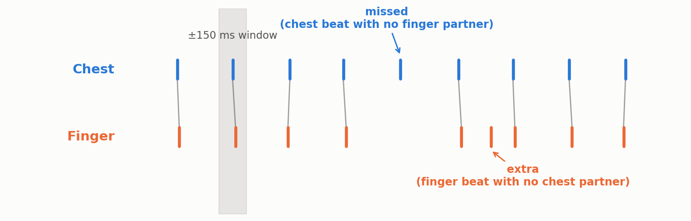
How a beat is scored
The chest beat train is the truth; each finger beat is matched to it, once
Sensitivity
matched ÷ (matched + missed)
Precision (P+)
matched ÷ (matched + extra)
Of the beats that really happened, how many did the finger find?
Of the beats the finger reported, how many were real?
150 ms tolerance and one-to-one matching follow the ANSI/AAMI EC57 standard, so the numbers are comparable with published work.
Notes:
Never quote a bare accuracy figure: sensitivity and precision fail in opposite directions and must be reported together.

Slide 7
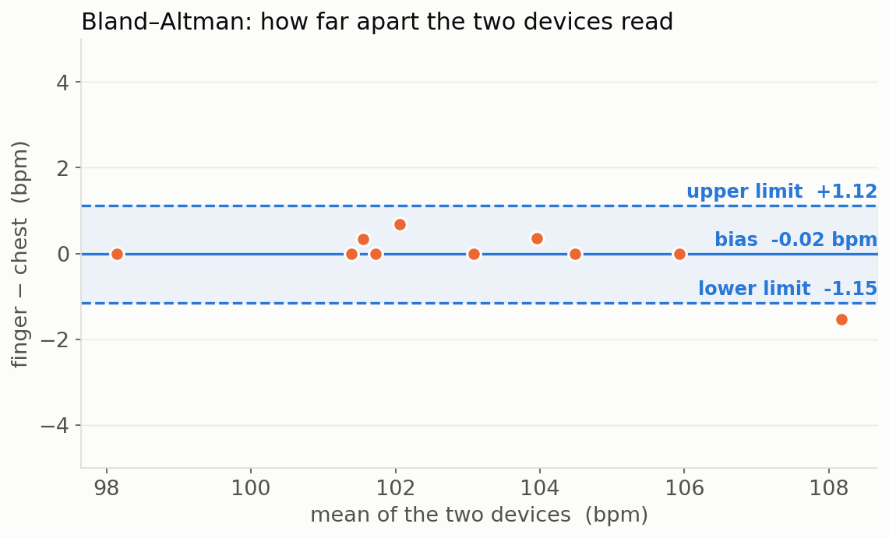
Heart-rate agreement
Correlation is not agreement — this asks how far apart the readings actually are
Reading this plot
Each dot is one 10-second window.
Across is the average of the two devices; up and down is the difference between them.
The solid line is the bias — a systematic offset would push it away from zero. Ours sits at −0.02 bpm.
The dashed lines hold 95 % of the differences: −1.15 to +1.12 bpm.
Flat and centred means the two devices can be used interchangeably at this heart rate.
Ten windows only — the honest sample size for a 105-second recording. A longer study is the next step.
Notes:
Bland-Altman is the standard for method comparison precisely because a high correlation can hide a constant offset.

Slide 8
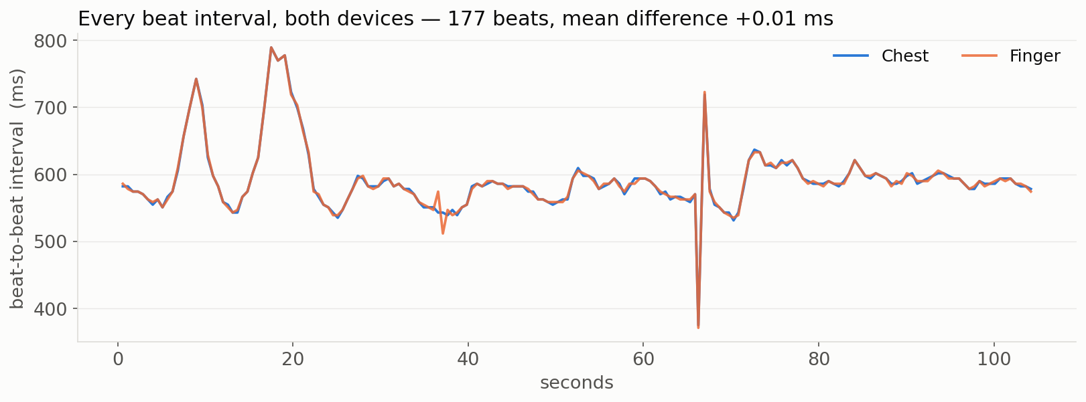
Every beat, not just the average
The interval between consecutive beats, measured by both devices
177
+0.01 ms
±8.5 ms
intervals compared
average difference
95 % of differences
The two lines are hard to tell apart, including the breathing rhythm at 8–22 s and the single irregular beat near 67 s that both devices caught.
Notes:
This is the most convincing single figure: the finger tracks the chest beat by beat, not merely on average.

Slide 9
The measures, and what each one asks
Each answers a different failure mode, which is why we report all of them
Measure | The question it answers | Our value
Sensitivity / Precision | Did we find every beat, and was every beat we found real? | 99.44 % / 99.44 %
Bland–Altman bias | Does one device read systematically higher than the other? | −0.02 bpm
Limits of agreement | How far apart can two readings of the same moment be? | −1.15 to +1.12 bpm
ICC(2,1) | Can these two devices be used interchangeably on the same subject? | 0.98
Lin's concordance | Do the readings fall on the line of equality, not merely a straight line? | 0.98
Pearson r | Do they move together? (Reported, but never on its own.) | 0.99
RMSSD | Do we recover the same beat-to-beat variability used in HRV work? | 36.3 vs 37.3 ms
A high correlation alone can hide a constant offset, so agreement is judged on bias and limits, never on r.
Notes:
If asked which single number matters: the limits of agreement. Bias says where the centre is, limits say how wide the spread is.

Slide 10
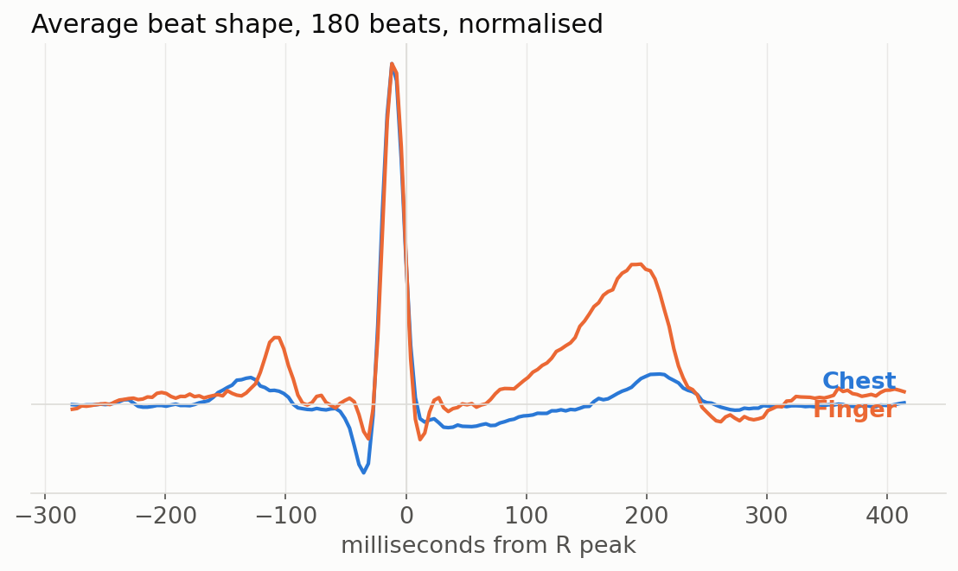
Same timing, different shape
Average of 180 beats at each site, scaled to the same height
What this shows
The sharp peaks sit exactly on top of each other — the finger sees the beat at the same instant.
The finger's T wave (the rounded bump after the peak) is four times larger relative to the peak.
That is a real difference between the two sites, not noise: they view the heart from different angles.
It matters for shape-based analysis, and not at all for timing.
Traces shown with corrected polarity: the electrodes were wired reversed, which inverts the display but changes no timing measurement.
Notes:
Be upfront about the polarity: it was found by inspection, it affects morphology claims only, and it is fixed by swapping two clips.

Slide 11
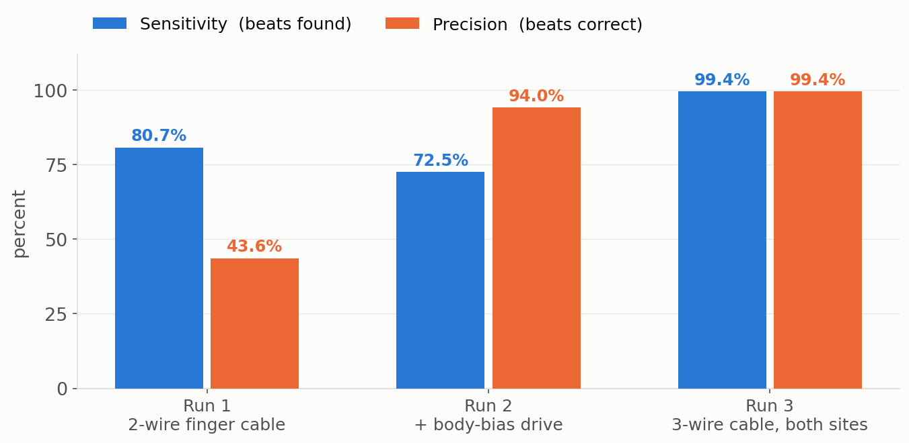
What it took to get here
The same two devices and the same subject — only the electrode setup changed
!
The finding
A finger electrode needs a third, reference contact. Without one the body floats and mains hum swamps the signal — 43 % of the power at 50 Hz instead of 0.4 %.
Most of a day went into isolating this. It is now a design requirement for the ring.
Reading the pattern: Run 2's high precision with low sensitivity is the signature of a signal too weak to detect — not one full of false beats. That is what pointed at the electrode rather than the detector.
The good result is not a first attempt, and we know why the earlier ones failed.
Notes:
Run 2's high precision with low sensitivity is the signature of a signal too weak to detect, rather than one full of false beats.

Slide 12
What this is not, yet
The result is real; the study is not finished
One subject, one posture
No motion condition
105 seconds, seated, at rest, hands deliberately still. This is a working measurement, not a validation study.
The finger site is the one most exposed to movement, and we have not yet tested it under any.
Quality thresholds uncalibrated
Clock drift not measurable
Our signal-quality check flagged the finger channel as marginal — and it then scored 99.4 %. The thresholds are borrowed, not ours.
Over 105 seconds the two devices' clocks differ by less than the beat-timing noise, so we can bound it but not measure it.
Every number in this deck is reproducible from a saved analysis file in the project repository.
Notes:
Saying the limits out loud first is how the result gets believed. None of them undermine the headline; they bound what it means.

Slide 13
Where this goes next
Month 1 target: heart-rate bias under 2 bpm, limits inside ±5 bpm → met, with room to spare
1
Widen the study
2
Fix the electrode wiring
Five-minute recordings across several subjects, with a light-motion condition added.
Swap the two leads so the trace records in standard polarity, then re-capture.
3
Calibrate quality thresholds
4
Carry the fix to the phone
Set the good/marginal boundaries from our own recordings instead of published defaults.
The detector improvement made here still needs porting to the Android app.
Notes:
Close on the milestone being met, then the four concrete next steps.

