Slide 1
Claude Code in Public Administration: Pragmatic, Privacy-Compliant, Productive
Rohrschach, August 25, 2026
Notes:
- Is the topic already old news? Who uses chatbots? Who uses coding assistants?

Slide 2
Chatbot vs. Coding Assistant
Chatbot (ChatGPT, Claude, etc.)
Chatbot (ChatGPT, Claude, etc.)
Coding Assistant (Claude Code, Codex, etc.)
Conversation-based, question-answer format
Text-only interaction in the chat window
No access to file system or terminal
(Mostly) no independent execution of
Agentic: acts independently instead of just responding
Reads/writes files directly in the project
Runs terminal commands, tests, Git operations
Works iteratively: Plan → Execute → Review → Correct
Understands the context of entire codebases, not just code snippets
Conversation partner for quick answers
Active agent within your own project

Slide 3
The problem: data privacy and AI in public administration seem incompatible
Locally installed tools such as Copilot, Cursor, Codex, or Claude Code usually cannot be used in a privacy-compliant way
Use is usually only possible on special devices that are not connected to the administrative unit's official network
Claude Code on the web (claude.ai/code) combined with GitHub offers a pragmatic, privacy-compliant solution

Slide 4
The problem: data privacy and AI in public administration seem incompatible
Anyone already using Claude Desktop or the CLI tool in a privacy-compliant way should stick with it and not switch to the web version

Slide 5
Use requires a paid plan and a GitHub account
Paid Claude plan (at least Pro)
GitHub account on the public github.com
Access rights to GitHub repositories for Claude Code
Can be used immediately at a cost of approx. 20 francs per month

Slide 6



How Claude Code works
Pull for local use
Created and populated via push
Assigns task in the web
GitHub repo
(private or public)
Claude Code (claude.ai/code)
Reads content
Pull request
Created, reviewed and merged
✓
New branch
Created and edited in an isolated sandbox

Slide 7


Where to use Claude Code
...and where less so
Chatbot (ChatGPT, Claude, etc.)
Prototyping (dashboards, pipelines, reports)
(extensive) documentation
Time-consuming fixes
Understanding larger codebases
«Whenever knowledge needs to be transferred from A to B»
Small fixes
Working out precise visual corporate design specifications
Generating ideas

Slide 8




5 tips for saving tokens
✔ Sonnet 5
Opus 5
Haiku 5
Renew session
One task = one session.
Too much context makes answers worse and more expensive
Claude.md
short Claude.md
general requirements for the tech stack as well as «Dos and Don'ts»
Prompts
Be precise
Give exact file paths and line numbers
Model
Right model for the respective task
Don't switch model within the session
Plan mode
Enables a precise plan
Editable
Saves tokens in the long run
Notes:
Make clever use of the 5-hour window
Send a message first thing in the morning

Slide 9


Example: dashboard workflow
Starting point
Repo with an “empty” skeleton (CSS, folder structure) for a dashboard in Thurgau style.
dbplyr code for retrieving data from the database in a views.R file
Claude.md indicating the techstack and noting that the database is not reachable, but the structure can be derived from the views
START
Prompt (example)
«Fill the dashboard skeleton with sample data and working logic. Context: - Read CLAUDE.md for the tech stack and notes on the database - Read views.R to understand the structure of the views (columns, types, granularity) - The database is not reachable. Use the views Build the dashboard with 2-3 meaningful visualizations (time series, comparison by municipality/category) - Filters/inputs matching the dimensions of the views - KPI boxes at the top. Use existing CSS classes/folder structure, don't invent a new structure. Comment clearly and briefly.»
Result
Functional dashboard that can be further developed (usually also with Claude Code)

Slide 10
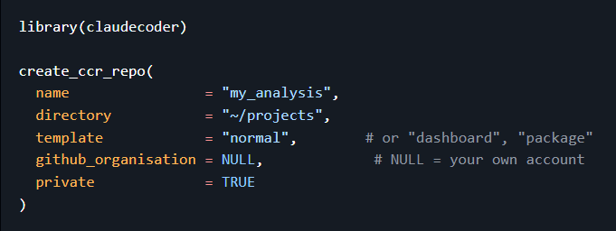
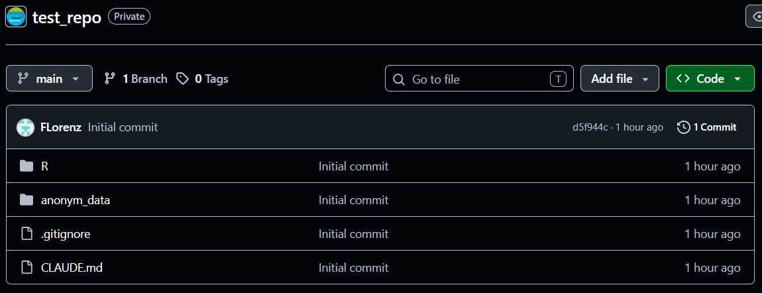
claudecoder: an R package for the right setup
✔
✔
Sets up the repo
Defines .gitignore so that the real data is only available locally
✔
✔
Depending on the template, the corresponding Claude.md is included
anonym_dir() additionally enables anonymization of the data

Slide 11
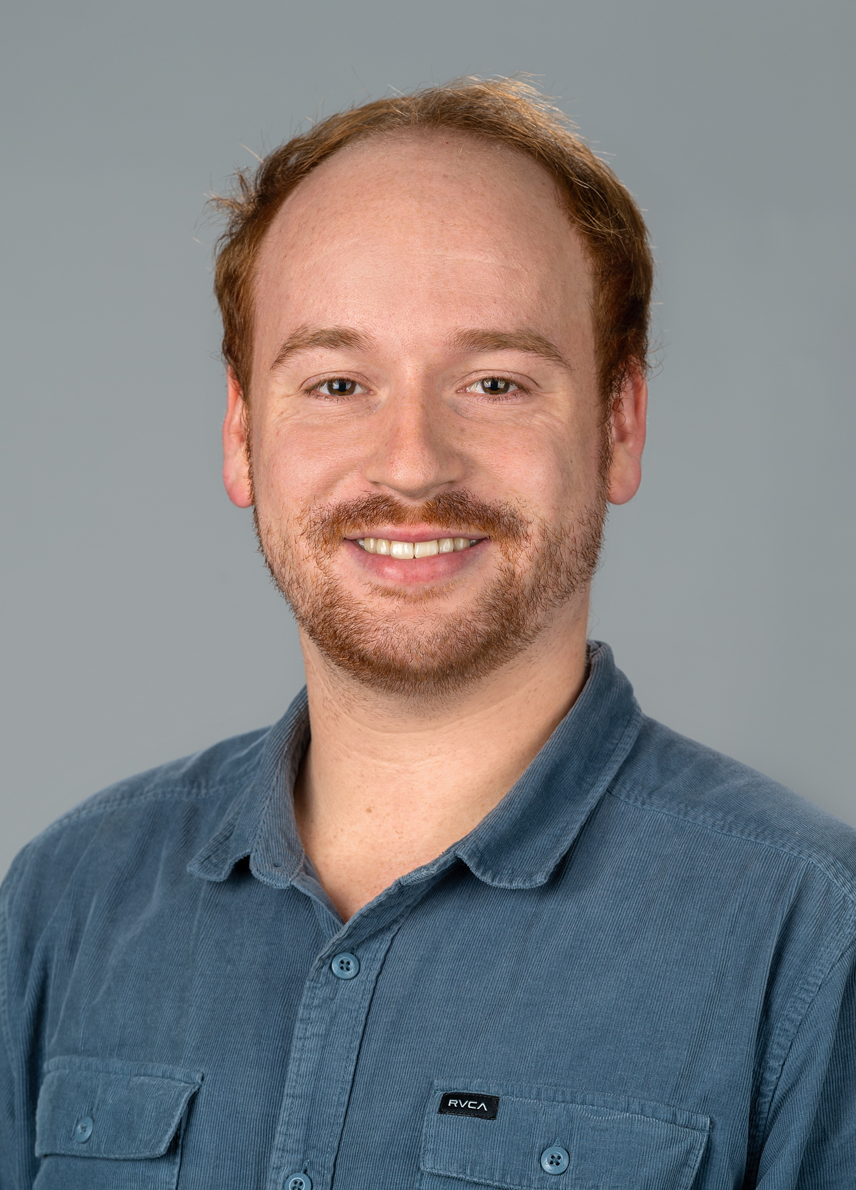
Thank you!
Felix Lorenz
OGD Specialist
Office for Data and Statistics
+41 58 345 53 67
felix.lorenz@tg.ch

