Slide 1
Do not edit How to change the design
What percentage of graduates of an R course (approx. 25 hours) would need to keep using R for you to consider the course a success?
The Slido app must be installed on every computer you’re presenting from

Slide 2

What percentage of graduates of an R course (approx. 25 hours) would need to keep using R for you to consider the course a success?
Notes:
How many graduates use R after completing the course?
Why does usage vary after course completion?
What can we learn from the results for course design?
What would an optimal course structure look like?
Limitations:
Small sample size
Self-selection (mostly satisfied participants for whom R was beneficial, especially in ZH since the course took place a while ago)
-> Observed correlations, not causal effects

Slide 3
R Courses in Public Administration: Learning Success or Flash in the Pan?
Felix Lorenz, Swiss Statistics Days 2026

Slide 4
A Survey in Four Cantons as a Starting Point
The survey was distributed to R course graduates in the cantons of Thurgau, Basel-Landschaft, Basel-Stadt, and Zürich
A total of 58 responses
Key question: What is the medium- and long-term benefit of R courses?
Notes:
How many graduates use R after completing the course?
Why does usage vary after course completion?
What can we learn from the results for course design?
What would an optimal course structure look like?
Limitations:
Small sample size
Self-selection (mostly satisfied participants for whom R was beneficial, especially in ZH since the course took place a while ago)
-> Observed correlations, not causal effects

Slide 5
Four Programs, One Survey
Very similar in content
 | BS | BL+TG | ZH
Format | Half-day introductory course | 6 modules of 3.5 h each | 10 modules of 2.5 h each
Self-study time announced | – | not specified | ~3 h per module
Final project | no | no | yes (+ 2 weeks before/after)
Cost | none | none | CHF 1,950
Responses | 16 | 19 | 22
The three course formats are evaluated separately but are NOT(!) ranked against each other. The three formats effectively represent three different "dosages": course time, commitment, self-directed effort and cost increase from BS through BL+TG to ZH.
Notes:
No ranking
BL+TG were combined, as they are very similar
ZH as a professional course with a professional instructor

Slide 6
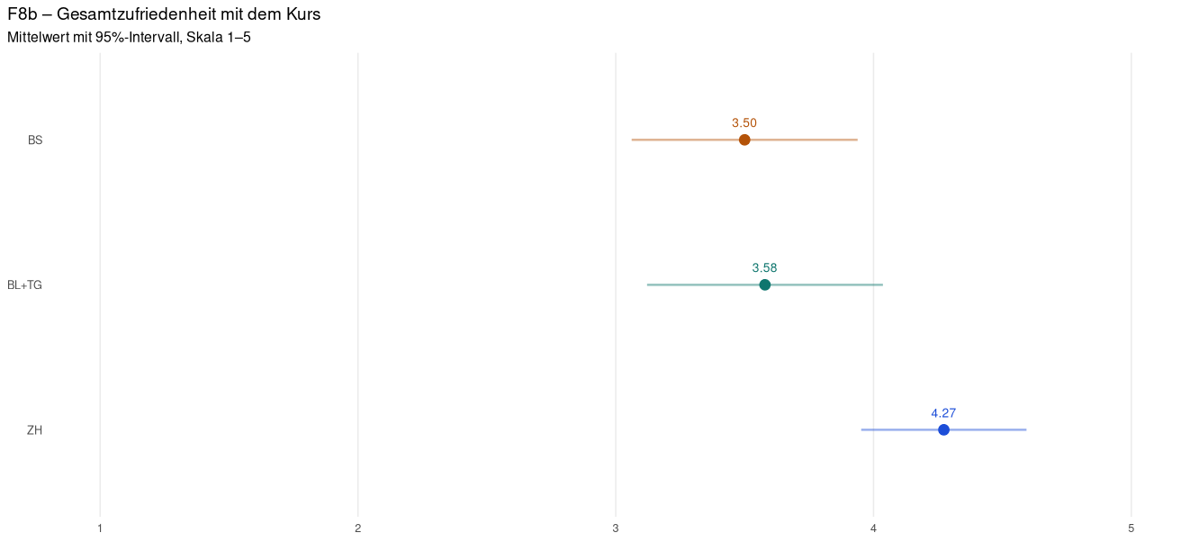
Most participants are satisfied with the course
Notes:
Satisfaction is present everywhere
"Happy sheet" -> satisfaction does not measure usage (should be kept in mind for course evaluations)

Slide 7
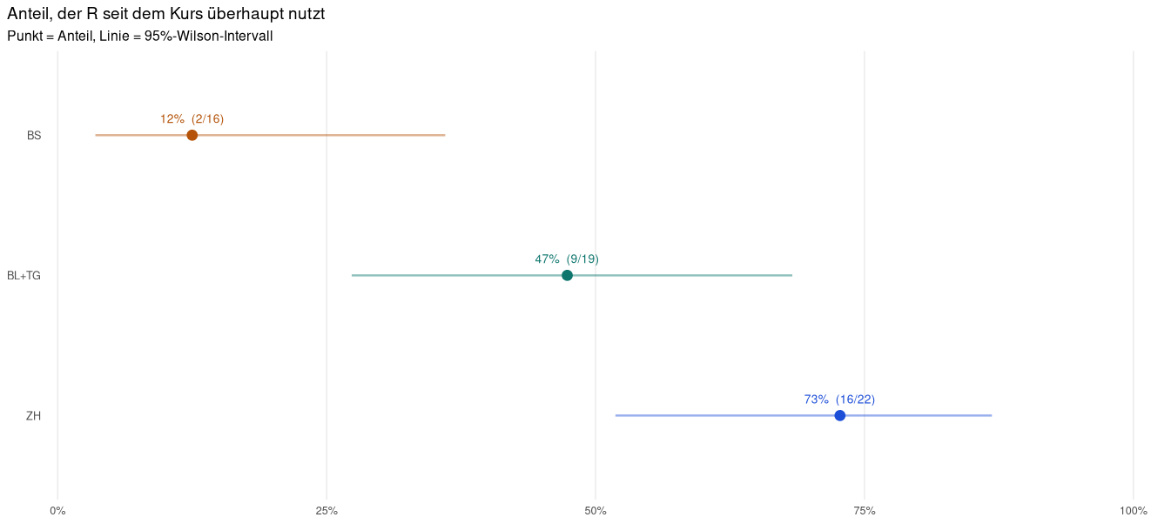
Who still uses R at all?
Notes:
Usage among the relatively large module courses BL+TG is below 50%
In ZH, almost 3/4 are users (27% invested that much time and money and still don’t use R)

Slide 8
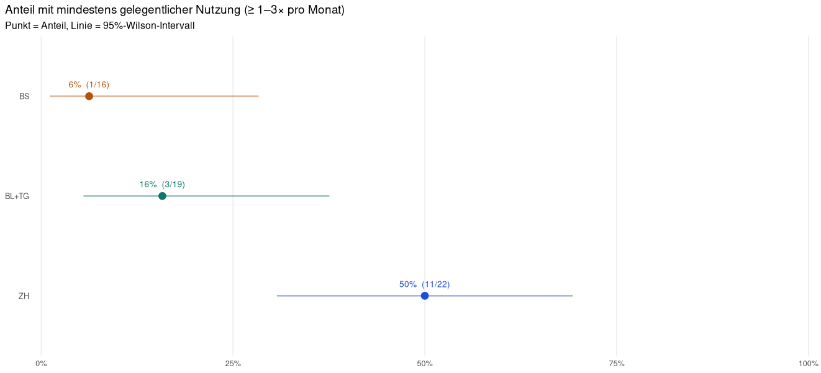
Who uses R regularly?
Notes:
Regular usage was only truly achieved in ZH

Slide 9
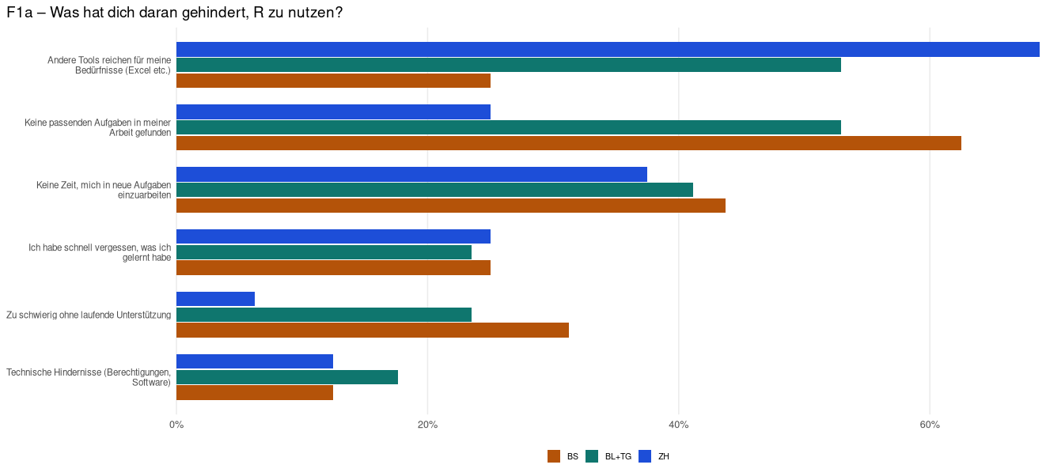
Many don’t know what to use R for
Learning: Suitable tasks should be identified before the course, so there is a reason to use it.
Notes:
Lack of time and quickly forgetting are problems that will always come up. The same goes for technical obstacles (unfortunately) Missing tasks, as well as other tools being sufficient, is something that could be ruled out beforehand

Slide 10
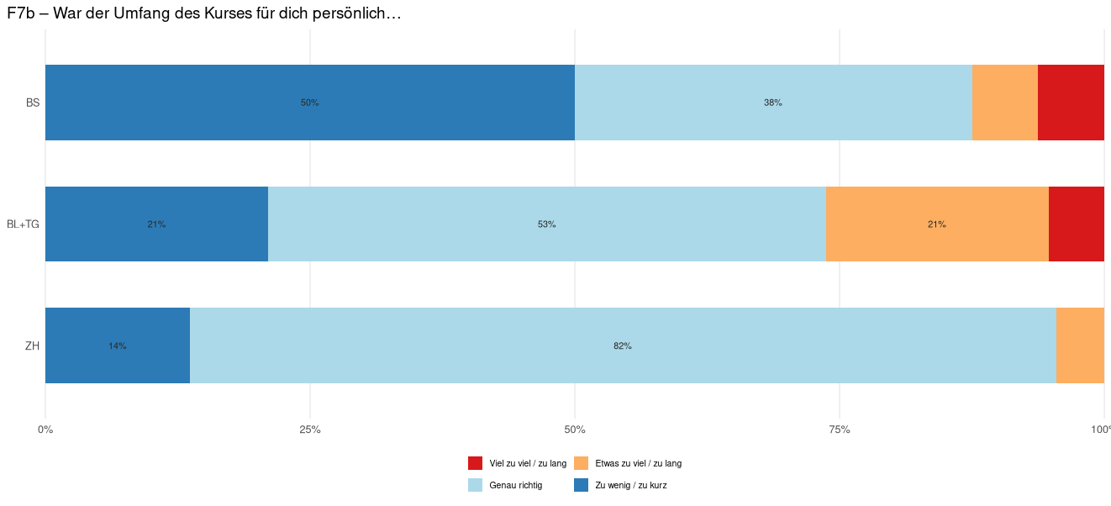
"Open" courses lead to heterogeneous target groups?
Too long
Learning: Not everyone needs to be able to program. The course should specifically target seriously interested people rather than casual samplers – e.g., through course fees and clear communication of the time commitment.
Notes:
Both the genuinely motivated and the "just taking a look” crowd were addressed and took part -> sharpen the target group

Slide 11
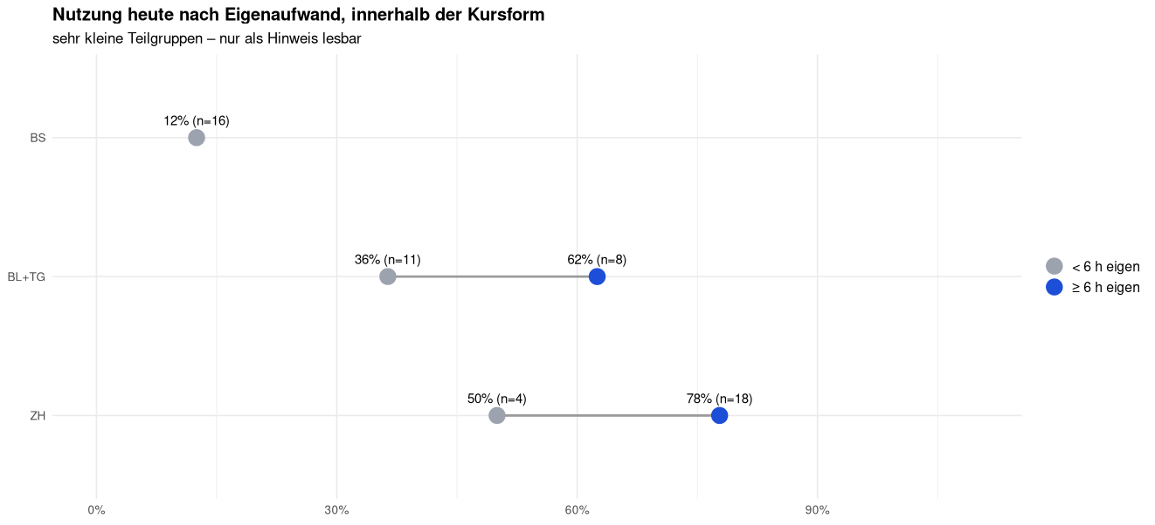
Increased self-directed effort leads to more sustainable usage
Learning: The course’s goal must be to foster self-initiative, as this contributes to long-term usage.
Notes:
Even removing those with prior knowledge, the difference becomes even bigger (though also smaller subgroups) 12% vs 50% and 0 vs 69% for ZH

Slide 12



Three Learnings for more sustainable use
Own projects as a basic prerequisite for participation
Specifically target genuinely interested and motivated colleagues
Foster self-initiative and communicate time commitment clearly

Slide 13


What this means for course design
Own projects as a basic prerequisite for participation
Preliminary workshop (separate from the R workshop)
Conceptual identification of automatable work steps/projects
Goal: identify an automatable project from one’s own area of work
Specifically target genuinely interested and motivated colleagues
Charge course fees, also to counteract no-shows
Participation in the preliminary workshop as a prerequisite (or with own project)
Foster self-initiative and communicate time commitment clearly
Implement own project as the final project
Follow-up support (R office hours, community, etc.)
Notes:
No definitive answer
R courses are very resource-intensive
At the limit when it comes to data literacy
Start earlier
What about AI?

Slide 14
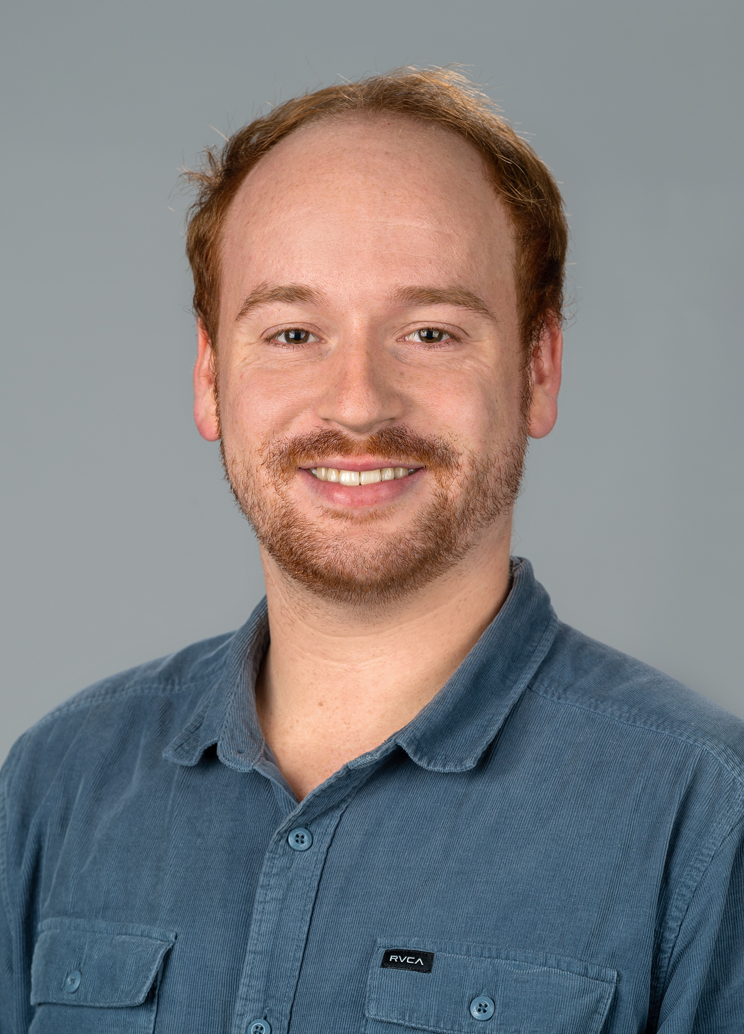
Thank you!
Felix Lorenz
OGD Specialist
Office for Data and Statistics
+41 58 345 53 67
felix.lorenz@tg.ch

