Slide 1
Data Analyst Portfolio
Oge

Slide 2
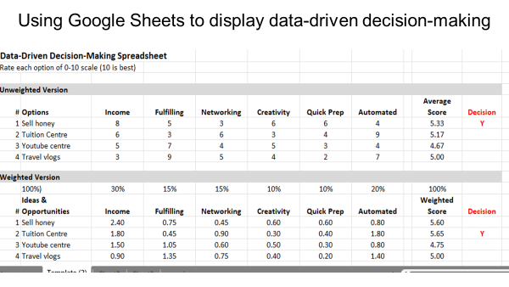

Slide 3
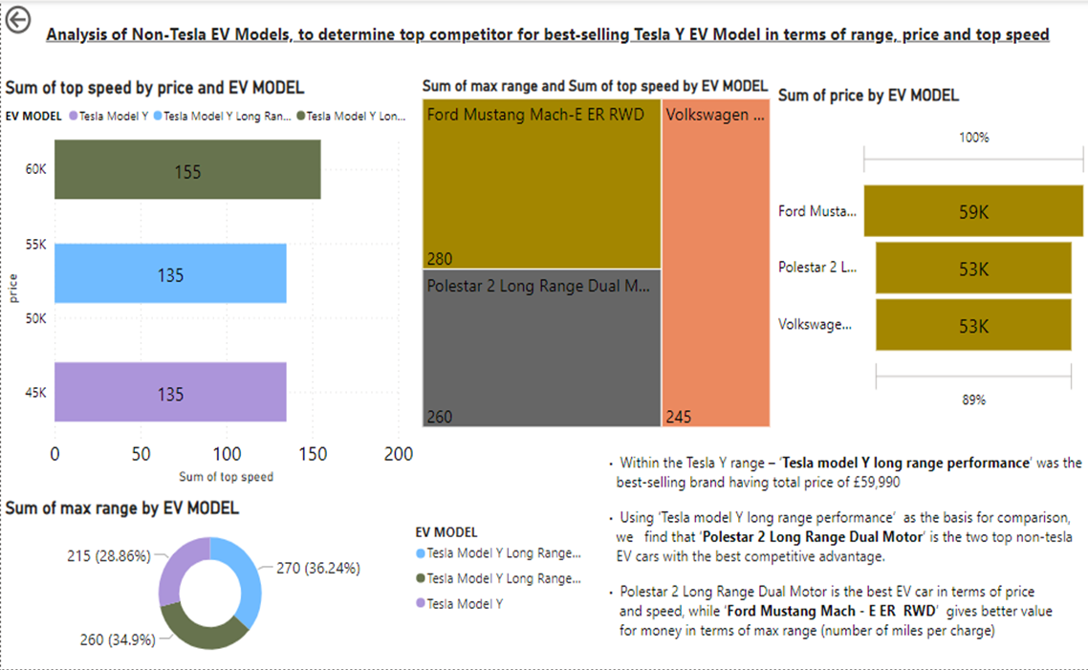

Slide 4
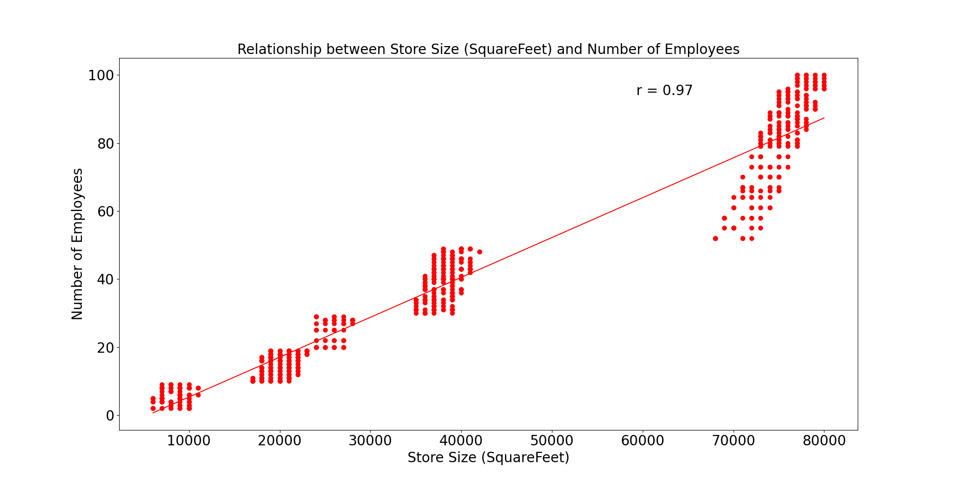
Assessing the relationship between the size of the stores, number of employees and revenue?
Relationship between the size of the stores and number of employees
The correlation coefficient of +0.97 suggest there is a very strong relationship between the size of the stores and number of employees

Slide 5
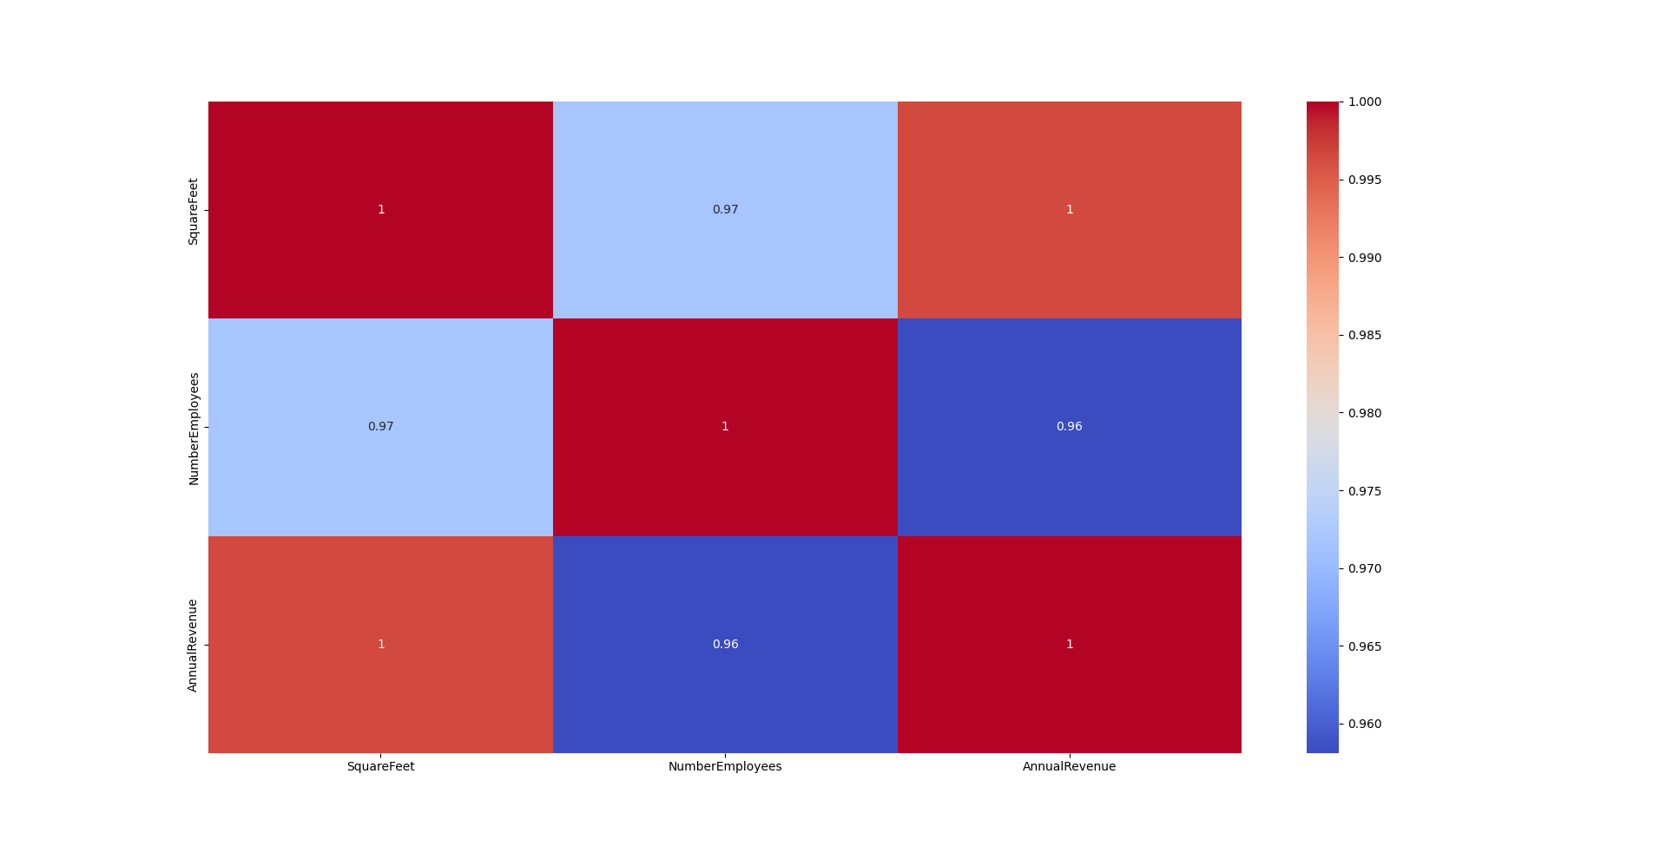
Further exploration of the relationship between the size of the stores, number of employees and revenue?
correlation matrix

Slide 6
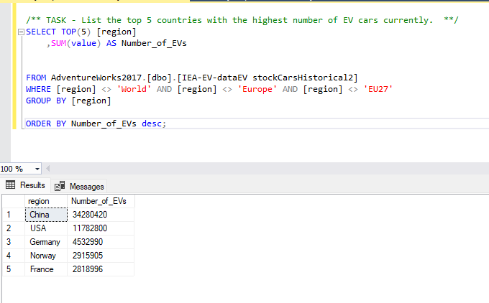
ANALYSIS OF STOCK OF ELECTRIC VEHICLES BY COUNTRY
The country with the highest number of electric vehicle cars was ‘China’ with 22 million more cars than other countries

