Slide 1
Problem
How can Lagos State Water Corporation determine if underground tertiary pipes are broken?

Slide 2
Solution?

Slide 3
Mami Wota
A crowd-sourced water pressure gauge

Slide 4
In the future…

Slide 5
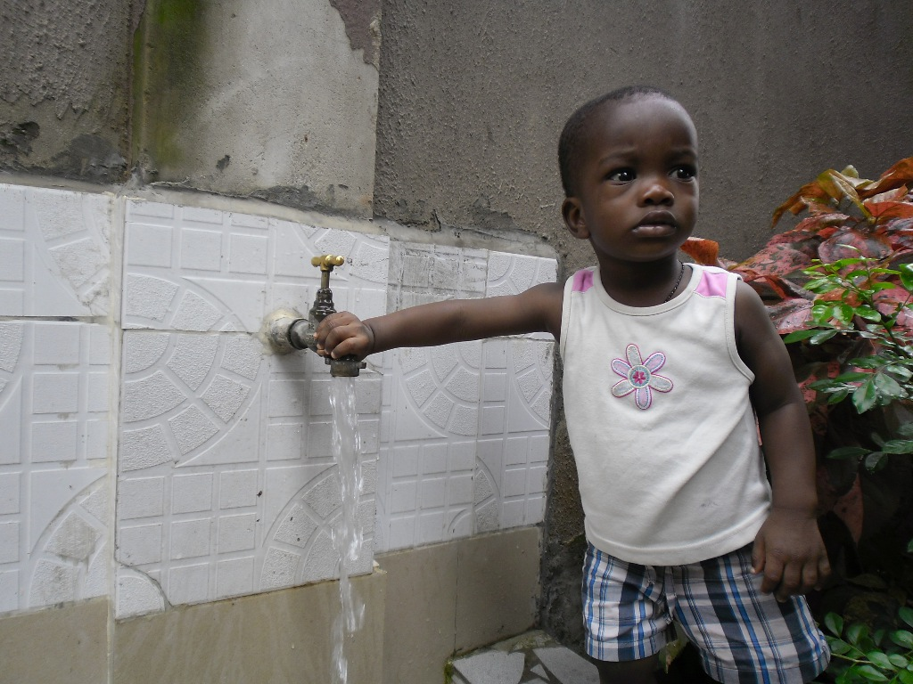

Slide 6
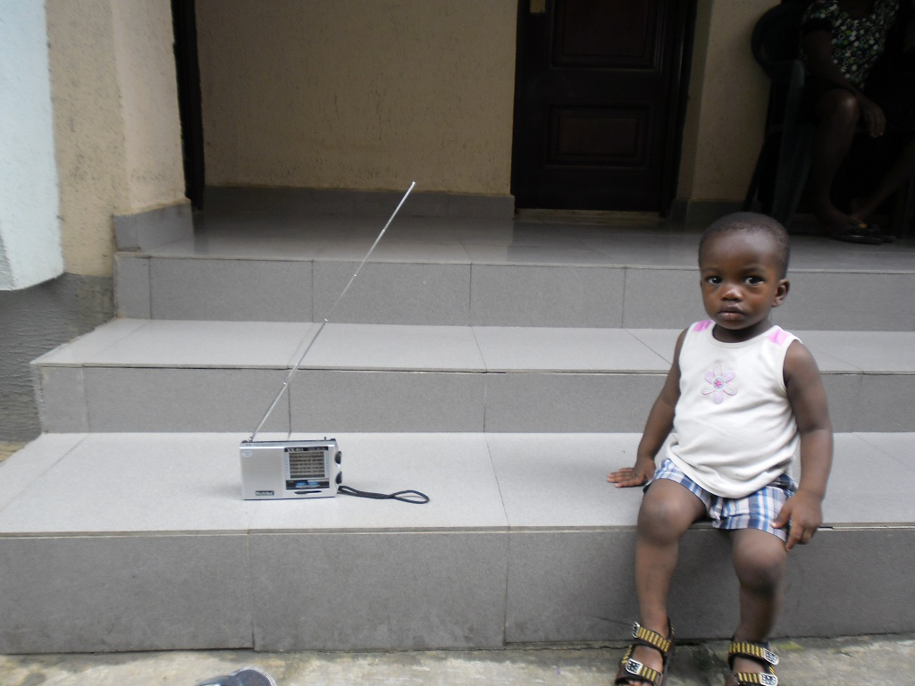
Sign up for the Mami Wota programme to receive ogbonge discounts on your water bill.

Slide 7
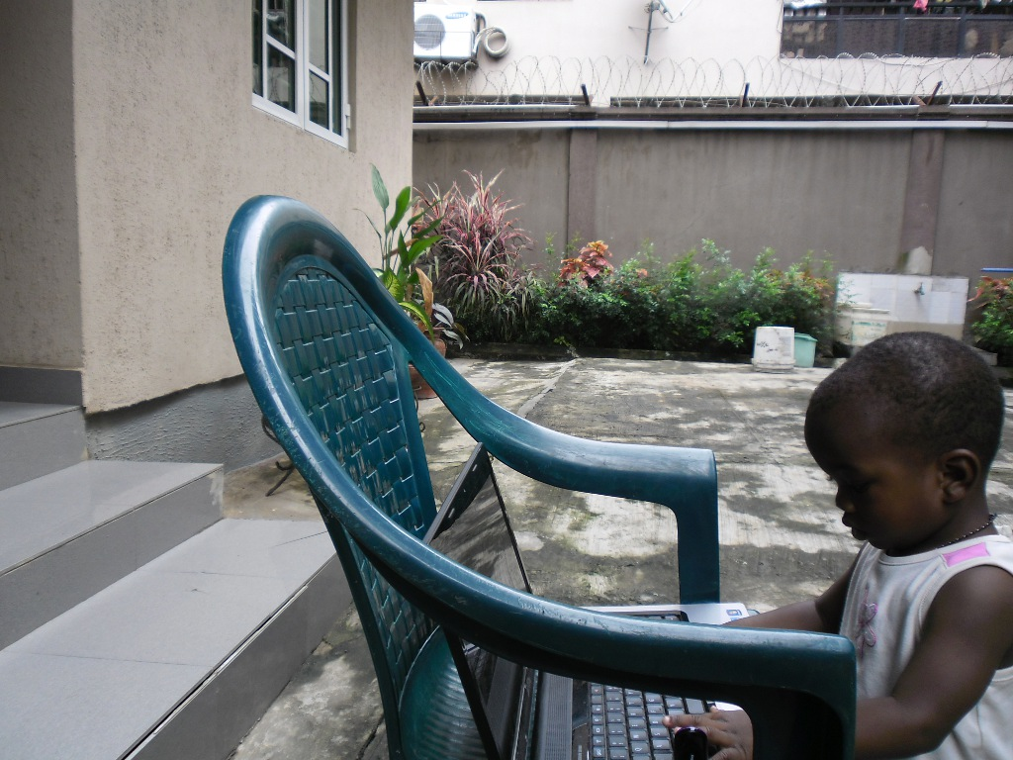
To sign up for Mami Wota:
Buy a water gauge
Attach it to your outdoors tap
Enter your phone number and wait for instructions

Slide 8
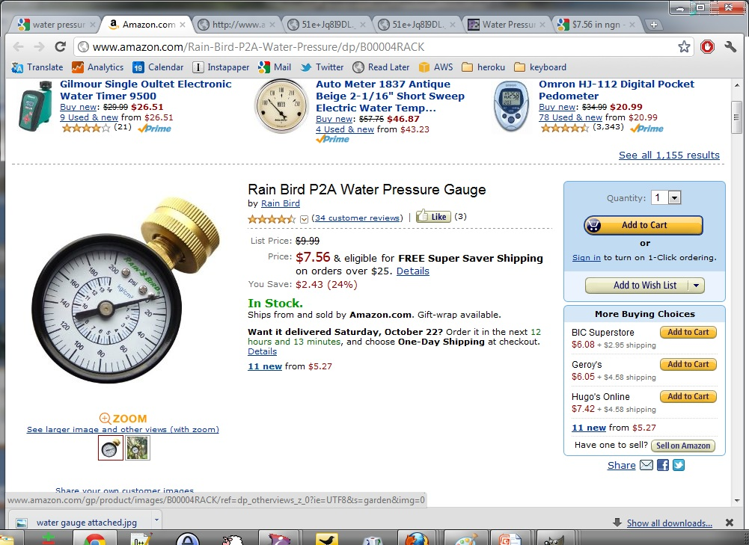

Slide 9
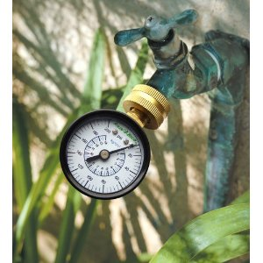

Slide 10
One week later…

Slide 11
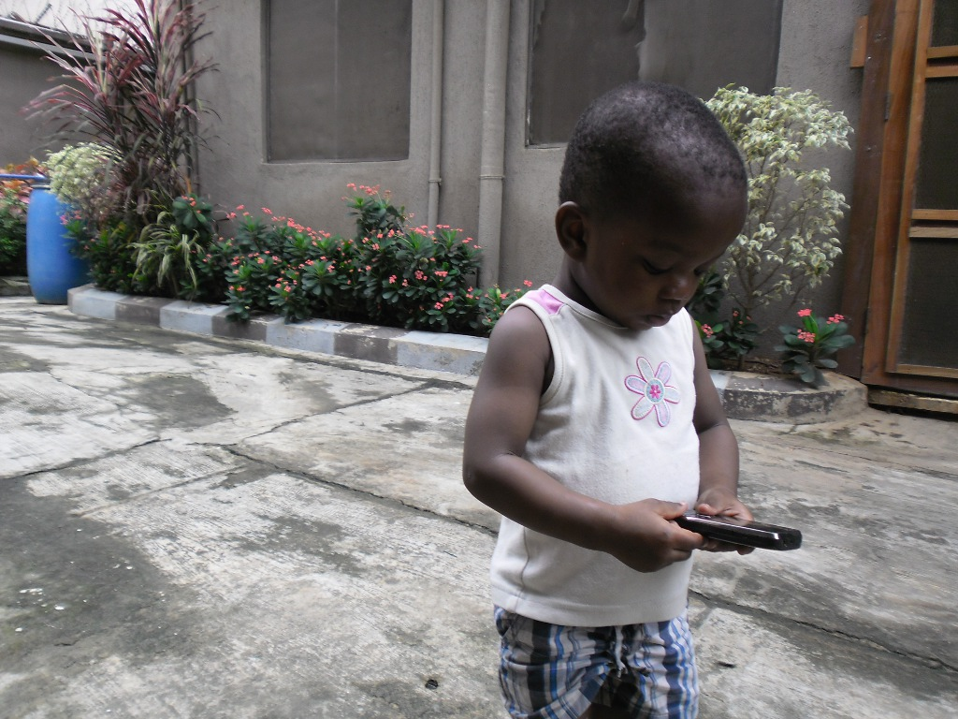
Send your water pressure within the next 24hrs to receive your ₦250 bonus

Slide 12
Send your water pressure within the next 24hrs to receive your ₦250 bonus
33.6 PSI

Slide 13
And a week after that...

Slide 14
Send your water pressure within the next 24hrs to receive your ₦250 bonus

Slide 15
Send your water pressure within the next 24hrs to receive your ₦250 bonus
35.0 PSI

Slide 16
After one year...

Slide 17
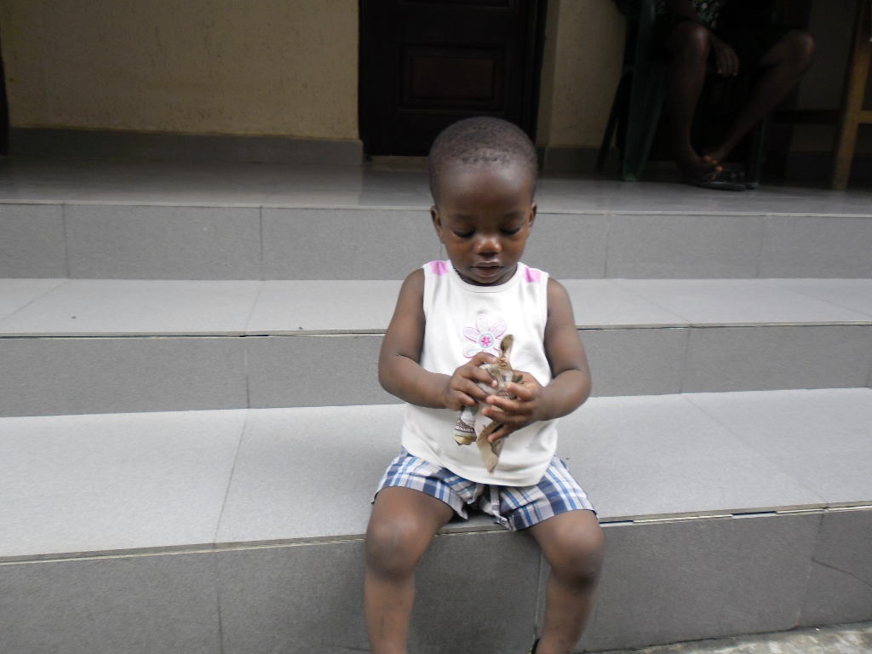
Yeaaah, savings!

Slide 18
Lagos State Water Corporation
Yeaaah, service!
☺

Slide 19
Everybody’s happy

Slide 20
The End.

Slide 21
Machine Learning Algorithms

Slide 22
Mami Wota
A crowd-sourced water pressure gauge
Oge Nnadi
http://oge.nnadi.org

