Slide 1
F
Tactile FLORA
Fingertip force as text for a vision-language reward model
Oren Gershony, Aaryan Patel, Kenan Blair and Parth Trivedi · Triton Droids, UC San Diego
2026-10-24
Notes:
Deck built from writeup/tactile-flora-report.md on 2026-10-24.

Slide 2
A vision-only reward model cannot see what the fingers feel
FLORA-Rewarder (NVIDIA, Qwen3.5-27B) watches a video mosaic and scores task success 1 to 5. It has no contact channel.
Released FLORA on a Baxter success
“the cube remained on the table in the final frames”
• Grasp or no grasp. An empty gripper closes, lifts and moves exactly like a loaded one.
• Hold or touch. A brief contact looks like a grasp on camera; the force says it ended early.
• Weak grip, re-grasp, slip. Visually unremarkable, obvious in the force trace.
• Small views. At 96 px per camera a cube is a few pixels wide; the lift is invisible.
The cube was 20 cm in the air, held for 2.9 s.
Rationale from the released model on rollout ep0000 (writeup/baxter-rollouts/README.md).
Tactile FLORA · 2026-10-24
2

Slide 3
The idea: render force as text, put it in the prompt, fine-tune with LoRA
Cameras
scene video
64-frame mosaic
released FLORA sampling, 96 px cells
FLORA-Rewarder
Qwen3.5-27B + LoRA r32
vision encoder frozen
Fingertip force
FSR pads / Inspire hand, 50 to 200 Hz
Resample
to the 64 frame times
Normalize
0 free space, 1 median grasp
Text block
per-frame lines + summary + classifier P
Score 1 to 5
E[s], success at 4.0
Everything released stays: weights, prompts, frame sampling. One addition: a force block after the video, introduced by one sentence that names its columns. Matched control: same training with the block omitted.
Tactile FLORA · 2026-10-24
3

Slide 4
The force block the model reads
• F total grip force; D pad asymmetry; dF its rate
• g hand closure, 0 open to 1 closed; c contact flag (F above 5% of grasp)
• summary label-free: contact segments, longest and total contact, peak, hold time and force, late/early hold ratio, low-force fraction
• P(success) a 120-tree, depth-2 gradient-boosted classifier over 31 force statistics, fitted on the 350 training clips; training clips see out-of-fold values
• budget at most 3,000 tokens per clip (largest seen: 2,700)
Force (normalized: 0 free space, 1 median grasp, max 3):
summary R: contacts=1 longest=6.00s total=6.00s peak=1.83 hold=5.67s
holdF=1.55 late/early=0.70 low=0% force-only classifier P(success)=0.76
t=0.00 L none | pad R F=0.00 D=0.00 dF=0.00 g=0.00 c=0
t=0.25 L none | pad R F=0.00 D=0.00 dF=0.00 g=0.00 c=0
...
t=12.50 L none | pad R F=1.62 D=0.21 dF=0.03 g=0.71 c=1
HRDexDB training clip inspire_dftp/cactus2/0, abbreviated. Per-trial tare, two most loaded pads, sign-corrected closure.
Why text: no new encoder, no change to the released model; the resampler keeps the raw slice so an encoder can be added later.
Tactile FLORA · 2026-10-24
4

Slide 5
Every claim is checked against two controls and two diagnostics
1
2
3
4
Matched no-force fine-tune
Shuffled force
Force removed
Video blanked
Same base, same 350 clips, same seed, epochs, learning rate, batch and LoRA; block omitted. A gain over it is a force gain, not a fine-tuning gain.
The tactile model with each clip's block replaced by another clip's. A gain that survives shuffling is not a force gain.
The tactile adapter with no block at all: does it still rank by what it learned from video?
Frames mid-gray, force only: what the force carries on its own.
Held-out sets are object-disjoint from training, split by object hash before any model ran, and scored once with fixed settings (threshold 4.0, no checkpoint selection).
Tactile FLORA · 2026-10-24
5

Slide 6
Four stages: each one fixed what the previous one showed was wrong
1
2
3
4
5
Pilot
Expanded v2
Bugs found
v3 (primary)
Baxter
32 / 16 HRDexDB clips
618 clips, aligned clocks, frozen object-disjoint splits 350 / 136 / 115
Inverted closure sign, force saturated at 37.5 units, contact flag always on
Tared, peak-ranked, sign-corrected, summary line, classifier P
FSR fingertips, 50 demos, ACT policy, 10 rollouts
No force benefit. Audit: tiny sample, unaligned sensor and video clocks.
Still no benefit: 82.4% vs 81.6%. Block found nearly uninformative.
Classifier on rendered lines: AUROC 0.57; on raw tared force: 0.78.
85.3% / AUROC 0.926 on dev; 72.2% / 0.800 on test.
Zero-shot: force takes AUROC from 0.31 to 1.0.
Training: released FLORA base, four epochs, seed 17, LoRA r32/a64, lr 2e-5, batch 16, 88 updates, two AMD MI210s. Only the force representation changed between v2 and v3.
Tactile FLORA · 2026-10-24
6

Slide 7
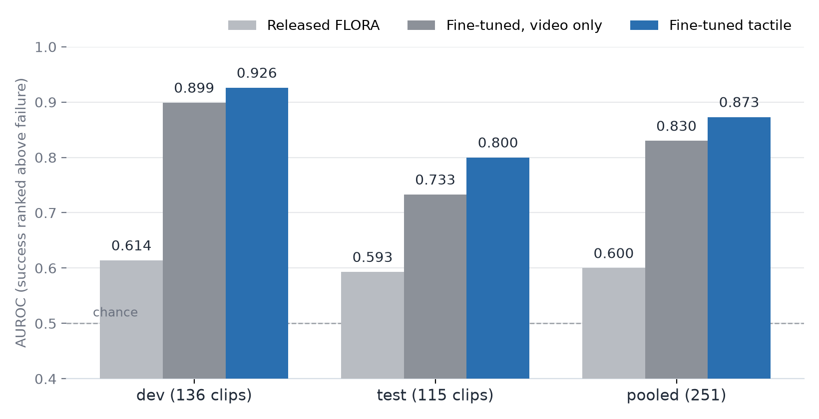
HRDexDB: the tactile fine-tune ranks best on every held-out split
Accuracy at the 4.0 threshold
Model | dev | test | pooled
Released | 66.2% | 67.0% | 66.5%
Video only | 82.4% | 69.6% | 76.5%
Tactile | 85.3% | 72.2% | 79.3%
MAE on dev (mean |score − truth| on the 1 to 5 scale, times 100): 150 released, 71 video only, 53 tactile.
251 clips over 32 objects never seen in training. Pooled: +12.8 accuracy points and +0.27 AUROC over released FLORA; +2.8 points and +0.043 AUROC over the matched video-only fine-tune.
Tactile FLORA · 2026-10-24
7

Slide 8
The ranking gain over the video-only fine-tune is significant; the accuracy gain is not
+0.043
+0.001 to +0.080
26 vs 19
AUROC, tactile minus video-only, pooled over 251 clips
object-level bootstrap 95% interval, p about 0.02
clips fixed vs clips broken relative to the video-only model
Per split
Against released FLORA
• dev: +0.026 AUROC (not significant); 12 wins, 8 losses
• test: +0.067 AUROC (p about 0.04); 14 wins, 11 losses
• accuracy +2.8 points overall, exact McNemar p = 0.37
• +12.8 accuracy points and +0.27 AUROC pooled
• dev MAE 150 to 53 (mean absolute error on the 1 to 5 scale, times 100)
• 251 clips cannot certify a 3-point accuracy gain; about 1,000 would
Tactile FLORA · 2026-10-24
8

Slide 9
The model reads the force: shuffle it and the gain disappears
Tactile adapter on dev (136) | Accuracy | AUROC | MAE ×100
Real force | 85.3% | 0.926 | 53
Shuffled force (another clip's block) | 73.5% | 0.824 | 109
Video blanked (force only) | 53.7% | 0.775 | 121
Video-only fine-tune, for reference | 82.4% | 0.899 | 71
25 : 9
paired clips lost : won when the force is shuffled, p = 0.009
• Shuffling costs 12 points. A gain that survived shuffling would not be a force gain; this one does not survive it.
• Force alone is weak. With the video blanked the model still ranks above chance (0.775) but calls almost everything a failure.
• Both channels are used. Neither video nor force alone reaches 0.926; the fine-tuned model combines them.
Tactile FLORA · 2026-10-24
9

Slide 10
The force settles the clips the video cannot call, and leaves the rest alone
Clips, split by the video-only model's confidence | Video only | Tactile | Gain
Uncertain: E[s] within 0.75 of the threshold (101 clips) | 66.3% | 72.3% | +6.0
Confident: the other 150 clips | 83.3% | 84.0% | +0.7
dev only, uncertain band (46 clips) | 71.7% | 82.6% | +10.9
What the wins look like
Stacking check
The video-only model under-calls successes whose hold is visually unremarkable (long, steady contact above the median force) and over-calls failures where the hand closes convincingly but the force shows a weak grip, a re-grasp, or contact that ends early.
A force-only classifier alone scores 76.5% / 0.777 on test, level with both VLMs on accuracy; a logistic stack of video score, tactile score and classifier reaches 88.2% / 0.928 on dev. The VLM, not the sensor, is the bottleneck.
Tactile FLORA · 2026-10-24
10

Slide 11
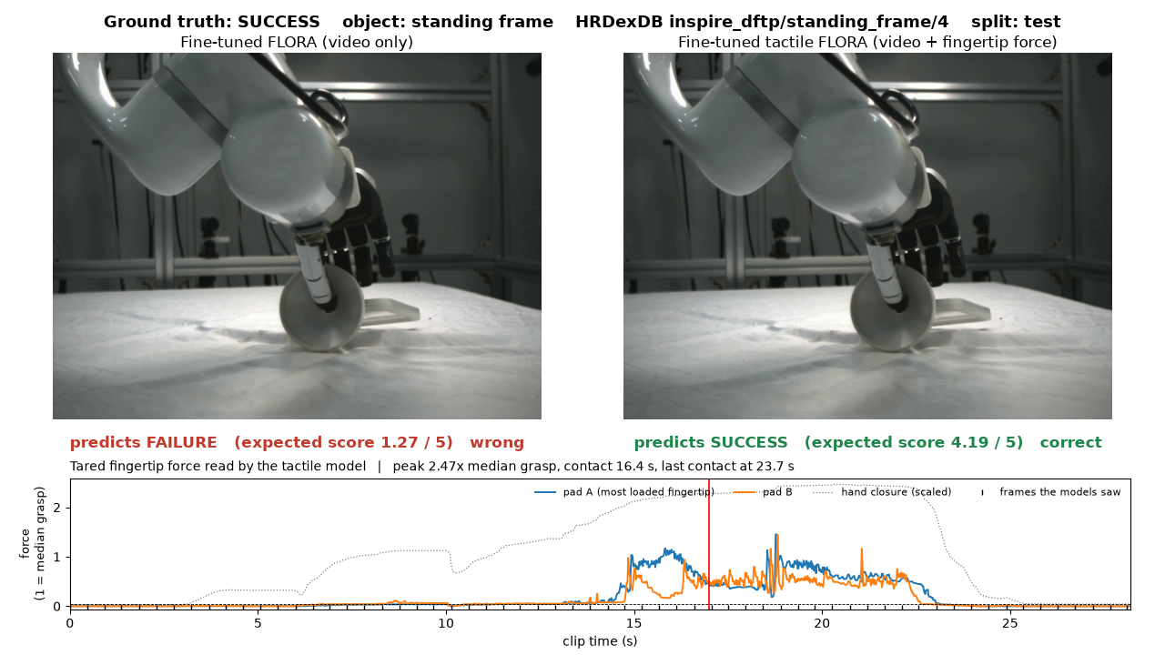
A win: standing frame #4, a success the camera scored 1.27
HRDexDB test clip
1.27
video only: failure
4.19
tactile: success (truth)
Force: peak 2.5x the median grasp, 16.4 s of contact, last contact at 23.7 s of 28.2 s.
All 26 such clips are rendered as side-by-side videos in writeup/hrdexdb/videos/; the 19 the video-only model wins are listed in writeup/hrdexdb/README.md.
Tactile FLORA · 2026-10-24
11

Slide 12
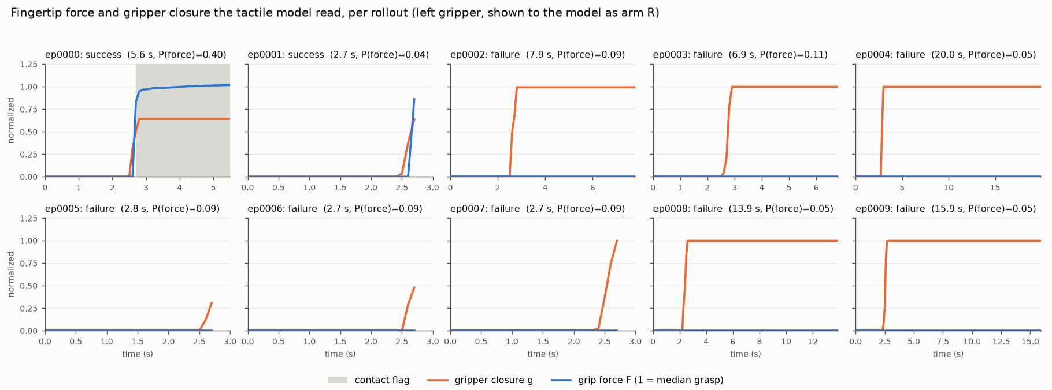
Baxter: our own fingertips, our own policy, zero-shot evaluation
Sensor
Demos
Policy
Rollouts
Four thin-film FSR pads in a 3.3 V divider, Teensy 4.0 at 200 Hz, 12-bit ADC, clock-fitted into ROS. Left gripper only; raw counts, resting offset 92.
50 hand-guided left-arm cube picks, 15 fps head and wrist cameras at 640 x 360, no tactile. Cut at the first sign of the gripper re-opening.
ACT (LeRobot 0.6.1): chunk 30, 15 action steps, ResNet-18, VAE; 50k steps on five RTX 2080 Ti. Rollouts use the 30k checkpoint (held-out L1 0.028).
Ten live runs at 30 Hz with joint-jump guard, fingertip box and speed cap, tactile recorded. Operator labels: ep0000 and ep0001 succeeded, eight failed.
Force and closure the tactile model read, per rollout
Only ep0000 shows a clean grasp signature: closure stops at 0.64 on the cube and force holds at the grasp level for 2.9 s. ep0001 has one contact frame at the very end. The eight failures closed on nothing (closure 1.0, force 0), and five of them then lift the empty gripper exactly as a success would.
Tactile FLORA · 2026-10-24
12

Slide 13
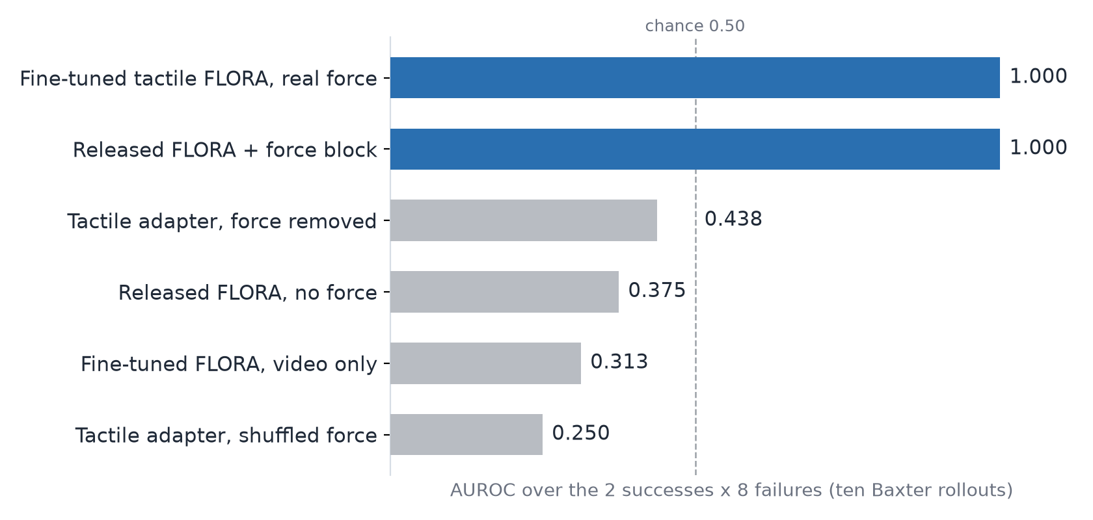
Baxter: the force block takes the ranking from below chance to perfect
0.31 → 1.00
AUROC, fine-tuned FLORA without and with the force block
0.375 → 1.00
released FLORA without and with the block, no training at all
Every condition has accuracy 0.80, the majority class: no model scores a success at or above 4.0, so the signal is the ranking. Shuffled force 0.25, force removed 0.44, force-only classifier 0.50.
Ten clips, two successes: 16 ordered pairs. A direction, not a significance result. Slurm job 6490, two MI210s, 8 min.
Tactile FLORA · 2026-10-24
13

Slide 14
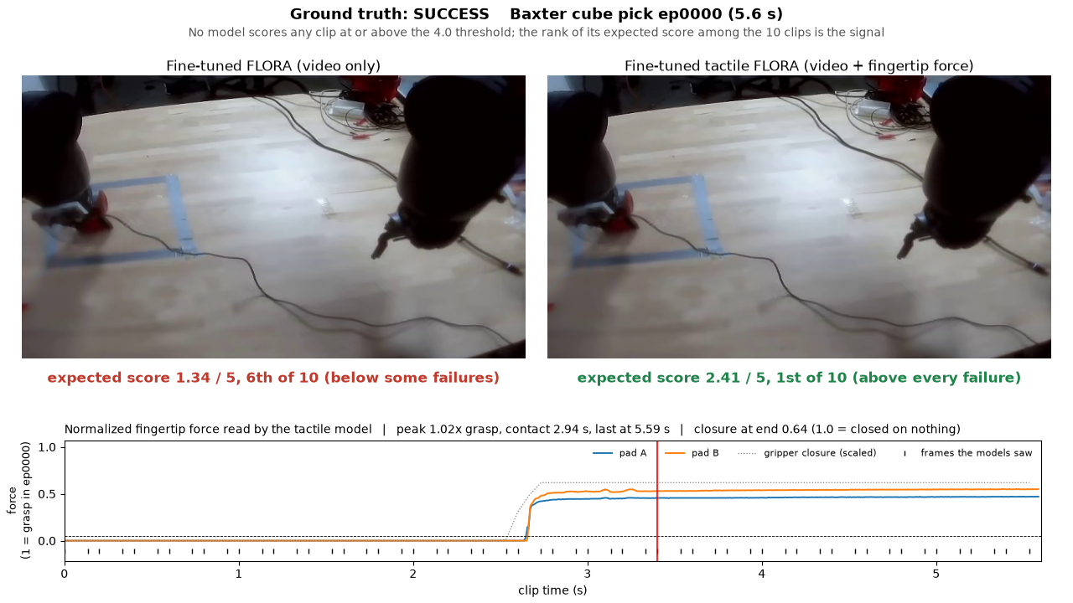
ep0000: the video models cannot see the lift, the force block can
Episode | Video only | Tactile
ep0000 success | 1.34, 6th of 10 | 2.41, 1st
ep0001 success | 1.05, 8th | 1.60, 2nd
ep0003 empty lift | 1.99, 1st | 1.09, 3rd
ep0008 empty lift | 1.75, 2nd | 1.04, 6th
Expected score and rank among the ten clips. The tactile model's lowest success (1.60) sits 0.51 above its highest failure (1.09).
ep0003 and ep0008 are the video-only model's two top scores: the arm closes, lifts and moves exactly as in a success. With its force block removed the tactile adapter also puts them on top (2.97, 2.31).
Side-by-side videos for the seven clips where the tactile model wins by at least 0.1: writeup/baxter-rollouts/videos/.
Tactile FLORA · 2026-10-24
14

Slide 15
Caveats
• Sample size. 251 held-out clips cannot certify a 3-point accuracy gain; the AUROC gain is the significant one. Baxter: ten clips, two positives, no significance claim.
• Control provenance. The video-only comparison is the v2 control adapter; the v3 control retrain was preempted. Inputs are identical, so only training noise is unmeasured.
• A small classifier rides in the block. Its probability is one line the VLM reads; the raw force lines stay. It cannot explain Baxter (its own AUROC there is 0.5).
• Undertrained. Loss floors by update 20 of 88: the target is a template plus one digit. Both fine-tunes are data-limited.
• 96 px views. All video models saw tiny thumbnails; higher resolution would help every one of them and may shrink the force gain.
• Baxter specifics. Normalization fitted on the ten test clips (label-free); ep0001 rests on one line of the block; uncalibrated FSR counts; left pads shown as the right-hand pads the adapter knew.
Tactile FLORA · 2026-10-24
15

Slide 16
Tactile FLORA outperforms regular FLORA at judging grasps
vs released FLORA
vs video-only fine-tune
the force is causal
+12.8 pts, +0.27 AUROC on HRDexDB; 0.375 to 1.0 on Baxter
+2.8 pts, +0.043 AUROC (p about 0.02); +6 pts where video is unsure; 0.31 to 1.0 on Baxter
shuffled: 25 lost / 9 won (p = 0.009), Baxter 0.25; removed: 0.44
What's next
• More held-out clips (about 1,000) to certify the accuracy gain, and a second training seed
• Higher-resolution video input, then re-measure how much force still adds
• Calibrated fingertip sensors on both Baxter grippers and more rollouts, including induced slips
• More embodiments: the same text block works for any force stream

