Slide 1

Faculty of Engineering & Technology
Jagran School of Engineering, Jagran Lakecity University, Bhopal
Major Project Presentation
EVALIXAI: AI-POWERED RECRUITMENT & CANDIDATE SCREENING PLATFORM
Under the Supervision of:
Dr. Dileep Kumar Singh
Professor & Head, JSEN
Presented by:
• Aakash Sarang (2023BTCSE001)
• Manish Kumar Srivastav (2023BTCSE009)

Slide 2
Outline of Presentation
1. Introduction & Project Overview
2. Problem Statement & Industry Motivation
3. Key Features & Core Intelligence Modules
4. System Architecture & Microservices Topology
5. AI Resume Screening & Data Flow Sequence
6. Tools, Technologies & Infrastructure Stack
7. 4-Month Phased Implementation Roadmap
8. Performance Evaluation & Quality Benchmarks
9. Conclusion & Future Scope

Slide 3
Introduction & Project Overview
Autonomous Recruitment Platform: EvalixAI is an AI-powered, cloud-native recruitment ecosystem engineered to automate candidate screening from application to final ranking.
Academic Evolution: Evolved from an intelligent academic assessment engine into a commercial-grade recruitment platform tailored for startups and SMEs.
Unified Screening Pipeline: Replaces fragmented toolchains by consolidating contextual resume parsing, cognitive testing, conversational AI mock interviews, and sandboxed code execution.
Data-Driven Candidate Ranking: Aggregates multi-stage performance vectors into an explainable, weighted composite index and real-time recruiter analytics dashboard.
Compliance & Privacy Mandate: Built in strict compliance with EU GDPR, India's DPDP Act 2023, and WCAG 2.1 Level AA web accessibility standards.

Slide 4
Problem Statement & Industry Motivation
Industry Problem Statement:
  Prohibitive Enterprise ATS Cost: Platforms like Workday & Greenhouse charge $10k+/yr, requiring complex setups inaccessible to startups.
  Manual Triaging Inefficiencies: Manual resume reviews cause weeks of delay, reviewer fatigue, and unconscious human bias.
  Keyword Parser Vulnerabilities: Lexical string matchers fail on synonyms and are easily gamed by resume keyword stuffing.
  Toolchain Fragmentation: Coding platforms and video tools operate in silos without centralized talent analytics.
Our Solution (EvalixAI Platform):
  AI-Native Pipeline: Contextual semantic matching, automated proctored tests, and conversational interview evaluations.
  60%–70% Turnaround Reduction: Sub-10s resume parsing and instant multi-criteria composite score aggregation.
  Accessible Economics: Cloud-native microservices architecture designed specifically for startup budgets.

Slide 5
Key Features & Core Intelligence Modules
Contextual Resume Intelligence: PDF/DOCX ingestion, structured JSON entity extraction, qualification gap analysis, and Claude LLM semantic scoring (FR-1.1–FR-1.11).
Cognitive & Technical Assessment: Question bank management, instant objective scoring, AI subjective grading, and browser tab-switch anti-cheat telemetry (FR-2.1–FR-2.11).
AI Conversational Mock Interviewer: Dynamic JD-tailored questions, audio/video response transcription, and multi-criteria rubric evaluation across clarity and depth (FR-3.1–FR-3.10).
Sandboxed Code Execution Suite: Judge0 runners for Python, Java, C++, JS, resource quotas (2s / 256MB), and AST plagiarism checks (FR-4.1–FR-4.10).
Composite Ranking & Analytics Dashboard: Recruiter-weighted scoring algorithm, dynamic talent leaderboard, funnel conversion metrics, and bias telemetry (FR-5.1–FR-5.9).

Slide 6
Tools, Technologies & Infrastructure Stack
Frontend Client Tier: Next.js (App Router), React
Backend & Microservices: Python FastAPI (AI Services), Prisma ORM
Database & Caching: PostgreSQL(Relational RDS), Redis (In-Memory Session Caching & Task Queues)
Storage & External AI: Minio(Object Storage), Anthropic Claude API (Claude Sonnet / Haiku)
Code Execution Engine: Judge0 API
DevOps & Ingress: Docker
Security & Auth: OAuth 2.0

Slide 7
4-Month Phased Implementation Roadmap
Phase 1 (Month 1 / W1–W4): Foundation, Auth/RBAC & Resume Ingestion
• PostgreSQL schema & Prisma ORM setup | OAuth 2.0 / JWT integration
• minio document ingestion pipeline | Claude LLM semantic parser & scoring
• Engineering: Aakash (Auth/minio) | Manish (Schema/Claude API)
Phase 2 (Month 2 / W5–W8): Cognitive Screening & Sandboxed Code Execution
• Question bank CRUD & assessment engine | AI-assisted subjective grading
• Monaco in-browser IDE & Judge0 Docker sandbox | Test runner & plagiarism detection
• Engineering: Aakash (Assessment UI) | Manish (Judge0 Sandbox)
Phase 3 (Month 3 / W9–W12): AI Mock Interviewer & Composite Ranking
• Dynamic interview question generator | WebRTC media capture & transcript review
• Multi-criteria response evaluation rubric | Composite ranking algorithm & dashboard
• Engineering: Aakash (Interview UI) | Manish (Ranking Engine)
Phase 4 (Month 4 / W13–W16): Pipeline Integration, Testing & Cloud Deployment
• Recruiter & candidate workflow integration | SendGrid automated email notifications
• Load testing (1,000 concurrent sessions) | Kubernetes / NGINX Ingress cloud deployment
• Engineering: Aakash (Workflow/WCAG) | Manish (K8s/Load Testing)

Slide 8
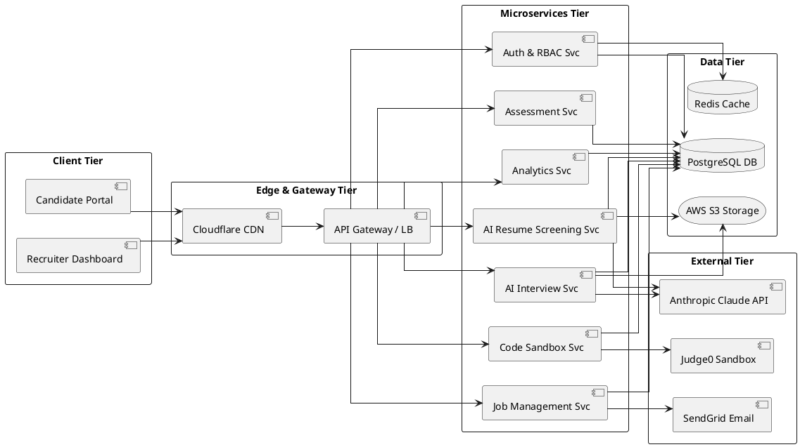
System Architecture & Microservices Topology

Slide 9
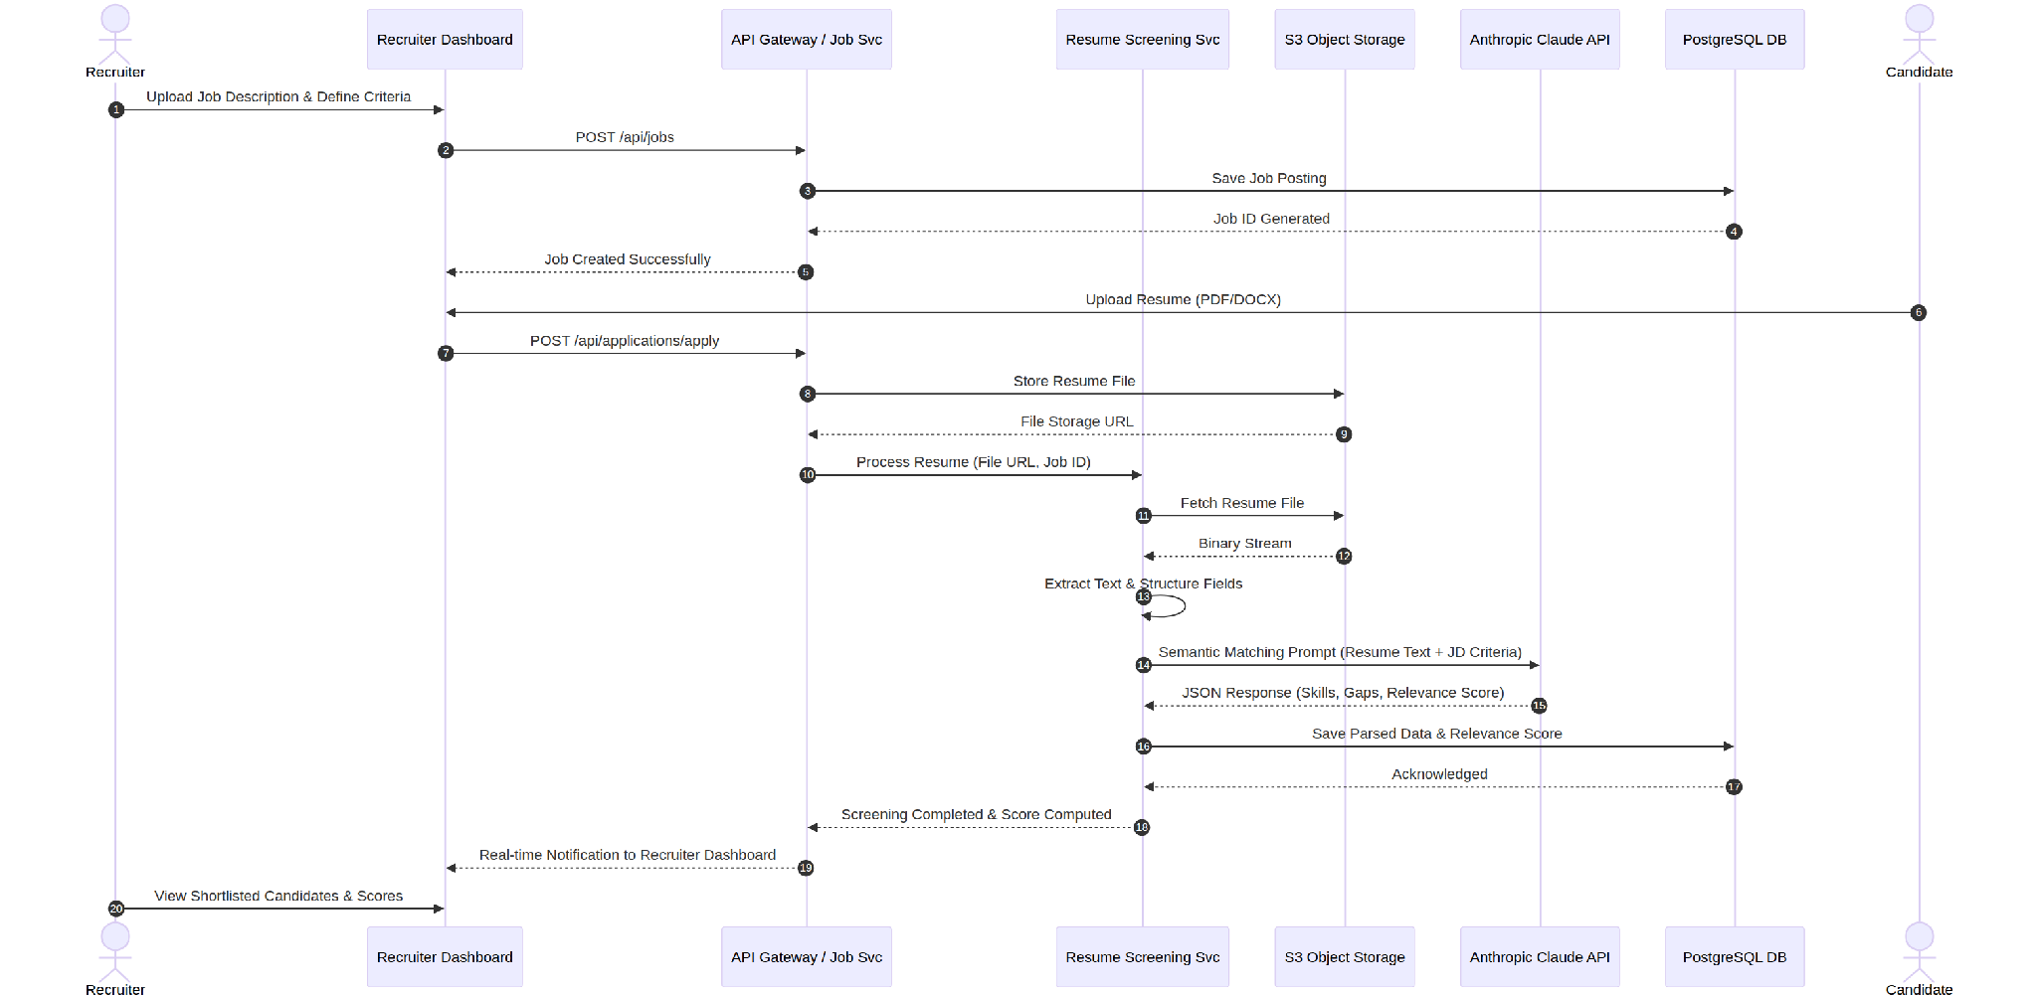
AI Resume Screening & Transaction Flow

Slide 10
Performance Benchmarks, Conclusion & Future Scope
Conclusion & Future Scope:
  Conclusion: EvalixAI establishes an accessible, end-to-end talent acquisition ecosystem uniting resume parsing, cognitive tests, mock interviews, and code sandboxes.
  Future Scope: Multi-modal video facial micro-expression analysis, native enterprise HRIS connectors (BambooHR, Workday), and continuous skill gap learning path recommendations.

