Slide 1

Vice President: Nikolas Ogg

Slide 2
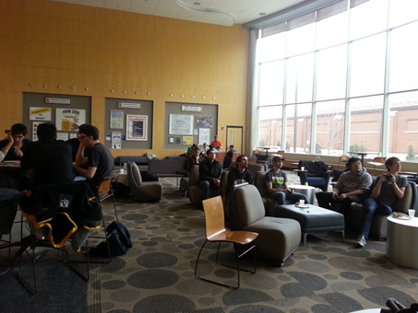
What is ACM?
A collection of groups focused on fields in computing
Game Development
Artificial Intelligence
Robotics
Etc…
Host Special Events
Company Tech Talks
Help Sessions
Student led Talks
Programming Competitions

Slide 3

How to: Install Linux
Why should I
use Linux?
What is EXT4?
What is SWAP?
Should I install
Arch Linux?
Partnered with PLUG

Slide 4
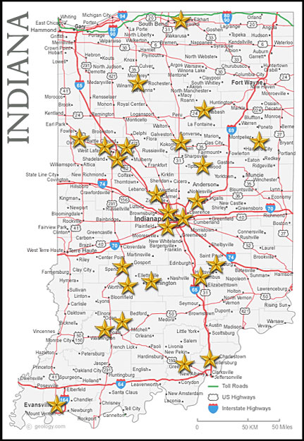


High School Coding Competition
Simple coding questions (think FizzBuzz)
Talk to students about CS and Purdue
Learn about competitive programming

Slide 5
SIGS: Special Interest Groups
Application Development
Artificial Intelligence
Game Development
Security
Robotics

Slide 6

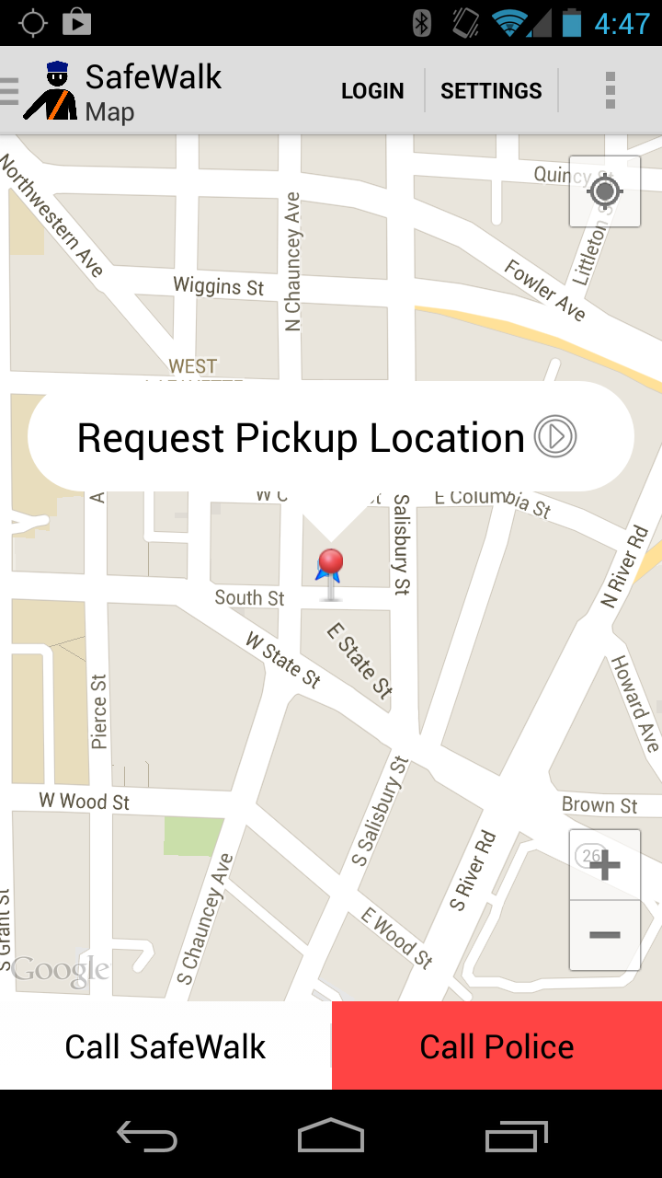
SIGS: Special Interest Groups
Application Development
Artificial Intelligence
Game Development
Security
Robotics

Slide 7
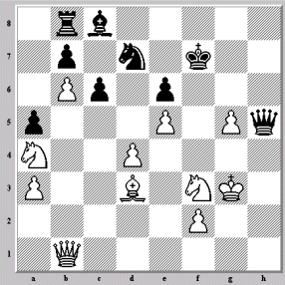
SIGS: Special Interest Groups
Application Development
Artificial Intelligence
Game Development
Security
Robotics

Slide 8
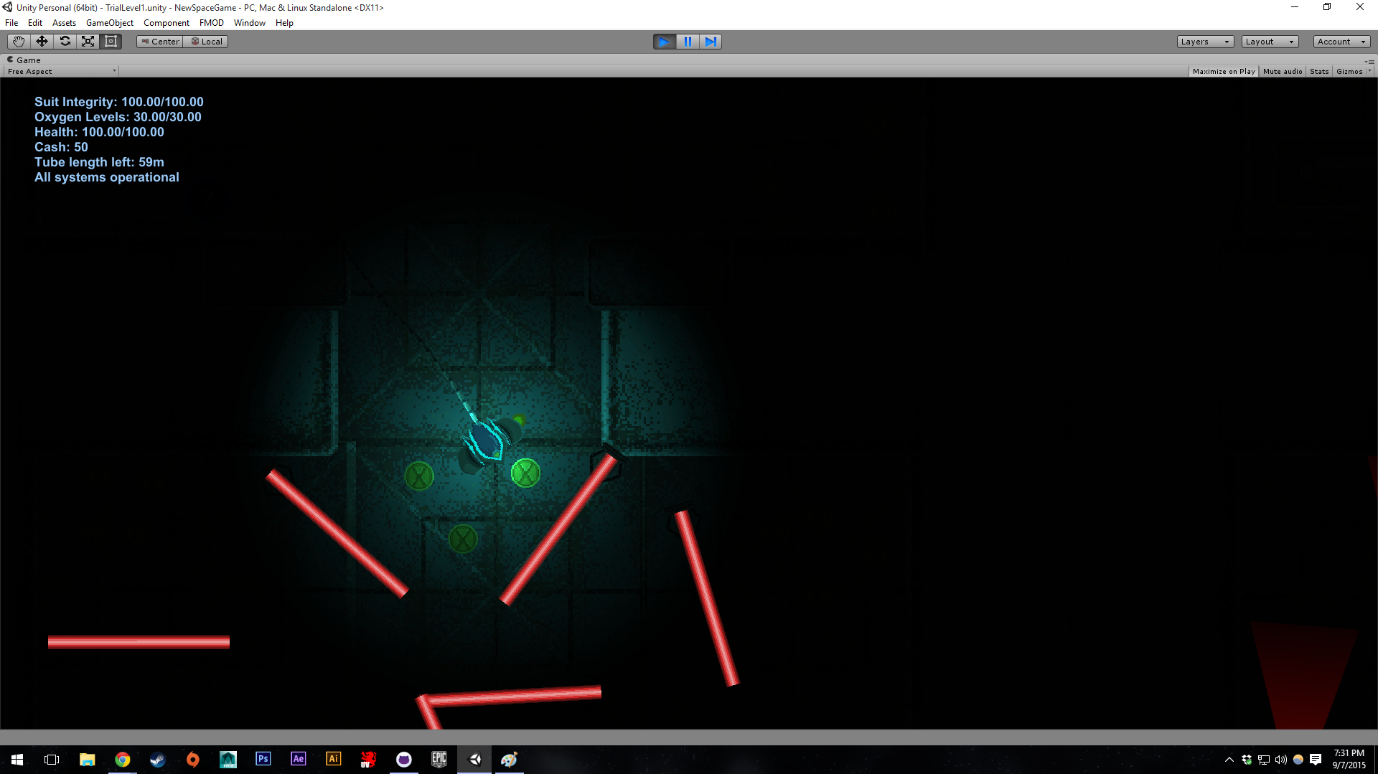
SIGS: Special Interest Groups
Application Development
Artificial Intelligence
Game Development
Security
Robotics

Slide 9

SIGS: Special Interest Groups
Application Development
Artificial Intelligence
Game Development
Security
Robotics

Slide 10
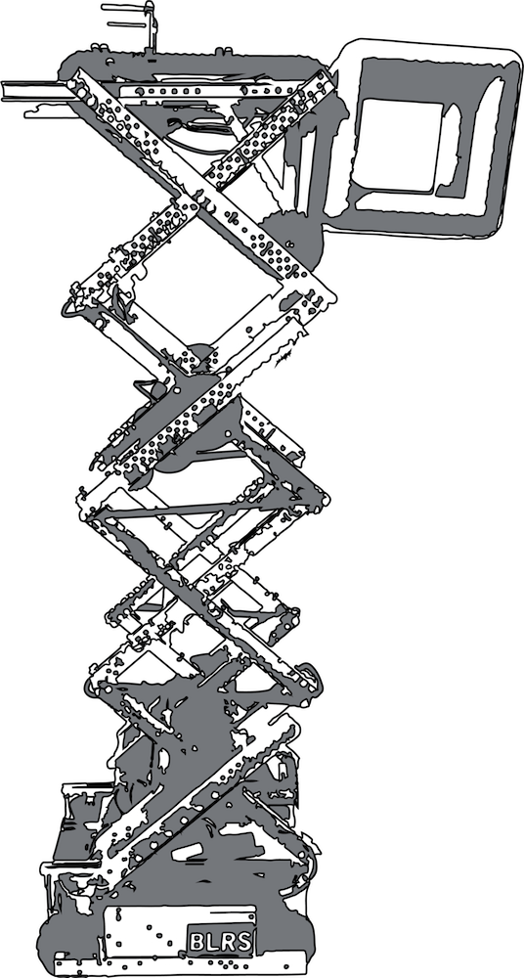
SIGS: Special Interest Groups
Application Development
Artificial Intelligence
Game Development
Security
Robotics

