Slide 1
Emojinator
Description
This is about building an object detection api.
we use this api to predict emoji’s based on the hand gestuers shown
Python Implementation
→Network Used- Convolutional Neural NetworkProcedure
→First, generate images using hand_images.py.
(Make sure that you take images from different angles.)
→Data will be stored in /data folder
→converting the data into as csv format(train_foo.csv)
→we train the using KERAS module of python using which we generate a CNN model
→we check the accuracy of the model if it is greater than desired value
then we use the model to predict the output (emojinator.h5)
→Finally, run Emojinator2.py via webcam

Slide 2
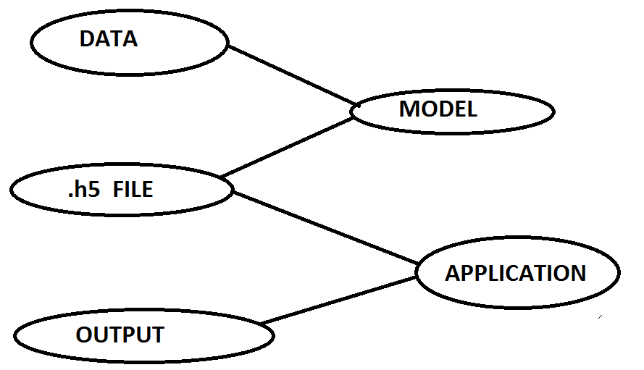
FLOW OF DATA

Slide 3
COLLECTING IMAGES FROM CAM AS DATA
SAVE DIFFERENT GESTURES PICS IN DIFFERNT FOLDERS TO TRAIN THE MODEL
MODEL CLASS
CREATING AND TRAINING THE MODEL BASIED ON THE CSV FILE
CONVERTING THE JPEG IMAGE TO CSV FILE
SAVE MODEL IN .H5
.h5 FILEE
APPLICATION CLASS
USING DEEPLEARNING AND
OPENCV WE CREATE APPLICATION
INTERACTS WITH CAM TO COLLECT THE GESTURES AND CHECKS IN FOR THE SAME TO PREDCIT
WEB CAM

