Slide 1
Jaro – Winkler Distance and Its Fuzzy Matching Application in Counter Terrorist Financing
Fan Xu

Slide 2
Table of Content
Introduction to Jaro-Winkler distance
Fuzzy Matching and Transaction Screening
R Code Representation

Slide 3



Jaro – Winkler distance
In computer science and statistics, the Jaro–Winkler distance is a string metric measuring an edit distance between two sequences. It is a variant proposed in 1990 by William E. Winkler of the Jaro distance metric (1989, Matthew A. Jaro).
In practice, the Jaro–Winkler distance metric is designed and best suited for short strings such as person names.
String 1: Jaro – Winkler
String 2: Jaro – Winkler
Similarity: 100%
String 1: Jaro – Winkler
String 2: Jalo – Winkler
Similarity: 96.19%
String 1: Jaro – Winkler
String 2: Joe – Edwards
Similarity: 66.70%
* Source from Wikipedia

Slide 4
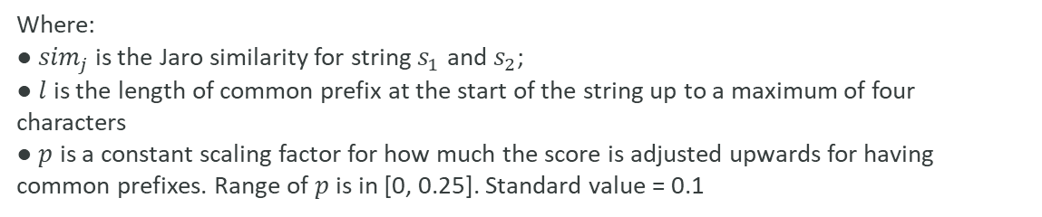


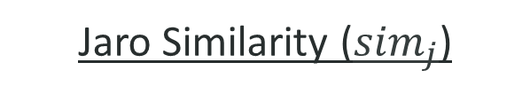
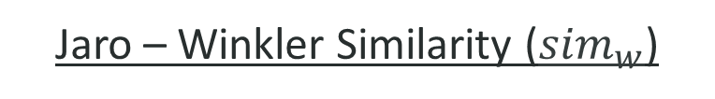
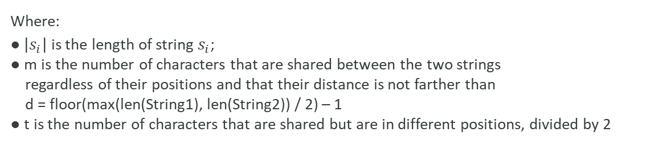

Jaro Similarity (${sim}_{j}$)
0 if m = 0
$${sim}_{j}=$$
$\frac{1}{3}+\left(\frac{m}{\left|s_{1}\right|}\right)+\left(\frac{m}{\left|s_{2}\right|}\right)+\left(\frac{m−t}{m}\right)$ otherwise
Where:
● $\left|s_{i}\right|$ is the length of string $s_{i}$;
● m is the number of characters that are shared between the two strings
regardless of their positions and that their distance is not farther than
d = floor(max(len(String1), len(String2)) / 2) – 1
● t is the number of characters that are shared but are in different positions, divided by 2
Jaro – Winkler Similarity (${sim}_{w}$)
It is a variant proposed in 1990 by William E. Winkler of the Jaro distance metric (1989, Matthew A. Jaro).
$${sim}_{w}={sim}_{j}+lp(1−{sim}_{j}）$$
Where:
● ${sim}_{j}$ is the Jaro similarity for string $s_{1}$ and $s_{2}$;
● $l$ is the length of common prefix at the start of the string up to a maximum of four characters
● $p$ is a constant scaling factor for how much the score is adjusted upwards for having common prefixes. Range of $p$ is in [0, 0.25]. Standard value = 0.1
* Source from Wikipedia

Slide 5


Transaction Screening
Financial institutions are responsible for blocking transactions from / to suspicious individuals (black list).
Transactions
Transactions
Txn No. | Name
1 | Amelia Davis
2 | Harper Rodriguez
3 | Roger Jolly
4 | Abigail Hernandez
5 | Emily Lopez
6 | William Cruz
7 | DathVader
8 | James Edwards
9 | Donald Dug
10 | Oliver Collins
Black List
Txn No. | Name | Result
1 | Amelia Davis
2 | Harper Rodriguez
3 | Roger Jolly
4 | Abigail Hernandez
5 | Emily Lopez
6 | William Cruz
7 | DathVader
8 | James Edwards
9 | Donald Dug
10 | Oliver Collins
Black List
Doland Duck
Darth Vader
Jolly Roger
Tony the Tiger
Mike Wazowski
Duck Dodgers

Slide 6
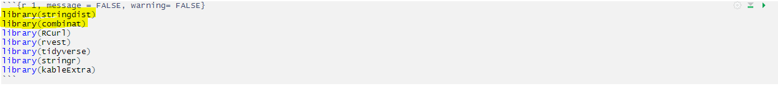
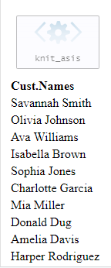
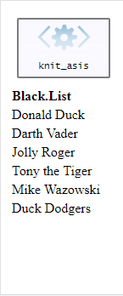
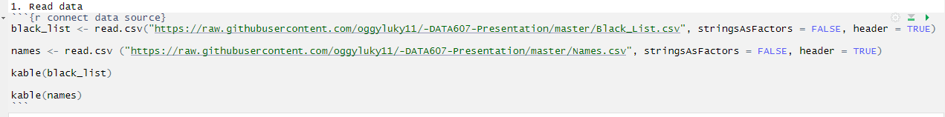
Packages and Data
R Code:
Packages:
Data:

Slide 7
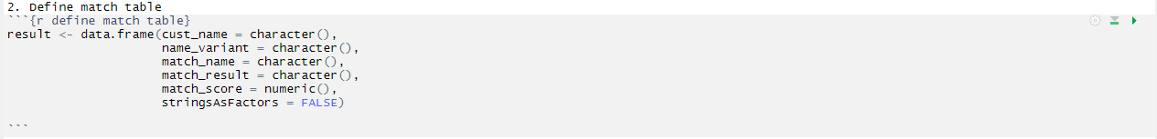
R Code:
Create a table for screening result

Slide 8
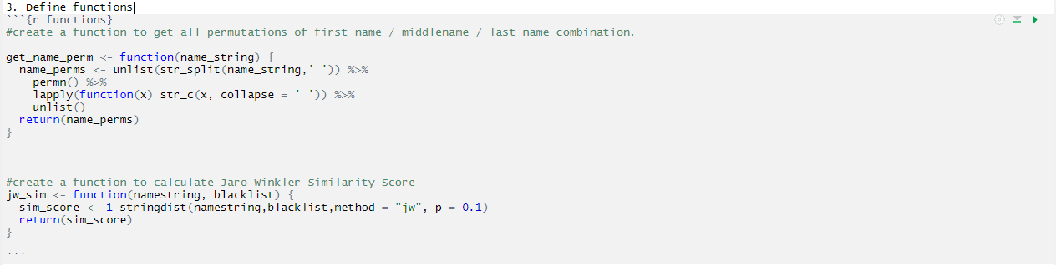
Create functions
R Code:
Get name permutations:
Eg:
Name: Jason David Frank
Name variants: Jason David Frank, Jason Frank David, David Jason Frank
David Frank Jason, Frank Jason David, Frank David Jason

Slide 9
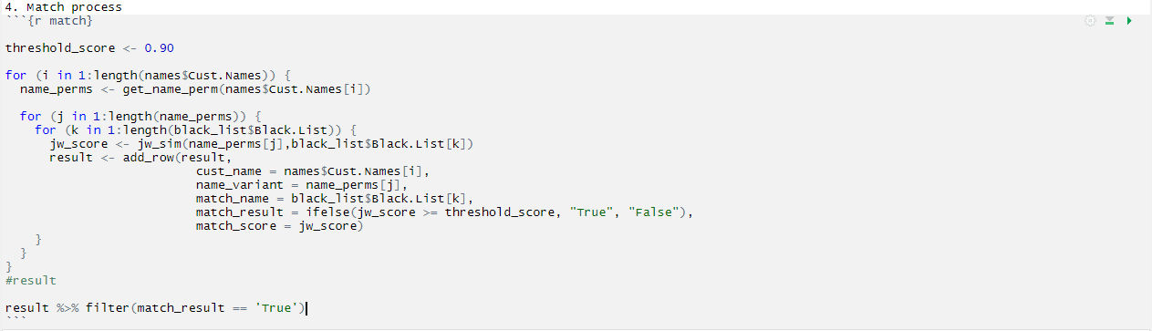
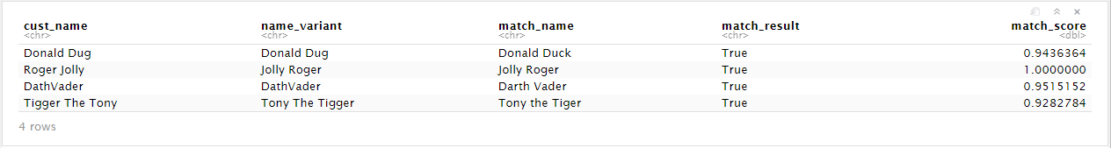
R Code:
Screening Process & Result
Result:

Slide 10
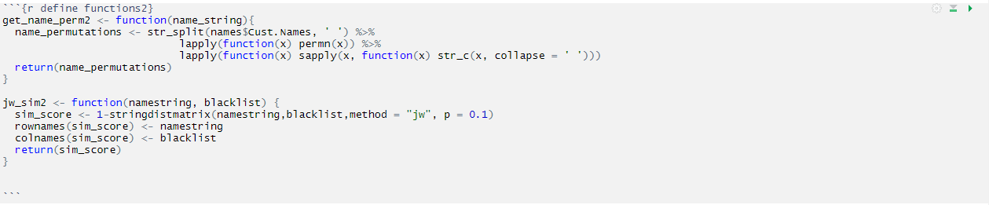
R Code:
Option 2:Create Functions (List Operation)

Slide 11
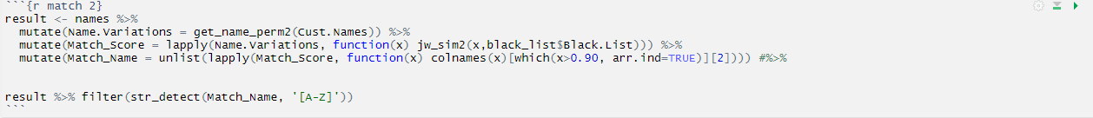
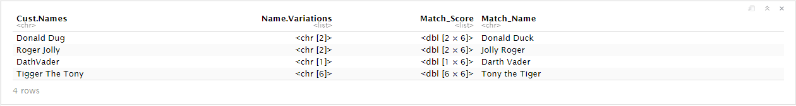
Option 2: Screening Process
R Code:
Result:

Slide 12
Thank You

