Slide 1
SMILE DETECTION
OMID GHAHROUDI
ARASH MOSHIRNIA

Slide 2
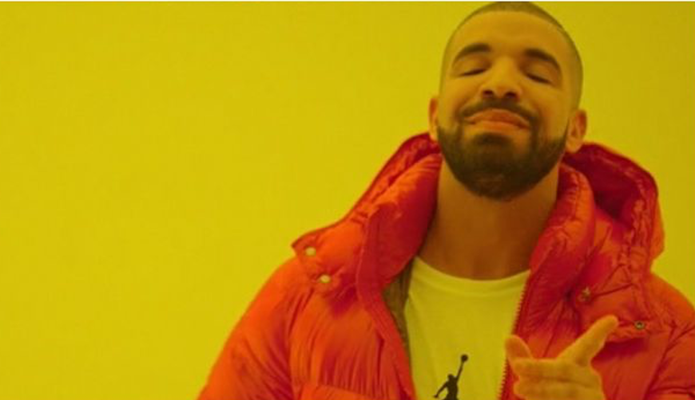
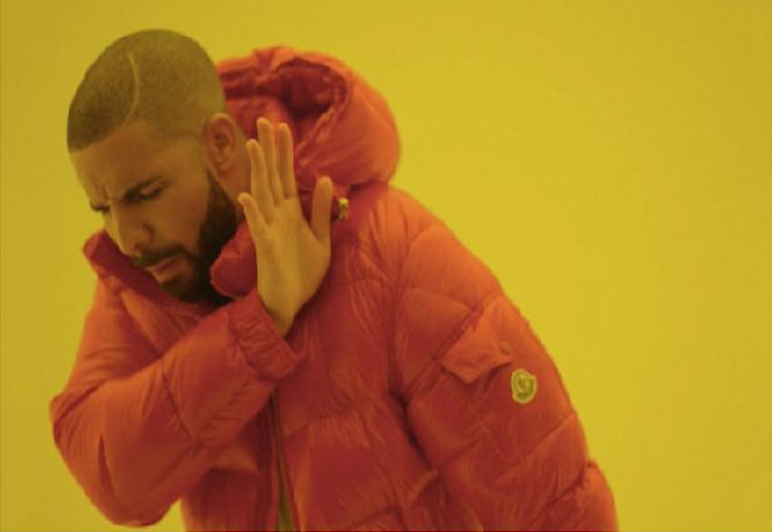
Smiling
Process
Input Image
Not Smiling

Slide 3
Dataset 1
GENKI-4k by University of California, San Diego
Consists of 4000 images from smiling and non-smiling faces
3200 instances used for training
800 instances used for testing

Slide 4
Dataset 2
https://github.com/hromi/SMILEsmileD.git
Consists of 13165 images from smiling and non-smiling faces
10532 instances used for training
2633 instances used for testing

Slide 5
Pre-Processing
Block
Reduce
RGB to
Grayscale
Initial Image
Normalize
180 * 192
60 * 64
Grayscale
/255
Ready!

Slide 6
Why Convolutional Neural Network?
Our input data is image
CNNs have proved to be effective for images
MLPs aren’t used because of their vectorized form of input
RNNs aren’t used because we don’t need to process pixels sequentially

Slide 7
Famous CNN Architectures
LeNet-5
AlexNet
ZFNet
GoogleNet
VGGNet
ResNet

Slide 8
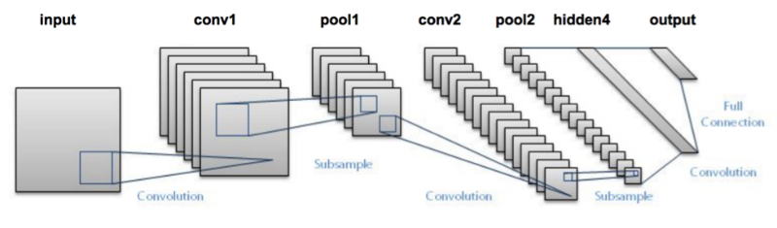
LeNet-5
Input → CONV → RELU → POOL → CONV → RELU → POOL → FC → RELU → FC

Slide 9
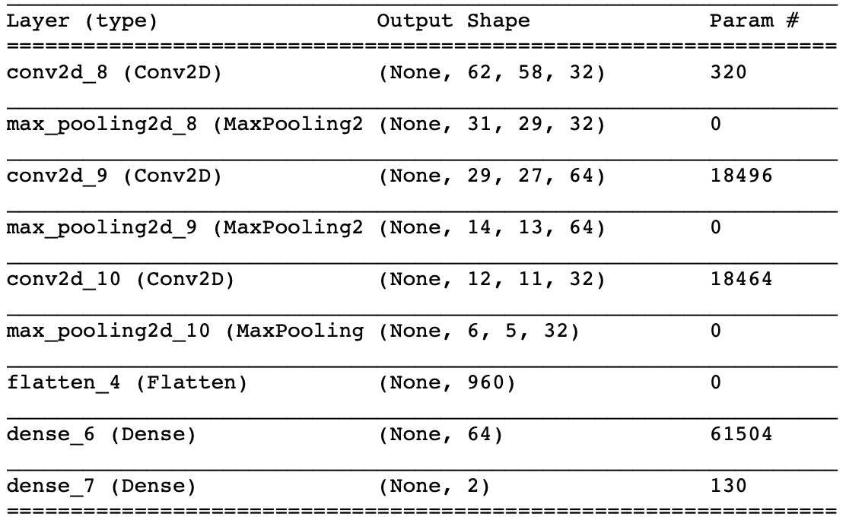
Our Architecture
Kind of like LeNet5
One more layer of Convolution + Pooling
Minus one fully connected layer

Slide 10
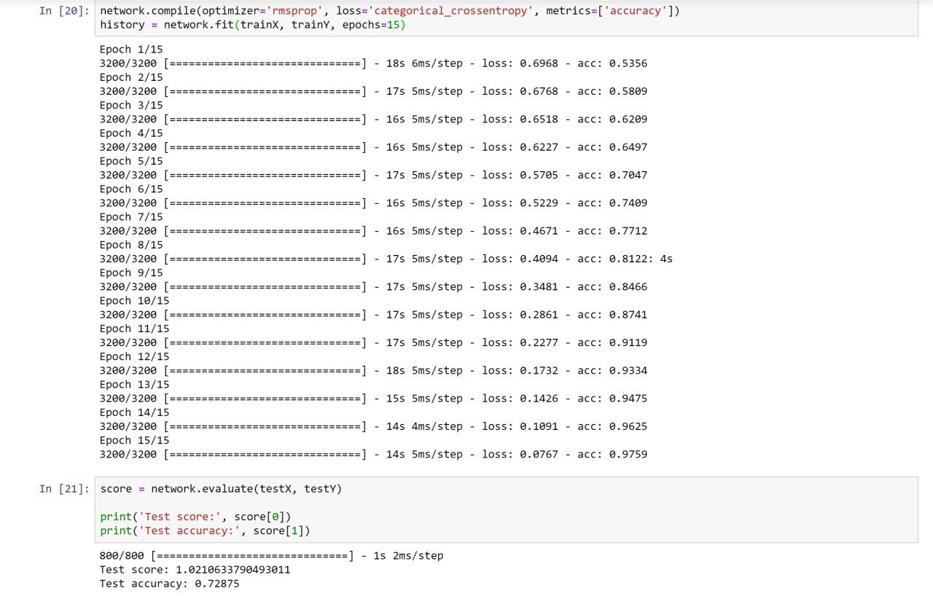
Results on first dataset
LeNet-5 : 72% Test Accuracy

Slide 11
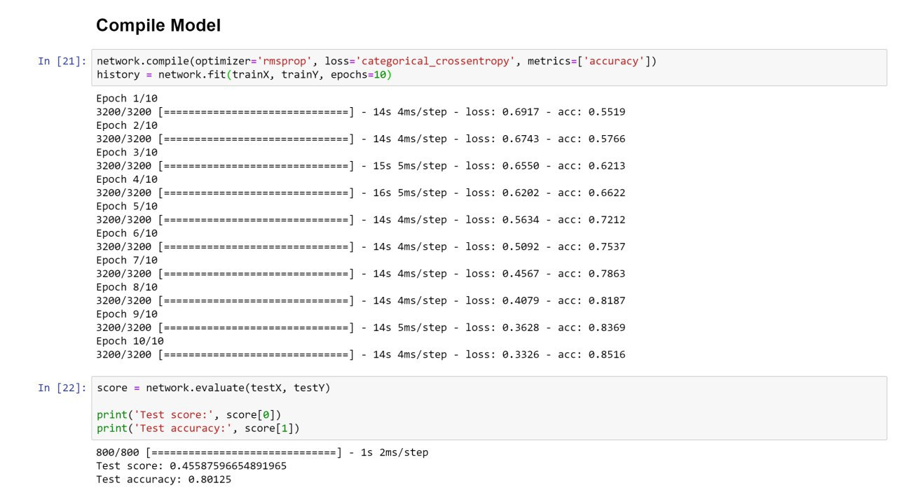
Results on first dataset
Our Arch : 80% Test Accuracy

Slide 12
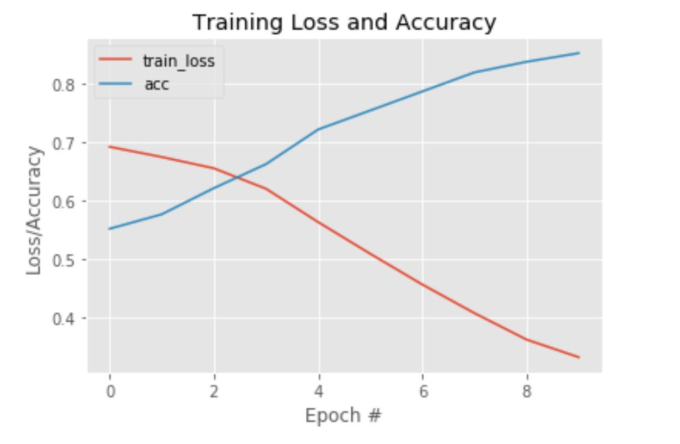
Results on first dataset

Slide 13
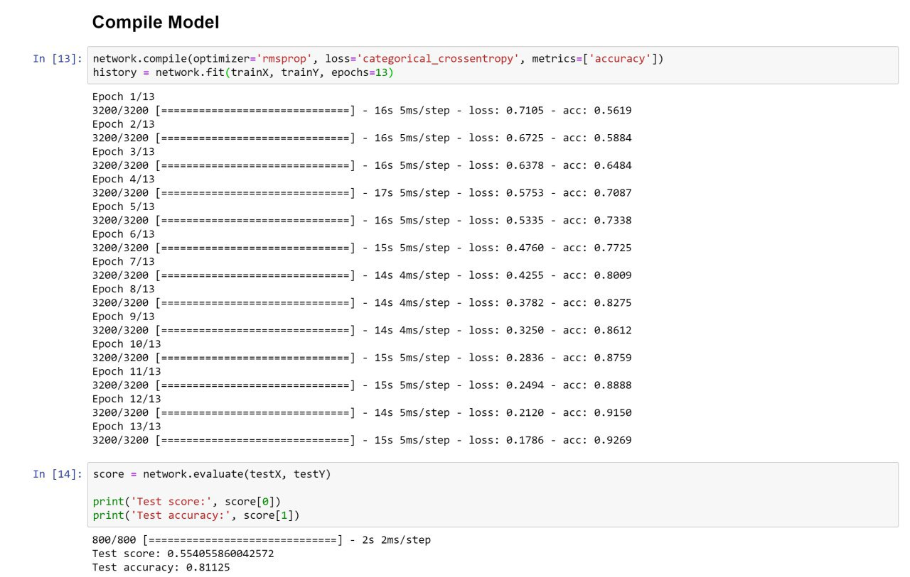
Results on first dataset
RELU + Tanh : 81% Test Accuracy

Slide 14
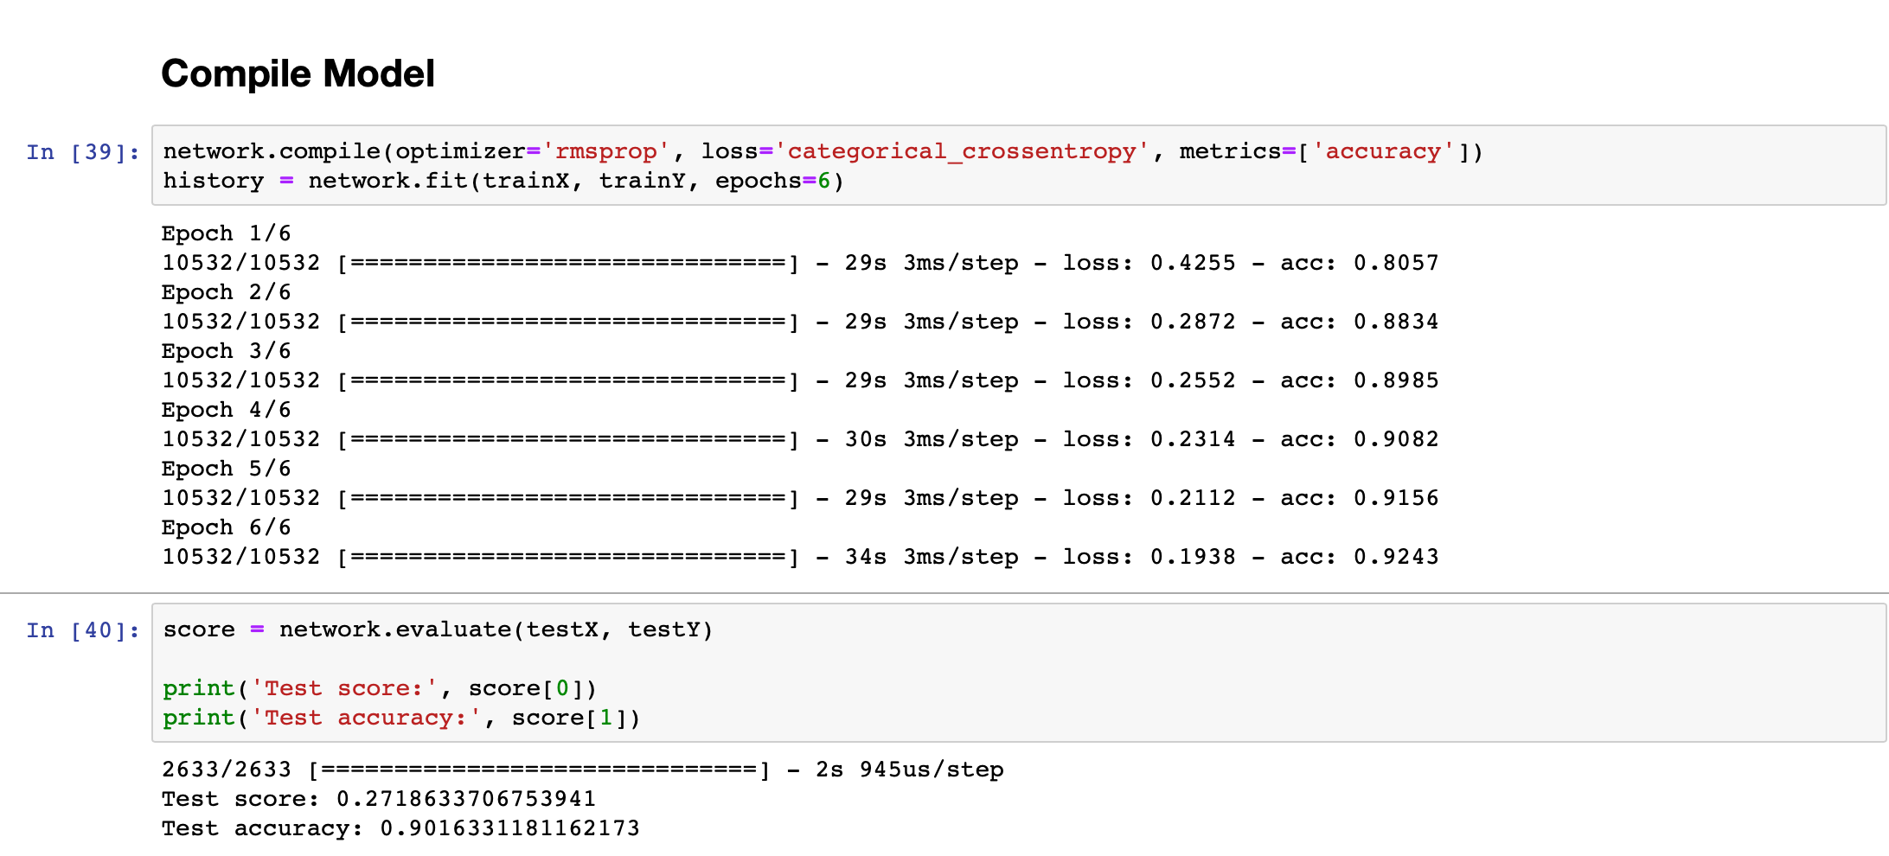
Results on second dataset
LeNet-5 : 90% Test Accuracy

Slide 15
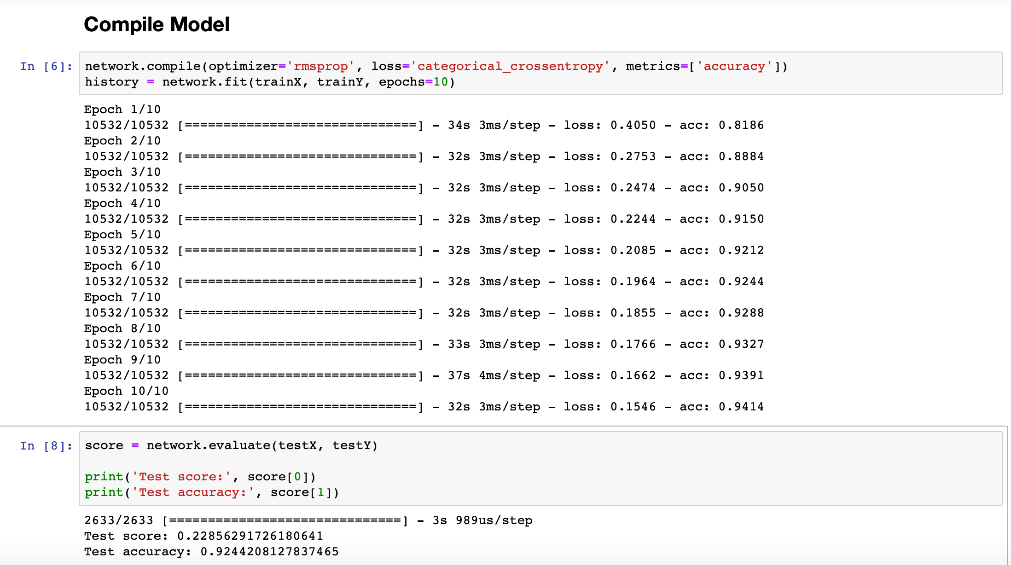
Results on second dataset
Our Arch : 92% Test Accuracy

Slide 16
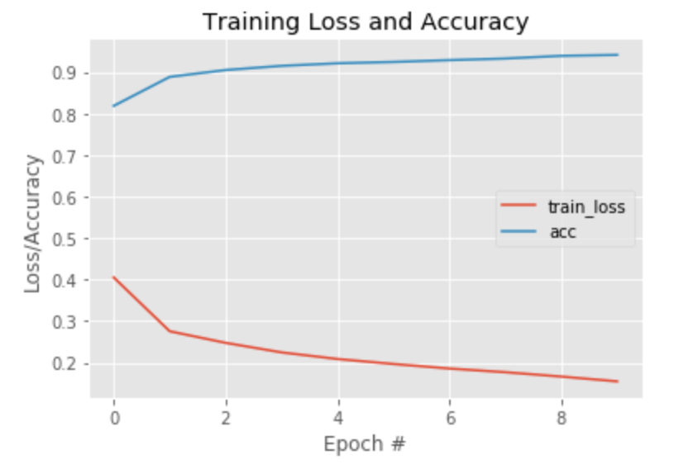
Results on second dataset

Slide 17
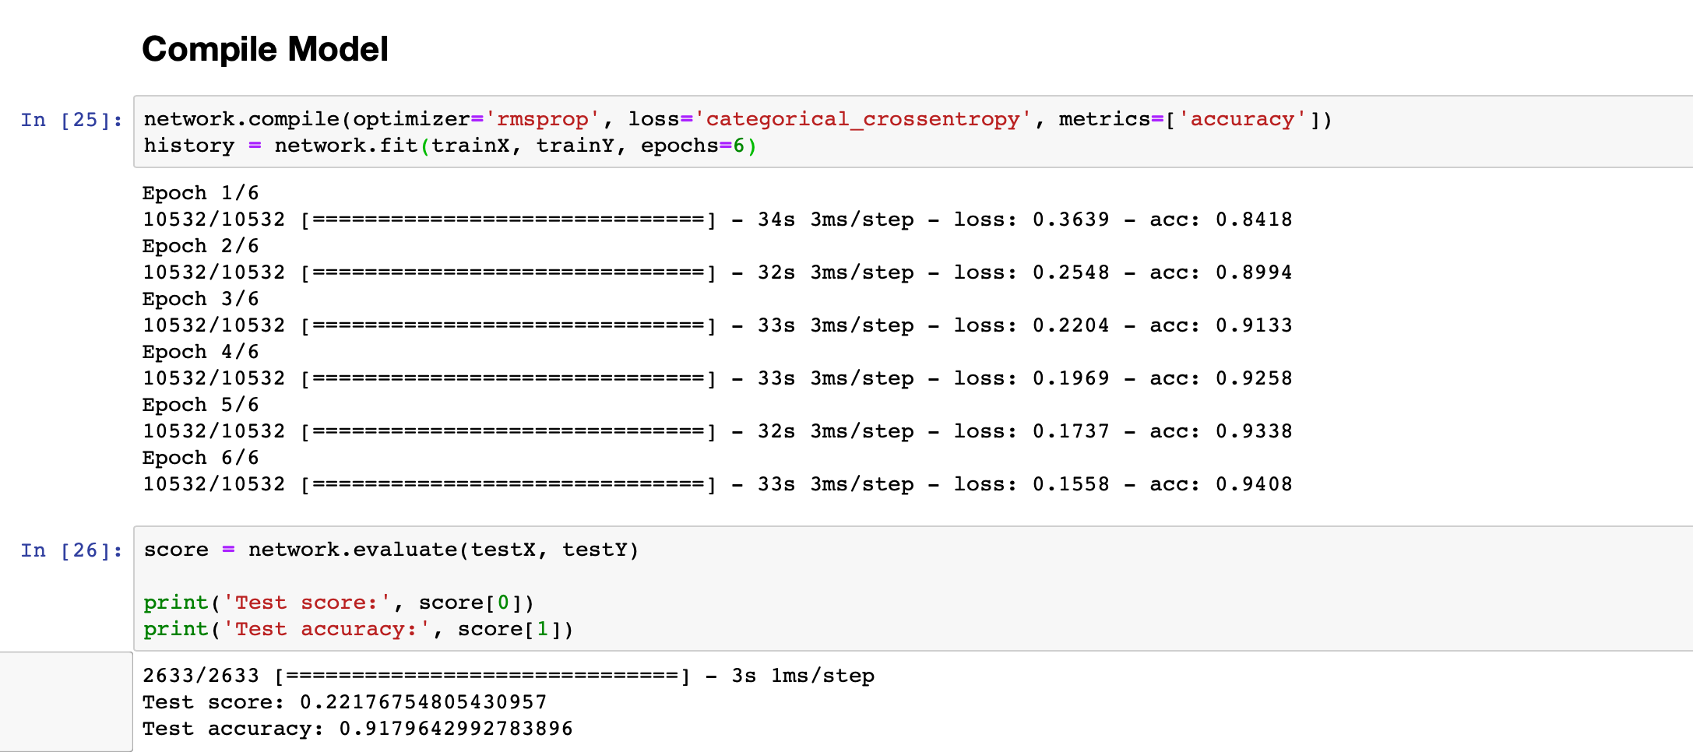
Results on second dataset
RELU + Tanh : 91% Test Accuracy

Slide 18
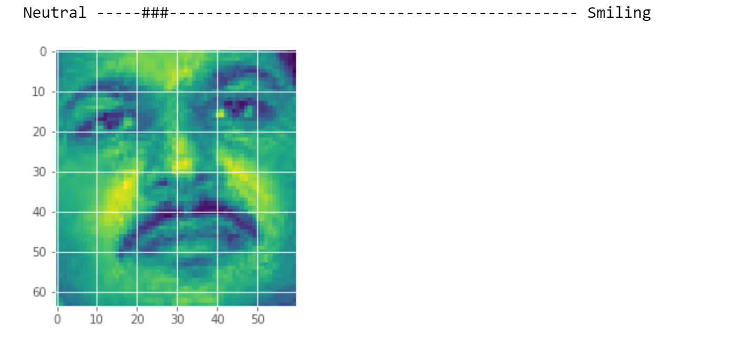
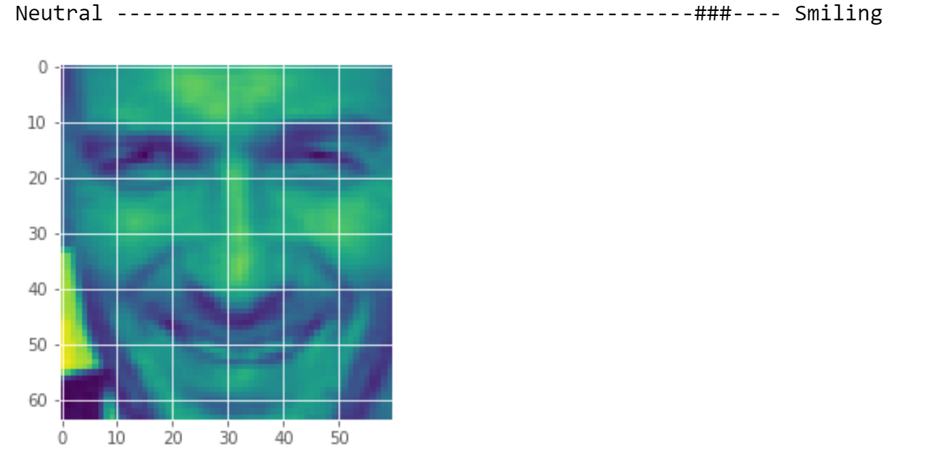
Samples

Slide 19
Thank You for your attention!

