Slide 1
PREDICTING THE ECONOMIC IMPACT OF POST COVID-19 IN SUB-SAHARAN AFRICAN COUNTRIES USING GRADIENT BOOSTING
OGHENEKARO EMMANUELLA AVWERUSUOGHENE
FSC/CSC/01801029
DEPARTMENT OF COMPUTER SCIENCE AND MATHEMATICS

Slide 2
PROJECT BACKGROUND
The outbreak of coronavirus named COVID-19 disrupted the Worlds economy and is spreading globally. Since mid-July 2021, COVID-19 deaths have surged across Africa (Su S, et al, 2016).
To better understand the possible economic consequences, this project uses machine learning model to explore different scenarios of how the economic impact of COVID-19 will evolve in the coming years (Wong G, et al, 2016).

Slide 3
PROBLEM STATEMENT
Based on previous research carried out, we found out that during the covid19, the economic risk of this pandemic was high in the poorer parts of the world (developing countries).
We are going to measure the post economic impact of 19 in developing countries with the aid of pre-pandemic data source using machine learning.

Slide 4
AIMS AND OBJECTIVES
To conduct a critical review on existing literature
To design a model for predicting economic impact of Covid-19 on Sub-Saharan countries.
To predict the impact of Covid-19 on Sub-Saharan countries using Gradient Boosting
To test and validate proposed model with existing ones

Slide 5
SUMMARY OF RELATED WORKS
S/N | Authors | Methods Used | Strength | Weakness | Year
1 | Brandon Buell, Carissa Chen, Reda Cherif, Hyeon-Jae Seo, Jiawen Tang, and Nils Wendt | Elastic net, SVR, random forest, XGBoost, and Voting Regression | In one of the past research work, the researchers Implemented an approach for greater flexibility to generate model predictions without the need to wait for all variables to be updated at month or quarter end | The Researchers posed that Data limitations pose substantial challenges to evaluating economic activity in real-time for countries in SSA. There is no central repository of high frequency data available for SSA countries and available quarterly or annual macroeconomic data is often further constrained by publishing delays. | April 2021

Slide 6
SUMMARY OF RELATED WORKS
S/N | Authors | Methods Used | Strength | Weakness | Year
2 | Abhishek Jaglan,Daksh Trehan, Priyansh Singhal | Dashboard(using Django for the backend and HTML, CSS and JavaScript), K-means statistical clustering analysis, Simple and Polynomial Linear Regression, TF-IDF Vectorization | In one of the past research work, the researchers successfully proposed a display of comprehensive steps taken to implement better prediction and understanding of virus’s spread in form of a dashboard. | The Researchers encountered some challenges when they tried to create similarities between question corpus that they fetched and the queries asked by the user | Dec, 2020

Slide 7
SUMMARY OF RELATED WORKS
S/N | Authors | Methods Used | Strength | Weakness | Year
3 | Samobi Andrew Onovo, Akinyemi Atobatele, Abiye Kalaiwo, Christopher Obanubi, Dolapo Ogundehin, Michele Russell | Supervised Machine Learning and Empirical Bayesian Kriging (EBK) techniques, Lasso regression | In one of the past research work, the researchers identified some variables that were significantly associated with the risk of coronavirus infection. They discussed the factors of coronavirus highlighted in our lasso model under two dimensions – 1.) infectious diseases: HIV, pneumonia, malaria, and diarrhea. 2.) growth rate- time. | The random distribution pattern of the research work about the coronavirus infection as indicated in the researchers study suggests that they cannot control the coronavirus pandemic by targeting interventions to a specific region or country. | May, 2020

Slide 8
SUMMARY OF RELATED WORKS
S/N | Authors | Methods Used | Strength | Weakness | Year
4 | Sina F. Ardabil, Amir Mosavi, Pedram Ghamisi, Filip Ferdinard, Timon Rabezuk, Varkonyi-Koeczy | Logistic, Linear, Quadratic, Cubic, and Exponential Model, Evolutionary Algorithm, Genetic Algorithm, Multi-layered Perceptron (MLP) and Adaptive neuro fuzzy inference system(ANFIS) | In one of the past research work, the researchers presents a comparative analysis of ML models(MLP and ANFIS) reported a high generalization ability for long-term prediction | The researcher encountered some challenges like predicting the maximum number of infected patients of the individual mortality rate. | April, 2020

Slide 9
RESEARCH GAP
What makes this project different from other projects is that, we made use of 5 supervised models to compare and picked the one that performed best in all 3 target variables which was Gradient Boosting
It is able to predict the economic impact of covid 19 in each of the countries used as a case study.

Slide 10
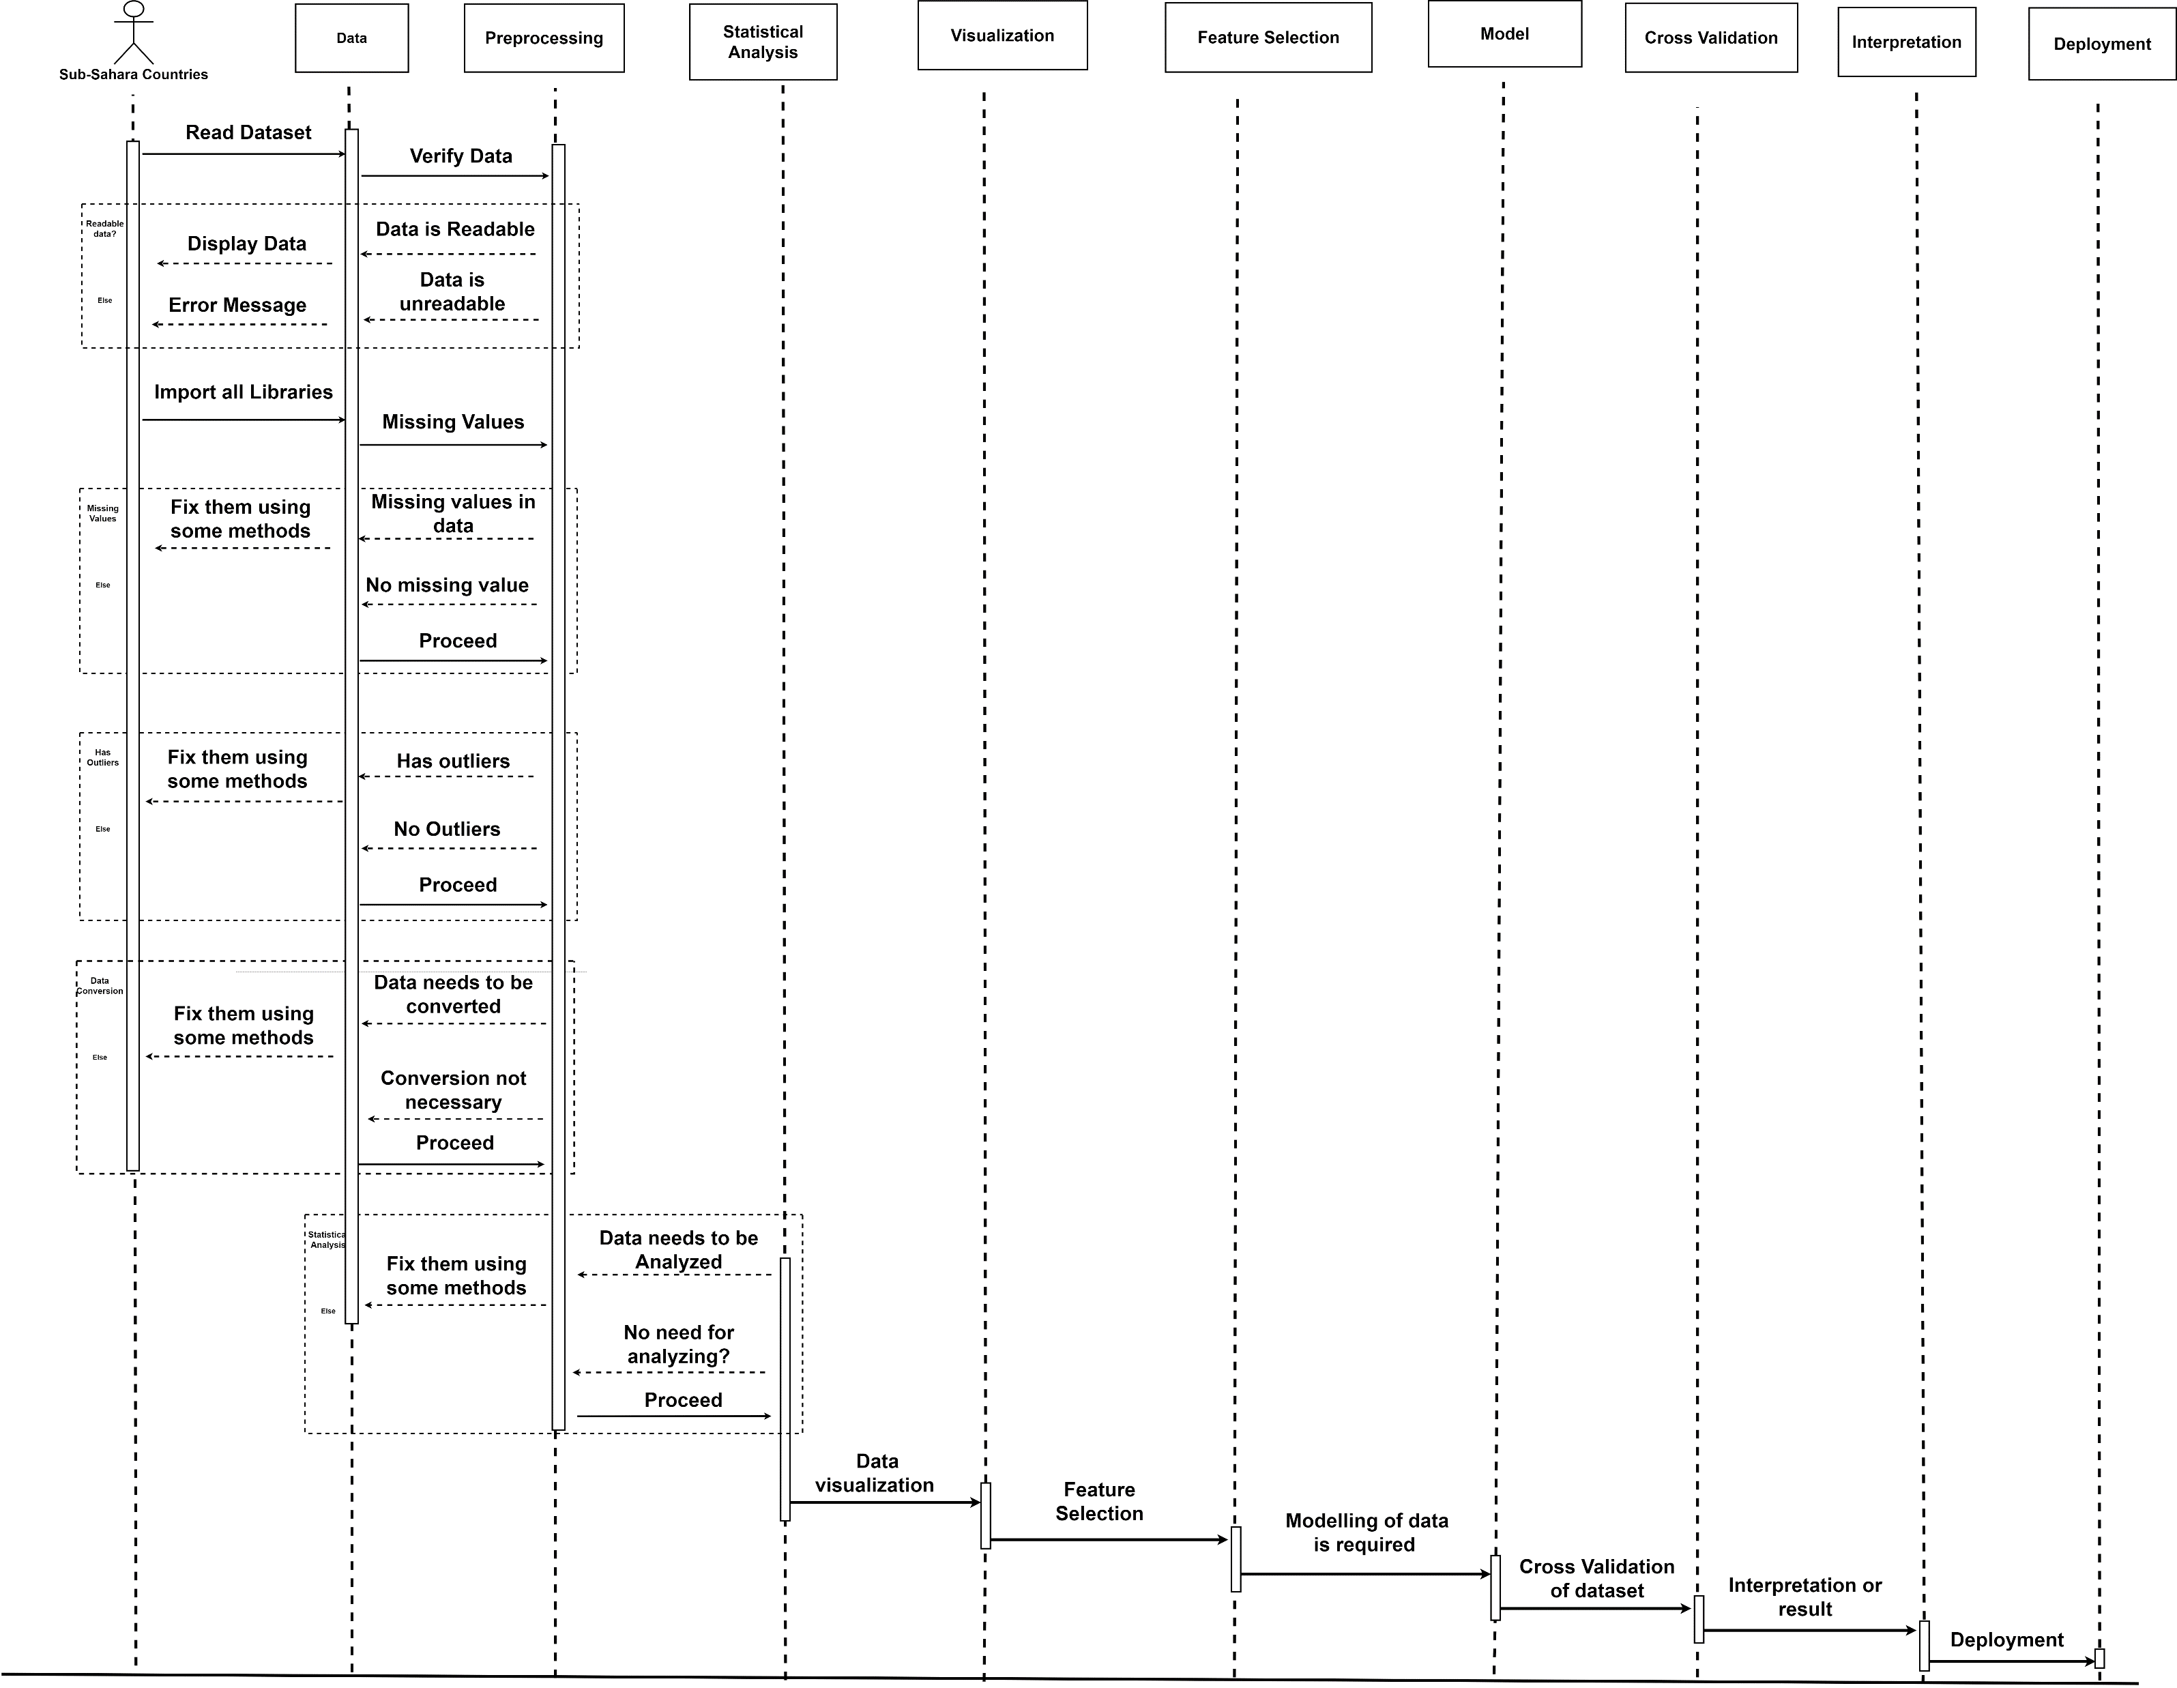
DESIGN AND METHODOLOGY
Figure 1: Proposed Sequence Diagram

Slide 11
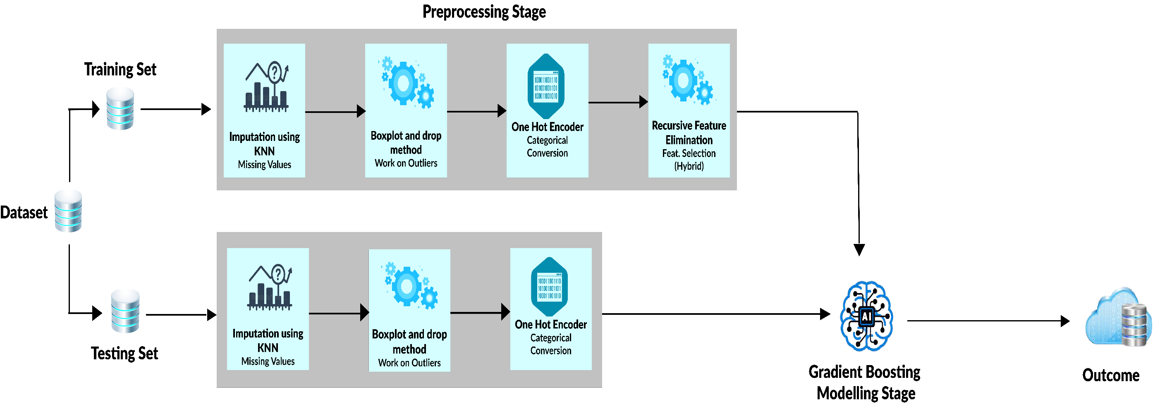
DESIGN AND METHODOLOGY
Figure 2: Proposed Architecture

Slide 12
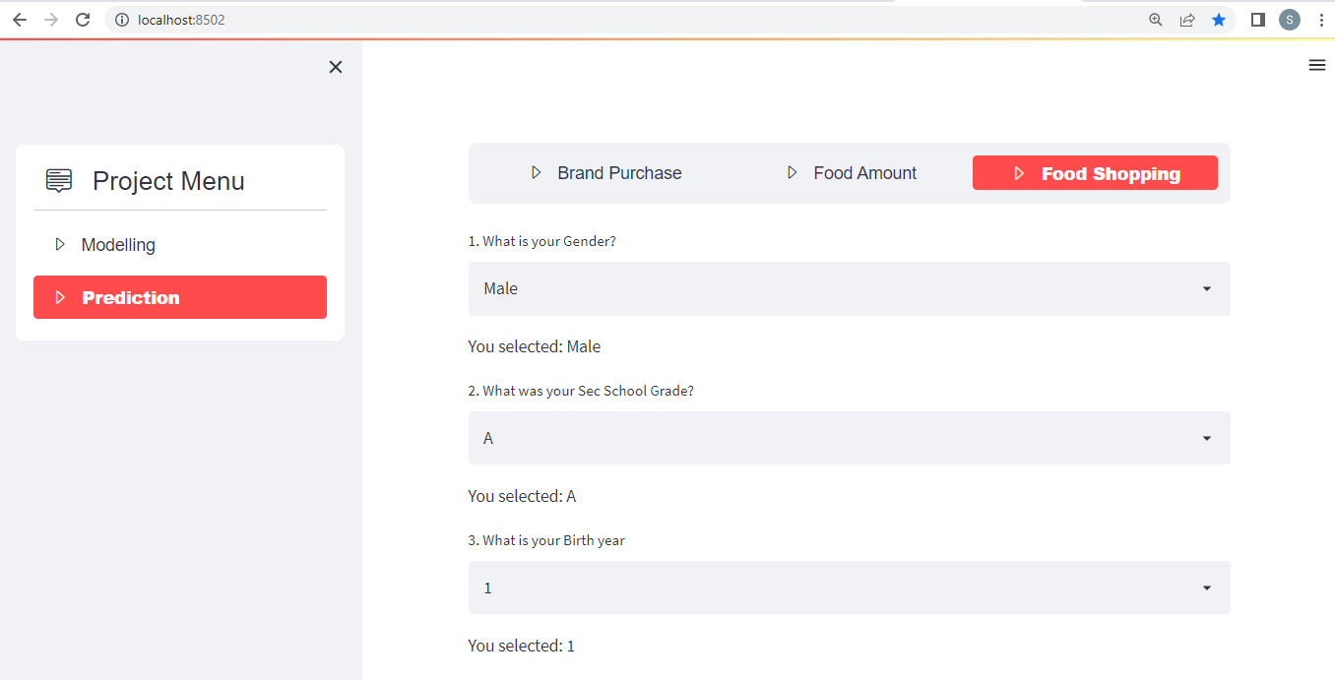
IMPLEMENTATION
Figure 3: System Design

Slide 13
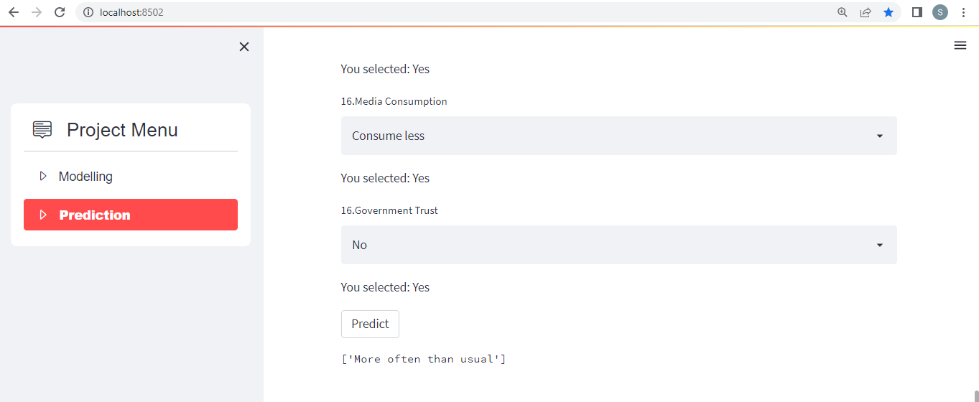
IMPLEMENTATION
Figure 4: System Design 2

Slide 14
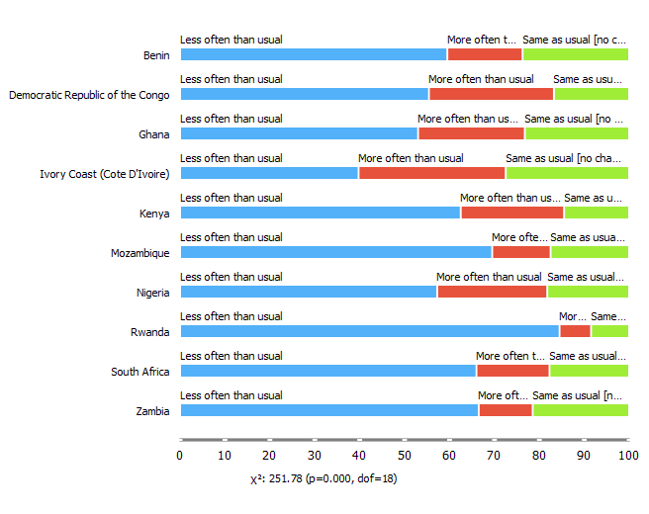
RESULTS
Figure 5: Box plot for Food Shopping

Slide 15
RESULTS
 | Aggregate | Less often than usual | More often than usual | Same as usual [no Total] | Total
Less often than usual | Count Majority | 2449.0 Rwanda | 0.0 ? | 0.0 ? | 2449.0 Rwanda
More often than usual | Count Majority | 0.0 ? | 784.0 Ivory Coast (Cote D’Ivoire) | 0.0 ? | 784.0 Ivory Coast (Cote D’Ivoire)
Same as usual [no change] | Count Majority | 0.0 ? | 0.0 ? | 755.0 Ivory Coast (Cote D’Ivoire) | 755.0 Ivory Coast (Cote D’Ivoire)
Total | Count Majority | 2449.0 Rwanda | 784.0 Ivory Coast (Cote D’Ivoire) | 755.0 Ivory Coast (Cote D’Ivoire) | 3988.0 Benin
Table 1: Pivot Table for Food Shopping

Slide 16
RESULTS
Model | AUC | CA | F1 | Precision | Recall
Tree | 1.000 | 1.000 | 1.000 | 1.000 | 1.000
Random Forest | 1.000 | 1.000 | 1.000 | 1.000 | 1.000
Gradient Boosting | 1.000 | 1.000 | 1.000 | 1.000 | 1.000
AdaBoost | 1.000 | 1.000 | 1.000 | 1.000 | 1.000
SVM | 1.000 | 0.999 | 0.999 | 0.999 | 0.999
KNN | 0.971 | 0.892 | 0.887 | 0.893 | 0.892
Table 2: Evaluation Result for Food Shopping

Slide 17
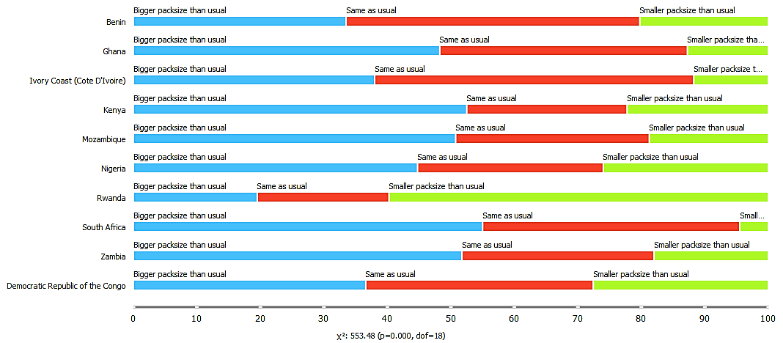
RESULTS
Figure 6: Boxplot for Food Amount

Slide 18
RESULTS
 | Aggregate | Bigger packsize than usual | Same as usual | Smaller packsize than usual | Total
Bigger packsize than usual | Count Majority | 1718.0 South Africa | 0.0 ? | 0.0 ? | 1718.0 South Africa
Same as usual | Count Majority | 0.0 ? | 1387.0 Ivory Coast (Cote D’Ivoire) | 0.0 ? | 1387.0 Ivory Coast (Cote D’Ivoire)
Smaller packsize than usual | Count Majority | 0.0 ? | 0.0 ? | 883.0 Rwanda | 883.0 Rwanda
Total | Count Majority | 1718.0 South Africa | 1387.0 Ivory Coast (Cote D’Ivoire) | 883.0 Rwanda | 3988.0 Benin
Table 3: Pivot Table for Food Amount

Slide 19
RESULTS
Model | AUC | CA | F1 | Precision | Recall
Tree | 1.000 | 1.000 | 1.000 | 1.000 | 1.000
Random Forest | 1.000 | 1.000 | 1.000 | 1.000 | 1.000
Gradient Boosting | 1.000 | 1.000 | 1.000 | 1.000 | 1.000
AdaBoost | 1.000 | 1.000 | 1.000 | 1.000 | 1.000
SVM | 1.000 | 0.999 | 0.999 | 0.999 | 0.999
KNN | 0.967 | 0.900 | 0.899 | 0.899 | 0.900
Table 4: Evaluation Result for Food Amount

Slide 20
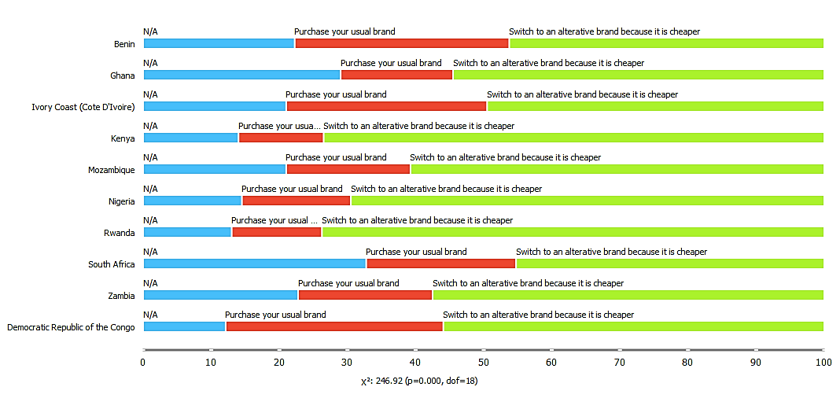
RESULTS
Figure 7: Boxplot for Brand Purchase

Slide 21
RESULTS
 | Aggregate | N / A | Purchase your usual brands | Switch to an alternative brand | Total
N / A | Count Majority | 808.0 South Africa | 0.0 ? | 0.0 ? | 808.0 South Africa
Purchase your usual brands | Count Majority | 0.0 ? | 841.0 Benin | 0.0 ? | 841.0 Benin
Switch to an alternative brand | Count Majority | 0.0 ? | 0.0 ? | 2339.0 Rwanda | 2339.0 Rwanda
Total | Count Majority | 808.0 South Africa | 841.0 Benin | 2339.0 Rwanda | 3988.0 Benin
Table 5: Evaluation Result for Brand Purchase

Slide 22
RESULTS
Model | AUC | CA | F1 | Precision | Recall
Tree | 0.611 | 0.694 | 0.701 | 0.709 | 0.694
Random Forest | 0.704 | 0.762 | 0.718 | 0.715 | 0.762
Gradient Boosting | 0.760 | 0.788 | 0.741 | 0.763 | 0.788
AdaBoost | 0.589 | 0.691 | 0.695 | 0.699 | 0.691
SVM | 0.590 | 0.585 | 0.612 | 0.665 | 0.585
kNN | 0.622 | 0.749 | 0.712 | 0.701 | 0.749
Table 6: Evaluation Result for Brand Purchase

Slide 23
SUMMARY
In this section, we sum up what we have done so far by analyzing the dataset, the proposed framework and its effect on the issue space, the cycles we went through to accomplish the outcomes, imperatives, as well as suggestions to empower further work on this project.

Slide 24
CONCLUSION
It is proven that the computer through artificial intelligence can outperform humans in most rudimentary processes. We leveraged machine learning to build a system that would enable countries in sub-Saharan Africa to predict the economic impact of covid. This will go a long way for countries in that region to be able to manage the country’s economy.

Slide 25
REFERENCES
Coronavirus COVID-19 global cases by the Center for Systems Science and Engineering (CSSE) at Johns Hopkins University (JHU) [May;2020]; Available https://coronavirus.jhu.edu/map.html 2020
Su S, Wong G, Shi W, et al. Epidemiology, genetic recombination, and pathogenesis of coronaviruses. Trends Microbiology. 2016;6:490–502. doi:10.1016/j.tim.2016.03.003. [Cross-ref], [Google Scholar]
Buell, B., Chen, C., Cherif, R., Tang, J., & Wendt, N. (2021). Impact of COVID-19: Nowcasting and Big Data to Track Economic Activity in Sub-Saharan Africa, IMF Working Papers, 2021(124), A001. Retrieved Dec 14, 2021, from https://www.elibrary.imf.org/view/journals/001/2021/124/article-A001-en.xml
Wang N, Shi X, Jiang L, et al. Structure of MERS-CoV spike receptor-binding domain complexed with human receptor DPP4. Cell Res. 2013;23:986–993. doi:10.1038/cr.2013.92. [Cross-ref], [Web of Science ®], [Google Scholar]

Slide 26
REFERENCES
Baker, S. R., Bloom, N., Davis, S. J., & Terry, S. J. (2020). COVID-Induced Economic Uncertainty (Working Paper No. 26983; Working Paper Series). National Bureau of Economic Research. https://doi.org/10.3386/w26983
Susan Athey, 2018. "The Impact of Machine Learning on Economics," NBER Chapters, in: The Economics of Artificial Intelligence: An Agenda, pages 507-547, National Bureau of Economic Research, Inc. https://ideas.repec.org/h/nbr/nberch/14009.html.
Samobi Andrew Onovo, Akinyemi Atobatele, Abiye Kalaiwo, Christopher Obanubi, , et al. Structure of MERS-CoV spike receptor-binding domain complexed with human receptor DPP4. https://www.medrxiv.org/content/10.1101/2020.04.27.20082057v1.full.pdf
Buell, B., Chen, C., Cherif, R., Tang, J., & Wendt, N. (2021). Impact of COVID-19: Nowcasting and Big Data to Track Economic Activity in Sub-Saharan Africa, IMF Working Papers, 2021(124), A001. Retrieved Dec 14, 2021, from https://www.elibrary.imf.org/view/journals/001/2021/124/article-A001-en.xml

Slide 27

Thank You!

