Slide 1



Basics to get started with the tutorial
Tuesday 16th November 2020

Slide 2
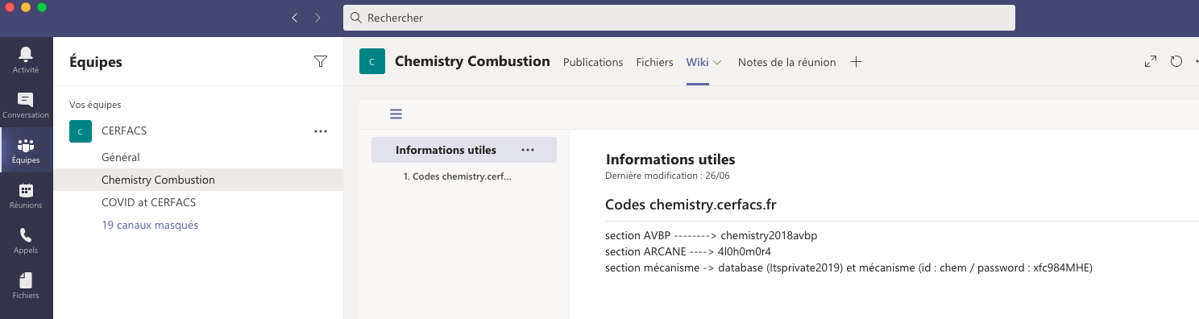
A word about website and password
To retrieve password on the website, you should go on the teams of chemistry combustion !
Notes:
----- Notes de la réunion (12/11/2014 12:11) -----
CA can perform 0D simulation so equ cal & time evol of closed and open reactors
It can also perform STEADY 1D simulations, mostly premixed configurations but a counterflow diffusion flame model is also implemented
recently it also became possible to add surface ..

Slide 3
Installing CANTERA
The procedure is written on the website.
Two solutions :
Either you work with your computer, then git clone the sources and run the install_cantera.py.
Or you work with NFS, module load cantera should be sufficient.
Notes:
----- Notes de la réunion (12/11/2014 12:11) -----
CA can perform 0D simulation so equ cal & time evol of closed and open reactors
It can also perform STEADY 1D simulations, mostly premixed configurations but a counterflow diffusion flame model is also implemented
recently it also became possible to add surface ..

Slide 4
How to work with jupyter notebook (2)
Jupyter python notebook works just like python script, but are more suitable for visualization.
If you are on your mac, maybe you have to type :
Notes:
----- Notes de la réunion (12/11/2014 12:11) -----
CA can perform 0D simulation so equ cal & time evol of closed and open reactors
It can also perform STEADY 1D simulations, mostly premixed configurations but a counterflow diffusion flame model is also implemented
recently it also became possible to add surface ..

Slide 5
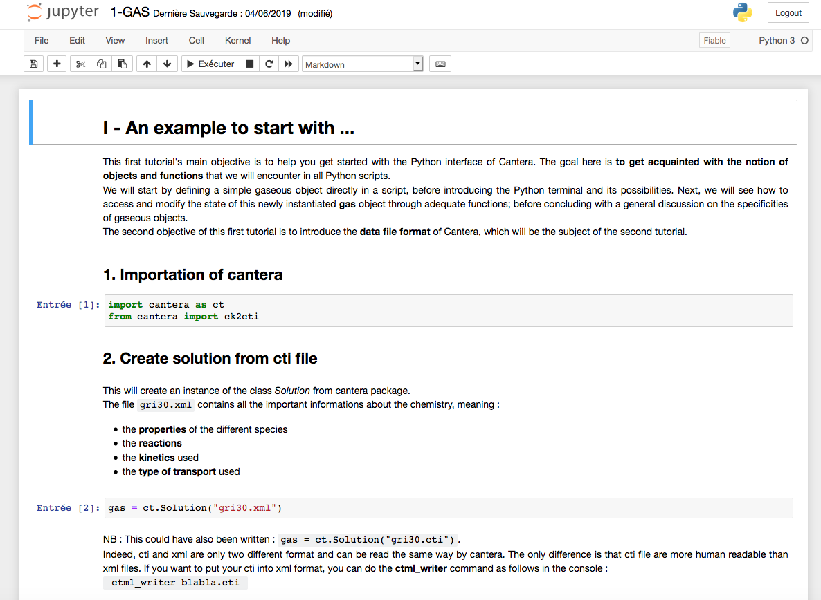
How to work with jupyter notebook
It will open a kernel. Then, a page on your browser will open :
Notes:
----- Notes de la réunion (12/11/2014 12:11) -----
CA can perform 0D simulation so equ cal & time evol of closed and open reactors
It can also perform STEADY 1D simulations, mostly premixed configurations but a counterflow diffusion flame model is also implemented
recently it also became possible to add surface ..

Slide 6
How to work with jupyter notebook
There you can launch all the script
This launches a cell of the script
This is a markdown cell
This is a code cell
Notes:
----- Notes de la réunion (12/11/2014 12:11) -----
CA can perform 0D simulation so equ cal & time evol of closed and open reactors
It can also perform STEADY 1D simulations, mostly premixed configurations but a counterflow diffusion flame model is also implemented
recently it also became possible to add surface ..

Slide 7
Comments
If you have some comments/feedbacks, do not hesitate to tell us !
Notes:
----- Notes de la réunion (12/11/2014 12:11) -----
CA can perform 0D simulation so equ cal & time evol of closed and open reactors
It can also perform STEADY 1D simulations, mostly premixed configurations but a counterflow diffusion flame model is also implemented
recently it also became possible to add surface ..

