Slide 1
Randomized attack
Main idea:
Simplified version of square-attack based on randomized search
Randomly choose k features to do the perturbation
Improvement: use shap values as probability distribution when choosing features

Slide 2
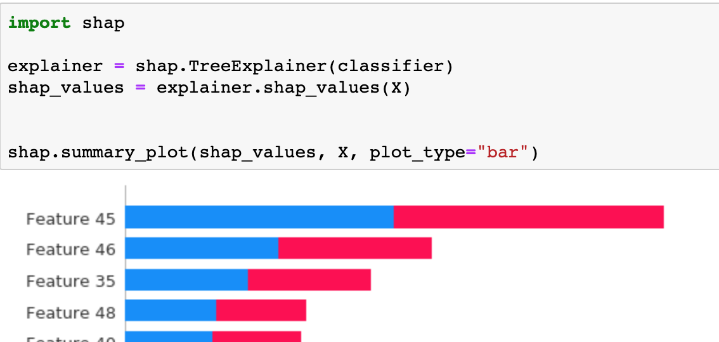
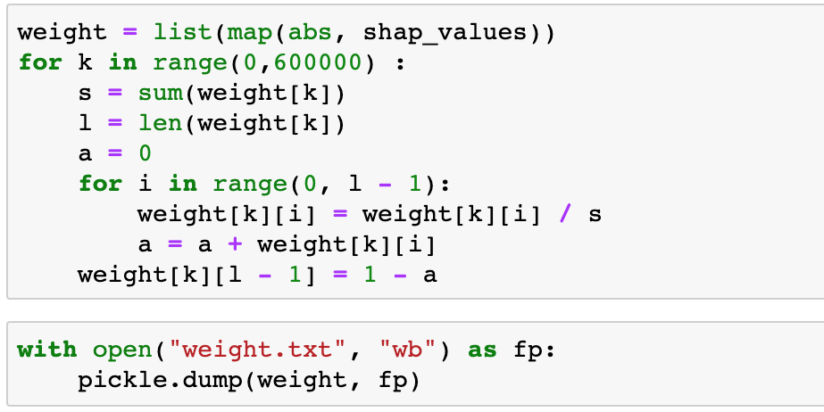
Step 1
Use the scaled shap value from random forest classifier as the weight for each feature, so that the features with greater importance are more likely to be selected.

Slide 3
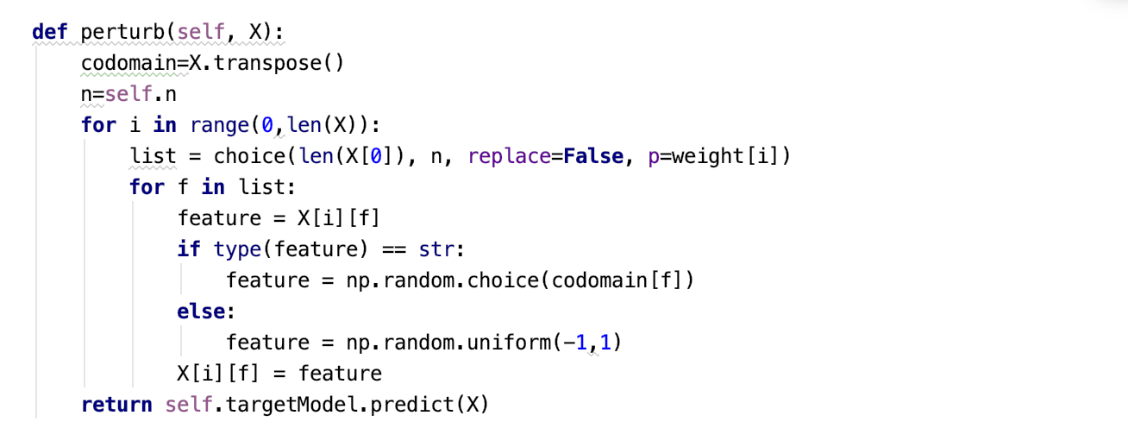
Step 2: Main part of the Randomized

Slide 4
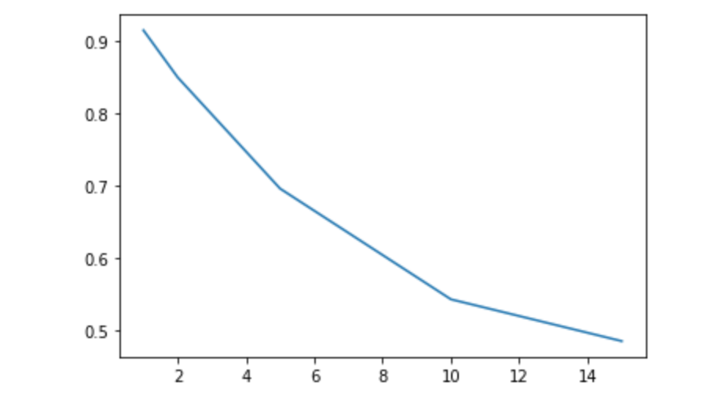
Step 3
Try randomized approach with different number of features to alter
k=[1, 2, 5, 10, 15] with
Auc=[0.915,0.850,0.696,0.546,0.486]

