Slide 1

INSPECT & UPSELL
The new frontier of automated sales
Notes:
Good morning everyone we are Team Inspect and upsell and we are here to present you the new frontier of automated Sales

Slide 2
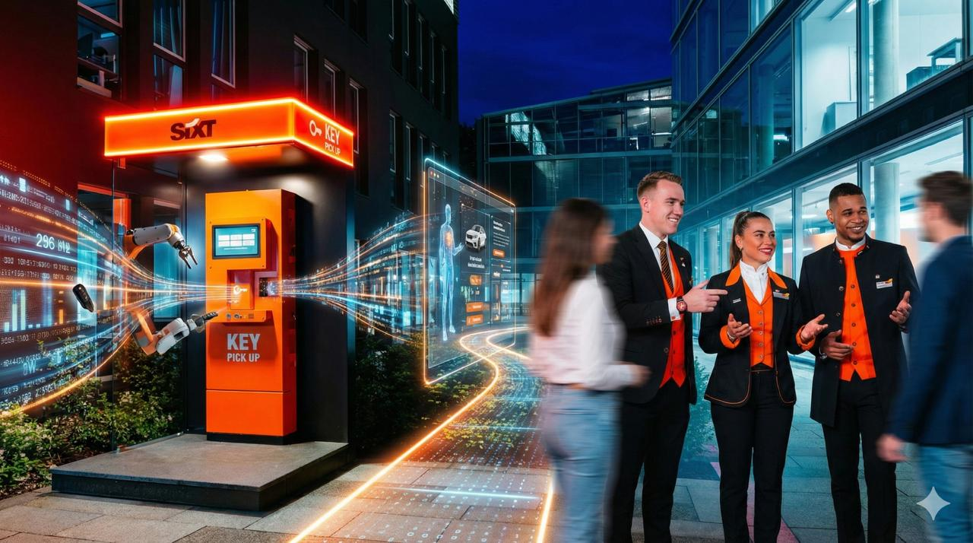
Notes:
SIXT automated key pickup, making it faster and cheaper. However, the absence of salespersons caused a direct revenue gap.

Slide 3


WHY?
TRUST INCREASES CONVERSION (WARMTH-COMPETENCE)
MORE ATTRACTIVE SALESPERSON MORE SALES
BUYING DECISIONS ARE NOT FULLY RATIONAL,
BUT EMOTIONAL
Notes:
Humans sell better because they read cues, build rapport, and adapt recommendations. Upselling is not rational—it's emotional. No flat UI can replicate this.
At the same time buying is not a rationale behaviour. For example we tend to spend more if the selling person is more attractive. That is why we believe that the optimal approach to this task is to keep it as close to what it is as possible.

Slide 4
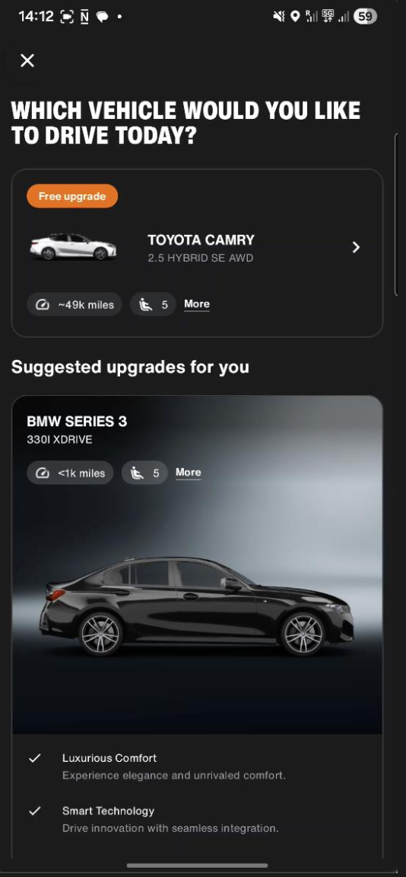
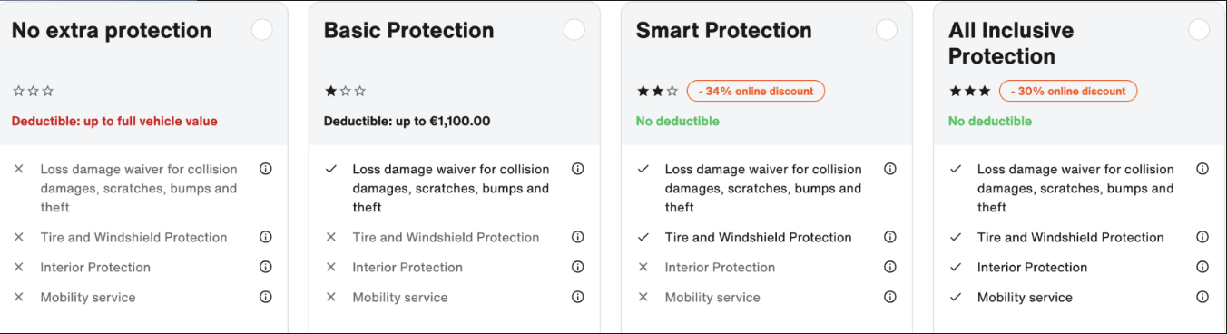
NOT ENOUGH
Notes:
Humans sell better because they read cues, build rapport, and adapt recommendations. Upselling is not rational—it's emotional. No flat UI can replicate this.
At the same time buying is not a rationale behaviour. For example we tend to spend more if the selling person is more attractive. That is why we believe that the optimal approach to this task is to keep it as close to what it is as possible.

Slide 5
HOW?
Notes:
Our goal: restore the persuasive power of a human salesperson, without changing the automated process or adding human labor.

Slide 6
HOW?
EMOTIONS
Notes:
Our goal: restore the persuasive power of a human salesperson, without changing the automated process or adding human labor.

Slide 7
HOW?
EMOTIONS
SEEING
SPEAKING
HEARING
Notes:
Our goal: restore the persuasive power of a human salesperson, without changing the automated process or adding human labor.

Slide 8
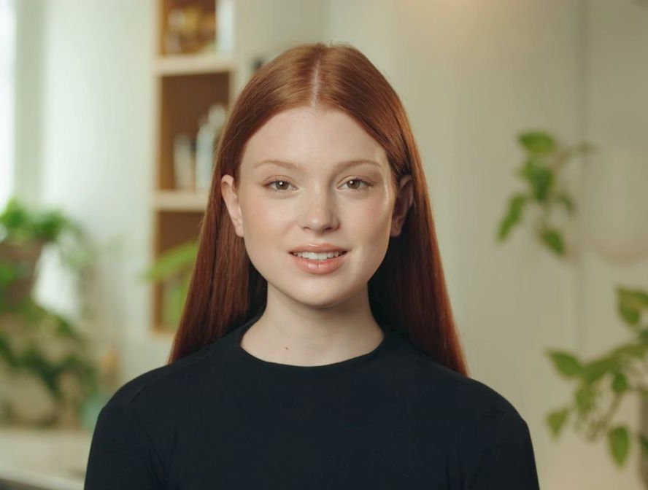
HOW?
EMOTIONS
SEEING
SPEAKING
HEARING
Notes:
Our goal: restore the persuasive power of a human salesperson, without changing the automated process or adding human labor.

Slide 9
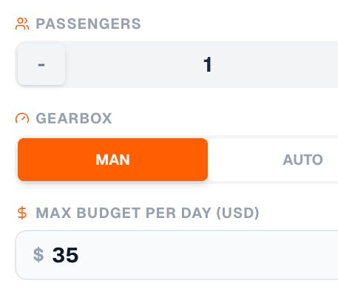
HOW?
GATHER EXTRA INFORMATION AT BOOKING
AIM: 130% BUDGET
Notes:
Our goal: restore the persuasive power of a human salesperson, without changing the automated process or adding human labor.

Slide 10

HOW?
GATHER EXTRA INFORMATION AT BOOKING
EXPLOIT SENTIMENT ANALYSIS
AIM: 130% BUDGET
Notes:
Our goal: restore the persuasive power of a human salesperson, without changing the automated process or adding human labor.

Slide 11
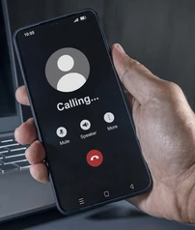
HOW?
GATHER EXTRA INFORMATION AT BOOKING
EXPLOIT SENTIMENT ANALYSIS
HUMAN ASSISTANT IF NEEDED
AIM: 130% BUDGET
Notes:
Our goal: restore the persuasive power of a human salesperson, without changing the automated process or adding human labor.

Slide 12
OUR SOLUTION
LIVE DEMO
Notes:
So we built a digital sales agent—a conversational avatar that replicates the natural sales moment. It talks, listens, personalizes offers, and rebuilds trust inside the automated workflow.

Slide 13
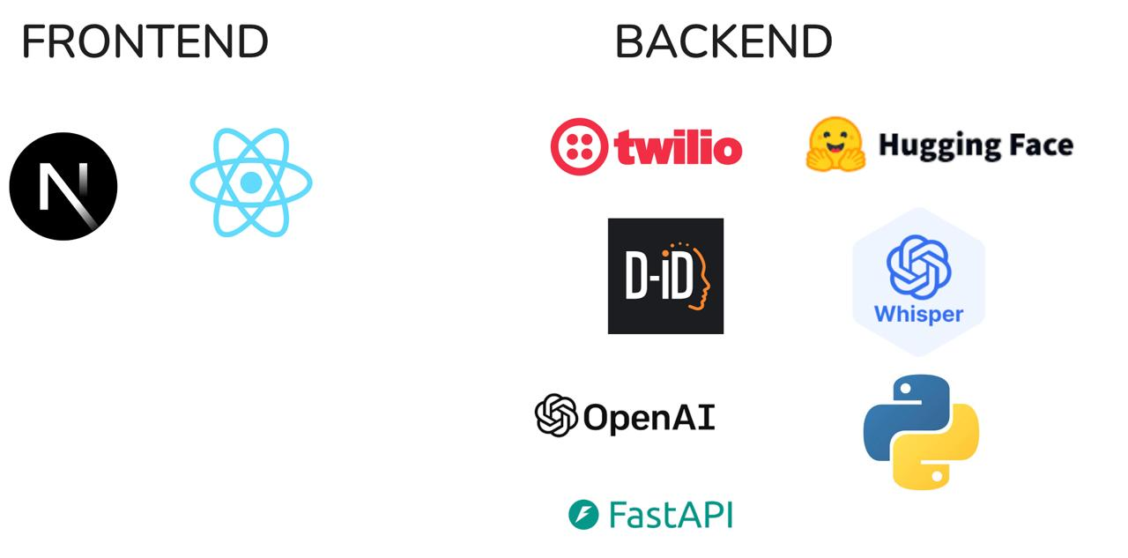
OUR SOLUTION
Notes:
So we built a digital sales agent—a conversational avatar that replicates the natural sales moment. It talks, listens, personalizes offers, and rebuilds trust inside the automated workflow.

Slide 14
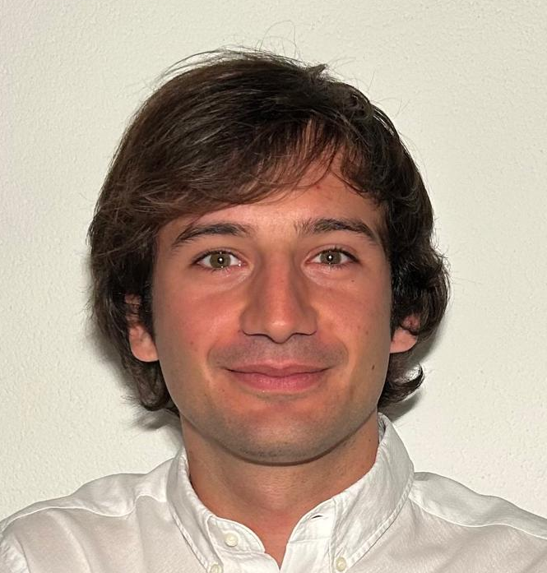

Thank you!
Mauro Leidi
PHD Student (EPFL alumni)
The Sense Research Center
Gioele Monopoli
Machine Learning Engineer (EPFL alumni)
German Aerospace Center (DLR)

