Slide 1


THE AI RUNTIME - BOSTON | JUNE 16, 2026
OPERATING MODEL
AI as a Teammate
Driving double-digit engineering productivity gains
Nirmal Kumar Jingar
Sr. Engineering Leader, Wayfair
Board Member
Author | Speaker
The shift is not from human to machine.
It is from isolated tools to accountable collaboration.
The AI Runtime - Boston
01
Notes:
Main message: Set up the talk as an operating-model discussion, not another tooling demo. Speaker notes: Open by saying: We have all seen AI write code. That is not the interesting part anymore. The interesting question is whether AI can participate in the way engineering teams think, decide, review, document, and operate systems. I will use production-oriented lessons and a framework called The AI Teammate Operating Model. No confidential company data will be used; examples are generalized from enterprise engineering contexts.

Slide 2

OPENING HOOK
The hidden bottleneck is not typing code.
AI can make a developer faster
and still make the team slower.
Non-obvious lesson: AI creates value only when it shortens the path from intent to safe production.
Local speed only becomes productivity when the whole value stream absorbs it: review, tests, release, operations, and learning.
IDEA
DESIGN
CODE
REVIEW
TEST
DEPLOY
OPERATE
+ speed
new queue
new queue
The AI Runtime - Boston
02
Notes:
Main message: AI productivity is a system-flow problem, not just a code-generation problem. Speaker notes: imagine an engineer generating a clean-looking pull request in twenty minutes, but the reviewer spends two days reconstructing intent, assumptions, and risk. The typing was faster; the system was not. This is why leaders should not ask only how much code AI generated. Ask where the queue moved. The first non-obvious idea: AI productivity is a value-stream property, not an individual activity property.

Slide 3
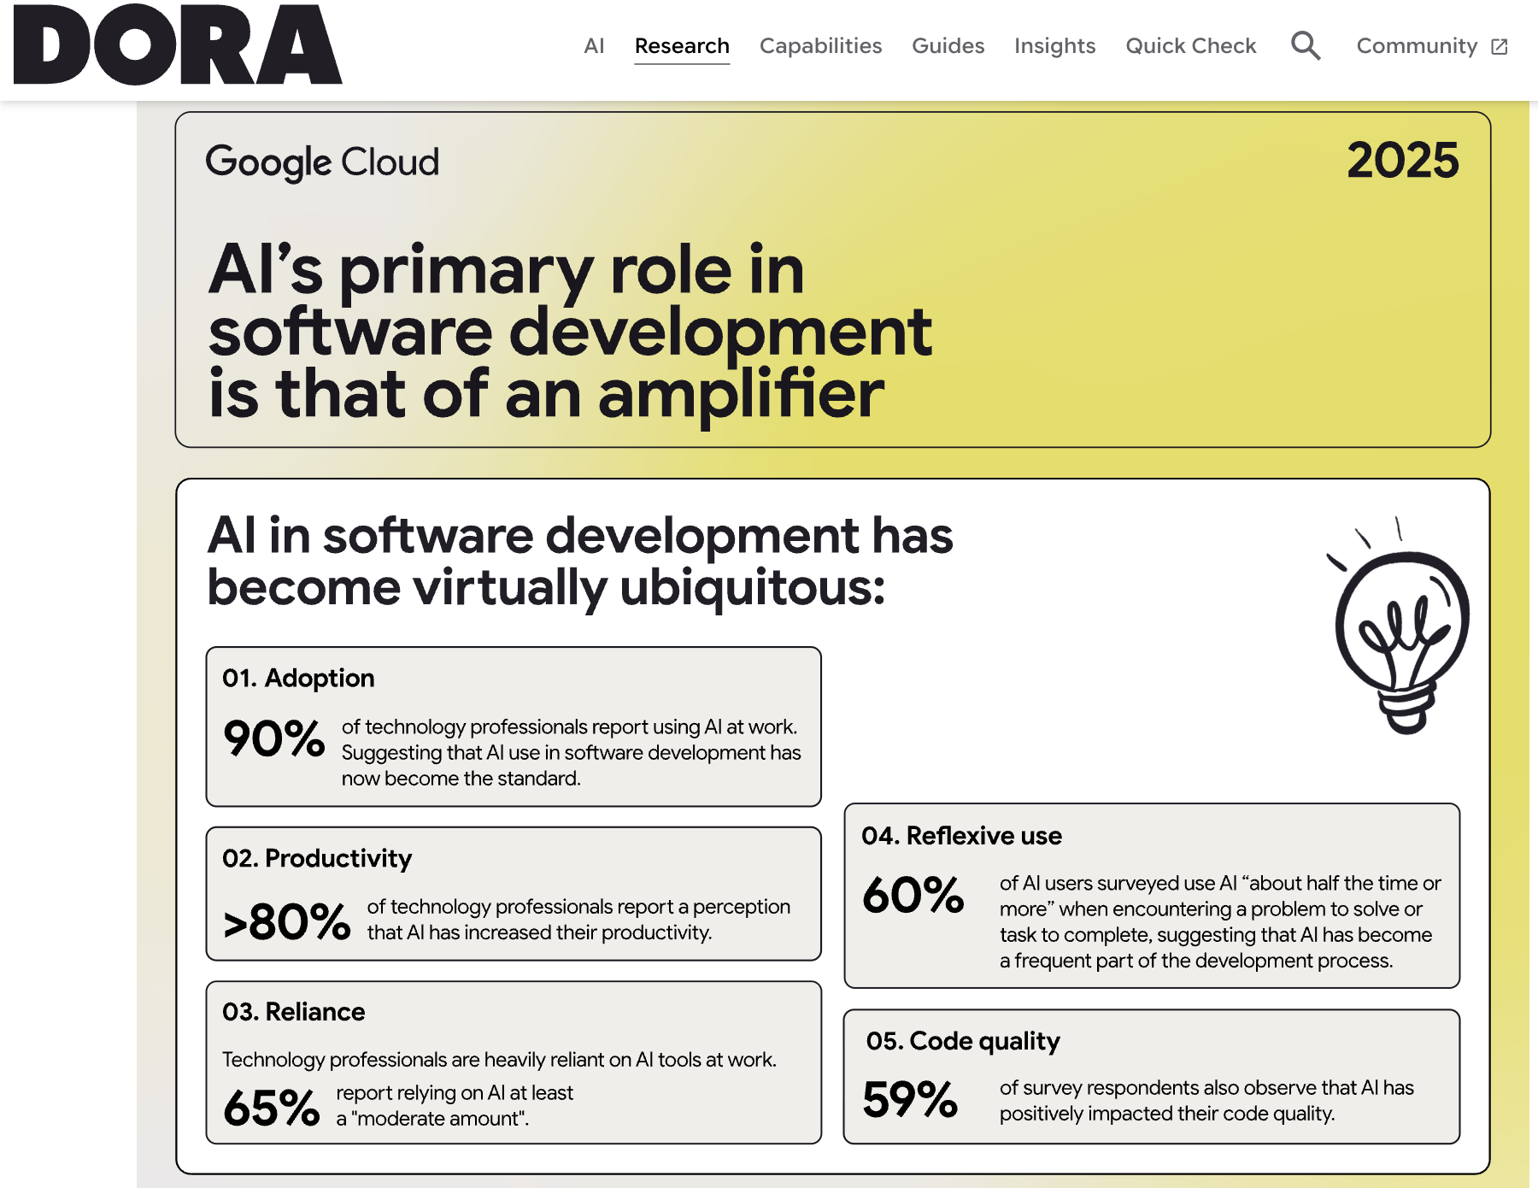

Slide 4
EVIDENCE WITHOUT HYPE
The evidence says AI is real - and uneven.
The measurable gains appear when AI changes the workflow around the developer.
55.8%
AI is an
amplifier
Measure
SPACE + DORA
faster completion in one controlled coding task with Copilot
It magnifies strengths in strong systems - and dysfunction in weak ones.
One metric will lie. A balanced metric set keeps speed honest.
Useful signal - not a universal ROI guarantee.
Tool adoption gives local lift.
Operating-model adoption converts it into sustained team throughput.
Evidence anchors: GitHub/Microsoft Research, DORA 2025, SPACE Framework. Numbers should be validated in your environment.
The AI Runtime - Boston
03
Notes:
Main message: AI productivity gains are credible but highly dependent on the system of work. Speaker notes: The Copilot controlled experiment is useful because it proves there can be a substantial time gain on a bounded task. But it was one task in one context. DORA 2025 gives the broader leadership message: AI is an amplifier. The same tool can help a strong team and expose a weak one. SPACE reminds us that developer productivity cannot be reduced to one metric like lines of code, commits, or PR count. These three points set up the operating model.

Slide 5
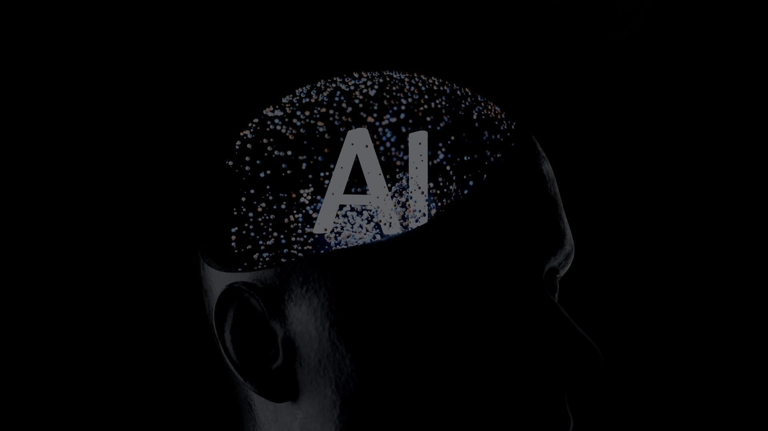
FRAMEWORK
The AI Teammate Operating Model
Five contracts turn AI from a helpful sidecar into a disciplined participant in engineering work.
1
Context
contract
5
Governance
contract
2
Work
contract
AI
Teammate
4
Learning
contract
3
Verification
contract
The model is deliberately not a list of tools.
It defines decision rights, context, evidence, feedback, and risk controls.
The AI Runtime - Boston
04
Notes:
Main message: AI becomes a teammate when five operating contracts are explicit. Speaker notes: Introduce the framework. A teammate is not just someone who does tasks. A teammate knows the context, understands the work agreement, produces evidence, learns from outcomes, and operates within governance. The five contracts are: context contract, work contract, verification contract, learning contract, and governance contract. The rest of the talk explains the contracts and how they create measurable productivity without sacrificing quality. Sources / evidence anchors: Internal operating model synthesis; no confidential company data included.

Slide 6
CONTRACT 1 - CONTEXT
Context engineering is the new compiler.
Prompts are requests. Context is the build system that makes the answer safe, relevant, and reviewable.
Current task
acceptance criteria, edge cases, constraints
Decision history
ADRs, tradeoffs, prior incidents
Business rules
policies, compliance, domain language
AI output
with assumptions
Context Pack
Runtime truth
logs, metrics, traces, alerts
Architecture map
dependencies, ownership, APIs
Codebase patterns
style, tests, naming, examples
What most teams miss:
AI quality is bounded by the context you package, not the cleverness of the prompt.
The AI Runtime - Boston
05
Notes:
Main message: Prompt quality matters, but sustained productivity comes from reusable context packs. Speaker notes: Most teams over-invest in prompt tips and under-invest in context architecture. The model quality is bounded by what it can see: current task, decision history, business rules, runtime evidence, architecture, and codebase patterns. A context pack can be a lightweight artifact: links to relevant files, API contracts, service owners, recent incidents, acceptance criteria, constraints, and test commands. The key is that context becomes reusable, versioned, and reviewable.

Slide 7
CONTRACT 3 - VERIFICATION
The output is not the code. It is the evidence packet.
Review gets faster when AI packages intent, assumptions, test proof, risk hotspots, and rollback guidance with the diff.
Pull Request
Evidence Packet
Intent
Why this change exists
Assumptions
What must be true
Tests
What proved it works
Risk map
Where reviewers focus
Rollback
How to unwind safely
Docs
What future readers need
Review changes from: "Do I trust this blob?"
To: "Does the evidence support the change?"
The AI Runtime - Boston
07
Notes:
Main message: AI should reduce review burden by producing evidence, not just more code. Speaker notes: This is one of the highest leverage workflow changes. Generated code alone can increase review debt. But a structured evidence packet lowers reviewer cognitive load. Ask AI to create the PR summary, list assumptions, identify risky files or boundary cases, draft tests, describe rollback, and update documentation. Reviewers still own the decision, but they spend less time reconstructing intent and more time judging evidence.

Slide 8
MEASUREMENT MODEL
How to claim double-digit gains without fooling yourself.
Measure flow improvement, quality preservation, and adoption sustainability together - or the number will lie.
Productivity gain
Flow
improvement
Quality
preserved
Adoption
sustained
=
x
x
Flow metrics
Quality guardrails
Human signals
- Cycle time
- Rework rate
- Dev satisfaction
- PR review time
- Defect escape rate
- Cognitive load
- Context search time
- Change failure rate
- Onboarding speed
- Idea-to-prod time
- Incident recovery time
- Trust calibration
Use a baseline. Pilot against matched work. Report ranges. Guard against activity metrics.
The AI Runtime - Boston
09
Notes:
Main message: Double-digit productivity claims require balanced metrics and quality guardrails. Speaker notes: Do not measure generated code, number of prompts, or accepted suggestions as productivity. Measure the value stream. Start with a baseline. Pick comparable work types. Use both leading and lagging indicators. A real gain should reduce cycle time or review time without increasing rework, defect escape, change failure, or incident load. Also measure developer satisfaction and context search time because AI can either reduce cognitive load or create new review stress.

Slide 9
FAILURE MODES
Seven traps that erase the gains.
Most AI failures are not model failures. They are workflow, trust, measurement, and governance failures.
1
Context
starvation
2
Confidence
without evidence
3
Review
debt
Local AI savings
Team productivity
4
Security
leakage
5
Metric
gaming
The antidote is not "less AI".
It is context, evidence, ownership, and control loops.
Security anchors: OWASP LLM Top 10 and NIST AI Risk Management Framework.
The AI Runtime - Boston
10
Notes:
Main message: AI failures usually come from weak operating discipline, not merely from bad models. Speaker notes: Walk through the traps quickly. Context starvation produces generic or wrong outputs. Confidence without evidence makes teams over-trust plausible answers. Review debt means the AI creates more work than it removes. Security leakage includes sensitive data exposure and unsafe agent behavior. Metric gaming happens when leaders celebrate activity rather than outcomes. Workflow fragmentation happens when AI lives outside the normal delivery system. The antidote is an operating model.

Slide 10

MATURITY MODEL
The maturity jump: from copilots to operating model.
Teams progress when AI moves from private assistant to shared, governed, context-aware workflow participant.
Most organizations are stuck between stages 1 and 2.
The unlock is the move to stages 3 and 4.
4
AI-native
value stream
3
Context-rich
teammates
AI participates across design, delivery, ops, learning
2
Team
patterns
Reusable context packs, evidence packets, evals
1
Ad hoc
users
Shared prompts, PR templates, basic usage guidance
Individual prompts, private habits, uneven outcomes
The AI Runtime - Boston
11
Notes:
Main message: The highest productivity gains require moving beyond individual tool use. Speaker notes: This maturity model helps every audience segment locate themselves. Students and engineers may recognize ad hoc usage. Managers may see team patterns. Executives should care about stages three and four, where context packs, evidence packets, evaluation, governance, and workflow integration exist. The point is not to shame early adoption. It is to show why tool rollout alone usually plateaus.

Slide 11
30 / 60 / 90 ROADMAP
Start small. Instrument early. Scale what survives quality gates.
A practical adoption path for engineering leaders, managers, and teams.
0-30 days
Baseline and focus
31-60 days
Package and prove
61-90 days
Scale with control
- Pick 2 workflows
- Create context packs
- Expand to design/review/ops
- Create AI working agreement
- Standardize PR evidence packet
- Instrument dashboards
- Baseline cycle/review/context time
- Run evaluation set
- Add governance reviews
- Define quality guardrails
- Train champions
- Publish lessons learned
Leadership move: do not mandate AI usage. Mandate measurable workflow outcomes.
The AI Runtime - Boston
12
Notes:
Main message: Adoption should be staged around workflows, evidence, and quality gates. Speaker notes: The roadmap is intentionally pragmatic. In the first thirty days, pick two workflows and baseline them. In the next thirty days, package context, standardize evidence, and run evaluations. In the third month, scale to adjacent workflows only if quality guardrails hold. A CEO or CTO takeaway: mandate the outcome, not the prompt. An engineering manager takeaway: build the working agreement. An engineer takeaway: make your AI work reviewable.

Slide 12
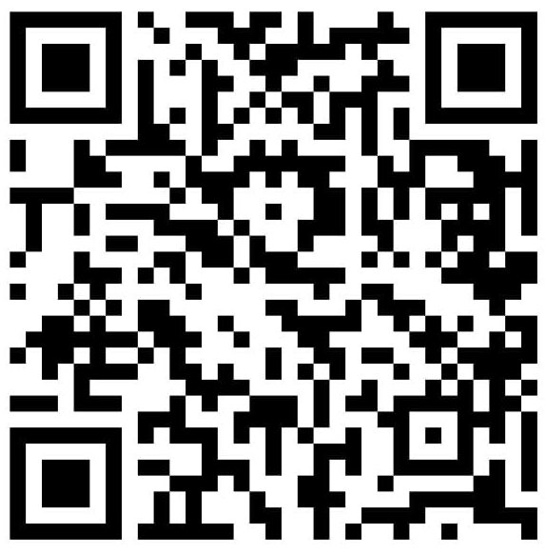
CLOSING
The question is no longer:
What can AI automate?
The better question is:
Where should AI participate?
Connect with me
Nirmal Kumar Jingar
AI as a Teammate: Driving Double-Digit Engineering Productivity Gains
Slides • Resources • LinkedIn
The AI Runtime - Boston
13
Notes:
Main message: The durable advantage comes from deciding where AI should participate in engineering work. Speaker notes: Close with a crisp call back to the title. AI as a teammate does not mean replacing engineers. It means designing the system of work so AI can carry context, generate options, expose risks, produce evidence, and help the organization learn. Leave the audience with three words: context, evidence, flow. If they remember only one sentence: do not ask what AI can automate; ask where AI should participate. Sources / evidence anchors: Overall synthesis based on the AI Teammate Operating Model introduced in this talk; evidence anchors cited in prior slides.

