Slide 1
Software Development Life Cycle Models

Slide 2
SDLC-is a splitting of software development work into distinct phases (or stages) containing activities with the intent of better planning and management. It is often considered a subset of the systems development life cycle. The methodology may include the pre-definition of specific deliverables and artifacts that are created and completed by a project team to develop or maintain an application.
SDLC, Software Development Life Cycle is a process used by software industry to design, develop and test high quality softwares. The SDLC aims to produce a high quality software that meets or exceeds customer expectations, reaches completion within times and cost estimates.
SDLC is the acronym of Software Development Life Cycle.
It is also called as Software development process.
The software development life cycle (SDLC) is a framework defining tasks performed at each step in the software development process.
ISO/IEC 12207 is an international standard for software life-cycle processes. It aims to be the standard that defines all the tasks required for developing and maintaining software.
A typical Software Development life cycle consists of the following stages:
Stage 1: Planning and Requirement Analysis
Stage 2: Defining Requirements
Stage 3: Designing the product architecture
Stage 4: Building or Developing the Product
Stage 5: Testing the Product
Stage 6: Deployment in the Market and Maintenance

Slide 3
SDLC Models
There are various software development life cycle models defined and designed which are followed during software development process. These models are also referred as "Software Development Process Models". Each process model follows a Series of steps unique to its type, in order to ensure success in process of software development.
Following are the most important and popular SDLC models followed in the industry:
Waterfall Model
Iterative Model
Spiral Model
V-Model
Agile
Rup

Slide 4
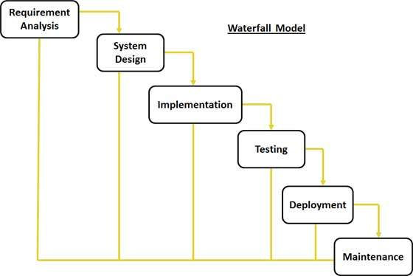
SDLC Waterfall Model
Waterfall Model design
Waterfall approach was first SDLC Model to be used widely in Software Engineering to ensure success of the project. In "The Waterfall" approach, the whole process of software development is divided into separate phases. In Waterfall model, typically, the outcome of one phase acts as the input for the next phase sequentially.
Following is a diagrammatic representation of different phases of waterfall model.

Slide 5
SDLC Waterfall Model
Waterfall Model Pros & Cons
Advantage
The advantage of waterfall development is that it allows for control. A schedule can be set with deadlines for each stage of development and a product can proceed through the development process model phases one by one.
Development moves from concept, through design, implementation, testing, installation, troubleshooting, and ends up at operation and maintenance. Each phase of development proceeds in strict order.
Disadvantage
The disadvantage of waterfall development is that it does not allow for much reflection or revision. Once an application is in the testing stage, it is very difficult to go back and change something that was not well-documented or thought upon in the concept stage.
The following table lists out the pros and cons of Waterfall model:
Pros | Cons
Simple and easy to understand and use Easy to manage due to the rigidity of the model . each phase has specific deliverables and a review process. Phases are processed and completed one at a time. Works well for smaller projects where requirements are very well understood. Clearly defined stages. Well understood milestones. Easy to arrange tasks. Process and results are well documented. | No working software is produced until late during the life cycle. High amounts of risk and uncertainty. Not a good model for complex and object-oriented projects. Poor model for long and ongoing projects. Not suitable for the projects where requirements are at a moderate to high risk of changing. So risk and uncertainty is high with this process model. It is difficult to measure progress within stages. Cannot accommodate changing requirements. Adjusting scope during the life cycle can end a project. Integration is done as a "big-bang. at the very end, which doesn't allow identifying any technological or business bottleneck or challenges early.

Slide 6
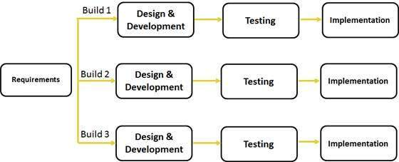
SDLC Iterative Model
Iterative Model design
Iterative process starts with a simple implementation of a subset of the software requirements and iteratively enhances the evolving versions until the full system is implemented. At each iteration, design modifications are made and new functional capabilities are added. The basic idea behind this method is to develop a system through repeated cycles (iterative) and in smaller portions at a time (incremental).
Following is the pictorial representation of Iterative and Incremental model:

Slide 7
SDLC Iterative Model
Iterative Model Pros and Cons
The advantage of this model is that there is a working model of the system at a very early stage of development which makes it easier to find functional or design flaws. Finding issues at an early stage of development enables to take corrective measures in a limited budget.
The disadvantage with this SDLC model is that it is applicable only to large and bulky software development projects. This is because it is hard to break a small software system into further small serviceable increments/modules.
The following table lists out the pros and cons of Iterative and Incremental SDLC Model:
Pros | Cons
Some working functionality can be developed quickly and early in the life cycle. Results are obtained early and periodically. Parallel development can be planned. Progress can be measured. Less costly to change the scope/requirements. Testing and debugging during smaller iteration is easy. Risks are identified and resolved during iteration; and each iteration is an easily managed milestone. Easier to manage risk - High risk part is done first. With every increment operational product is delivered. Issues, challenges & risks identified from each increment can be utilized/applied to the next increment. Risk analysis is better. It supports changing requirements. Initial Operating time is less. Better suited for large and mission-critical projects. During life cycle software is produced early which facilitates customer evaluation and feedback. | More resources may be required. Although cost of change is lesser but it is not very suitable for changing requirements. More management attention is required. System architecture or design issues may arise because not all requirements are gathered in the beginning of the entire life cycle. Defining increments may require definition of the complete system. Not suitable for smaller projects. Management complexity is more. End of project may not be known which is a risk. Highly skilled resources are required for risk analysis. Project.s progress is highly dependent upon the risk analysis phase.

Slide 8
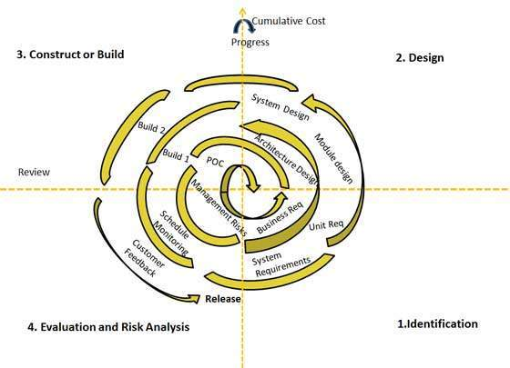
SDLC Spiral Model
Spiral Model design
The spiral model has four phases. A software project repeatedly passes through these phases in iterations called Spirals.
Identification:This phase starts with gathering the business requirements in the baseline spiral. In the subsequent spirals as the product matures, identification of system requirements, subsystem requirements and unit requirements are all done in this phase.
This also includes understanding the system requirements by continuous communication between the customer and the system analyst. At the end of the spiral the product is deployed in the identified market.
Design:Design phase starts with the conceptual design in the baseline spiral and involves architectural design, logical design of modules, physical product design and final design in the subsequent spirals.
Construct or Build:Construct phase refers to production of the actual software product at every spiral. In the baseline spiral when the product is just thought of and the design is being developed a POC (Proof of Concept) is developed in this phase to get customer feedback.
Then in the subsequent spirals with higher clarity on requirements and design details a working model of the software called build is produced with a version number. These builds are sent to customer for feedback.
Evaluation and Risk Analysis:Risk Analysis includes identifying, estimating, and monitoring technical feasibility and management risks, such as schedule slippage and cost overrun. After testing the build, at the end of first iteration, the customer evaluates the software and provides feedback.

Slide 9
SDLC Spiral Model
Spiral Model Pros and Cons
The advantage of spiral lifecycle model is that it allows for elements of the product to be added in when they become available or known. This assures that there is no conflict with previous requirements and design.
This method is consistent with approaches that have multiple software builds and releases and allows for making an orderly transition to a maintenance activity. Another positive aspect is that the spiral model forces early user involvement in the system development effort.
On the other side, it takes very strict management to complete such products and there is a risk of running the spiral in indefinite loop. So the discipline of change and the extent of taking change requests is very important to develop and deploy the product successfully.
The following table lists out the pros and cons of Spiral SDLC Model:
Pros | Cons
Changing requirements can be accommodated. Allows for extensive use of prototypes Requirements can be captured more accurately. Users see the system early. Development can be divided into smaller parts and more risky parts can be developed earlier which helps better risk management. | Management is more complex. End of project may not be known early. Not suitable for small or low risk projects and could be expensive for small projects. Process is complex Spiral may go indefinitely. Large number of intermediate stages requires excessive documentation.

Slide 10
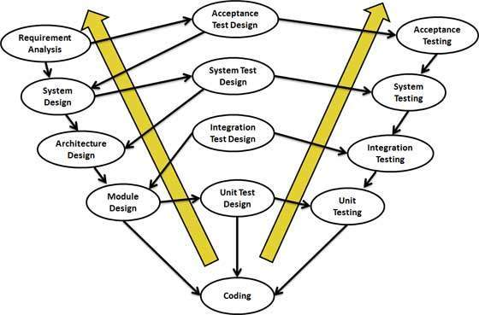
SDLC V Model
V- Model design
Under V-Model, the corresponding testing phase of the development phase is planned in parallel. So there are Verification phases on one side of the .V. and Validation phases on the other side. Coding phase joins the two sides of the V-Model.
The below figure illustrates the different phases in V-Model of SDLC.
V- Model Pros and Cons
The advantage of V-Model is that it.s very easy to understand and apply. The simplicity of this model also makes it easier to manage. The disadvantage is that the model is not flexible to changes and just in case there is a requirement change, which is very common in today.s dynamic world, it becomes very expensive to make the change.
The following table lists out the pros and cons of V-Model:
Pros | Cons
This is a highly disciplined model and Phases are completed one at a time. Works well for smaller projects where requirements are very well understood. Simple and easy to understand and use. Easy to manage due to the rigidity of the model . each phase has specific deliverables and a review process. | High risk and uncertainty. Not a good model for complex and object-oriented projects. Poor model for long and ongoing projects. Not suitable for the projects where requirements are at a moderate to high risk of changing. Once an application is in the testing stage, it is difficult to go back and change a functionality No working software is produced until late during the life cycle.

Slide 11
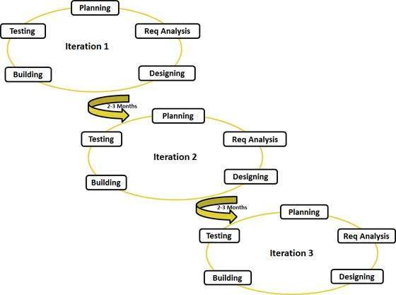
SDLC AGILE MODEL
AGILE- Model design
Agile model believes that every project needs to be handled differently and the existing methods need to be tailored to best suit the project requirements. In agile the tasks are divided to time boxes (small time frames) to deliver specific features for a release.
Iterative approach is taken and working software build is delivered after each iteration. Each build is incremental in terms of features; the final build holds all the features required by the customer.
Here is a graphical illustration of the Agile Model:
Agile Model Pros and Cons
Agile methods are being widely accepted in the software world recently, however, this method may not always be suitable for all products. Here are some pros and cons of the agile model.
Following table lists out the pros and cons of Agile Model:
Pros | Cons
Is a very realistic approach to software development Promotes teamwork and cross training. Functionality can be developed rapidly and demonstrated. Resource requirements are minimum. Suitable for fixed or changing requirements Delivers early partial working solutions. Good model for environments that change steadily. Minimal rules, documentation easily employed. Enables concurrent development and delivery within an overall planned context. Little or no planning required Easy to manage Gives flexibility to developers | Not suitable for handling complex dependencies. More risk of sustainability, maintainability and extensibility. An overall plan, an agile leader and agile PM practice is a must without which it will not work. Strict delivery management dictates the scope, functionality to be delivered, and adjustments to meet the deadlines. Depends heavily on customer interaction, so if customer is not clear, team can be driven in the wrong direction. There is very high individual dependency, since there is minimum documentation generated. Transfer of technology to new team members may be quite challenging due to lack of documentation.

Slide 12
Summary
This was about the various SDLC models available and the scenarios in which these SDLC models are used. The information in this tutorial will help the project managers decide what SDLC model would be suitable for their project and it would also help the developers and testers understand basics of the development model being used for their project.
We have discussed all the popular SDLC models in the industry, both traditional and Modern. This tutorial also gives you an insight into the pros and cons and the practical applications of the SDLC models discussed.
Waterfall and V model are traditional SDLC models and are of sequential type. Sequential means that the next phase can start only after the completion of first phase. Such models are suitable for projects with very clear product requirements and where the requirements will not change dynamically during the course of project completion.
Iterative and Spiral models are more accommodative in terms of change and are suitable for projects where the requirements are not so well defined, or the market requirements change quite frequently.
Agile is the most popular model used in the industry. Agile introduces the concept of fast delivery to customers using prototype approach. Agile divides the project into small iterations with specific deliverable features. Customer interaction is the backbone of Agile methodology, and open communication with minimum documentation are the typical features of Agile development environment.
Agile is based on the adaptive software development methods where as the traditional SDLC models like waterfall model is based on predictive approach.
Predictive teams in the traditional SDLC models usually work with detailed planning and have a complete forecast of the exact tasks and features to be delivered in the next few months or during the product life cycle. Predictive methods entirely depend on the requirement analysis and planning done in the beginning of cycle. Any changes to be incorporated go through a strict change control management and prioritization.
Agile uses adaptive approach where there is no detailed planning and there is clarity on future tasks only in respect of what features need to be developed. There is feature driven development and the team adapts to the changing product requirements dynamically. The product is tested very frequently, through the release iterations, minimizing the risk of any major failures in future.
Customer interaction is the backbone of Agile methodology, and open communication with minimum documentation are the typical features of Agile development environment. The agile teams work in close collaboration with each other and are most often located in the same geographical location.

